Slide 1
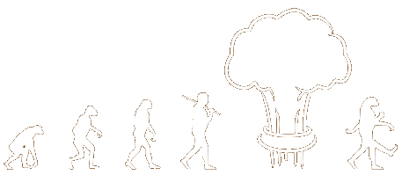
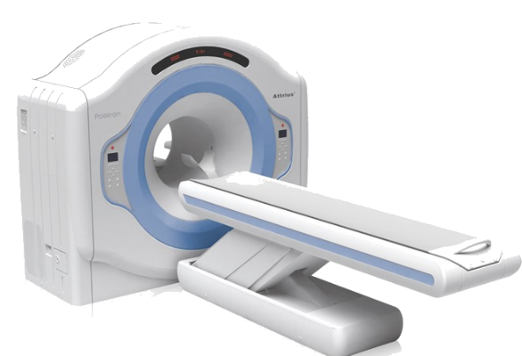
INTRODUCTION TO pet/CT
Mark H. Crosthwaite, M.Ed. CNMT, PET, FSNMMI-TS
Program Director and Associate Professor

Slide 2
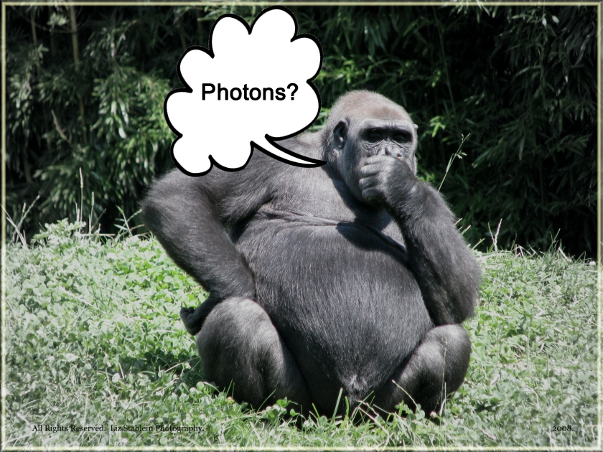
Let’s start of with a Question
When an electron and a positron annihilate, causing a coincidence of energy heading in opposite directions, what does the PET system acquire?
Is it 2 – 511 keV gammas scintillating the crystal at the same time?
Just a thought are they really gamma rays?

Slide 3
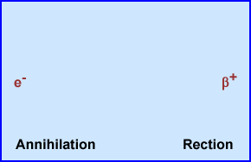
Generating a Positron
Comes for Proton Rich Nuclei
P⁺ ----> Nº + β⁺ + v
Positron l losses energy as it attracting e⁻ - s
At rest mass the annihilation reaction occurs

Slide 5
Making of a Positron
Positrons and Half-Lifes
¹¹C - 20.3 minutes
¹³N - 10 minutes ¹³NH₃ (ammonia)
¹⁵O - 2 minutes
¹⁸F - 109.75 minutes

Slide 6
Negative Cyclotron
Most commercial cyclotrons are between 12 - 18 MeV
Need a charged particle Get a H⁻ / H⁻²
Goal - Electron gets pulled through the system gaining energy
Dee's change polarity ~ 3.0 x 10⁻⁶/second, increase speed of the ion
~200 cycles, at the edge of the Dees
Alters H⁻ path and electron is stripped by the extraction foil
P⁺ hits the target

Slide 7
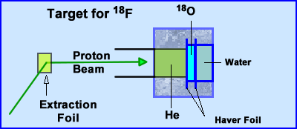
The ¹⁸O Target Makes ¹⁸F
Once the P⁺ leaves the extraction fold it heads to the target
P⁺ Beam passes through a He gas and slams into ¹⁸O
The following chemical reaction occurs
¹⁸O (p,n) ¹⁸F
Production and extraction of ¹⁸F takes between 2 to 3 hours = 2000 - 3000 mCi in solution …
Process is repeated to create more ¹⁸F

Slide 8
How Many mCi in the Calibrated Dose?
Assume you are getting ready to inject a 15 mCi dose of ¹⁸FDG at 11:00am that came from a 4 am calibration. How many mCi were in the pre-calibrated syringe at 4 am?
75 mCi
142 mCi
197mCi
213 mC
264 mCi

Slide 9
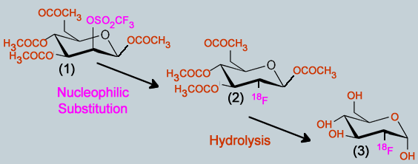
¹⁸F ¹⁸FDG
Starts with Mannose Triflate
Via Nucleophilic substitution Trimethly sulfate (OSO₂CF₃) leaves the carbon ring and ¹⁸F replaces it
Acetal groups (H₃COCO and OCOCH₃) are removed and replaced with OH via hydrolysis using HCl or NaOH
The final Component is FDG. Acetone and acetonitrile are used to remove any impurities. Solution is then sent through a microspore filter

Slide 10
Pathology of ¹⁸FDG
FDG enter the cell and phosphorylates via hexokinase (OH to PO₄)
Since ¹⁸F replaced the other OH group, the second PO₄ cannot be exchanged on the carbon ring. Process stops! FDG is locked into the cell

Slide 11
A Look at Other PET Radiopharms

Slide 12
Other PET Radiopharmaceuticals
¹¹C-acetate
¹¹C-choline
¹¹C-palmitate
¹⁸Fluorothymidine (FLT)
¹⁸F-Fluoromisonidazole (FMISO)
¹³NH₃
¹⁵O₂/¹⁵O-water
⁸²Sr-⁸²Rb generator
¹⁸F-fluorodopa (FD)
Na¹⁸F

Slide 14
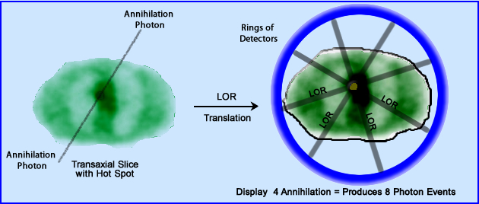
Let us Consider Resolution
Lines of Response (LOR) instead of dots: 2 photons are detected 180º
creating an LOR.
The acquired count occurred somewhere within the LOR
Data is then stored as a sinogram by the distance r and the angle of projection on the y axis.

Slide 15
Linograms to Sinograms

Slide 16
Axial Resolution
In a whole body format resolution degrades on the extreme
ends of the Field of View (FOV). For this reason the whole
body segments overlap.

Slide 17
Travel in the Extreme
¹⁸F - 1/3 β⁺_{max} = 0.213 meV to 0.64 meV. Max range in water = 2.2 mm
⁸²Rb - 1/3 β⁺_{max} = 1.12 meV to 3.35 meV. Max range in water = 15.5 mm

Slide 18
Coincidence of 2 Photons ≠ 180º?
Annihilation at rest mass e⁻ + β⁺ = “death spiral”
This causes a ±0.25º variation from 180º photons that generate the LOR
As distance increases away from the event the resolution continues to degrade.
Events that occur a the center of the FOV (70 cm) there maybe up to 2.1 mm variation

Slide 19
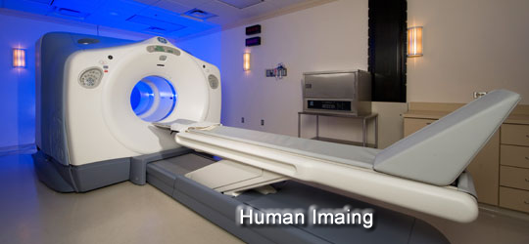
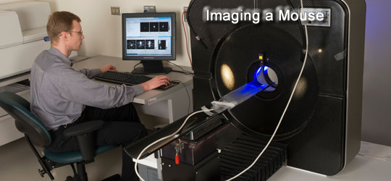
Question?
Consider imaging a mouse or a
human, which system has better
resolution and why?
Human system, consider the
amount PMTs and crystal surface
Human system, since it can image
a larger 3D volume/area
C) Mouse system because
non-colinearity is less of an issue
No difference either systems is equal

Slide 20
Timing Window
Recording the Coincidence
In order to record an LOR
Detectors at both ends must record the photon at the “same” time
Acceptance range 4 -12 nsec
Scatter can still be recorded
Reducing the timing window will reduce scatter
↓ timing window = ↓ scatter

Slide 21
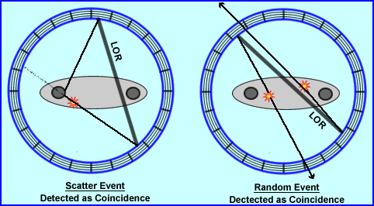
Scatter and Random Events
Other issues on system resolution
1) Where does scattered photons come from?
2) How do random events occur?

Slide 22
PHA
LLD and ULD settings are greater than 20%!
Typically the window is set to 60%
LLD = 350 keV
ULD = 650 keV
Food for thought
Reducing the window will improve energy resolution and decrease scatter
However, this will reduce counting efficiency
PET has 2 rejection circuits
PHA
Timing Window

Slide 23
Radial Elongation
When a coincident event is recorded at the edge of the detector block the photons arrive at its tangent, causing the event to be recorded by two blocks
Influencing Factors
Smaller FOV +
Further away from the center -
Thicker crystals -

Slide 24
2-D vs 3-D Acquisition
2-D
Lead annulars (septa) are 1mm thick and 7 – 10 mm long
reduces cross talk to about 5 rings
Reduces scatter
3-D
Greatly increases counts
Counts from scatter can reach 30 – 40%

Slide 25
Gamma Camera vs PET Imaging
Does increasing your distance from the patient increase scatter?
In PET do we use a 20% window?
When doing whole body how is the table and camera synchronized?
Which system has the better sensitivity?
Which system has greater counts?
What about spatial resolution in PET vs SPECT?
Backprojection vs Iterative reconstruction.

Slide 26
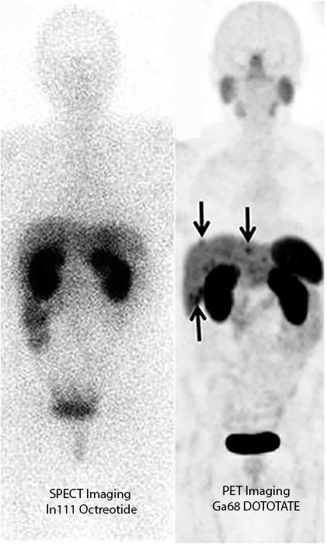
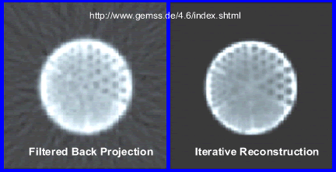

Slide 27
Factors Of Contrast
Effected By
Patient motion
Count/cm²
Lesion – size and counts
Hot with low BKG
Cold with high BKG
Noise and statistics
Scatter effect
Count density depends on
Dose
Injection vs. scanning
Acquisition time
Detector efficiency
C – Contrast
N – Count density normal tissue
A – Count density abnormal tissue

Slide 28
The Type of Crystal/Design
Properties | NaI | BGO | LSO
gm/cm³ | 3.7 | 7.1 | 7.4
Scintillation Decay | 231 | 300 | 7.4
Light Output | 100 | 15 | 75
%E Resolution-511keV | 6.6 | 20 | 10
Crystal evaluation in PET – should
consider then following:
Density
Scintillation Decay
Light Output
Energy resolution

Slide 29
Let us Consider Time of Flight
Would resolution improved if we could determine the exact spot of the coincident event along the LOR?
TOF Formula
9 cm segment of the LOR – from 70 cm
LSO/LYSO crystal
0.6 nsec timing window
Consider a bariatric patient and S/N
Grey LOR = 70 cm
Red LOR = 9cm
↓ Deadtime + ↓Timing Window +↑ light out = Improved S/N

Slide 30
PET and CT and Image Fusion
Partial Volume Effect
Physiology and Anatomy come together
128 matrix vs. 512 matrix
Where is the lesion

Slide 31
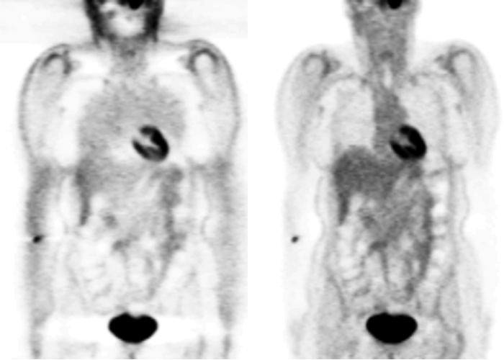
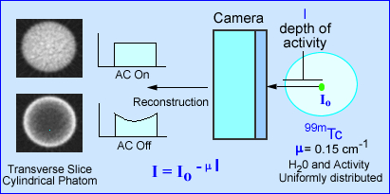
Attenuation Effect

Slide 32
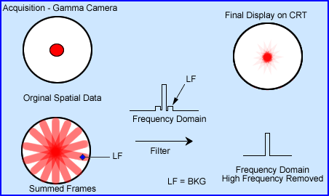
Filtered Backprojection
Filtered Back-Projection looks at all the angles (360 degrees) and collects the data
A hot spots translates to a “sum of the rays” or angles that display the hotspot
Goal is to filter out the rays by removing low frequency
In PET it is difficult to filter out all the rays. Consider the amount of hot spots

Slide 33
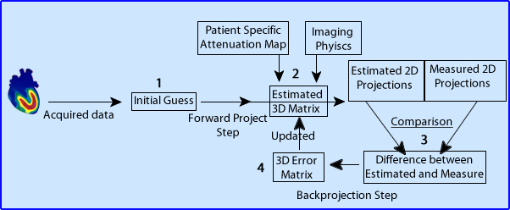
The Iterative Approach
Iterative reconstruction
Goal is to determine the amount of LORs in each voxel
More the iterations the closer the estimates
MLEM - Maximum Likelihood Expectation Maximization
OSEM – Ordered Subset Expectation Maximization

Slide 34
Reconstruction - FBP vs IR
FBP exaggerates hot spots showing increase in rays
MLEM removes to rays and improves contrast
Since FDG is “hot spots” imaging .. which reconstruction method would you prefer?
Results of a Clinical Receiver Operating Characteristic Study Comparing Filtered Backprojection and Maximum Likelihood
Estimator Images in FDG PET Studies/ J. Llacer, et. al., JNM Vol. 34, No. 7, July 1993 (Figure 2)

Slide 35
Intermission

Slide 36
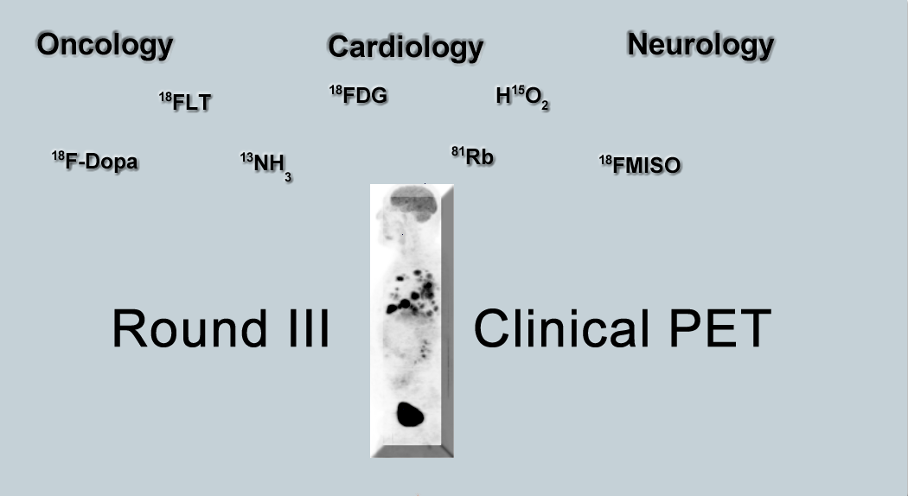

Slide 37
Oncology, FDG, and Reimbursement
Type of Cancer
PET’s Role
Breast: A - D
Colorectal: A - C
Esophageal: A - C
Lung
Single nodule: B
NSCLC: A - C
Head and Neck: A - C
Lymphoma: A - C
Melanoma: A – C*
Thyroid: C – and (-) ¹³¹I
A) Diagnosis
B) Staging
C) Re-staging
D) Pre-Post therapy
* - not covered for regional nodes
http://www3.gehealthcare.com/~/media/Downloads/us/Product/Reimbursement/Customer-Advisories/
GEHealthcare-Customer-Advisory_Position-Emission-Tomography-PET-Reimbursement-Info-2014.pdf

Slide 38
What is Normal FDG Uptake
Brain uses only glucose
Heart runs on either fatty acids or glucose
Muscle uptake
GI track
Spine
Kidney
Key – What parts of the human system is metabolically active?
http://www.flickr.com/photos/64181524@N00/404383660

Slide 39
Metabolically Active
Melanoma
Cancer must be metabolically active
As a general rule - Greater the uptake in the tumor the more metabolically active the disease
After hexokinase glycolysis stop and ¹⁸FDG is locked into the cell
Less active cancers may blend in with the BKG
Standard Uptake Value (SUV)

Slide 40
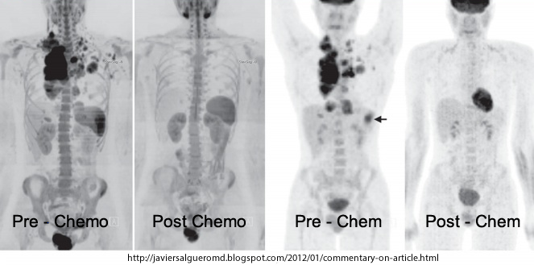
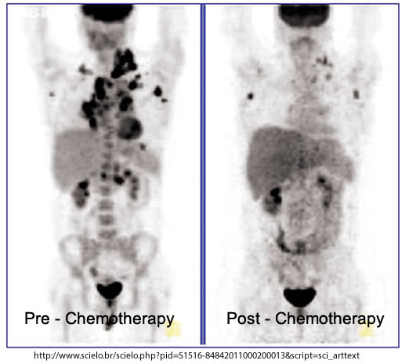
Facts about SUV
To make SUV work Consider
Always measure the patient’s height and weight vs. asking, “How much to you weigh?”
Measure remaining activity in the syringe
Focus on time and record the time correctly
If the patient returns for another scan .. Keep the cooking time and dose the same
Keep the PET scanner QC’ed!
In general (SUV) – the hotter the tumor
The more metabolically active

Slide 41
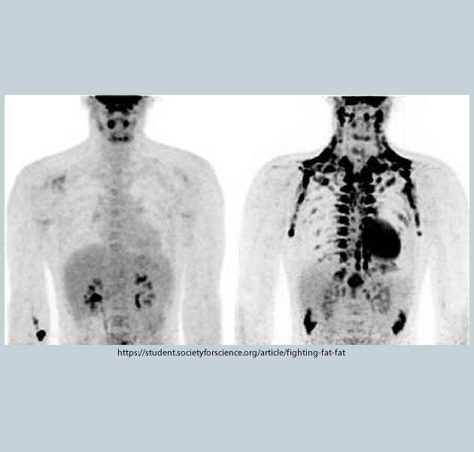
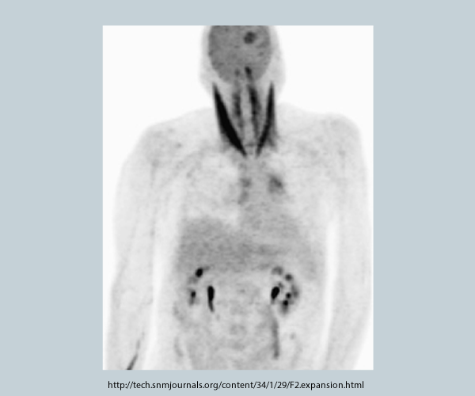
Pre-Post IV FDG - Consider
No heavy exercise prior to the scan (24 hrs)
Fast for at least 4 hours prior to exam
Medications can be taken prior to the scan
Glucose level should be <200 mg/dL
Keep the patient warm – brown fat
Keep movement to a minimum after the FDG injection
The hardest thing for me is to stop talking with the patient after his/her injection

Slide 42
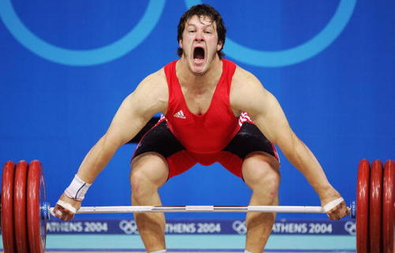
What Caused Pectoralis take?
Pt had surgical removal of melanoma from the Rt ankle. Six years later disease was found in Rt inguinal node. PET was ordered. What happen?
Patient didn’t fast
Exercise
Metastatic disease
Increased BUN level
http://www.biij.org/2009/2/e7/

Slide 43
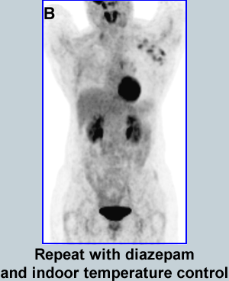
What’s the Uptake?
PET scan was ordered on a patient with known breast cancer. What are we looking at?
A) Extensive lymphatic involvement
B) Too much exercise
C) Not fasting
D) BAT sign
Prevention of Brown Adipose Tissue Activation in ¹⁸F-FDG
PET/CT of Breast Cancer Patients Receiving Neoadjuvant
Systemic. Therapy, TS Aukema, et. Al. JNMT 109.065557

Slide 44
Attenuation Correction with CT
→ With and without attenuation correction is displayed
→ Chang filter can be applied if surrounding density does not vary
Role of CT
CT finds ↑ density and adds photons to the PET image
CT finds↓ density and subtracts photons from the PET image

Slide 45
AC or Lack of in PET/CT
Application of AC – Part I
CT notes a shiny object on the breast
AC shows increased uptake in the same area. Mimicking disease.
AC off - arrow shows no disease.
Object was a nipple ring
PET/CT Imaging Artifacts. W Sureshbabu, JNMT Vol 33, Number 3, 2005

Slide 46
AC or Lack of in PET/CT
Application of AC – Part II
AC – Corrects for attenuation in diaphragm Problem is CT was acquired with breath hold
- PET was acquired with patient breathing
- Therefore, CT subtracts excess PET count at the base of the liver/lung, removing counts – But where is the lesion really located?
A – AC is on B – AC is off
AC off defines the lesion’s location
PET/CT Imaging Artifacts. W Sureshbabu, JNMT Vol 33, Number 3, 2005

Slide 47
Truncation
This artifact occurs when the body habitus is outside the CT’s FOV but within
the PET FOV
Beyond the AC range, increased tissue uptake is seen
Might there be an issue if the patient had excessive skin uptake and r/o
melanoma?

Slide 48
Abnormal Bone Marrow Uptake?
Chemotherapy may cause myelosuppression
Granulocyte-stimulating factor (G-CSF) is administered to increase leukocyte production
Hence, where there is active marrow there is active FDG uptake
Clinical Role of FDG PET in Evaluation of Cancer Patients. L Kostakoglu, et al. RadioGraphics, March 2003

Slide 49
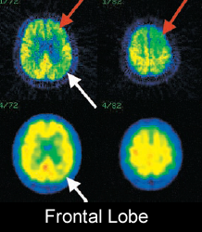
PET’s Role in Dementia
Sixty-six percent sensitive in finding AH in its early stage - Eventually all false-negative become positive
Cortical atrophy
AH is usually first seen in temporal and parietal lobes
Over time it effects the frontal lobe
Direct Comparison of Spatially Normalized PET and SPECT Scans in Alzheimer’s Disease. K Herholz, et al., JNMT Vol. 43 No. 1 21-26, 2002

Slide 50
AD imaging with FDG and Amyvid (florbetapir)
Normal vs AD with FDG
Atrophy causes reduced sugar
uptake
2. Result shows decreased FDG
Normal vs AD with Amyvid
Seeks out β-Amyloid Plaque
Shows reverse uptake when
compared to FDG

Slide 51
Prostate Imaging
Axumin (Fluciclovine) will uptake in prostate-specific membrane antigen (PMSA)
Tagged to ¹⁸F
Uptake varies when compared to FDG

Slide 52
Cardiac Physiology
Preferred metabolic pathway of the heart is the oxidation of fatty acid – occurs when the a person is fasting
Heart converts to glucose metabolism
After eating
Resulting in high glucose levels in the blood

Slide 53
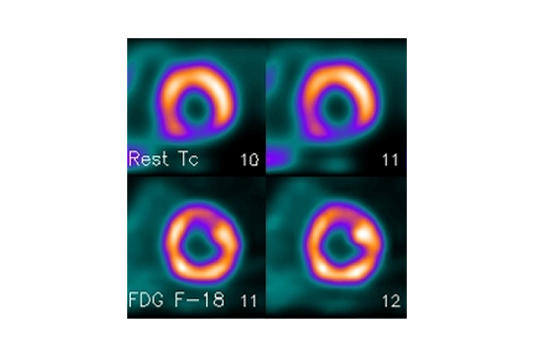
Myocardial Viability
Myocardial viability and the use of FDG
Patient must be NPO for at least 4-6 hours
Administer 50 mg or more of glucose PO
Start taking blood glucose levels at 1 hour post administration and then every 15 minutes
When the sugar level begins to drop administer your FDG dose and scan 1 hour later
Images from PETNET Solutions

Slide 54
^{82m}Rb/⁸²Sr Generator

Slide 55
⁸²Rb Cardiac Protocol
Rb Advantage
- Greater throughput
- Above timeline uses adenosine as the pharmacological stress agent
Reduced attenuation artifacts when compared to SPECT
Bateman TM, et. al. identify the superiority of PET over SPECT
Improved stenosis threshold
More accurate

Slide 56
⁸²Rb Images
Images from PETNET Solutions

Slide 57
Comment on Cardiac Resoluiton
Cardiac phantom data
Compares the resolution of different radionuclides
Can you match the right image to the correct radioactive element?
^{99m}Tc _______
¹⁸F _______
⁸²Rb _______
Comparison of 18F SPECT With PET in Myocardial Imaging : Methods

Slide 58
Targeted Therapy - Theranostics
⁶⁸Ge generator is eluated and produces ⁶⁸Ga and tagged to DOTATATE
DOTATATE has an affinity for neuroendocrine tumors
Once neuroendocrine tumors are identified the patient undergoes therapy
177Lu-DOTATATE used beta particles to kill the neuroendocrine tumor
Example – see next page or visit http://people.vcu.edu/~mhcrosthwait/clrs%20417web/DOTATATE.html

Slide 59
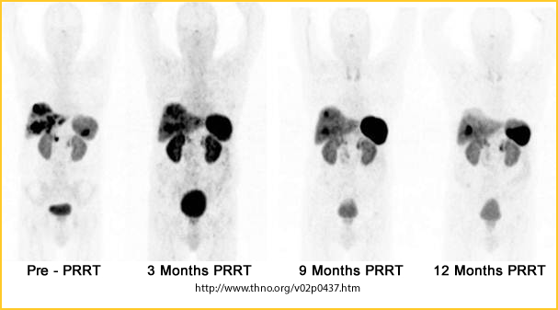
Imaging and Therapy

Slide 60
Eligibility Requirement - NMTCB
If you want to be certified in PET and your not a Nuke then the following criteria is required:
Active certification with ARRT or CAMRT: radiography or therapy
Complete 700 clinical PET hours with a certified NM technologist and a Board certified physician
15 CE hours (each area): Radiopharamcy, NM Instrumentation, and Radiation Safety

Slide 61
State Requirements for PET/CT
Operating with ionizing radiation
License required if institution is not JRC accredited
Technologist must pass national registry or certification in Radiography or Radiation Therapy
Nuclear Medicine and Radiation Therapy can apply for State license but there currently no specific statement states this
18VAC85-101-110 A. The radiologic technologist's responsibilities are to administer and document procedures within the limit of his professional knowledge, judgment and skills.
http://www.dhp.virginia.gov/medicine/medicine_laws_regs.htm

Slide 62
Now For Some Island Time

