Slide 1
Myers-Briggs
16 Personality Types
Who are You?

Slide 2
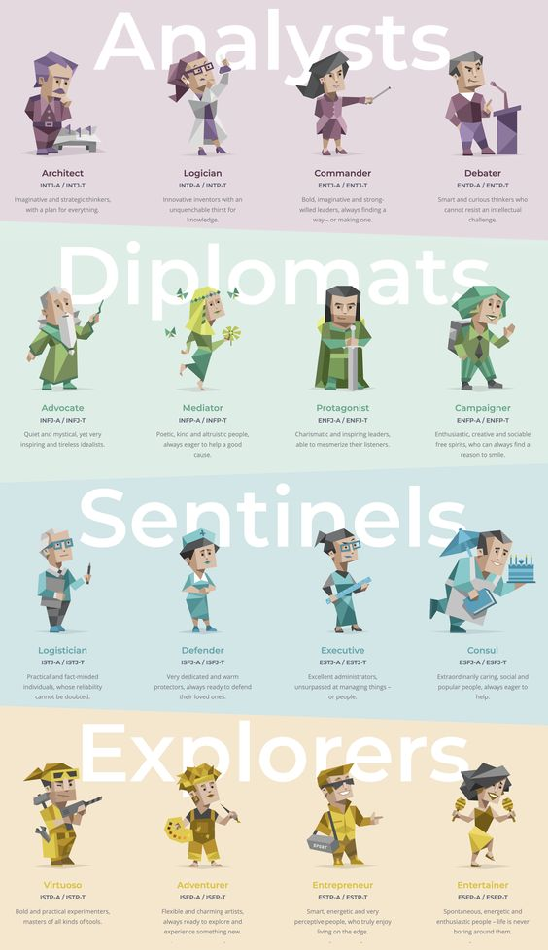
Components of Myers-Brings
There are four general categories and sixteen different personality types
Extrovert vs introvert
Sensing vs Intuition
Judging vs perceiving
Thinking vs feeling

Slide 3
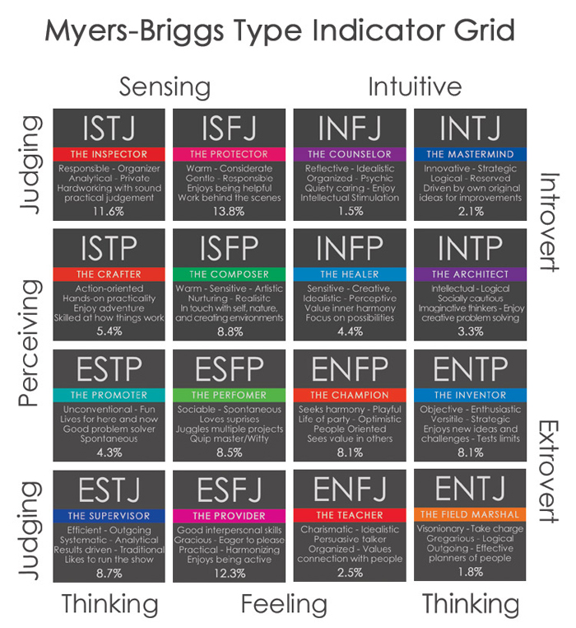

Slide 4
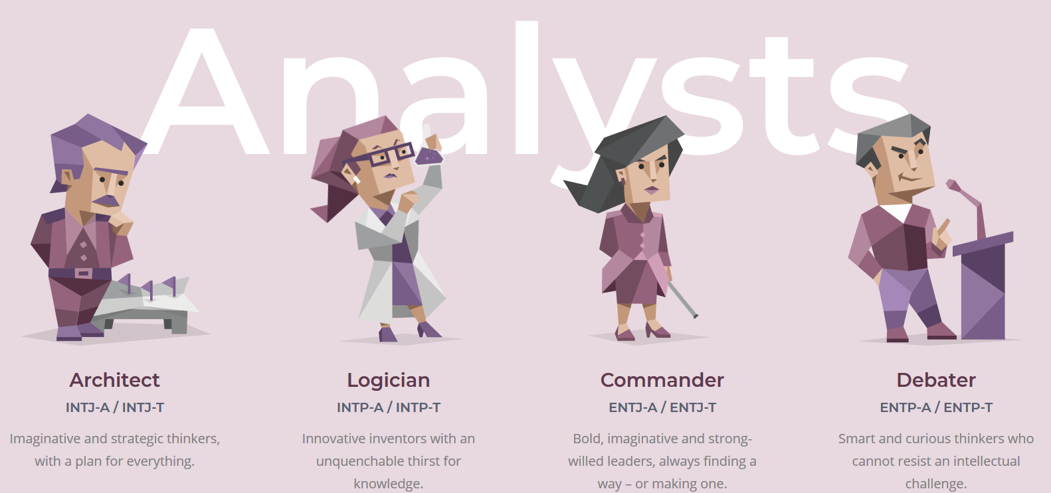

Slide 5
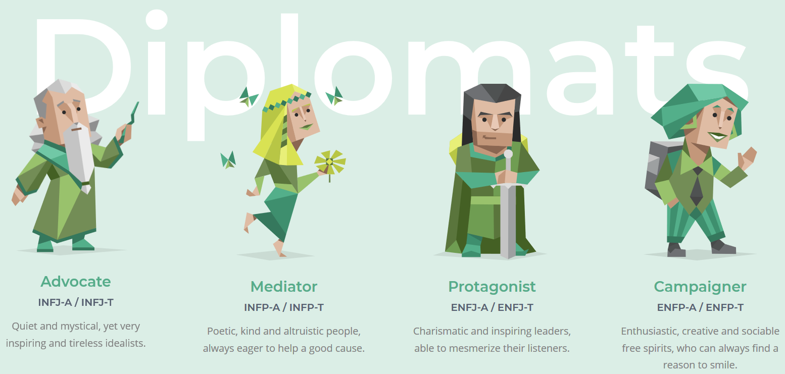

Slide 6
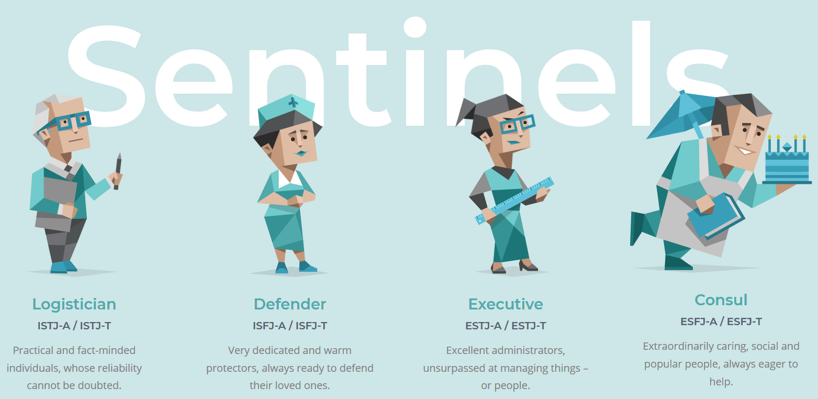

Slide 7
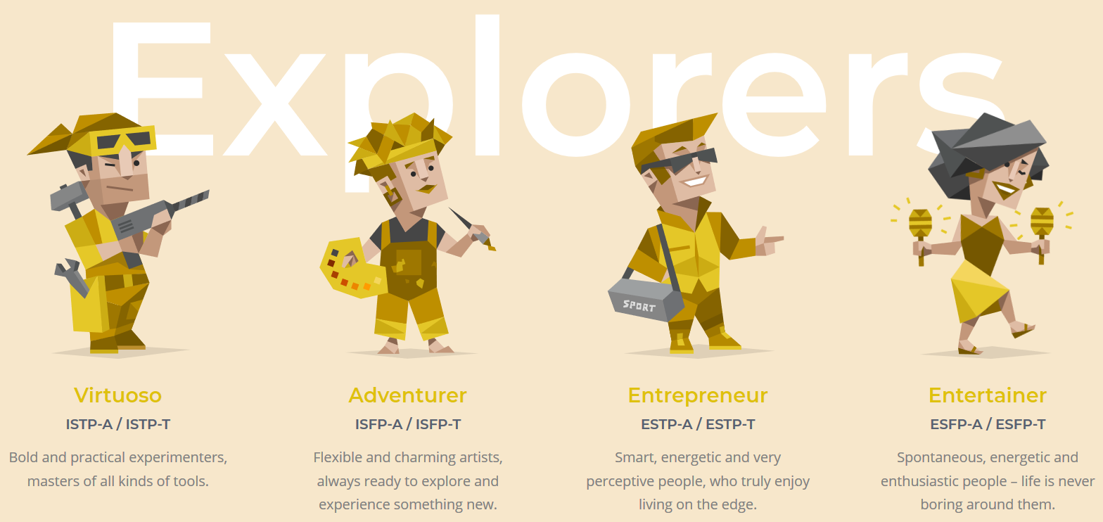

Slide 8
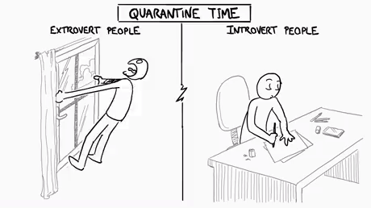
Extrovert – E vs Introvert - I
Energy is directed towards the outside
World and gets their energized by interacting
With people.
Their energy is directed inwardly and are
Energized Reflecting on ideas, memories,
and experiences.

Slide 9
Sensing S --- Intuition N
Takes information that is real and tangible.
Focuses mostly on our 5 senses.
Takes information by seeing the big picture.
Looks for patterns and interrelationships they
Perceive.

Slide 10
Judging - vs Perceiving -P
Approach the world with decisiveness
And like planning and closure
Approach the world in a more flexible manner.
Enjoy spontaneity and openness.

Slide 11
Thinking – T vs Feeling – F
Conclusions are based on logic where
Accuracy and objective truth are primary
Base their decisions on and conclusions on personal
And social values with a blend of harmony being
Their goal

Slide 12
Let’s Look at OUR Personality Types

