Slide 1
Rodionova et al. (2017) The phosphocarrier protein HPr of the bacterial phosphotransferase system globally regulates energy metabolism by directly interacting with multiple enzymes in Escherichia coli.
Translated by: Shravani Wadwekar

Slide 2
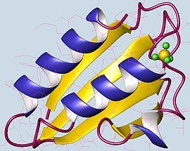
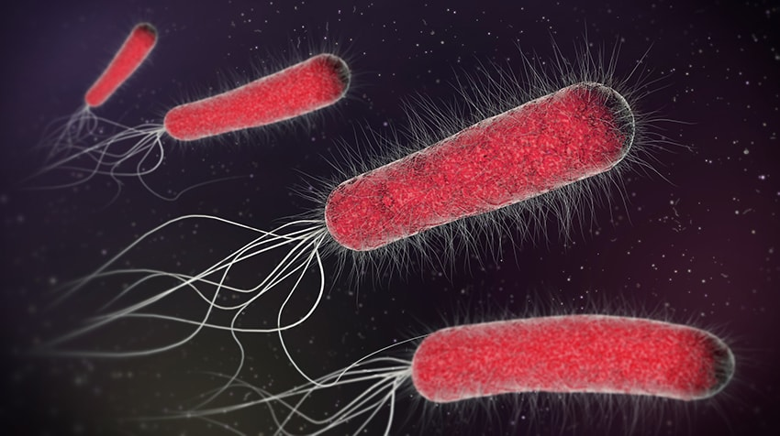
What is hpr?
Histidine-Phosphorylatable Phosphocarrier Protein
What it does
PTS (Phosphotransferase system) → regulation?
Importance of this system
E. coli (Escherichia coli)
HPr with proteins
Rodionova et al. (2017)

Slide 3
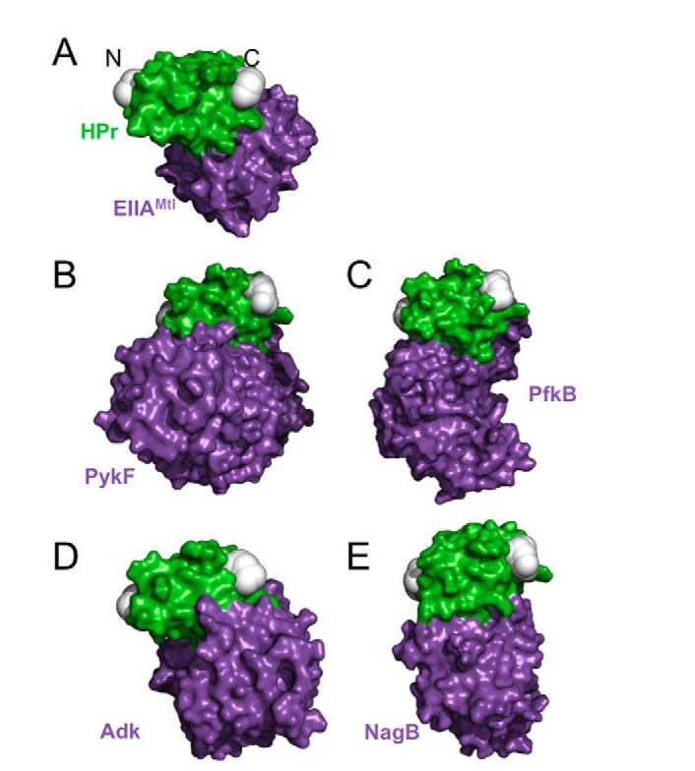
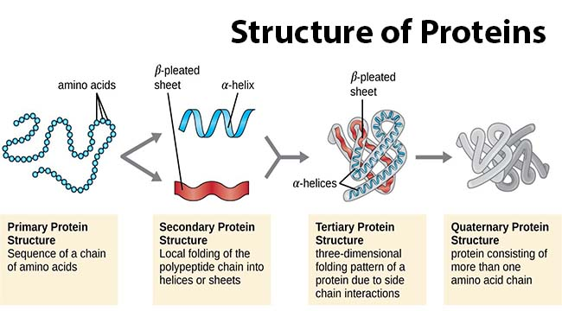
Protein-Protein Interaction
What do we interact it with?
How do we measure protein-protein interaction?
Coupled Assay → Steady State Kinetics

Slide 4
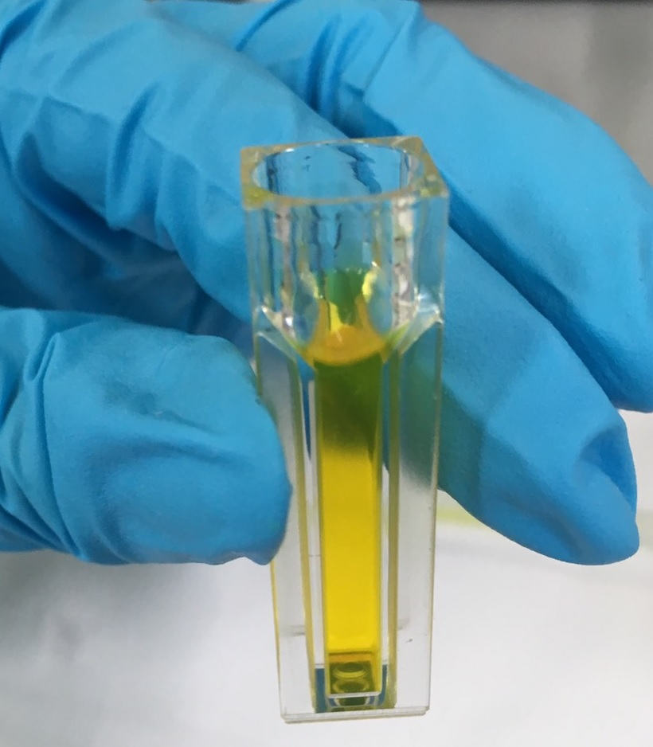
Coupled Assay
What is a coupled assay?
Process
HPr Assay → cuvette, incubation
Coupled Assay + HPr or HPr-P → titration
Steady-State Kinetics: K_{half}, V_{max}, Hill Coefficient

Slide 5
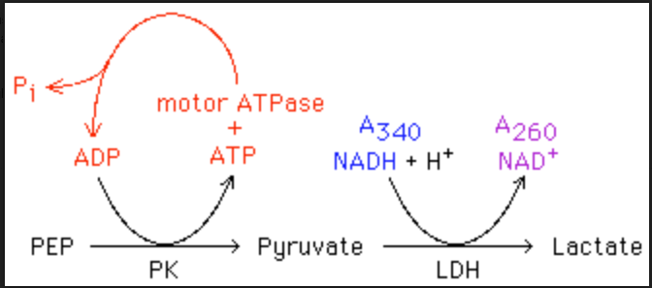
Coupled Assay

Slide 6
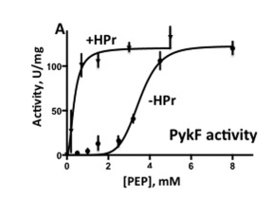
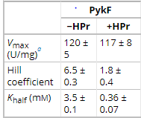
Observations
Central question: Does HPr interact with E. coli proteins?
Activity vs. no activity

Slide 7
Was there evidence?
Did HPr interact with E. coli proteins?
Activation
If no activation?
Affinity

Slide 8
References
https://en.wikipedia.org/wiki/Phosphocarrier_protein
https://healthblog.uofmhealth.org/wellness-prevention/what-you-should-know-about-e-coli-outbreaks-updated
https://www.ncbi.nlm.nih.gov/pmc/articles/PMC5572926/figure/F5/
https://en.wikipedia.org/wiki/Cuvette
https://www.ncbi.nlm.nih.gov/pubmed/28634232
https://en.wikipedia.org/wiki/File:Checkmark_green.svg

