Slide 1
COSTIN BN, DEVER SM, MILES MF (2013). ETHANOL REGULATION OF SERUM GLUCOCORTICOID KINASE 1 EXPRESSION IN DBA2/J MOUSE PREFRONTAL CORTEX
TRANSLATION BY RIA SHAH

Slide 2
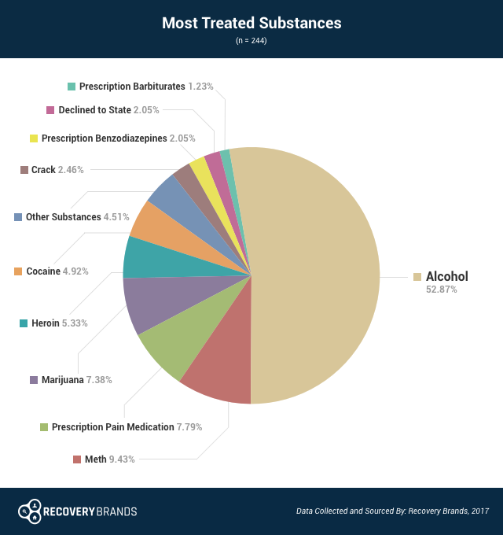
Why Alcohol?
Alcoholism effects over a million people in the United States
No cure for Alcoholism
Neuroplasticity
Goals:
Serum Glucocorticoid Kinase 1(sgk1) via Hypothalamus Pituitary Adrenal (HPA) Axis
Notes:
Goals
1. HPA axis
With constant intake of alcohol an addiction can develop known as Alcoholism.
The addiction can hinder many tasks, due to changes in the brain region (neuroplasticity.)
Unfortunately, a cure has not been developed to help treat this condition that effects millions of people in the United States.
Out of all the glucocorticoid responsive gene, Serum Glucocorticoid Kinase 1 (sgk1) was selected for further analysis due to it's function to regulate ion channels, learning & memory, and cell growth. Sgk1 is part of the Hypothalamic-pituitary-adrenal (HPA) axis(Fig. 1).
Synaptic plasicity
The HPA axis responds to stress in the body connecting two major systems (endocrine and nervous system.) A major goal for the HPA axis is to maintain a balance by making sure levels of chemical signals aren't too high or too low.

Slide 3
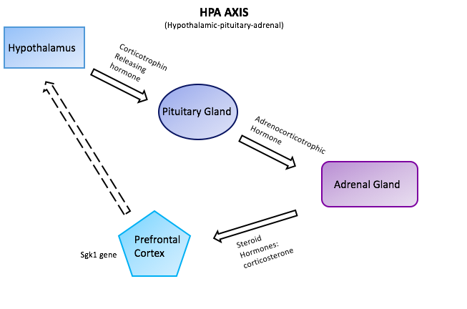
BACKGROUND: HPA Axis
Notes:
Understand how ethanol effects HPA and what parts
Corticotrophin – involved in stress response
Regulated through negative feedback

Slide 4
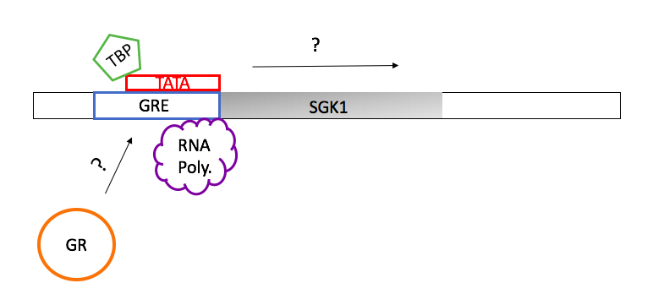
Overview of Experiment
Genes & Central Dogma
Purpose to understand molecular mechanism of sgk1 production
Method: Chromatin immunoprecipitation Assay (ChIp)

Slide 5
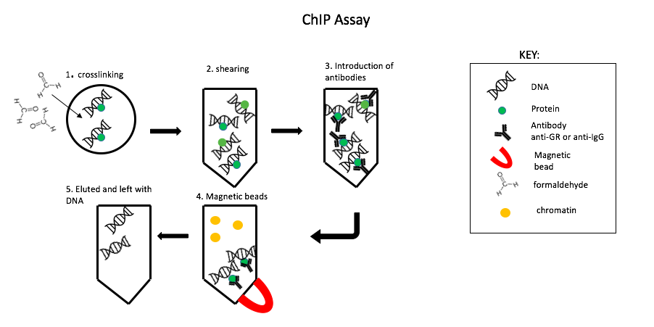
Chromatin Immunoprecipitation Assay
Notes:
A ChIp assays is extremely useful because it allows us to focus on a particular DNA segment (SGK1 promotor region) through the interaction of proteins with DNA. Then find out the quantity through Q-PCR.
Interaction between protein and DNA
Restrictive enzyme (nonspecific)
How transcription regulated

Slide 6
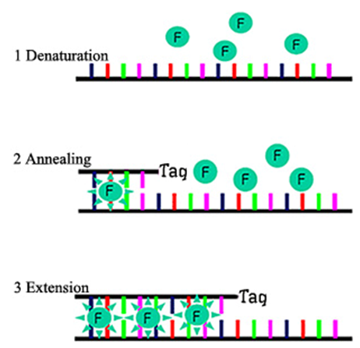
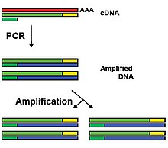
Qrt-PCR
Notes:
Analyze the gene expression
Chip total/ total DNA – before exponential

Slide 7
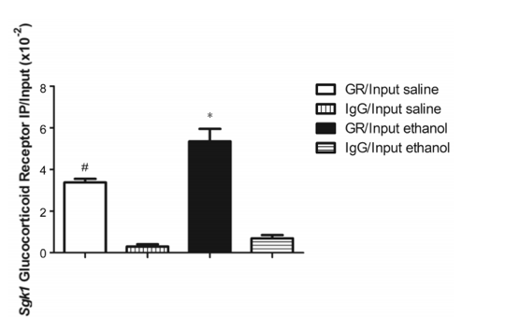
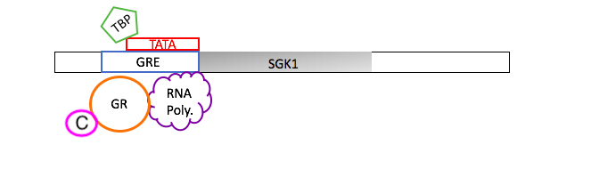
The Mechanism
Graph
increased glucocorticoid receptor to binding site
Saline vs Ethanol
Sgk1 mRNA mechanism
Overall dysregulation of HPA axis
Treatment groups
Adrenal Gland

Slide 8
REFERENCES
https://www.ncbi.nlm.nih.gov/pubmed/15242652
https://www.ncbi.nlm.nih.gov/pubmed/23991167
https://www.ncbi.nlm.nih.gov/pmc/articles/PMC3456489/
https://en.wikipedia.org/wiki/Reverse_transcription_polymerase_chain_reaction
http://www.sinobiological.com/sybr-green-qpcr-method-cro-service.html

Slide 9
PRIMERS: QRT-PCR
PRIMERS spanning the glucocorticoid response element (GRE) in the Sgk1 promoter region:
(Forward- ACCCCTGCTCCCTCTAACTC and Reverse-GCGGAAATAAGTCTCTGCTCT)

