Slide 1
Human Mitochondrial DNA Polymerase Holoenzyme: Reconstitution and Characterization
Translated by: Perray Saravanane

Slide 2
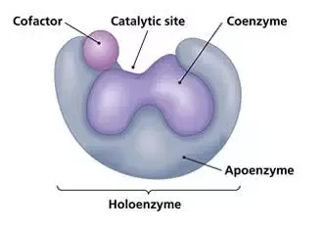
Holoenzyme
Enzymes with protein and non-protein components
Complete/catalytically active form of an enzyme
Consists of a apoenzyme (inactive form) and it’s cofactor/s

Slide 3
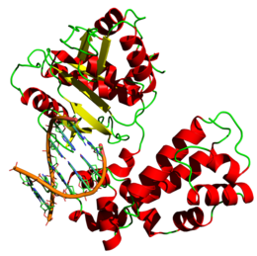
DNA Polymerase Gamma
Essential in mitochondrial DNA replication and repair
Lead to a lack of mitochondrial function and cellular energy produced for key organs and muscles (brain, eye)
Consists of two subunits: catalytic subunit, accessory subunit

Slide 4
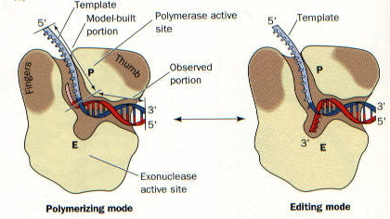
Major subunits of DNA Poly. G
Catalytic
Polymerase function (5’-3’)
exonuclease function (3’-5’)
Accessory
Tighter binding of DNA and nucleotide
Maximum DNA polymerization rate increases
Faster replication
Called a “processivity factor”

Slide 5
Key areas of investigation
The individual function of the accessory subunit
Finding the correct cDNA (complementary DNA) in Homo Sapiens
Assembling a soluble, active human mitochondrial DNA polymerase holoenzyme
Containing artificial catalytic and accessory subunits

Slide 6
Experimental Procedures

Slide 7
Creation of cDNA strands/Bacterial Construct
ORF of 485 amino acid sequence was found by the authors for the human mitochondrial DNA poly accessory subunit.
AA sequences of Hs, Xl, and Dm were aligned using Clustal X and allowed for truncation of the sequence due to the shared homology
PCR was run on the truncated sequences which were restriction digested, purified, and the bacteria was grown in broth samples (centrifuged)
The bacterial samples underwent sonication and another round of centrifugation, the supernatant was kept

Slide 8
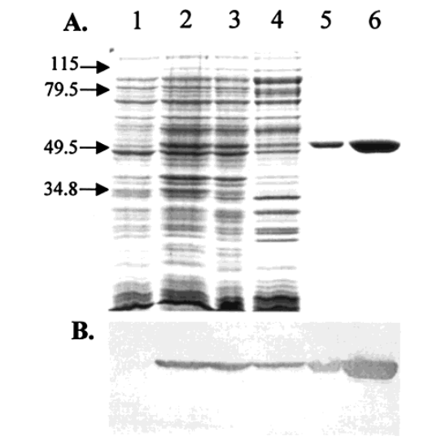
Chromatography methods + Western Blot
Chelating sepharose chromatography was run to distinguish and purify proteins with affinities to chelating ions.
Mono-S chromatography was used to allow for high resolution polishing of proteins for analysis.
Figure 2B is the result of the western blot gel with six different lanes of cell fractions. Each lane refers to a previous stage where the cell culture was further purified using a unique method.

Slide 9
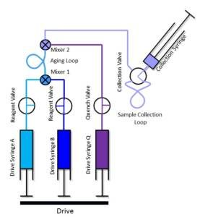
Pre-Steady/Steady State Assays (Single Nucleotide Incorporation)
Steady State rate of elongation
Rapid Quench Flow Instrument
Pre-Steady State rate of elongation

Slide 10
Catalytic and Accessory Subunit Interaction
The dissociation constant for the reconstitution of holoenzyme was observed

Slide 11
Active Site Titration
The dissociation constant for the DNA-binding to holoenzyme + concentration of active enzyme was observed

Slide 12
Nucleotide Dissociation Constant and Maximum Polymerization Rate

Slide 13
Results
The authors have demonstrated that the accessory subunit plays a role in :
Tighter polymerase binding to the DNA
Tighter poly. Binding to the nucleotide
Increased rate of nucleotide incorporation into DNA

Slide 14
Significance
In combating diseases such as AIDS and Hepatitis B, nucleoside analogues are used to decrease the binding of the DNA backbone from occurring, however a major side of effect is causing a decrease in mitochondrial function.
Through a better understanding of the complex nature of DNA poly. Gamma and its subunits, researchers can perform structure-function studies to screen new nucleoside analogues that have low toxicity levels.

