Slide 1
Ceramide kinase is required for a normal eicosanoid response and the subsequent orderly migration of fibroblasts.
Wijesinghe et. al. 2014.
Presentation by Jeetika Sainani
Notes:
Full citation:
Wijesinghe, D. S., Brentnall, M., Mietla, J. A., Hoeferlin, L. A., Diegelmann, R. F., Boise, L. H., & Chalfant, C. E. (2014). Ceramide kinase is required for a normal eicosanoid response and the subsequent orderly migration of fibroblasts. Journal of Lipid Research,55(7), 1298-1309. doi:10.1194/jlr.m048207

Slide 2
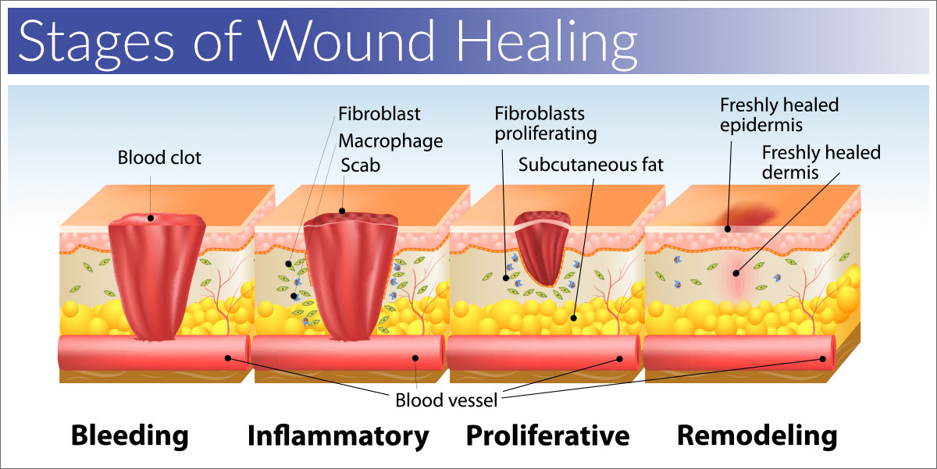
Wound Healing: A process we experience quite frequently, but rarely understand
What is this process? Why does it matter?
Four stages of wound healing
Efficiently cure wound
Important molecules:
Ceramide Kinase
Ceramide-1-phosphate
Fibroblasts
Why is migration so important? Disorders
Cytosolic phospholipase A2
Arachidonic acid to eicosanoids

Slide 3
How are all of these related?
Ceramide Kinase
Ceramide-1-phosphate
Cytosolic Phospholipase A₂
Arachidonic Acid
Eicosanoids
Fibroblasts
Notes:
Ceramide Kinase is an enzyme for the production of ceramide-1-phosphate.
Ceramide-1-phosphate is a sphingolipid that promotes proper eicosanoid response and fibroblast migration. Sphingolipids are lipids that specifically consist of long chains available to link to fatty acids
Ceramide-1-phosphate is an activator for cytosolic phospholipase A₂ and mechanical trauma also induces cytosolic phospholipase A₂
Cytosolic phospholipase A₂ promotes production of arachidonic acid
Arachidonic acid is metabolized enzymatically to eicosanoids
Eicosanoids promote fibroblast migration

Slide 4
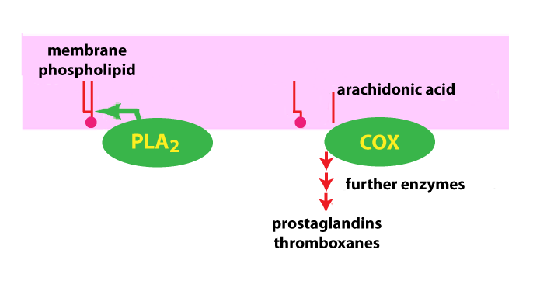
Measurement of arachidonic acid release in response to mechanical trauma
Does ceramide-1-phosphate from ceramide kinase promote fibroblast migration?
Where does arachidonic acid come into play?
Mice used to conduct experiments
Measurement taken by Scintillation

Slide 5
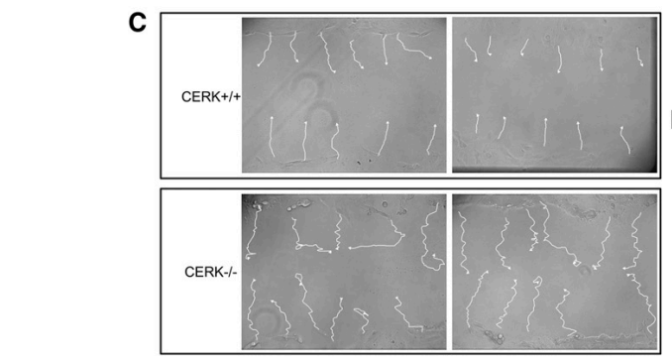
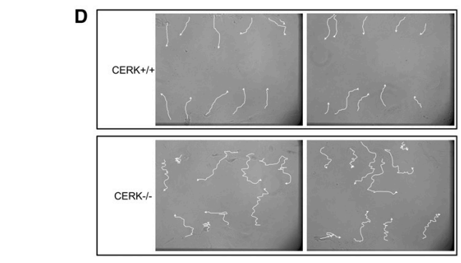
Mouse Embryonic Fibroblasts
Genetic ablation
CERK-null MEFs
CERK wild-type MEFs
Primary fibroblasts vs. immortalized fibroblasts
What’s the difference?
Fibroblasts seeded with DMEM, 10% FBS and
penicillin/streptomycin
³H Arachidonic Acid
Fig. 5C: Fibroblast migration patterns from immortalized ceramide kinase of both wild type and ablated fibroblasts.
Fig. 5D: Fibroblast migration patterns from primary ceramide kinase of both wild type and ablated fibroblasts.
Notes:
Ablation of ceramide kinase – CERK-null fibroblasts, genetic loss of ceramide kinase
Wild-type – ceramide kinase is naturally occurring
Primary fibroblasts – extracted naturally
Immortalized fibroblasts – usually infected with some kind of virus that keeps it fresh

Slide 6
Scintillation Counter – using flashes of light to count molecules
Radioactive compound: Trituum-3

Slide 7
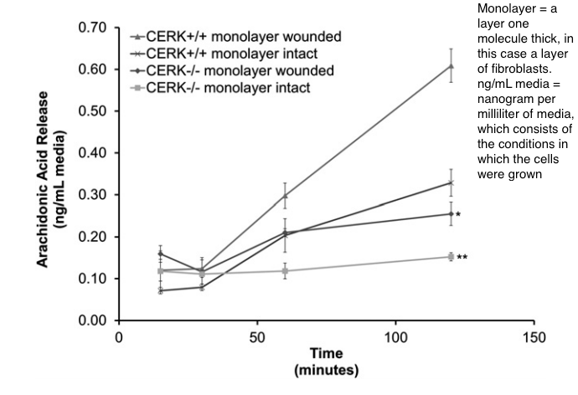
CERK-null and CERK wild-type fibroblasts demonstrated significant differences in the release of Arachidonic Acid

Slide 8
References
Wijesinghe, D. S., Brentnall, M., Mietla, J. A., Hoeferlin, L. A., Diegelmann, R. F., Boise, L. H., & Chalfant, C. E. (2014). Ceramide kinase is required for a normal eicosanoid response and the subsequent orderly migration of fibroblasts. Journal of Lipid Research,55(7), 1298-1309. doi:10.1194/jlr.m048207
http://www.ntanet.net/how-do-sodium-iodide-scintillation-detectors-work
https://www.biodermis.com/what-are-the-stages-of-wound-healing-s/221.htm
https://courses.washington.edu/conj/membrane/arachidonic.htm

