Slide 1
Understanding the mechanism of Chemokine CXCL13 and Glycosaminoglycan interaction will help improve immunotherapies.
By Jacob Rodriguez
Notes:
These can be changed to reflect your school’s specific rules.

Slide 2
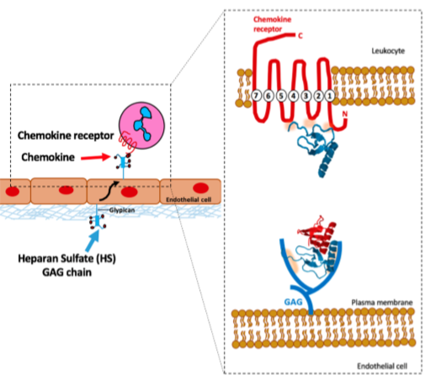
GAGs (glycosaminoglycans): essential component of cellular signaling. -located on the extra–cellular matrix, attached on a proteoglycans. -They are the most complex, natural linear bio-copolymers. -Affects the human physiology and pathology by modulating more than 400 proteins such as, growth factors, growth factors receptors, morphogens, pathogen surface proteins, viral surface proteins, and chemokines

Slide 3
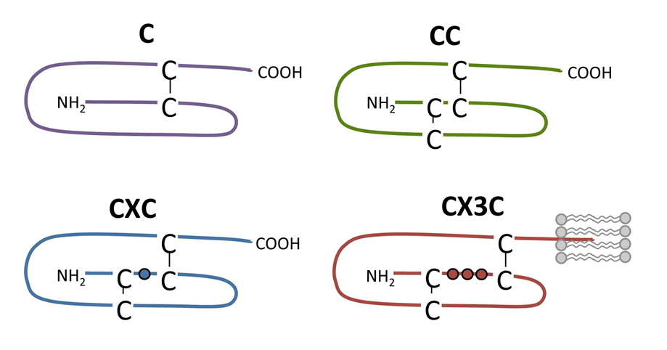
What are chemokines and what do they do?
-size of 8-14 kD (1 dalton is the mass of a proton)
-Chemokines direct the migrations of leukocytes during inflammation.

Slide 4
Heparan Sulfate: represent one of the 4 major classes of GAGs.
50,000 unique sequence

Slide 5
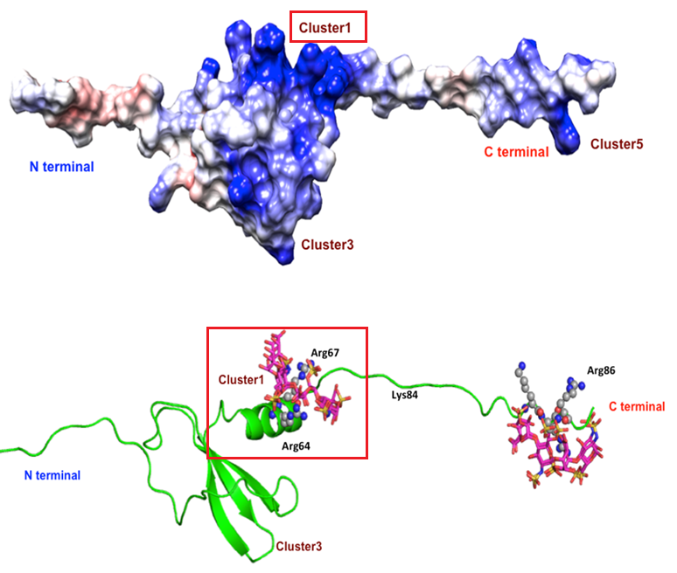

Slide 7
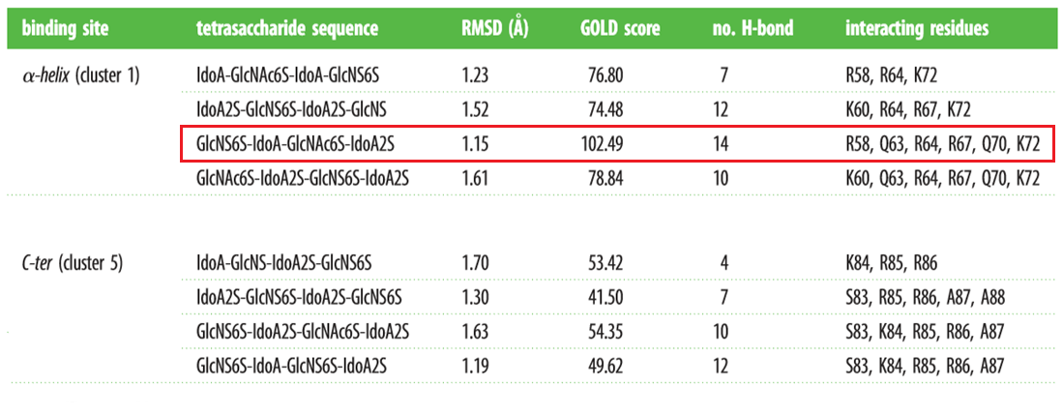

Slide 8
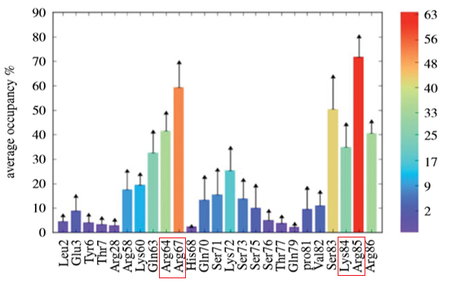
Average Occupancy of hydrogen bonding from all 5 molecular dynamics simulations

