Slide 1
The Protein Interactome of Streptococcus pneumoniae and How Bacterial Meta-Interactomes Improves Function Predictions.
TRANSLATED BY: KARUN RAJESH

Slide 2
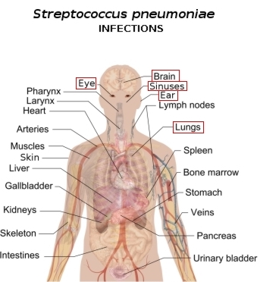
What is Streptococcus Pneumoniae?
Dangerous pathogenic bacterium
Life-threatening illnesses
Over 1.8 million deaths in children under 5 years of age
Only third of proteins’ functions are known
How can we try to characterize these unknown protein functions?
Wuchty et al. approached this problem from two angles

Slide 3
Characterization of Proteins
How do we find out the function of proteins?
Find out what the protein interacts with
Why?
Multitude of ways to characterize protein functions
Focused on Yeast-2-Hybrid approach and Bacterial Meta-Interactome

Slide 4
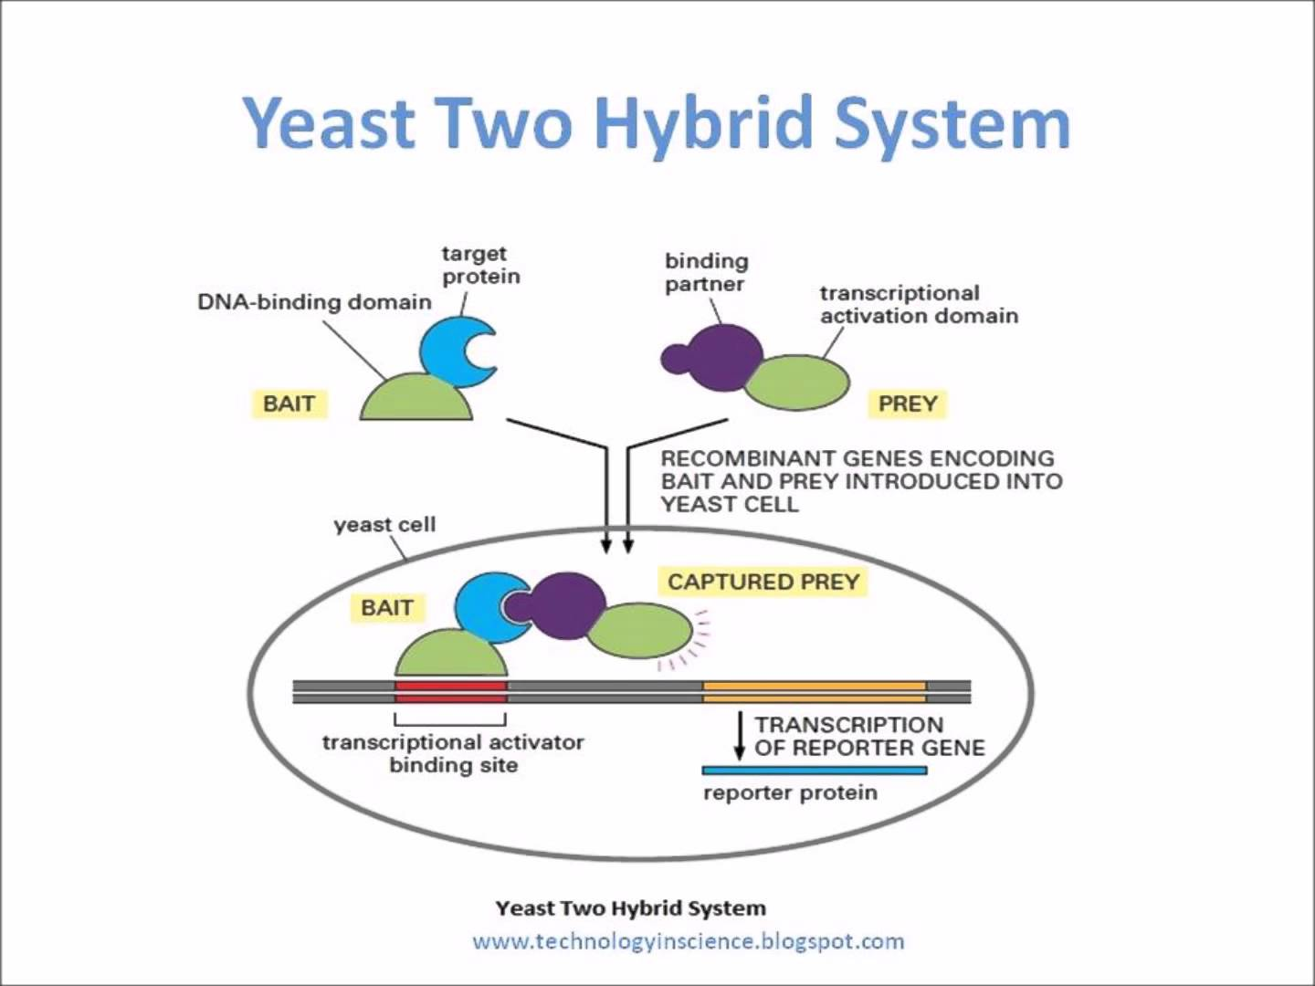
Yeast-2-Hybrid Method
Process:
Isolate two proteins
Attach halves of transcription activation factor
If interaction → then what?
If no interaction?
How to decide function of protein given interaction network
Majority Rule
From Paper:
Method resulted in 2,353 interactions for 918 proteins
Limitations?
Of the 918 proteins, 342 proteins’ functions were unknown
How can this number be improved?

Slide 5
Formation of Bacterial Meta-Interactome
Bacterial Meta-Interactome
What is it?
For this paper: Eight well-studied bacteria
Orthologs: Genes in different species evolving from common ancestor, retain same function of gene through evolution
Can be found through BLASTp
Orthologous proteins’ interactions were used as additional interactions for the given protein
Leads to more interactions for a given protein

Slide 6
Formation of Bacterial Meta-Interactome (cont.)
Known Protein B
Proteins of S. pneumoniae
Proteins of B. subtilis
BLASTp
Known Protein A
Unknown Protein X
Unknown Protein X
Ortholog
Known Protein A
Known Protein C
Known Protein D

Slide 7
Formation of Bacterial Meta-Interactome (cont.)
Yeast-2-Hybrid + Bacterial Meta-Interactome
Unknown Protein Z
Yeast-2-Hybrid Alone
Known Protein Y
Known Protein Y
Unknown Protein X
Unknown Protein X
Known Protein B
Known Protein D
Unknown Protein Z
Known Protein C

Slide 8
Augmentation of Protein Network with Bacterial Meta-Interactome
Without supplemental data:
4 Other, 1 Posttransl, 1 transcrpt
With supplemental data:
2 Posttransl, 2 Signal Transd, 3 Transcr, 5 Other
How is this useful?

Slide 9
Quality Control Check
80% used to predict, function known
Repeated 1000 times
Done for both yeast-2-hybrid approach by itself and yeast-2-hybrid approach with bacterial meta—interactome
ROC curves were generated for each run
Area under the curve measures prediction quality
Significant shift to higher values for augmented meta-interactome network
Proteins with Known Function
20% to be predicted, function erased

Slide 10
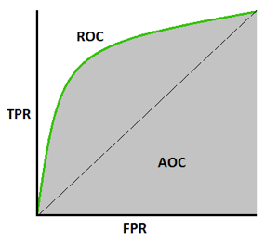
Quality Control Check (cont.)
- Increase in average area under ROC curve with +metainteractome
Created through 1000 runs
Measures the accuracy of the actual test

Slide 11
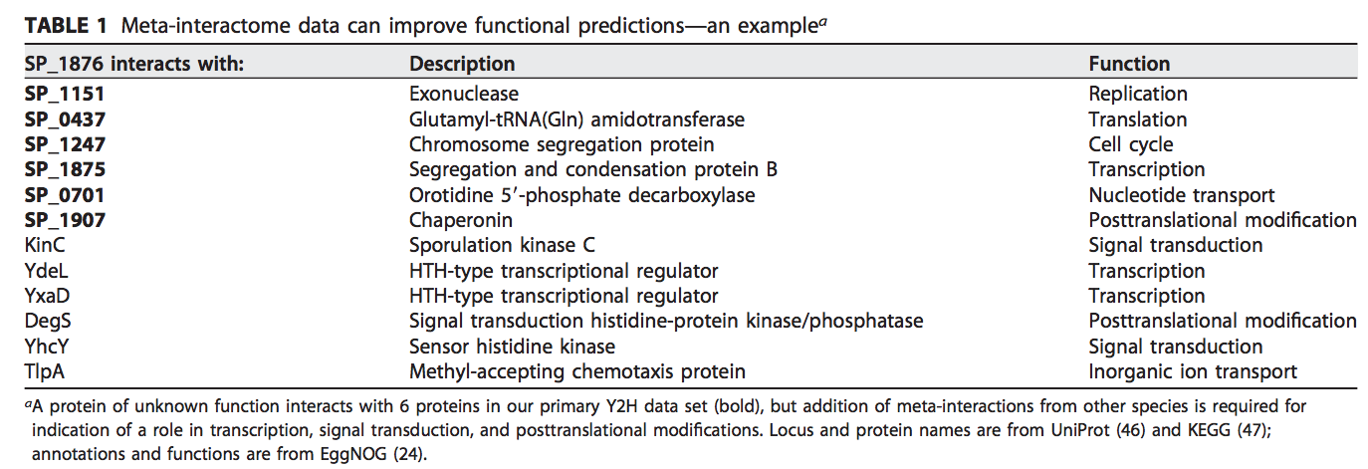
Determination of Protein Functions
Functionally predicted 342 poorly characterized S. pneumoniae proteins
299 characterized
Most (60%) were found to be involved in transcriptional/translational activities

Slide 12
Conclusion
With the yeast-2-hybrid approach alone:
Of the 2,045 PPI’s found, 1,328 involved at least one uncharacterized protein
Why is that bad/a problem?
The bacterial meta-interactome protein network
Significantly improved ability to predict functions of uncharacterized proteins
Method could be used for other streptococci species
Share core proteome of around 60-70% of proteins

