Slide 1
Development of Potential Agents for the Treatment of Sickle Cell Anemia
Mock Presentation- November 26, 2018
Nupur Pandya

Slide 2
Sickle Cell Anemia
Affects between 70,000-100,000 Americans
Characterized by sickle shape
Leads to several downstream effects
Vaso-occlusive crisis
Hemolysis
Pain
Stroke
Organ dysfunction
Splenic Sequestration
Other Complications
Figure from: https://www.mayoclinic.org/-/media/kcms/gbs/patient-consumer/images/2013/08/26/10/24/ds00324_im01729_r7_sicklecellsthu_jpg.jpg
Notes:
Inherited blood disorder
Affects between 70,000 and 100,000 americans
Is characterized by a sickle shaped rbc [FIGURE: SICKLE RBC]
RBC sickling can lead to several downstream pathophysiological events including obstruction of blood vessels (vaso-occlusive crisis), destruction and loss of RBC (hemolysis), severe pain, stroke, chronic organ dysfunction, splenic sequestration (the trapping of sickled RBC in the spleen), and other complications¹⁴.

Slide 3
Hemoglobin
Quaternary Protein with four subunits and a prosthetic heme group
Figure from JMOL Protein Explorer, PDB ID #1BZ0
Notes:
“Fuckin Hb”
[FIGURE: PDB IMAGE OF HB, p50 graph]
Disease is caused by a single point mutation in the proien Hb
Hb is a quaternary allosteric protein consisting of four subunits (a1, b1, a2, b2) and contain a prosthetic heme group (w/ iron)
Four subunits are arranged around eachother to form a large cenetarl water cavity where O2 binds
The primary function of Hb is to transport O2 from the lungs to the tissues
This can be measured by an oxygen equilibrium curve which plots the percent hb saturation vs the po2
The po2 at 50% hb saturation can be used to measure o2 affinity for hb

Slide 4
Hemoglobin
α-subunits
Quaternary Protein with four subunits and a prosthetic heme group
Figure from JMOL Protein Explorer, PDB ID #1BZ0
Notes:
“Fuckin Hb”
[FIGURE: PDB IMAGE OF HB, p50 graph]
Disease is caused by a single point mutation in the proien Hb
Hb is a quaternary allosteric protein consisting of four subunits (a1, b1, a2, b2) and contain a prosthetic heme group (w/ iron)
Four subunits are arranged around eachother to form a large cenetarl water cavity where O2 binds
The primary function of Hb is to transport O2 from the lungs to the tissues
This can be measured by an oxygen equilibrium curve which plots the percent hb saturation vs the po2
The po2 at 50% hb saturation can be used to measure o2 affinity for hb

Slide 5
Hemoglobin
β-subunits
Quaternary Protein with four subunits and a prosthetic heme group
Figure from JMOL Protein Explorer, PDB ID #1BZ0
Notes:
“Fuckin Hb”
[FIGURE: PDB IMAGE OF HB, p50 graph]
Disease is caused by a single point mutation in the proien Hb
Hb is a quaternary allosteric protein consisting of four subunits (a1, b1, a2, b2) and contain a prosthetic heme group (w/ iron)
Four subunits are arranged around eachother to form a large cenetarl water cavity where O2 binds
The primary function of Hb is to transport O2 from the lungs to the tissues
This can be measured by an oxygen equilibrium curve which plots the percent hb saturation vs the po2
The po2 at 50% hb saturation can be used to measure o2 affinity for hb

Slide 6
Hemoglobin
Heme Group
Quaternary Protein with four subunits and a prosthetic heme group
Figure from JMOL Protein Explorer, PDB ID #1BZ0
Notes:
“Fuckin Hb”
[FIGURE: PDB IMAGE OF HB, p50 graph]
Disease is caused by a single point mutation in the proien Hb
Hb is a quaternary allosteric protein consisting of four subunits (a1, b1, a2, b2) and contain a prosthetic heme group (w/ iron)
Four subunits are arranged around eachother to form a large cenetarl water cavity where O2 binds
The primary function of Hb is to transport O2 from the lungs to the tissues
This can be measured by an oxygen equilibrium curve which plots the percent hb saturation vs the po2
The po2 at 50% hb saturation can be used to measure o2 affinity for hb

Slide 7
Hemoglobin
Central Water Cavity
Quaternary Protein with four subunits and a prosthetic heme group
Figure from JMOL Protein Explorer, PDB ID #1BZ0
Notes:
“Fuckin Hb”
[FIGURE: PDB IMAGE OF HB, p50 graph]
Disease is caused by a single point mutation in the proien Hb
Hb is a quaternary allosteric protein consisting of four subunits (a1, b1, a2, b2) and contain a prosthetic heme group (w/ iron)
Four subunits are arranged around eachother to form a large cenetarl water cavity where O2 binds
The primary function of Hb is to transport O2 from the lungs to the tissues
This can be measured by an oxygen equilibrium curve which plots the percent hb saturation vs the po2
The po2 at 50% hb saturation can be used to measure o2 affinity for hb

Slide 8
Hemoglobin
Quaternary Protein with four subunits and a prosthetic heme group
Primary function is transport of oxygen
Figure from JMOL Protein Explorer, PDB ID #1BZ0
Notes:
“Fuckin Hb”
[FIGURE: PDB IMAGE OF HB, p50 graph]
Disease is caused by a single point mutation in the proien Hb
Hb is a quaternary allosteric protein consisting of four subunits (a1, b1, a2, b2) and contain a prosthetic heme group (w/ iron)
Four subunits are arranged around eachother to form a large cenetarl water cavity where O2 binds
The primary function of Hb is to transport O2 from the lungs to the tissues
This can be measured by an oxygen equilibrium curve which plots the percent hb saturation vs the po2
The po2 at 50% hb saturation can be used to measure o2 affinity for hb

Slide 9
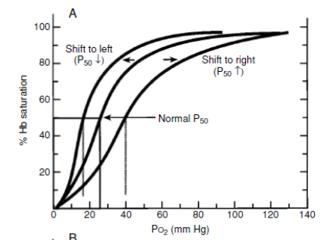
Hemoglobin
Quaternary Protein with four subunits and a prosthetic heme group
Primary function is transport of oxygen
Function can be measured with an Oxygen Equilibrium Curve
P50 value
Figure reproduced from Safo M, Kato G (2014)
Notes:
“Fuckin Hb”
[FIGURE: PDB IMAGE OF HB, p50 graph]
Disease is caused by a single point mutation in the proien Hb
Hb is a quaternary allosteric protein consisting of four subunits (a1, b1, a2, b2) and contain a prosthetic heme group (w/ iron)
Four subunits are arranged around eachother to form a large cenetarl water cavity where O2 binds
The primary function of Hb is to transport O2 from the lungs to the tissues
This can be measured by an oxygen equilibrium curve which plots the percent hb saturation vs the po2
The po2 at 50% hb saturation can be used to measure o2 affinity for hb

Slide 10
Hemoglobin Carries out it’s Function in Two States
Equilibrium between oxygenated, relaxed (R-state) and deoxygenated, tense (T-state)
Figure from JMOL Protein Explorer, PDB ID #1BZ0
Notes:
[FIGURE: R TO T TRANSITION]
Hemoglobin accomplishes its function by having multiple conformations, a high O2 affinity state that binds O2 (oxyHb) in the lungs then carries it to the tissues and changes to the low-affinity T-state to release O2 to cells (deoxy Hb)

Slide 11
Natural allosteric effectors
Natural allosteric effectors mediate the transition between the two states of Hb
Carbon Monoxide
2,3-Biphosphoglycerate
Figure from: http://oregonstate.edu/instruct/bb450/fall14/stryer7/7/figure_07_17.jpg
Notes:
[FIGURE: BINDING OF 2,3-BPG]
This equilibrium is maintained by allosteric effectors (which include 2,3-bpg, CO)
Ex: 2,3-bpg binds the b cleft of hb
They tie together the two b subunits to stabilize the t-state
This lowers the oxygen affinity of Hb and encourages it to release the O2 in the cells

Slide 12
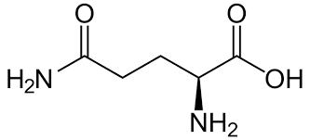
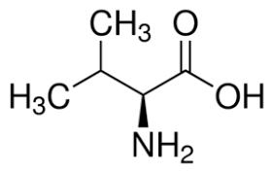
Sickle Cell Mutation
Sickle Cell Anemia is caused by a single point mutation
βGlu6 to βVal6
Glutamine
Figure from JMOL Protein Explorer, PDB ID #1BZ0
Valine
Notes:
[figure: pdb, highlight sickle mutation // polymerization // sickle rbc ]
Scd is caused by a point mutation in the b subunit of hb
It changes the 6th aa from hydrophilic b glu to nonpolar b val
The mutation doesn’t affect the R-state
In the t-stae the exsposed b val 6 of the deoxy hbs makes hydrophobic contacts w/ adj deoxy hbs
This leads to polymerization which then leads to sickle rbc

Slide 13
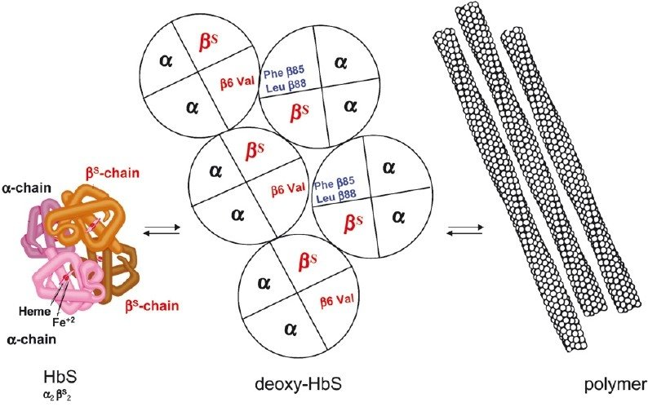
Sickle Cell Mutation
Sickle Cell Anemia is caused by a single point mutation
βGlu6 to βVal6
This leads to polymerization of the Hb leading to the sickle shaped Red Blood Cell
Figure from:https://www.researchgate.net/profile/Jacques_Elion/publication/51804205/figure/fig1/AS:202774865289217@1425356703126/Basic-pathophysiological-mechanism-of-sickle-cell-disease-the-polymerization-of.png
Notes:
[figure: pdb, highlight sickle mutation // polymerization // sickle rbc ]
Scd is caused by a point mutation in the b subunit of hb
It changes the 6th aa from hydrophilic b glu to nonpolar b val
The mutation doesn’t affect the R-state
In the t-stae the exsposed b val 6 of the deoxy hbs makes hydrophobic contacts w/ adj deoxy hbs
This leads to polymerization which then leads to sickle rbc

Slide 14
Current Treatments of Sickle Cell Anemia
Hydroxyurea Therapy
Resynthesis of HbF
Reduction of sickled cell adhesion
Toxicity
Blood Transfusions
Addition of normal RBC into patients
Metabolism of RBC
Notes:
Hydroxyurea therapy
Hu is known to resynthesize Hb F
HbF is known to inhibit Hb S polymerization
Symptoms of SCD show up after HbF drops (~6-12 months after birth
Hu helps w/ that
Hy also reduces the adhesion of sickled cells (vaso-occlusive crisis)
Hu is v fucking toxic
Esp to kids
Fda has only approved treatments toward adults
Blood transfusions
Alleviate complications
Is dangerous b/c patients may not react positively toward donated blood
Rbc are metabolized and transfusions must be done multiple times

Slide 15
What other options do we have?
Notes:
Obv a different treatment must be done

Slide 16
Aromatic Aldehyde Allosteric Effectors
Aromatic Aldehydes can form Schiff-base interactions with the free N-terminal α Valine 1
Figure from: https://chem.libretexts.org/@api/deki/files/2647/image061.png?revision=1
Notes:
[FIGURE: STRUCTURES OF VANILLIN/5-HMF, formation of Schiff base, metabolism of 5/hmf]
there are several schools of thought on types of new scd treatmetns
One is the use of allosteric effectors to increase the o2 affinity of hb to prevent rbc sickling
Main candidates are aromatic aldehydes
Thy can form shchiff-base interactions w/ free n-terminal a val 1 to stabilize r-state and increase hb affinity for o2
Vanillin was one of the first
It was good in vitro
Nonbioavailible in vivo → not clinically viable
5-hmf
Has been studied in clinical trials
Is very antisickling
Undergoes extreme metabolism of the reactive aldehyde group → phase ii clinical trials were ended

Slide 17
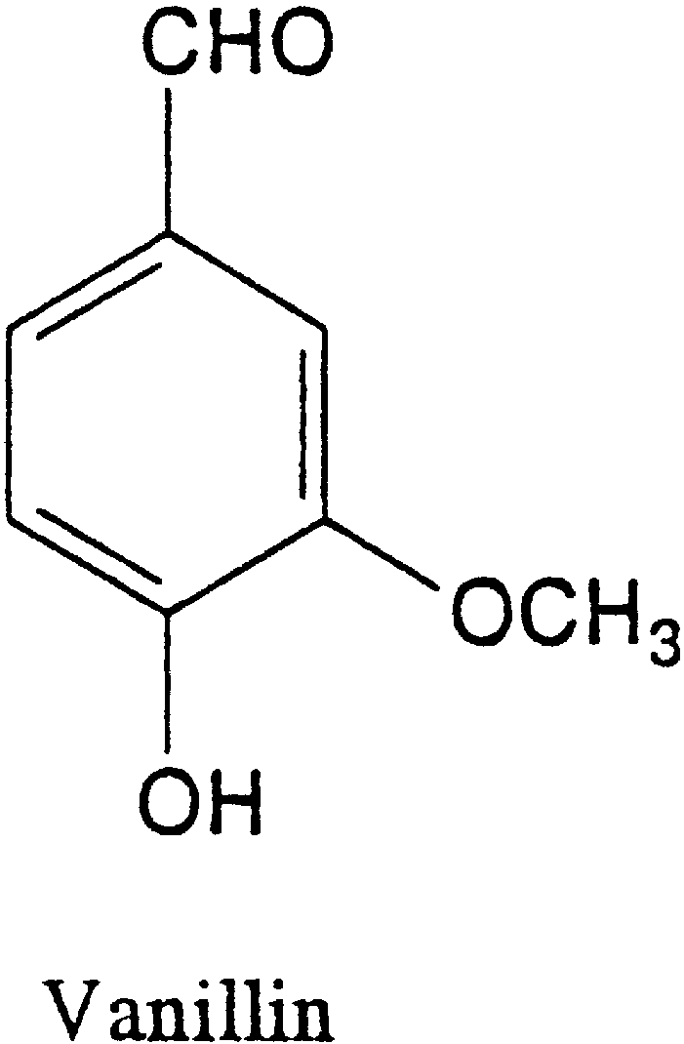
Aromatic Aldehyde Allosteric Effectors
Aromatic Aldehydes can form Schiff-base interactions with the free N-terminal α Valine 1
Vanillin
Figure from: https://ars.els-cdn.com/content/image/1-s2.0-S0031942203001493-gr1.gif
Notes:
[FIGURE: STRUCTURES OF VANILLIN/5-HMF, formation of Schiff base, metabolism of 5/hmf]
there are several schools of thought on types of new scd treatmetns
One is the use of allosteric effectors to increase the o2 affinity of hb to prevent rbc sickling
Main candidates are aromatic aldehydes
Thy can form shchiff-base interactions w/ free n-terminal a val 1 to stabilize r-state and increase hb affinity for o2
Vanillin was one of the first
It was good in vitro
Nonbioavailible in vivo → not clinically viable
5-hmf
Has been studied in clinical trials
Is very antisickling
Undergoes extreme metabolism of the reactive aldehyde group → phase ii clinical trials were ended

Slide 18
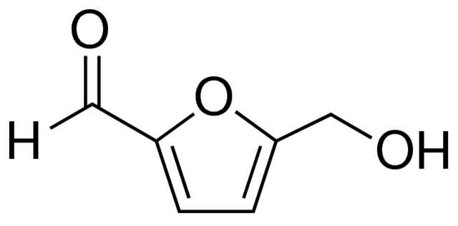
Aromatic Aldehyde Allosteric Effectors
Aromatic Aldehydes can form Schiff-base interactions with the free N-terminal α Valine 1
Vanillin
5-hydroxymethyl-2-furfural
Figure from: https://5-hmf.com/wp-content/uploads/2018/01/5-HMF_sial.png
Notes:
[FIGURE: STRUCTURES OF VANILLIN/5-HMF, formation of Schiff base, metabolism of 5/hmf]
there are several schools of thought on types of new scd treatmetns
One is the use of allosteric effectors to increase the o2 affinity of hb to prevent rbc sickling
Main candidates are aromatic aldehydes
Thy can form shchiff-base interactions w/ free n-terminal a val 1 to stabilize r-state and increase hb affinity for o2
Vanillin was one of the first
It was good in vitro
Nonbioavailible in vivo → not clinically viable
5-hmf
Has been studied in clinical trials
Is very antisickling
Undergoes extreme metabolism of the reactive aldehyde group → phase ii clinical trials were ended

Slide 19
This study seeks to investigate the possible antisickling properties of five aromatic aldehydes

Slide 20
A
B
C
2,4,6-trihdroxybenzaldehyde
Syringaldehyde
4-formylbenzoic acid
D
E
2,5-di(5-aldehyde-2-thienyl)-1,4-dioctyloxybenzene
An aromatic aldehyde isolated from the roots of Uvaria siamensis (Annonaceae).
Figure 5: Proposted Allosteric Effectors
(A) Figure from Maton A, et al. (2016)
(B) Figure from Cheng B, et al. (2017)
(C) Figure from Kamimura N, et al. (2017)
(D) Figure from Geng Y, et al. (2015)
(E) Figure from Salae AW, et al. (2017)
Notes:
My proposal is to study these 5 aromatic aldehydes
Hopefully we can develop aromatic aldehydes that don’t just exhibit antisickling effects but are also stable from metabolism
Will use p50 to study this

Slide 21
Testing the Oxygen Equilibrium Curve and P50
Testing the shift in the Oxygen Equilibrium Curve and P50 value of the Hb-effector complex
The procedure will follow the procedures listed in Deshpande T, et al (2018)
Figure reproduced from Safo M, Kato G (2014)
Notes:
[figure oec curve again]
Test the shift in the oec of the aromatic aldehyde allosteric effectors
The figure shows the left and right shift of the oec curve and the resulting p50 values
This can be influenced by effector binding
If the effector binds to hb and promotes o2 affinity (r-state), p50 will decrease and oec is shifted left
If the effector binds to hb and inhibits o2 (t-state), p50 will increase and oec is shifted right
The direction and magnitude of the shift depends on the structure/binding properties
The degree of change from the normal p50, directly correlates to the degree of inhibition
By measuring the p50 of the allosteric hb-effector complex we can measure the direction and magnitude of the shift
The procedure will follow the procedures listed in Deshpande T, et al (2018)

Slide 22
Formation of Hb-effector complexes
First normal whole blood will be suspended in buffer with serum and incubated with the proposed compounds under normal room air
To form Hb-effector complexes
This is then transferred to incubate under hypoxic (low o2) conditions
To form deoxy Hb
Then this will be washed, and 2% glutaraldehyde will be added to terminate the Schiff-base reaction, fix the Schiff base adducts, and reduce the free reactive aldehydes
Lastly, a control solution will also be set up, with equal parts Hb and buffer
Notes:
Suspending normal whole blood in buffer w/ serum and incubating under normal room air to form Hb-effector complexes
This is then transferred to incubate under hypoxic (low o2) conditions
Then this will be washed and 2% glutaraldehyde will be added to shiff-base raction, fix the Schiff base adducts, and reduce the free reactive aldehydes
Lastly, a control soln will also be set up, with equal parts Hb and buffer

Slide 23
Measurement
Oxygen Equilibrium Studies will be conducted with aliquot samples of Hb-effector adducts
Lysates will be resuspended in buffer and subjected to OEC and P50 analysis using a HEMOX analyzer
It uses dual wavelength spectrophotometry for the measurement of the optical properties of Hb to measure partial pressure of oxygen
The degree of shift in the P50 will be expressed as a percent fraction of control samples
Notes:
Oec studies will be conducted with aloquat samples of Hb-effector aducts
Lysates will be resuspended in buffer and subjected to analysis using a HEMOX analyzer to assess the shifts in OEC or P50 values
Hemox analyzer uses dual wavelength spectrophotometry for the measurement of the optical properties of hb for measuring the o2 partial pressure in mmHG
This method uses two separate wavelengths of radiation and passes them through the specimen (in this canse an aliquot of blood with liganded Hb-effectors)
The degree of shift of p50 will be expressed as the percent fraction of control samples

Slide 24
What can this tell us?
Desired outcome:
Lower P50 and left-shift of OEC curve
Possible Outcome:
Higher P50 and right-shift of the OEC curve
Figure reproduced from Safo M, Kato G (2014)
Notes:
[figure: oec curve)
p50 value of an hb-effector can tell us its potential antisickling activities
If it has a lower p50 this means for the amount of hb in the soln more o2 is bound to hb (and therefore po2 Is lower) than is not → there will be a left shift in the p50 value
This means the hb-effector complex has a high o2 affinity (transition into R-state) and therefore high antisickling activity
This is the desired outcome
It is possible that the opposite can happen and the drug (still binds in the free nitrogen of a 1val) can promote the T-state and lower the oxygen affinity moving the curve to the right
This can happen if there is a carboxyl group on the same ring as the aldehyde, the carboxyl interacts with the a 141 arg of the same subunit and promotes the t0-state
None of the propose compounds have a carboxyl group on the aldehyde ring
Its possible that these will not be strong enough at antisickling

Slide 25
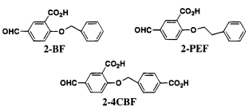
What can this tell us?
Desired outcome:
Lower P50 and left-shift of OEC curve
Possible Outcome:
Higher P50 and right-shift of the OEC curve
Figure from Abraham D, et al. (1995)
Notes:
[figure: oec curve)
p50 value of an hb-effector can tell us its potential antisickling activities
If it has a lower p50 this means for the amount of hb in the soln more o2 is bound to hb (and therefore po2 Is lower) than is not → there will be a left shift in the p50 value
This means the hb-effector complex has a high o2 affinity (transition into R-state) and therefore high antisickling activity
This is the desired outcome
It is possible that the opposite can happen and the drug (still binds in the free nitrogen of a 1val) can promote the T-state and lower the oxygen affinity moving the curve to the right
This can happen if there is a carboxyl group on the same ring as the aldehyde, the carboxyl interacts with the a 141 arg of the same subunit and promotes the t0-state
None of the propose compounds have a carboxyl group on the aldehyde ring
Its possible that these will not be strong enough at antisickling

Slide 26
What’s next?
Time and Concentration Dependent Adduct Formation Study
X-Ray Crystallography
in vivo pharmacokinetic/pharmacodynamic studies
Notes:
Need to test the potency via a time and concentration dependent adduct frormationn stidy
the amount of time they form Hb-effector complexes before metabolism and the concentration at which Hb-effector complex formation is optimal.
Study the binding scheme via x-ray crystallographic study
In vivo pharmacokinetic/pharmacodnynamoc stidoes
Observe in vivo antisickling properties
Observe in vivo metabolism

Slide 27
Final Thoughts
A
B
C
2,4,6-trihdroxybenzaldehyde
Syringaldehyde
4-formylbenzoic acid
New drug development for sickle cell disease is crucial
D
E
2,5-di(5-aldehyde-2-thienyl)-1,4-dioctyloxybenzene
An aromatic aldehyde isolated from the roots of Uvaria siamensis (Annonaceae).
Figure 5: Proposted Allosteric Effectors
(A) Figure from Maton A, et al. (2016)
(B) Figure from Cheng B, et al. (2017)
(C) Figure from Kamimura N, et al. (2017)
(D) Figure from Geng Y, et al. (2015)
(E) Figure from Salae AW, et al. (2017)
Notes:
The development of a new drug for SCD is crucial, as the population suffering from the disease is high, and no proper treatment exists yet. Although it is possible the aromatic aldehyde effectors proposed in this paper may have low antisickling properties, low potency in vivo, or high rates of metabolism; this school of thought-- development of antisickling aromatic aldehyde effectors to treat SCD-- is extremely important in treating sickle cell disease patients all over the world.

Slide 28
References
http://www.hematology.org/Patients/Anemia/Sickle-Cell.aspx
http://www.tcssci.com/hemox/index.htm
Abraham D, et al. (1995). How Allosteric Effectors Can Bind to the Same Protein Residue and produce Opposite Shifts in the Allosteric Equilibrium. Biochemistry, 34(15006-15020)
Deshpande T, et al. (2018). Rational modification of vanillin derivatives to stereospecifically destabilize sickle hemoglobin polymer formation. Acta Crystallogr D Struct Biol, 74(10):956-964
Fernandes Q. (2017). Therapeutic strategies in Sickle Cell Anemia: The past present and future. Life Sciences, 178:100-108.
Safo M, Kato G. (2014). Therapeutic Strategies to Alter the Oxygen Affinity of Sickle Hemoglobin. Hematology/Oncology Clinic of North America, 24(217-231).
Safo M, et al. (2010). Hemoglobin-ligand binding: Understanding Hb function and allostery on atomic level. Biochimica et Biophysica Acta, 1814(6):797-809.

