Slide 1
Tie1 and Tie2 Dimerization and the Possible Inhibition of Angiogenesis in Tumor endothelial cells.
Sarah Otih
Mentor: Dr. William Barton

Slide 2
Tumor Introduction
Tumors are known as some unusual mass in which cells divide uncontrollably.
Tumors can be benign or malignant
In the case of malignant tumors, the tumor cells continue to grow uncontrollably and invade healthy organs and healthy cells.

Slide 3
Receptor Tyrosine Kinase
Tyrosine Kinases are enzymes that transfers a phosphate group.
Basically acts as a cellular on and off switch.
Regulate normal cellular processes.
These Tyrosine Kinases are linked to angiogenesis→ Process of creating new blood vessels from preexisting blood vessels.

Slide 4
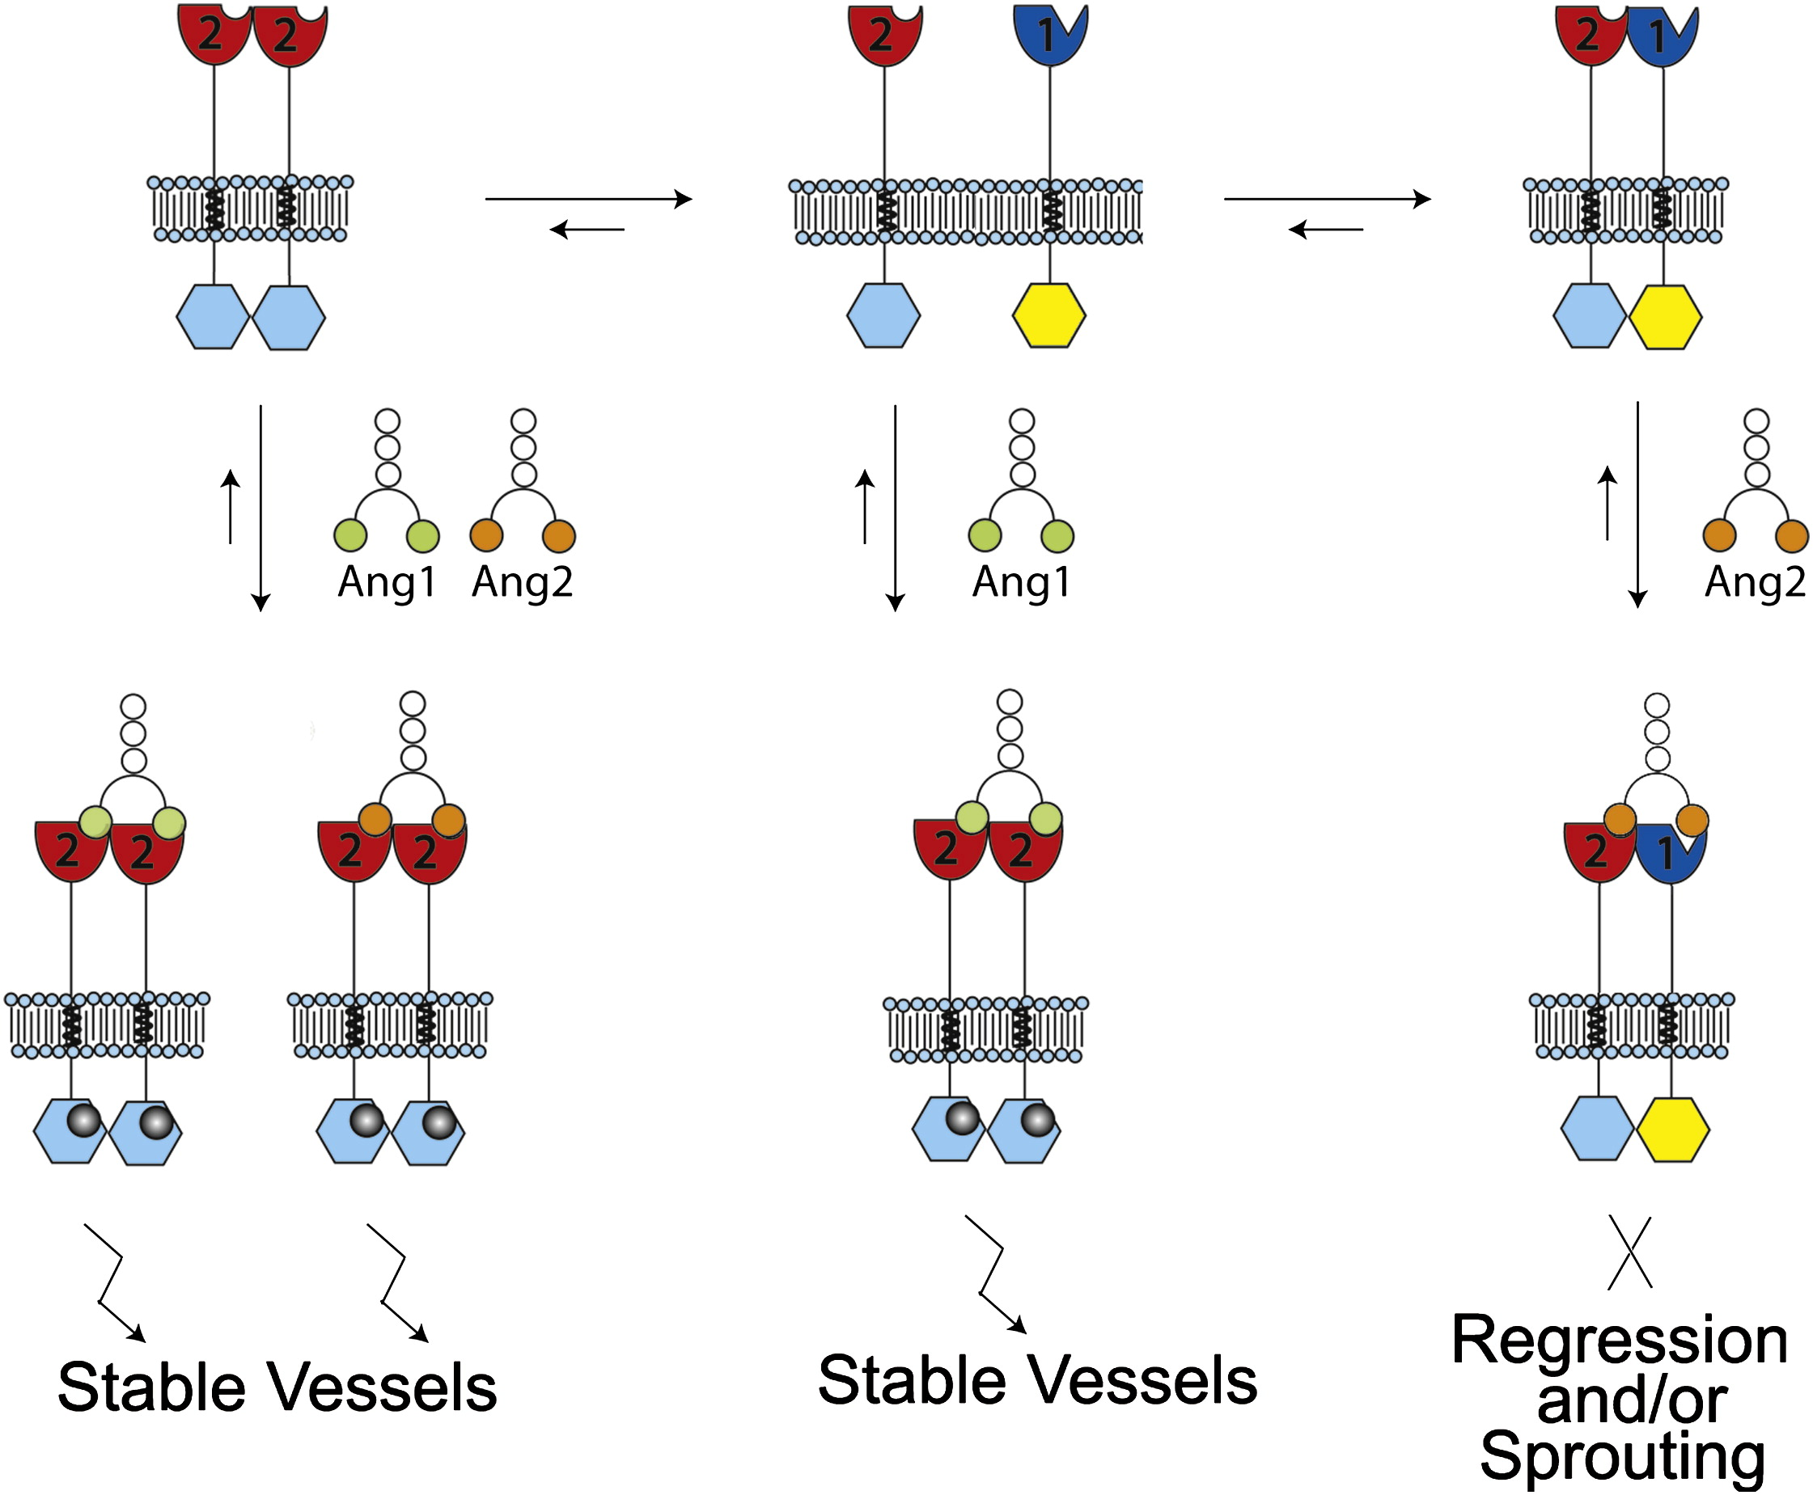
Tie1 and Tie2 Receptor Tyrosine Kinases
Create endothelial specific signaling pathway with important functions in regulation of angiogenesis.
Activated by Angiopoietins which are growth factors, specifically, Angiopoietin 1(Ang1).
Barton et al 2010

Slide 5
Ang1 is the angiopoietin responsible for binding to Tie2/Tie2 dimer. When Ang1 binds to this dimer, it initiates angiogenesis.
Barton et al 2010

Slide 6
When Ang1 is not present, Tie1 and Tie2 are bound together causing angiogenesis to stop.
Barton et al 2010

Slide 7
If angiogenesis is permanently stopped, could this result in cellular death?
Could a constant physical interaction between Tie1 and Tie2 result in the hault of angiogenesis in targeted endothelial cells?

Slide 8
Barton et al. 2010
Barton et al.(2010) discovered that there were positive surface and negative surface on Tie1 and Tie2 respectively.
If the isolation of the charged amino acids of both Tie1 and Tie2 at these charged surfaces could be found, we could utilize mutagenesis to amplify the attraction between Tie1 and Tie2.

Slide 9
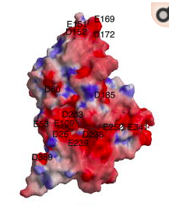
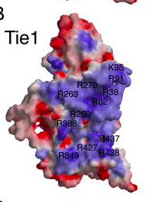
Tie2 Tie1
Barton et al 2010

Slide 10
Experiment
Identify specific amino acids on charged surfaces of both Tie1 and Tie2.
Tie1 is positively charged, containing arginine and lysine at the charged surface
Tie2 is negatively charged containing glutamic acid and aspartic acid
How?
Pymol→ this is a protein program that allows users to manipulate and view proteins.

Slide 11
Experiment cont...
2) The use of site-directed mutagenesis to mutate the identified amino acids.
Tie1: glutamic acid and aspartic acid mutated to arginine and lysine.
Tie2: serine and threonine to glutamic and aspartic acid.

Slide 12
Experiment cont...
3) Measure the attraction
Ang1 causes Tie1 and Tie2 to break apart. If the experiment was successful, Ang1 should not be able to cause Tie1 and Tie2 to break apart at all.
The introduction into Ang1 and its ability to break apart Tie1 and Tie2 would decipher if the experiment was successful.
This could be measured by Fret(Fluorescence Resonance Energy Transfer).

Slide 13
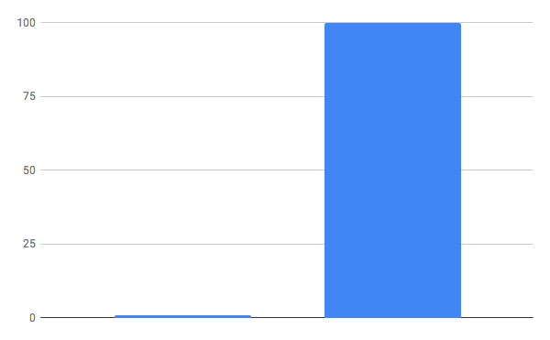
Possible Outcomes
Ang1 has no effect. Tie1 and Tie2 Ang1 is able to cause Tie1 and Tie2 stay physically attached to break apart

Slide 14
Possible Issues
When selecting the specific amino acids we wish to mutate, it is imperative to avoid hydrophobic areas as this could cause issues with protein folding and function.

Slide 15
The big picture...
If my experiment is successful, this could be used as a basis for the future of tumor and cancer treatment once technological advancements arise allowing us to target specific cancerous cells.

Slide 16
Questions?

Slide 17
How do could we ensure that this Tie1/Tie2 dimerization would take place in only cancer cells?
No current cancer therapies/technologies
Once a technology is created, this Tie1/Tie2 dimerization could be a potential target.
Bivalent antibodies
In vivo, bivalent antibodies could potentially attach to both Tie1 and Tie2 and from there be inserted into targeted cells.

Slide 18
References
Seegar, T. C. M., Eller, B., Tzvetkova-Robev, D., Kolev, M. V, Henderson, S. C., Nikolov, D. B., & Barton, W. A. (2010). Article Tie1-Tie2 Interactions Mediate Functional Differences between Angiopoietin Ligands. https://doi.org/10.1016/j.molcel.2010.02.007
Yu, X., Seegar, T. C. M., Dalton, A. C., Tzvetkova-Robev, D., Goldgur, Y., Rajashankar, K. R.,
Barton, W. A. (2013). Structural basis for angiopoietin-1-mediated signaling initiation. Proceedings of the National Academy of Sciences of the United States of America, 110(18), 7205–7210. https://doi.org/10.1073/pnas.1216890110
Adair, T. H., & Montani, J.-P. (2010). Overview of Angiogenesis. Retrieved from https://www.ncbi.nlm.nih.gov/books/NBK53238/
Shlamkovich, T., Aharon, L., Barton, W. A., Papo, N., Shlamkovich, T., Aharon, L., … Papo, N. (2017). Utilizing combinatorial engineering to develop Tie2 targeting antagonistic angiopoetin-2 ligands as candidates for anti-angiogenesis therapy. Oncotarget, 8(20), 33571–33585. https://doi.org/10.18632/oncotarget.16827

