Slide 1
Targeted Mutagenesis of Guinea Pig Cytomegalovirus Using CRISPR/Cas9-Mediated Gene Editing
Mario Melchor-Guerra

Slide 2
What is cytomegalovirus? Why does it matter?
Common herpesvirus
Maternal-fetal CMV infections are common
Leads to serious birth defects or other long term injury
Can cause mental retardation, seizure disorders, and issues with development
No prevention readily available

Slide 3
Bacterial Artificial Chromosomes (BACs)
done by using E. coli to make mutant viruses.
They are very stable and will usually not change over time
BACs allow for even the smallest change to the viral sequence

Slide 4
CRISPR/Cas9
Natural system used by bacteria to protect themselves from infection by viruses
when bacteria detect the virus dna, 2 rna strands are produced
1 of which contains a sequence that is the same as the invading virus
the 2 rna strands form a complex with cas-9
cas-9 is a nuclease (enzyme that can cut dna)
when the matching sequence, guiding dna, finds the target within the viral genome
Cas9 cuts the dna and disables the virus
by changing the guide rna to a desired target, the cas9 can precisely cut any sequence not just virus

Slide 5
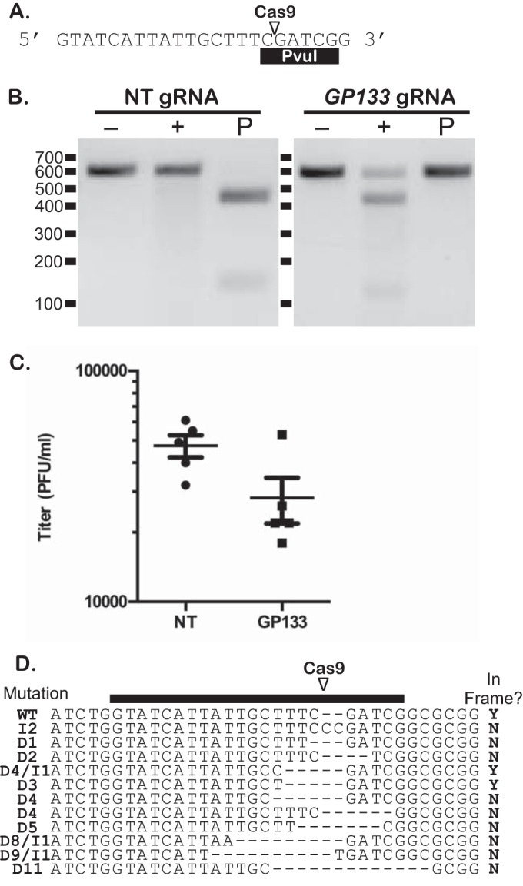
Experiment

Slide 6
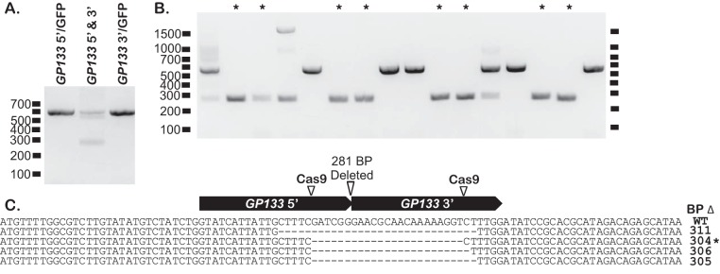
Experiment

Slide 7
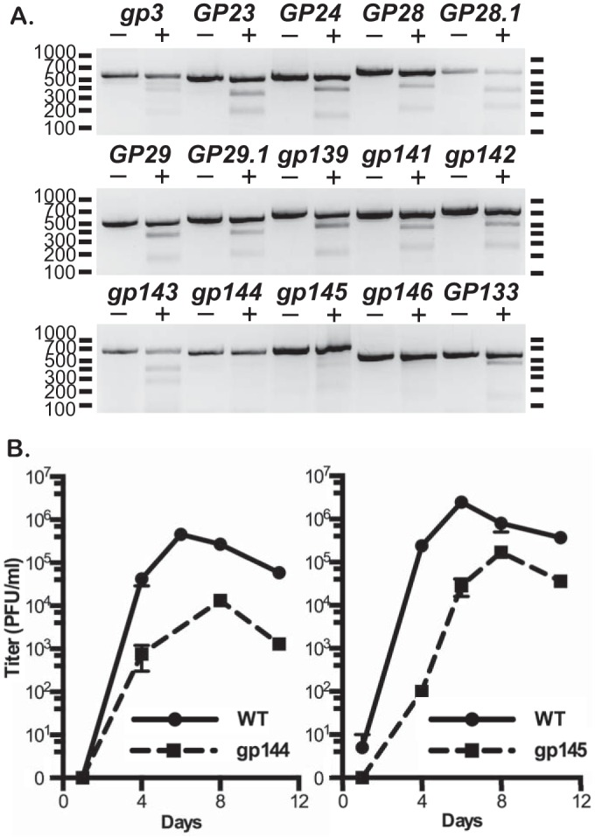
Experiment

Slide 8
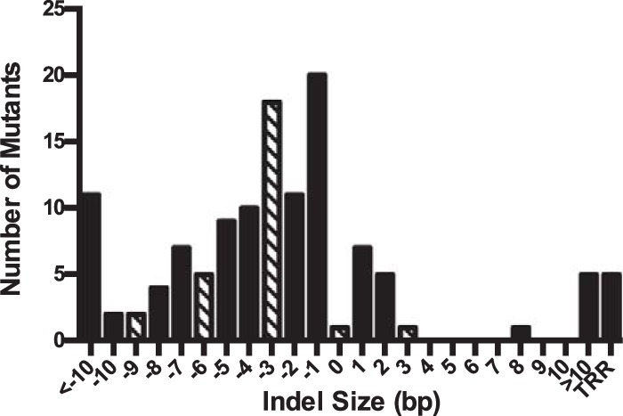
Results

