Slide 1
The Functional Diversity of CYC2 Transcriptional Factors during the Evolution of Schizanthus
Mock Presentation 11/27/18
Amrita Kondeti

Slide 2
TCP Transcriptional Factors
TCP Stands for:
Teosinte Branched 1 (TB1)
Cycloidea (CYC)
Proliferating Cell Factors (PCF1 & PCF2)
TCP GENE FAMILY
Class I
Class II
Gene Function of Class I and Class II
Notes:
Tb1 originally found from maize
CYC was first found from snapdragon
PCF1 & PCF2 were initially detected from rice
TCP gene family was first described in 1999, as a small group of plant genes encoding proteins that share TCP domain that allows DNA binding, protein-protein interactions, and encode for transcriptional factors.
These transcriptional factors greatly influence the growth patterns of tissues and organs during plant development, which are key essentials for plants to form
TCP Gene family is broken down into two clades – Class I & Class II
Class I
FIND GENE FUNCTION FROM THE BOOK
Class II
FIND GENE FUNCTION FROM THE BOOK

Slide 3
Class II Clade
The gene function of Class II members of the TCP family are better studied.
Further divided into:
CIN
Development of leaves
CYC/TB1
Control of floral symmetry
Control of branching patterns
Notes:
The members of CIN clade has been suggested involving in the development of leaves in multiple plant species.
CYC-like and TB1-like genes are usually found in the control of the floral symmetry and branching patterns, respectively.

Slide 4
Purpose
Purpose
Agriculture and Environmental purposes
Ex: Adaptation to resources availability, pollination success, vegetables
Are there anymore gene functions TCP controls we don’t know about?
Check the relationship between gene duplication
Based on phylogeny tree
Use BLAST
Critical to understand flower
Zygomorphic plants can have more species than anticmorphic
Notes:
These functions are important because they are related to agriculture purposes as well as the traits are important for Environmental purposes.
People have already found these gene functions pertaining to agricultural purposes
We know that the TCP controls so and so functions and traits, but we don’t know if there are more gene functions that TCP controls
So we want to test whether there are more functions in the Class II clade.
In order to do this, we have to check the relationship between gene duplication. Basically in new species when a single gene becomes two.
Sometimes during gene duplication, the new copy can have a new function.
We have to know how gene duplication occurs based on a phylogeny tree.
To get the tree we look at sequences from Basica Local Alignment Search Tool (BLAST)

Slide 5
Next Generation Sequencing Database
Gene controls many functions and traits – that we don’t know about yet.
NGS is used to test if there is any diversity of the genes in the sequences
Need to detect sequences from NGS to see if there are any changes
Notes:
There are more resources that are available for data mining, so I used NGS to test if there is any diversity of the genes in the sequences.
We create a phylogeny tree to detect how many gene duplications have happened and where they have happened.

Slide 6
Datamining
Basic Local Alignment Search Tool (BLAST)
Mine TCP genes from NGS database from 80 different plants species.
Geneious
Manually check for regions in the sequences that share similarities
Gene Evolution Analysis
Reconstructed phylogenetic tree
Focused on CYC2 lineage of CYC/TB1 clade
Notes:
BLAST
Runs Blast runpip.sh file
Retrieves sequences from database
Takes Reverse Compliment
Finds Open Reading Frames
Gets the alignment
Geneious
Used to manually check for regions in the sequences that share similarities
Sequences are significantly different from other sequences are deleted
Process is repeated until all sequences share similarities to each other
Gene Evolutional Analysis
Reconstructed phylogenetic relationship between the detected TCP genes.
When focus on the CYC2 linage of CYC/TB1 clade, I found that the gene structures were modified in several plant groups.
CYC2-like genes are usually with three consistent coding domains, i.e., TCP, ECE, and R domains.

Slide 7
Schizanthus
Genus of Solanaceae family
Notes:
1. Found a lot of gene duplication over TCP gene family during the evolution of all the plant species in the NGS database. (around 80)
2. For example, this particular genus that caught my eye was Schizanthus that belong to Solanaceae family.
This family has a gene duplication of CYC2, which makes all the members in the family have 2 copies of CYC2.
The second duplication happen over the genus, Schizanthus, in which only one copy was duplicated.

Slide 8
Small Question
What is The Functional Diversity of CYC2 Transcriptional Factors during the Evolution of Schizanthus
Snapdragon (controls flower symmetry)
Malpighiaceae (controls flower symmetry)
These two examples all have two copies of CYC2.
Notes:
How can I test the gene function? I used VIGS method as a molecular mechanism.

Slide 9
Virus Induced Gene Silencing Method
A method that silences a particular gene from being expressed.
Aka. Gene knockout

Slide 10
VIGS - Part 1
The first step is designing an efficient TRV2 VIGS is the selection of the CYC2 gene fragment.
The goal is to choose a gene fragment that produces siRNAs with a minimal predicted off-target gene silencing.

Slide 11
VIGS - Part 2
The second step is selecting an appropriate tissue of Schizanthus at a particular time of day or night to extract the RNA.
In this case, tissue was selected during the day time.
This depends on the expression pattern of the CYC2 gene.

Slide 12
VIGS - Part 3
The third step is to clone the CYC2 gene fragment into TRV2 based vector.

Slide 13
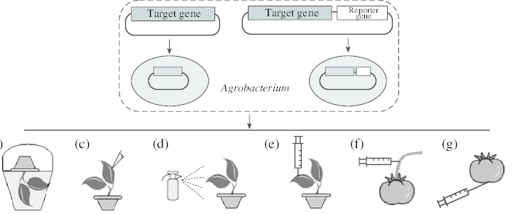
VIGS - Part 4
Vacuum of VIGS
Notes:
Infiltrating the plants.
Grow seeds of Schzanthus
Get plants
Put the plant into the solution (Agrobacteria)
Vacuum the air out
In the container the pressure is high which will put the solution in the plants.

Slide 14
Results
Silencing the CYC2 gene results in the changes of floral symmetry of Schizanthus.
It is expected that zygomorphic becomes active.

Slide 15
Pitfalls / Limitations of VIGS
The sequence is not silenced completely.
Successful ratios is not really high.

Slide 16
Citations
Martin-Trillo, M. and Cubas, P. TCP genes: a family snapshot ten years later. Cell Press, December 2009; 10.1016
Behjati, S. and Tarpey, P.S. What is next generation sequencing? US National Library of Medicine National Institutes of Health, August 2013; 10.1136
Preston, J.C. and Hileman, L.C. Developmental genetics of floral symmetry evolution. Trends in Plant Science, March 2009; 10.1016
Senthil-Kumar, M. and S Mysore, K. Tobacco rattle virus-based virus-induced gene silencing in Nicotiana benthamiana. National Institute of Plant Genome Research, June 2014; 10.1038

