Slide 1
The protein interactome of Streptococcus pneumoniae and Bacterial meta-interactomes Improve Function Predictions
Translation by Farhana Khan

Slide 2
The Significance of Experiment
What is Streptococcus pneumoniae?
Commonly known as pneumonia
Obtain better understanding of bacterial strain
Protein-protein interactions
Determine relationship between proteins
Mapping of interactome

Slide 3
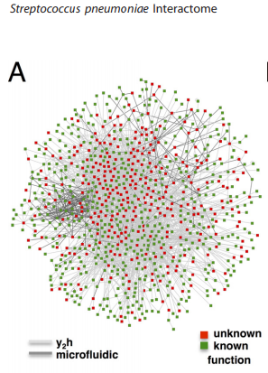
Detection of S. pneumoniae Interactome
Two methods:
Part 1: Yeast Two-Hybrid Protocol
Part 2: Compilation of a bacterial
“meta-interactome”
Part 1: 43% of interactome known
functions of proteins

Slide 4
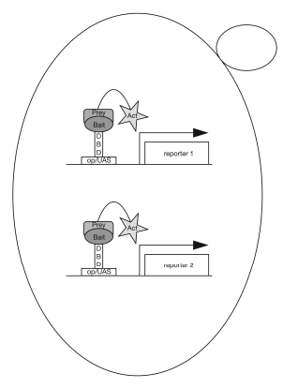
Yeast Two-Hybrid Protocol
Mapping of PPIs
Bait: Protein bound to DNA-binding
domain
Prey: Protein bound to transcriptional activation domain (Gal4 used for this experiment)
In a total of 2500 interactions, 900 proteins were found with known functions
Notes:
Process used to test number of preys and their interactions with the bait which ultimately helps detect and identify protein pairs in terms of functional relationships

Slide 5
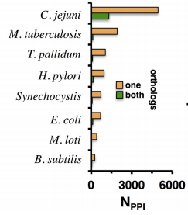
Orthologous Determination of Meta-interactome
Orthologous protein: protein that has deviated and evolved from a common ancestor (with S. pneumoniae)
Meta-interactome: union of all interactions of all orthologous proteins
The more interaction partners (degrees) a protein had, the more accurate the meta-interactome was to identify unknown partners

Slide 6
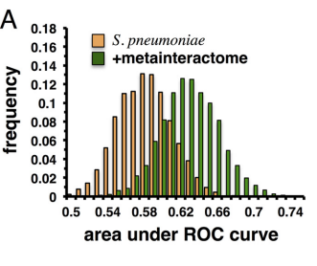
Functional Prediction Accuracy
Quality Check
ROC curve calculated to identify the quality and accuracy of the protein functional predictions
Functional annotations used from eggNOG Database
Each protein that is given a predicted function given a profile
Reflects probability of having that function
Augmented Network created: listing pairings of known proteins with orthologous predicted proteins from meta-interactome
Notes:
See a shift of increased values in ROC curve -> represents that the probability of accurately identifying protein functions is correct, with the parameter being the protein-protein interactions

Slide 7
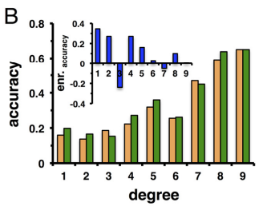
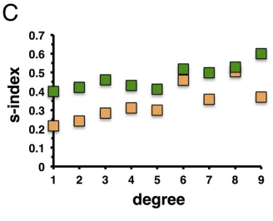
Enrichment of Accuracy as a Degree
Addition of bacterial meta-interactome shown to increase the prediction accuracy of S. pneumoniae proteins with low degrees (low PPIs)
Simpson s-index calculated
The closer to 1, the more
accurate a function is
Notes:
Simpson s-index: measure of heterogeneity of probabilities aka how closely related two given proteins are. Closer to 0 if probabilities are equally distributed

Slide 8
Impact of Study
Ultimately the experiment was able to compile a quality interactome
By obtaining data sets of evolutionarily conserved bacteria that share commons ancestors with this strain
Proteins in S. pneumoniae can be used to determine unknown functions in other strains as well
Uphold definition of including orthologous proteins
In total, the meta-interactome created included a little over 2,000 PPIs with about 1300 of them being functionally predicted proteins.
Discovered that majority of proteins in augmented network held transcription functions

Slide 9
References
Hennah W, Porteous D (2009). Reif, Andreas, ed. "The DISC1 pathway modulates expression of neurodevelopmental, synaptogenic and sensory perception genes”. PLoS ONE 4 (3) e4906.
Mariano, R., Khuri, S., Uetz, P., Wuchty, S. (2016). Local Action with Global Impact: Highly Similar Infection Patterns of Human Viruses and Bacteriophages. mSystems 1(2).
Serebriiskii, Ilya. (2010). Yeast Two-Hybrid System for Studying Protein-Protein Interactions--Stage 1: Construction and Characterization of a Bait Protein. Cold Harbor Springs Protocols.
Wuchty, S., Rajagopala, S. V., Blazie, S. M., Parrish, J. R., Khuri, S., Finley, R. L., & Uetz, P. (2017). The Protein Interactome of Streptococcus pneumoniae and Bacterial meta-interactomes Improve Function Predictions.

