Slide 1
How in-utero exposure to buprenorphine affects myelination
A Translation of:
Sanches E, Bigbee J, Fobbs W, Robinson S, Sato-Bigbee C (2008). Opioid Addiction and Pregnancy: Perinatal Exposure to Buprenorphine Affect Myelination in the Developing Brain. Glia 56:1010-1027

Slide 2
Opioid Epidemic
In 2016, opioids were involved in 42,249 overdose related deaths[1].
Maintenance Therapy
Buprenorphine
Pregnant women

Slide 3
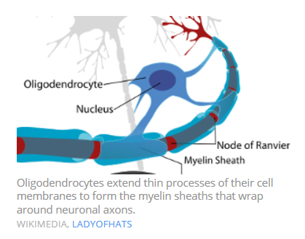
Oligodendrocyte

Slide 4
Myelin
Role:
Protects axons
Increases speed of electrical impulses
Components:
MAG: Myelin-associated Glycoprotein
MBP: Myelin Basic Protein

Slide 5
Research Question
Does in-utero exposure to buprenorphine affect myelination in the developing brain?

Slide 6
Experimental Design
Measured:
Myelin Basic Protein
Myelin-associated Glycoprotein
Glycosylated form
Interaction with Fyn
Size, diameter, and G-Ratio of axons

Slide 7
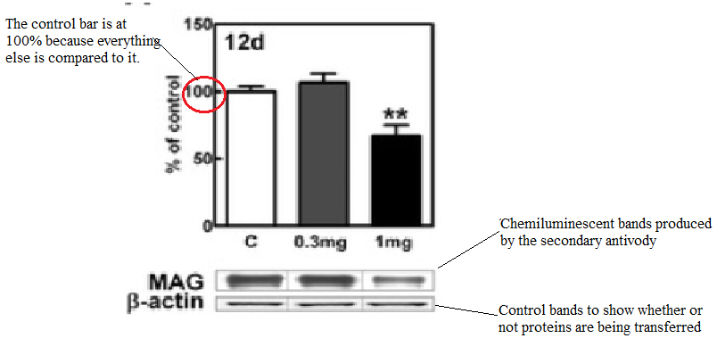
Protein Levels: Western Blot

Slide 8
Affect on Myelin Basic Proteins

Slide 9
Affect on Myelin-associated Glycoprotein

Slide 10
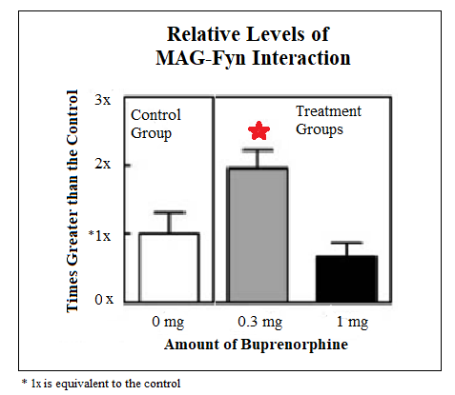
MAG Interactions
Gly-MAG Levels

Slide 11
Implications: Biphasic Dose Response
In the 12 Day age group, an increase in expression was seen in the lower dosage group and a decrease in the higher dosage group

Slide 12
Implications: Importance of MAG
MAG mutant mice: delay in myelin formation[14]
MAG knockout mice: less stable axons[15]
Fyn deficient mice: decreased MBP content[16]
Hypothesis: Increased levels of MBP is caused by is caused by increased levels of MAG-Fyn Interaction.
Hypothesis: Increased levels of MAG-Fyn interaction is caused by increased MAG glycosylation.

Slide 13
References
1. Center for Disease Control and Prevention. (2017, February 09). Opioid Data Analysis and Resouces. Retrieved from https://www.cdc.gov/drugoverdose/data/analysis.html
2. Morell P, Quarles RH. The Myelin Sheath. In: Siegel GJ, Agranoff BW, Albers RW, et al., editors. Basic Neurochemistry: Molecular, Cellular and Medical Aspects. 6th edition. Philadelphia: Lippincott-Raven; 1999. Available from: https://www.ncbi.nlm.nih.gov/books/NBK27954/
3. Swanson, J. W. (2017, June 30). Demyelinating disease: What can you do about it? Retrieved from https://www.mayoclinic.org/diseases-conditions/multiple-sclerosis/expert-answers/demyelinating-disease/faq-20058521
4. Morell P, Quarles RH. Developmental Biology of Myelin. In: Siegel GJ, Agranoff BW, Albers RW, et al., editors. Basic Neurochemistry: Molecular, Cellular and Medical Aspects. 6th edition. Philadelphia: Lippincott-Raven; 1999. Available from: https://www.ncbi.nlm.nih.gov/books/NBK28151/
5. Laule, C., Vavasour, I.M., Kolind, S.H. et al. Neurotherapeutics (2007) 4: 460. https://doi.org/10.1016/j.nurt.2007.05.004
6. NIDA. (2018, June 8). Medications to Treat Opioid Use Disorder. Retrieved from https://www.drugabuse.gov/publications/research-reports/medications-to-treat-opioid-use-disorder on 2018, November 17
7. Knapp, P. E., Maderspach, K. and Hauser, K. F. (1998), Endogenous opioid system in developing normal and jimpy oligodendrocytes: Î¼ and Îº opioid receptors mediate differential mitogenic and growth responses. Glia, 22: 189-201. doi:10.1002/(SICI)1098-1136(199802)22:2<189::AID-GLIA10>3.0.CO;2-U
8. Eschenroeder, A. C., Vestalâ€Laborde, A. A., Sanchez, E. S., Robinson, S. E. and Satoâ€Bigbee, C. (2012), Oligodendrocyte responses to buprenorphine uncover novel and opposing roles of Î¼â€opioidâ€ and nociceptin/orphanin FQ receptors in cell development: Implications for drug addiction treatment during pregnancy. Glia, 60: 125-136. doi:10.1002/glia.21253
9. Bartsch, U. , Kirchhoff, F. and Schachner, M. (1989), Immunohistological localization of the adhesion molecules L1, Nâ€CAM, and MAG in the developing and adult optic nerve of mice. J. Comp. Neurol., 284: 451-462. doi:10.1002/cne.902840310
10. Taylor, A. (2014, October). Myelin's Role in Motor Learning. Retrieved from https://www.the-scientist.com/daily-news/myelins-role-in-motor-learning-36579
11. Novus Biologicals. (2018). Western Blotting. Retrieved from https://www.novusbio.com/application/western-blotting
12. EDVOTEK. (2018, March). Biotechnology Basics: SDS Polyacrylamide-Gel Electrophoresis. Retrieved from http://www.edvotek.com/SDS-PAGE
13. Expedeon. (2018). Immunoprecipitation. Retrieved from https://www.expedeon.com/resources/applications/immunoprecipitation/
14. Biffiger K,Bartsch S,Montag D,Aguzzi A,Schachner M,Bartsch U. 2000. Severe hypomyelination of the murine CNS in the absence of myelin‐associated glycoprotein and fyn tyrosine kinase. J Neurosci 20: 7430–7437.
15. Fruttiger M,Montag D,Schachner M,Martini R. 1995. Crucial role for the myelin‐associated glycoprotein in the maintenance of axon‐myelin integrity. Eur J Neurosci 7: 511–515.
16. Umemori H,Kadowaki Y,Hirosawa K,Yoshida Y,Hironaka K,Okano H,Yamamoto T. 1999. Stimulation of myelin basic protein gene transcription by Fyn tyrosine kinase for myelination. J Neurosci 19: 1393–1397.

Slide 14
Limitations
Buprenorphine could be acting directly on Oligodendrocytes or mediated through other cell types
More studies needed to know the mechanism behind these affects
Unsure if buprenorphine acts differently than the endogenous opioid

Slide 15
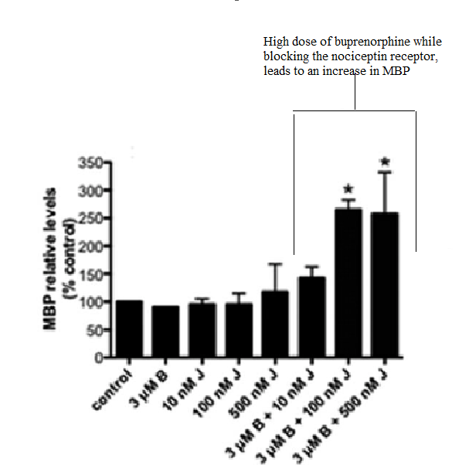
Biphasic Dose Response 2

Slide 16
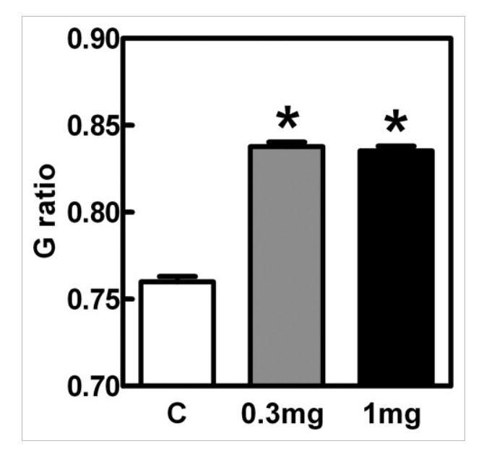
G-Ratio
A: Diameter of naked axon B: Diameter of myelinated axon G Ratio= A/D

Slide 17
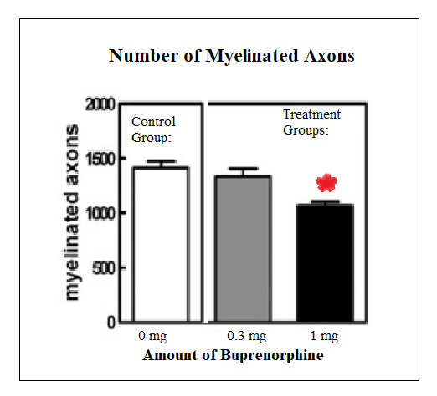
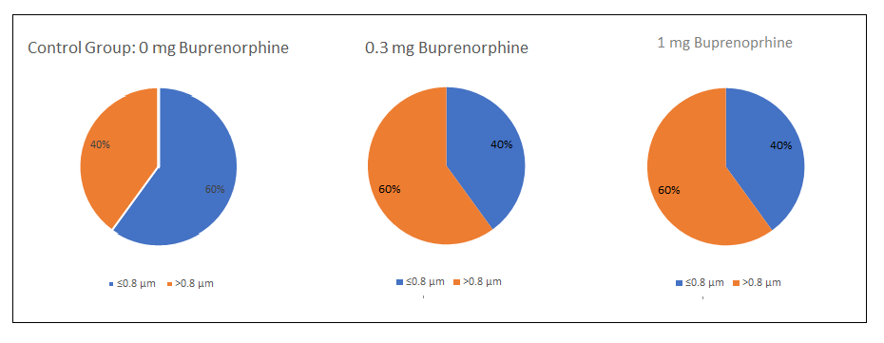
Axon Diameter

Slide 18
Coimmunoprecipitation

