Slide 1
mda-7/IL-24 Induces Cell Death in Neuroblastoma through a Novel Mechanism Involving AIF and ATM
Translated by Krishna Karamsetty

Slide 2
Background
Neuroblastoma affects children before 5 years. It is a CNS tumor. If detected kind off early it can be survivable. Most of the time detected when the tumor has metastasized

Slide 3
Introduction
MDA-7 is a tumor suppressing gene discovered in 1995
As neuroblastoma is in its advance stages, it becomes resistant to normal forms of cancer therapy.
The scientists in this article are trying to find a way to combat this stage IV neuroblastoma.

Slide 4
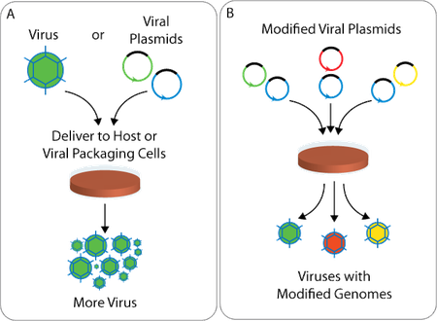
Viral Vector
A virus (Ad.5/3-CTV) was genetically modified to specifically attack neuroblastoma cancer cells and inject them with the MDA-7 gene which causes the cell to start synthesizing the necessary proteins to cause apoptosis.

Slide 5
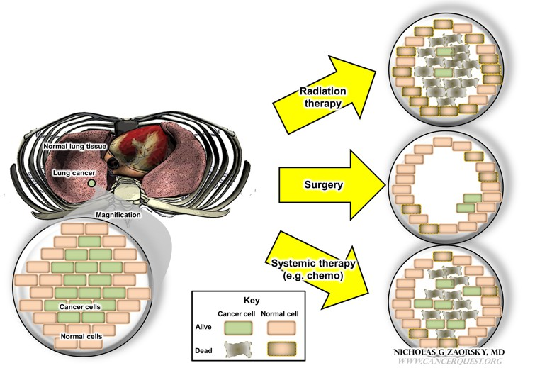
Specific Question
Since neuroblastoma is a cancer that normally targets children younger than five years of age, normal cancer treatments are way too harsh for them. How can we create a less harsh form of treatment that does the job better than other cancer treatments.

Slide 6
How is this done?
Western blot, TUNEL assay and FACS analysis were the main techniques used in this experiment.
There were six experiments that were done.
2 were to show that the virus was successfully doing its job
2 were to show that the virus was using a different pathway than normal cancer killing
1 was to show that AIF was increased by upstream molecules like ATM and y-H2AX
The last one was to show that the treatment was effective in a live subject.

Slide 7
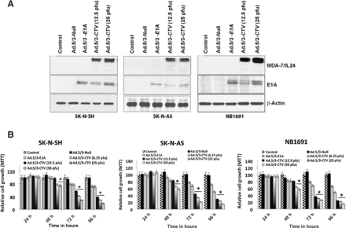
Experiment 1
Figure 1A shows that if the line is thicker for 3-CTV (cancer terminating virus), this means that the virus successfully injected MDA-7 into the cancer cell and cell death was occurring. Figure 1B shows that if the proliferation rate is lower, the cells aren’t growing due to the MDA-7 gene in them.

Slide 8
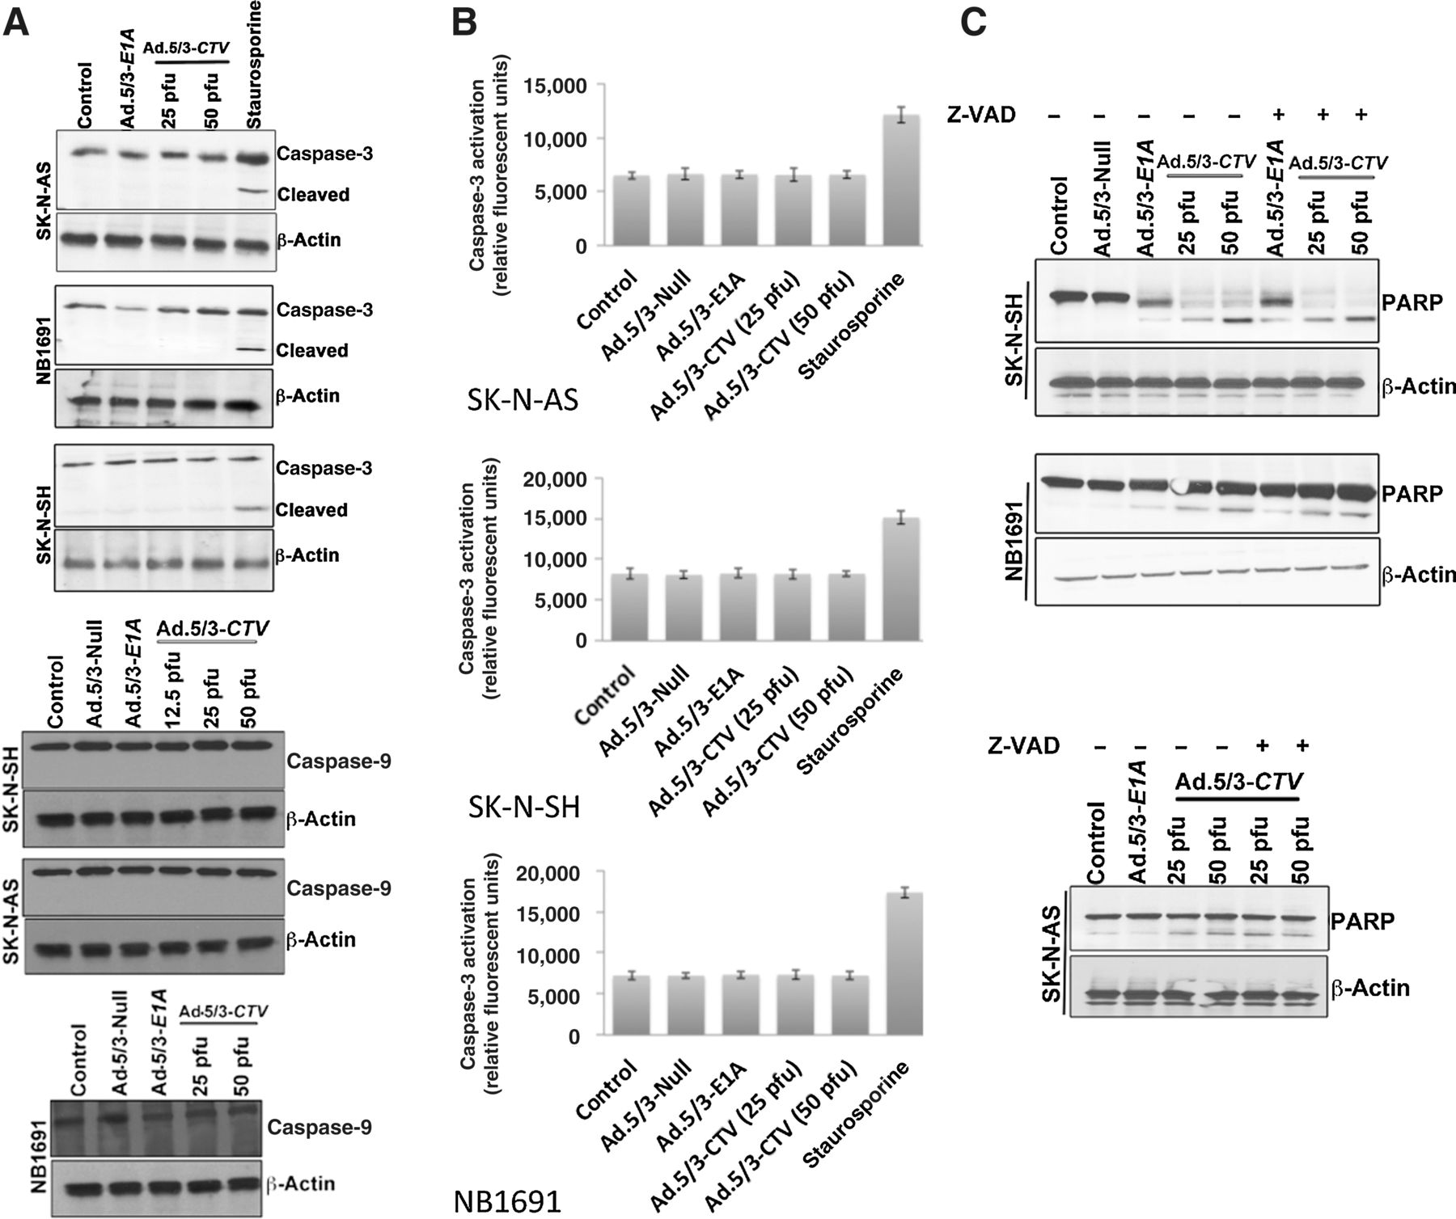
Experiment 3
Figure 3A shows how if the normal cell death activity was there, then there would be two lines showing how the protein was cleaved. However, due to the lack of the two lines, this means that MDA-7 is using some other pathway to induce cell death. In Figure 3C, caspase protein is inhibited however, cell death is still going through which means that MDA-7 is using different factors than normal.
Notes:
If caspase was cleaved, then the cell used normal apoptosis pathways. However if there aren’t two lines, MDA-7 is using different pathways.

Slide 9
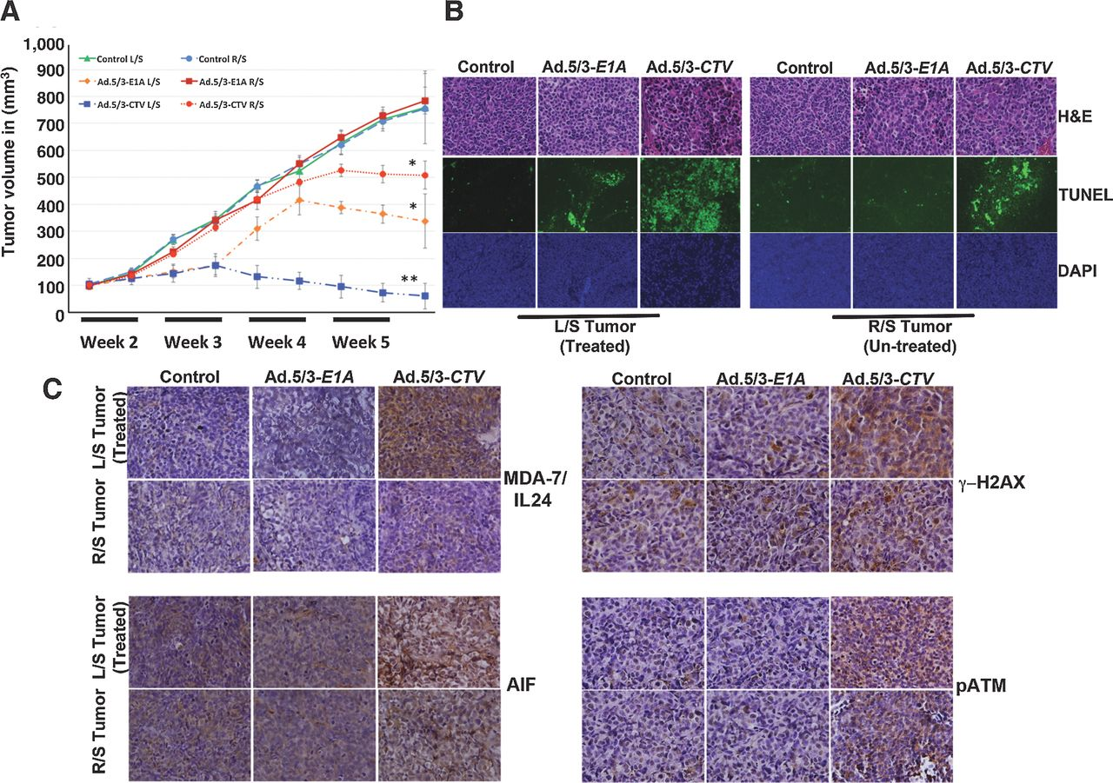
Experiment 6
Figure 6A is showing that neuroblastoma tumor growth is reducing inside the animals. Figure 6B is showing the presence of cell death inside the tumor of the animal. Figure 6C shows that the molecules that were expressed in-vitro are also expressed in-viro

Slide 10
Conclusions
Ad.5/CTV-3 is successfully infected neuroblastoma cells with the MDA-7 gene and the gene was successfully lysing the neuroblastoma cells.
The next part of this research is to find a way for the virus to bypass the immune system to attack the neuroblastoma cells.

Slide 11
References
Bhoopathi, Praveen, et al. “Mda-7/IL-24 Induces Cell Death in Neuroblastoma through a Novel Mechanism Involving AIF and ATM.” Cancer Research, American Association for Cancer Research, 15 June 2016, cancerres.aacrjournals.org/content/76/12/3572.
“Cancer Treatments.” CancerQuest, www.cancerquest.org/patients/treatments.

