Slide 1
Docking Simulation:
A Virtual Experiment

Slide 2
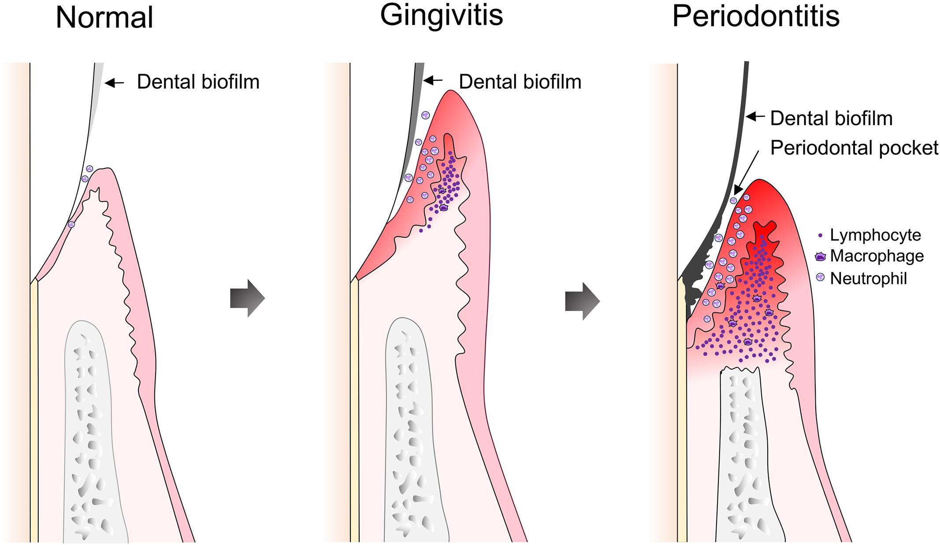
The Oral Cavity
Biofilm = collection of microbes adhering any surface in the mouth
Harmful microbes within the biofilms can lead to harmful oral diseases
Periodontitis - potentially lead to bone loss and tissue damage if unchecked
aerobic and anaerobic bacteria can bepresent in biofilm

Slide 3
The Oral Cavity
Source: Montana State University

Slide 4
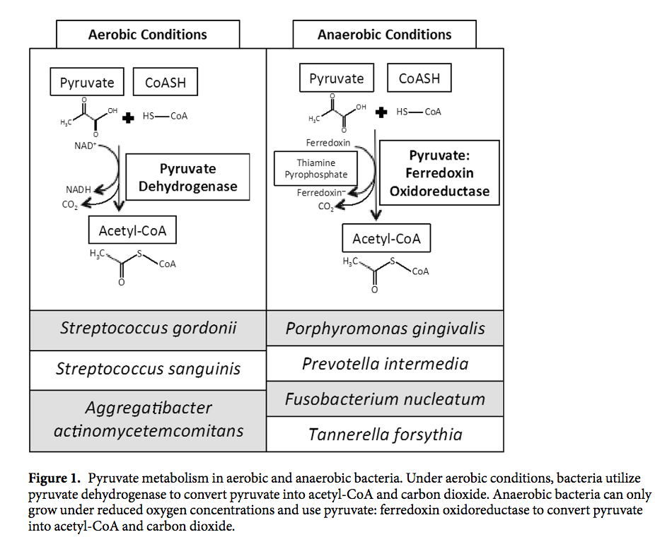
Anaerobic vs. Aerobic Bacteria
Main difference - different enzyme in pyruvate oxidation
Pyruvate: ferredoxin oxidoreductase (PFOR) in anaerobic bacteria
Pyruvate converted to Acetyl-CoA with cofactor (helper) thiamine pyrophosphate (TPP)
Notes:
Talk about pyruvate being blocked by a drug

Slide 5
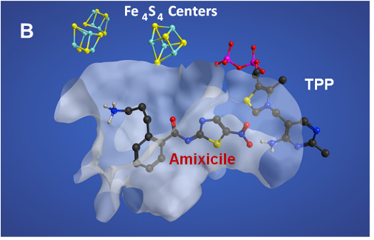
Pyruvate
CoA-SH
Source: Frontiers

Slide 6
Acetyl-CoA
Source: Frontiers

Slide 7
Pyruvate
CoA-SH
Source: Frontiers

Slide 8
Accumulation = harmful side effects!
Source: Frontiers

Slide 9
Less concentration = more effective….why?
Source: Frontiers

Slide 10
NTZ and Amixicile structure
NTZ structure virtually manipulated to generate many derivations (modifications) of its structure - amixicile was the derivation that was chosen for projected efficiency
Main difference = an extension of the tail in amixicile (called propylamine tail)

Slide 11
How does NTZ and amixicile bind to PFOR and block pyruvate?

Slide 12
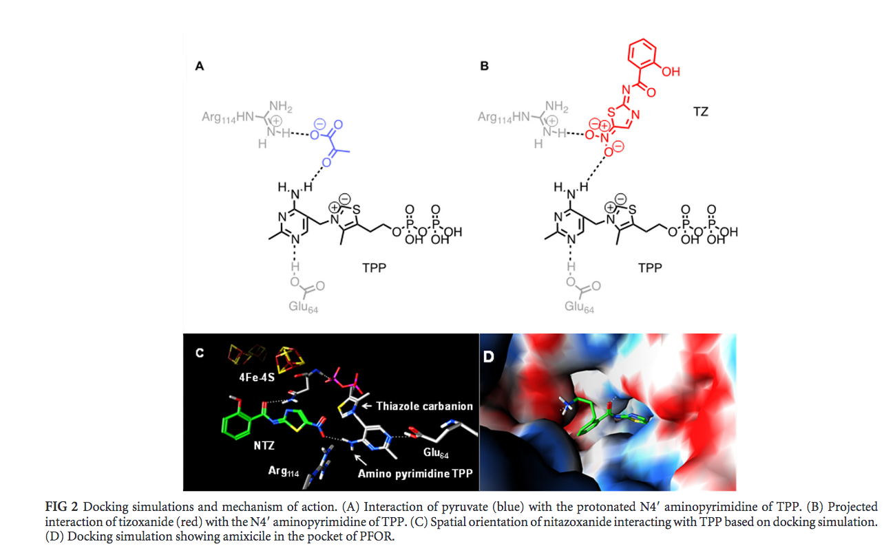
The Experiment - What is Docking Simulation?
Software that allows for the manipulation of molecular structures of interest virtually
Molecular operating environment (MOE)
Deals with interaction of a drug molecule and the target molecule (that the drug binds to)
Triangle Match algorithm

Slide 13
Triangle Match Algorithm - 2 subprocedures
Modifying the drug molecule of interest - Merck molecular force field
Predicting the interaction of a drug molecule and the target molecule (to which the drug binds to) - London dG scoring function

Slide 14
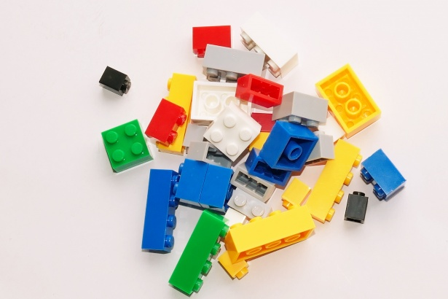
Part 1 - Merck molecular force field
To modify the molecular structure virtually -
implements fundamental organic chemistry reactions to allow for simulation of the modification of the drug molecule of interest
“Source code”

Slide 15
Part 1 - Merck molecular force field
nitro group of NTZ (the red structure in Figure 2-B) was docked into the PFOR active site
rest of amixicile’s structure were added (head group, amide linker and benzene ring)
Only the nitro group of NTZ!
Notes:
TO make the amixcile structure

Slide 16
Part 1 - Merck molecular force field
Only the nitro group!
Notes:
Using the normal interaction of pyruvate and PFOR active site, where pyruvate forms a hydrogen bond with TPP
Different conformations of the NTZ-amixicile combination were virtually generated

Slide 17
Part 2 - London dG scoring function
To predict the efficiency of the binding of two molecules:
A mathematical function, scores binding affinity between two molecules
How well does the drug molecule and the target molecule bind to each other?
Notes:
Different conformations of the NTZ-amixicile combination were virtually generated
Specifically, different benzene linkers and tail groups were virtually assessed and scored and the orientation with the highest score was chosen as the amixicile model.

Slide 18
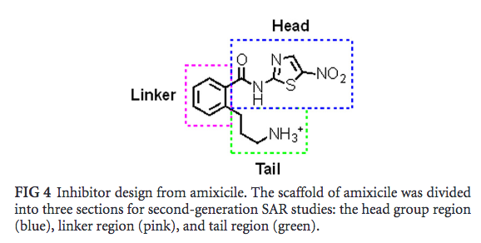
Part 2 - London dG scoring function
confirmations with the highest binding affinity were implemented again in the PFOR active site
NTZ-amixcile confirmation with the highest score was then used to further assess and modify the scaffold of amixicile
Notes:
Different conformations of the NTZ-amixicile combination were virtually generated
Specifically, different benzene linkers and tail groups were virtually assessed and scored and the orientation with the highest score was chosen as the amixicile model.

Slide 19
Part 2 - London dG scoring function
Notes:
Different conformations of the NTZ-amixicile combination were virtually generated
Specifically, different benzene linkers and tail groups were virtually assessed and scored and the orientation with the highest score was chosen as the amixicile model.

Slide 20
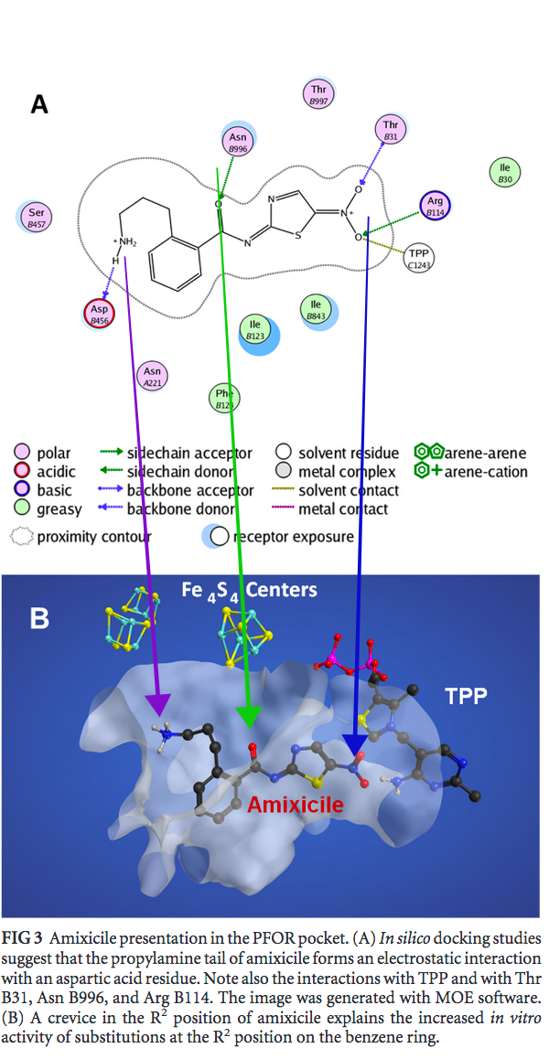
Result
space for interaction in the PFOR active site may be more abundant with amixicile
addition of a propylamine tail in amixicile
Interaction with PFOR amino acid residues
Notes:
addition of a propylamine tail in amixicile allowed for more interaction with the active site of PFOR

Slide 21
NTZ and Amixicile structure
Main difference = an extension of the tail in amixicile (called propylamine tail)

Slide 22
Result
ArgB114 and ThrB31 with the nitro group (blue arrow)
AsnB996 with keto group of the amide bond (green arrow)
AspB456 with amine of the propylamine tail (purple arrow)
Notes:
addition of a propylamine tail in amixicile allowed for more interaction with the active site of PFOR

Slide 23
Implications
Mutated active site of PFOR?
rigidity?

Slide 24
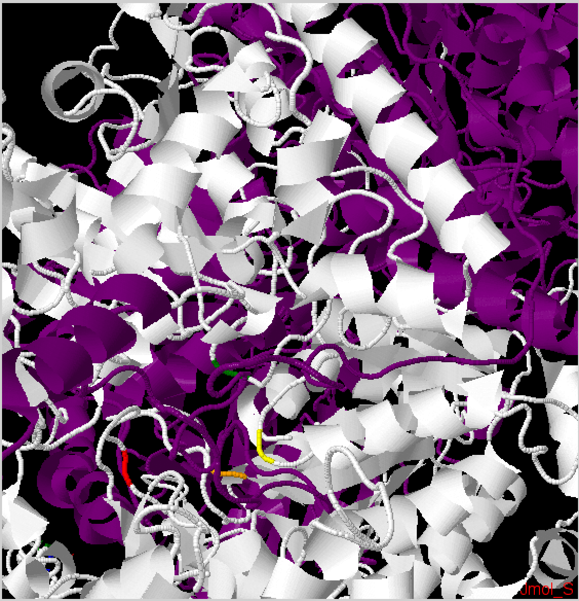
PFOR Structure
Chain A - Dark Purple, Chain B - White
Amino acid residues:
ThrB31 - yellow
ArgB114 - orange
AsnB996 - green
AspB456 - red
Source: Jmol Protein Explorer

Slide 25
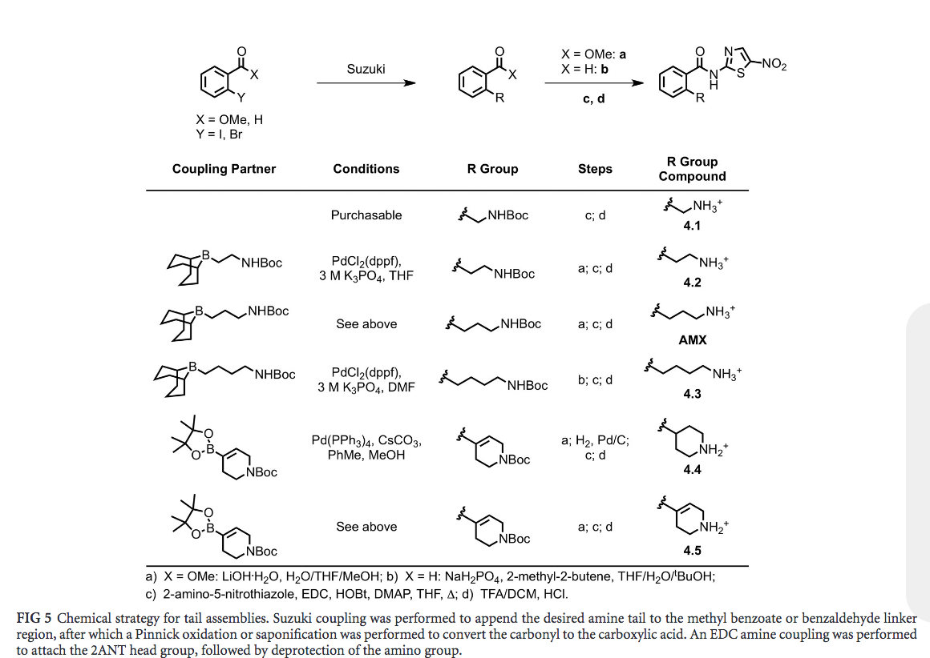
Next Steps - Wet Lab/Clinical aspect

Slide 26
References
Dubreuil L, Houcke X, Mouton Y, Rossignol JF. 1996. In vitro evaluation of the activities of nitazoxanide and tizoxanide against anaerobes and aerobic organisms. Antimicrob Agents Chemother 40: 2266 –2270. Pankuch GA, Appelbaum PC. 2006. Activities of tizoxanide and nitazoxanide compared to those of five other thiazolides and three other agents against anaerobic species. Antimicrob Agents Chemother 50: 1112–1117. http://dx.doi.org/10.1128/AAC.50.3.1112-1117.2006
https://www.frontiersin.org/articles/10.3389/fmicb.2018.00053/full

