Slide 1
Determining the Neuron Type Specificity of a Potential Mechanism for Alcohol Addiction
Dalton Huey

Slide 2
Alcohol Use Disorders (AUD)
Characterized by compulsive craving and consumption of alcohol despite negative consequences
4th leading cause of preventable death in the United States
Largely heritable, genetic factors account for 40-60% of risk for developing AUD (Kendler et al, 1994)

Slide 3
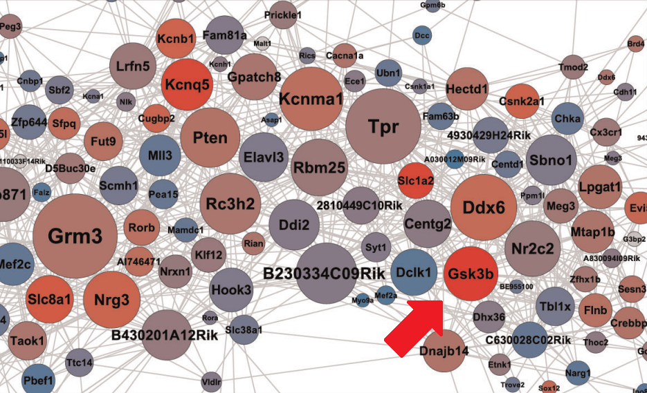
Glycogen Synthase Kinase 3 Beta (GSK3B)
Wolen et al (2012) expression Quantitative Trait Loci (eQTL) Mapping
Generated gene network based on changes in expression after acute ethanol
Gsk3b showed high transcriptional response to ethanol and high connectivity to other genes.

Slide 4
Glycogen Synthase Kinase 3 Beta (GSK3B)
GSK3B – Serine/Threonine Kinase
Multifunctional
Involved in ethanol induced neurotoxicity, shown to decrease neurite outgrowth (Chen et al, 2009)

Slide 5
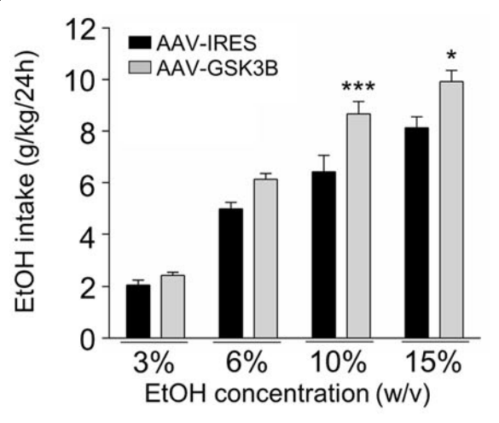
GSK3B and Alcohol Consumption
Overexpression of Gsk3b in neurons of mouse forebrain
Significant increase in alcohol consumption compared to controls
Black: Control, wild-type mice
Grey: Gsk3b overexpressed
Figure from Figure 2A from van der Vaart (2018)

Slide 6
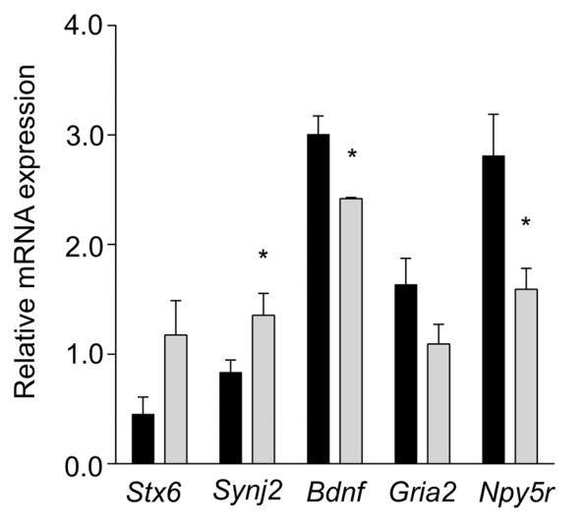
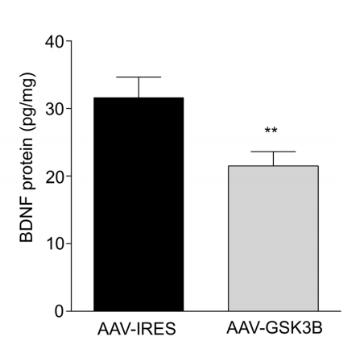
Brain Derived Neurotrophic Factor (BDNF)
Same overexpression experiment, measure expression levels of synaptic signaling genes (left). Measure BDNF protein (right)
Black: Wild Type Mice Grey: Gsk3b overexpressed
Figures from Figure 3 from van der Vaart (2018)

Slide 7
Brain Derived Neurotrophic Factor (BDNF)
Protein levels reported to increase in concentration after ethanol consumption (Logrip et al, 2015)
Protective effect: Decrease in concentration correlates to increased ethanol consumption
Possible negative feedback loop
Gsk3b decreases Bdnf expression in neurons: potential mechanism to explain why increasing Gsk3b increases alcohol consumption

Slide 8
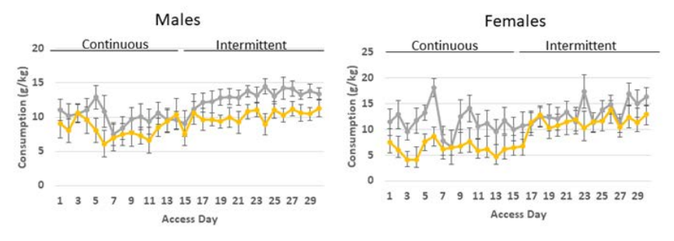
Neuronal Specificity of GSK3B
Gsk3b deleted in glutamatergic pyramidal neurons in the forebrain
Used Cre-mediated deletion
Neurons express CamkIIa gene
Yellow: Gsk3b Deleted Grey: Wild Type Mice

Slide 9
Experiment Overview
Goal:
To determine if Bdnf downregulation induced by Gsk3b overexpression is specific to glutamatergic pyramidal neurons in the mPFC of mice.
Process:
1. Overexpress Gsk3b only in CamkIIa+ neurons
2. Measure expression levels of Bdnf
3. Compare against controls

Slide 10
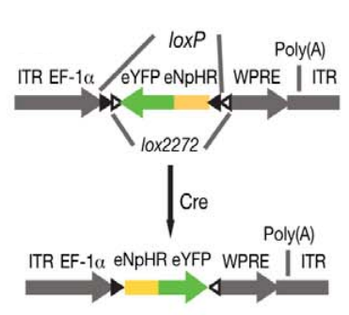
Cre-Dependent Overexpression of Gsk3b
Use of a Double Inverted Open Reading Frame Viral Vector
Active Cre-recombinase enzyme will flip the inverted open reading frame into the correct orientation to allow for transcription
Figure obtained from Figure 1A from Andrew-Zwilling et al (2012)

Slide 11
Synthesis by Gibson Assembly
Figure obtained from Figure 15.4 from Gibson (2011)

Slide 12
Synthesis by Gibson Assembly

Slide 13
Measuring Bdnf Expression Levels
Use Real Time Quantitative Polymerase Chain Reaction (RT-qPCR)
Blue represents template DNA and Green represents newly synthesized DNA. Figure obtained from Thermo Fisher Scientific - PCR Basics.

Slide 14
Comparison against Controls
Overexpress Gsk3b in CamkIIa+ neurons
Measure Bdnf expression
Overexpress Gsk3b in
all neurons
Measure Bdnf expression
No overexpression
Measure Bdnf expression

Slide 15
Possible Results
Possibility 1
Interpretation:
CamkIIa+ neurons – Major Decrease in Bdnf expression
Other neurons – Slight Increase in Bdnf expression

Slide 16
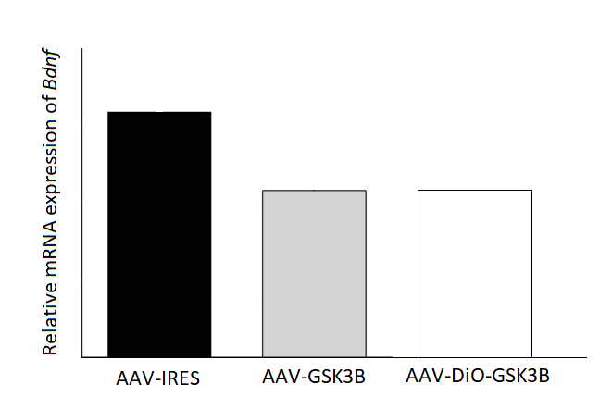
Possible Results
Possibility 2
Interpretation:
CamkIIa+ neurons – Decrease in Bdnf expression
Other neurons – No change

Slide 17
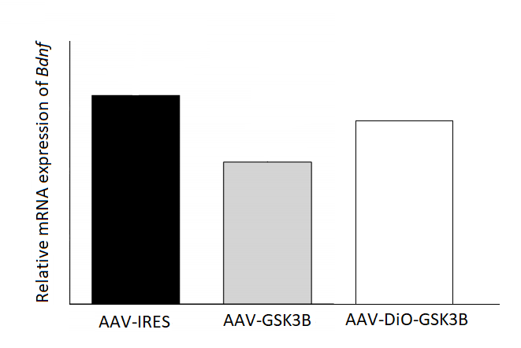
Possible Results
Possibility 3
Interpretation:
CamkIIa+ neurons – Decrease in Bdnf expression
Other neurons – Decrease in Bdnf expression

Slide 18
Possible Results
Possibility 4
Interpretation:
CamkIIa+ neurons –No change
Other neurons – Decrease in Bdnf expression

Slide 19
Possible Results
Possibility 5
Interpretation:
CamkIIa+ neurons – Slight Increase in
Bdnf expression
Other neurons – Major Decrease in
Bdnf expression

Slide 20
Possible Pitfalls and Future Studies
Only observing one neuron type
If effect is clearly also in other neuron types (possibility 3), interpretation is difficult
Follow up studies may involve observing different cell types (DiO viral vector is dependent on Cre, so changing expression does not require recreating plasmid)

Slide 21
Acknowledgements
Dr. Michael Miles – Principal Investigator
Guy Harris – Bench Mentor
Miles Lab

Slide 22
References
Kendler, K. S., Neale, M.C., Heath, A.C., Kessler, R.C., Eaves, L.J. (1994) A twin-family study of alcoholism in women. Am J Psychiatry 151, 707–715.
Wolen, A. R., Phillips, C. A., Langston, M. A., Putman, A. H., Vorster, P. J. ... Miles, M. F. (2012) Genetic Dissection of Acute Ethanol Responsive Gene Networks in Prefrontal Cortex: Functional and Mechanistic Implications, PLoS One, 7(4):e33575, doi:10.1371/journal.pone.0033575
Chen, G., Bower, K. A., Xu, M., Ding, M., Shi, X ... Luo, J. (2009) Cyanidin-3-glucoside reverses ethanol-induced inhibition of neurite outgrowth: role of glycogen synthase kinase 3 Beta. Neurotox Res 15, 321–331. doi:10.1007/s12640-009-9036-y
van der Vaart, A. D., Meng, X., Bowers, M. S., Batman, A. M., Aliev, F. ... Miles, M. F. (2018). Glycogen synthase kinase 3 beta regulates ethanol consumption and is a risk factor for alcohol dependence. Neuropsychopharmacology. 0:1-11, doi: 10.1038/s41386-018-0202-x
Logrip, M. L., Barak, S., Warnault, V., Ron, D. (2015). Coritcostriatal BDNF and alcohol addiction. 1628. 60-67.
van der Vaart, A. D. (2018). Molecular Brain Adaptations to Ethanol: Role of Glycogen Synthase Kinase-3 Beta in the Transition to Excessive Consumption. (Doctoral dissertation). Retrieved from VCU Electronic Theses and Dissertations (Number 5510).
Andrews-Zwilling, Y., Gillespie, A. K., Kravitz, A. V., Nelson, A. B., Devidze, N. ... Huang, Y. (2012). Hilar GABAergic Interneuron Activity Controls Spatial Learning and Memory Retrieval. PLoS One. 7(7), e40555. doi:10.1371/journal.pone.0040555
Gibson, D. G. (2011). Enzymatic Assembly of Overlapping DNA Fragments. Methods in Enzymology. 497, 349–361. doi:10.1016/B978-0-12-385120-8.00015-2

