Slide 1
Do endo-symbiotic bacteria synthesize anticancer compounds from Annonaceae? (Custard Apple family)
Casey Harless

Slide 2
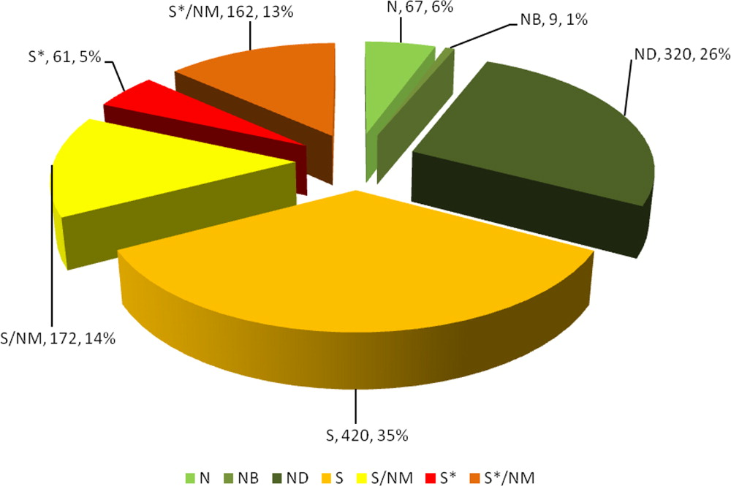
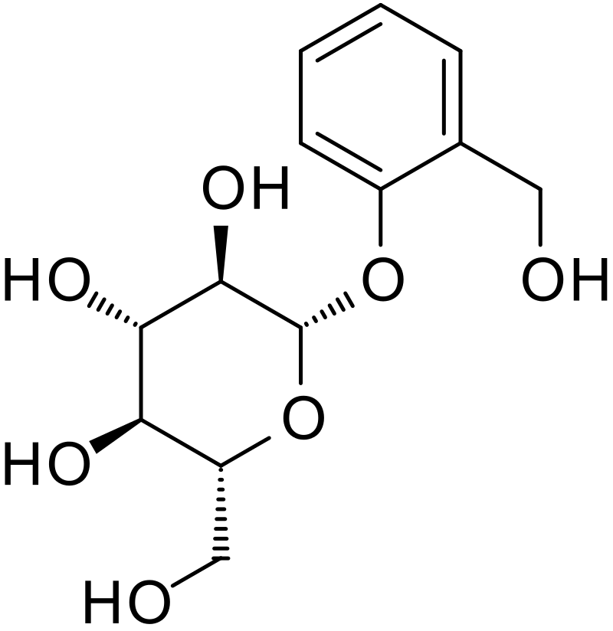
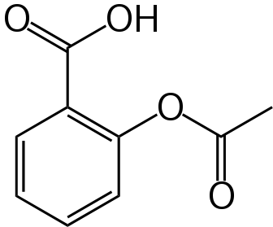
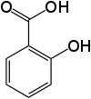
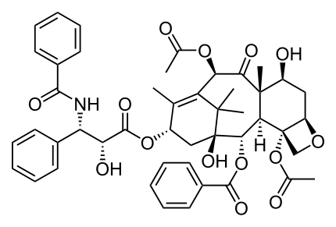
Small Molecule Natural Products (NP)
Most drugs still come from NPs
Direct source ex. Taxol
Indirect source (Inspiration) ex. aspirin
Salicin (willow tree)
Aspirin
human metabolism
semi-synthetic derivative
Taxol (Pacific Yew tree)
Approved drugs 1981-2014 (n = 1211)
(Newman and Cragg, 2014)
Salicylic Acid

Slide 3
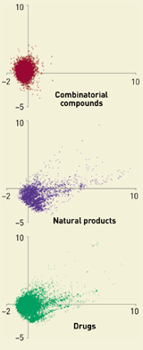
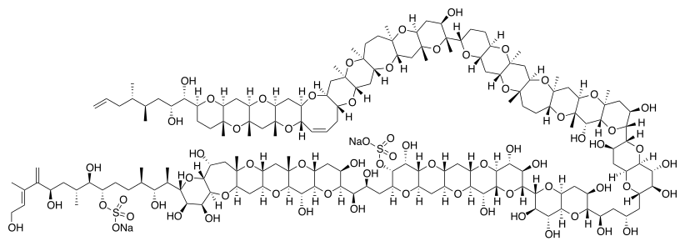
Natural Product cont.
Diversity and Novelty unmatched
Evolution likely responsible for usefulness
Maitotoxin (Striated Surgeonfish)
(Feher and Schmidt, 2003)

Slide 4
Microorganisms as NP producers
I lied!
NP sources are not always as they seem
This is (usually) a good thing
Taxol (endosymbiotic fungus)
Taxol (Pacific Yew tree)
Maitotoxin (Marine Dinoflagellate)
Maitotoxin (Striated Surgeonfish)

Slide 5
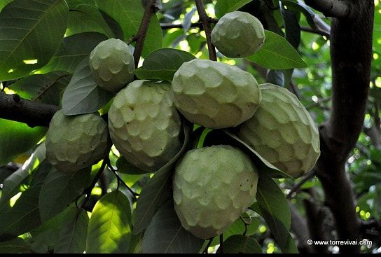
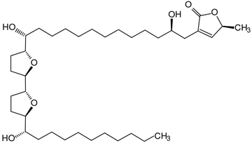
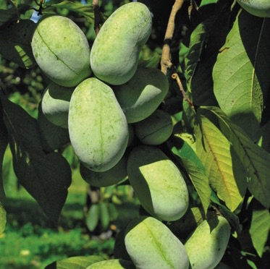
Annonaceous Acetogenins (ACGs)
“Annonaceous”- from Annonaceae or Custard Apple family
Acetogenins- compounds unique to Annonaceae
Over 500 ACGs isolated
Highly bio-active
Potent antitumor
Antioxidant
Cation binding
Pesticidal
Etc.
Cherimoya (Annona cherimola)
Terminal lactone
Common pawpaw (Asimina triloba)
https://www.torrevival.com
https://onegreenworld.com/product/ksu-atwood-2/

Slide 6
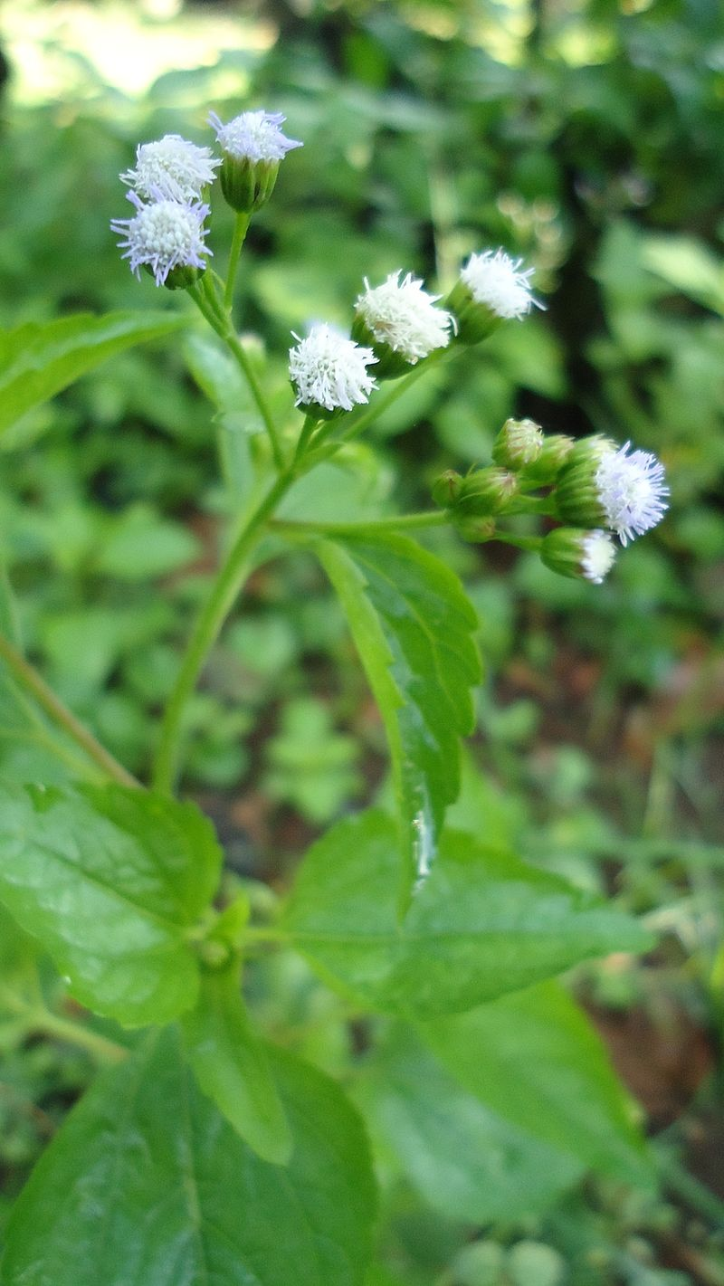
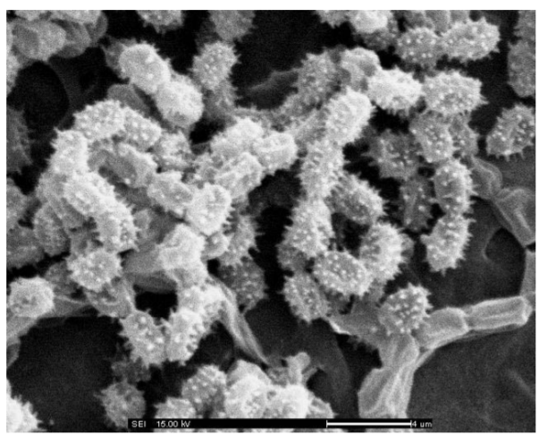
ACG Biosynthetic source?
No direct evidence until 2016
Bacterial endophyte Streptomyces sp. VE2 (Taechowisan et al, 2016)
Streptomyces genus is large and well known NP producer
Polyketide synthase pathway likely
By Obsidian Soul - Own work, CC0, https://commons.wikimedia.org/w/index.php?curid=12698737

Slide 7
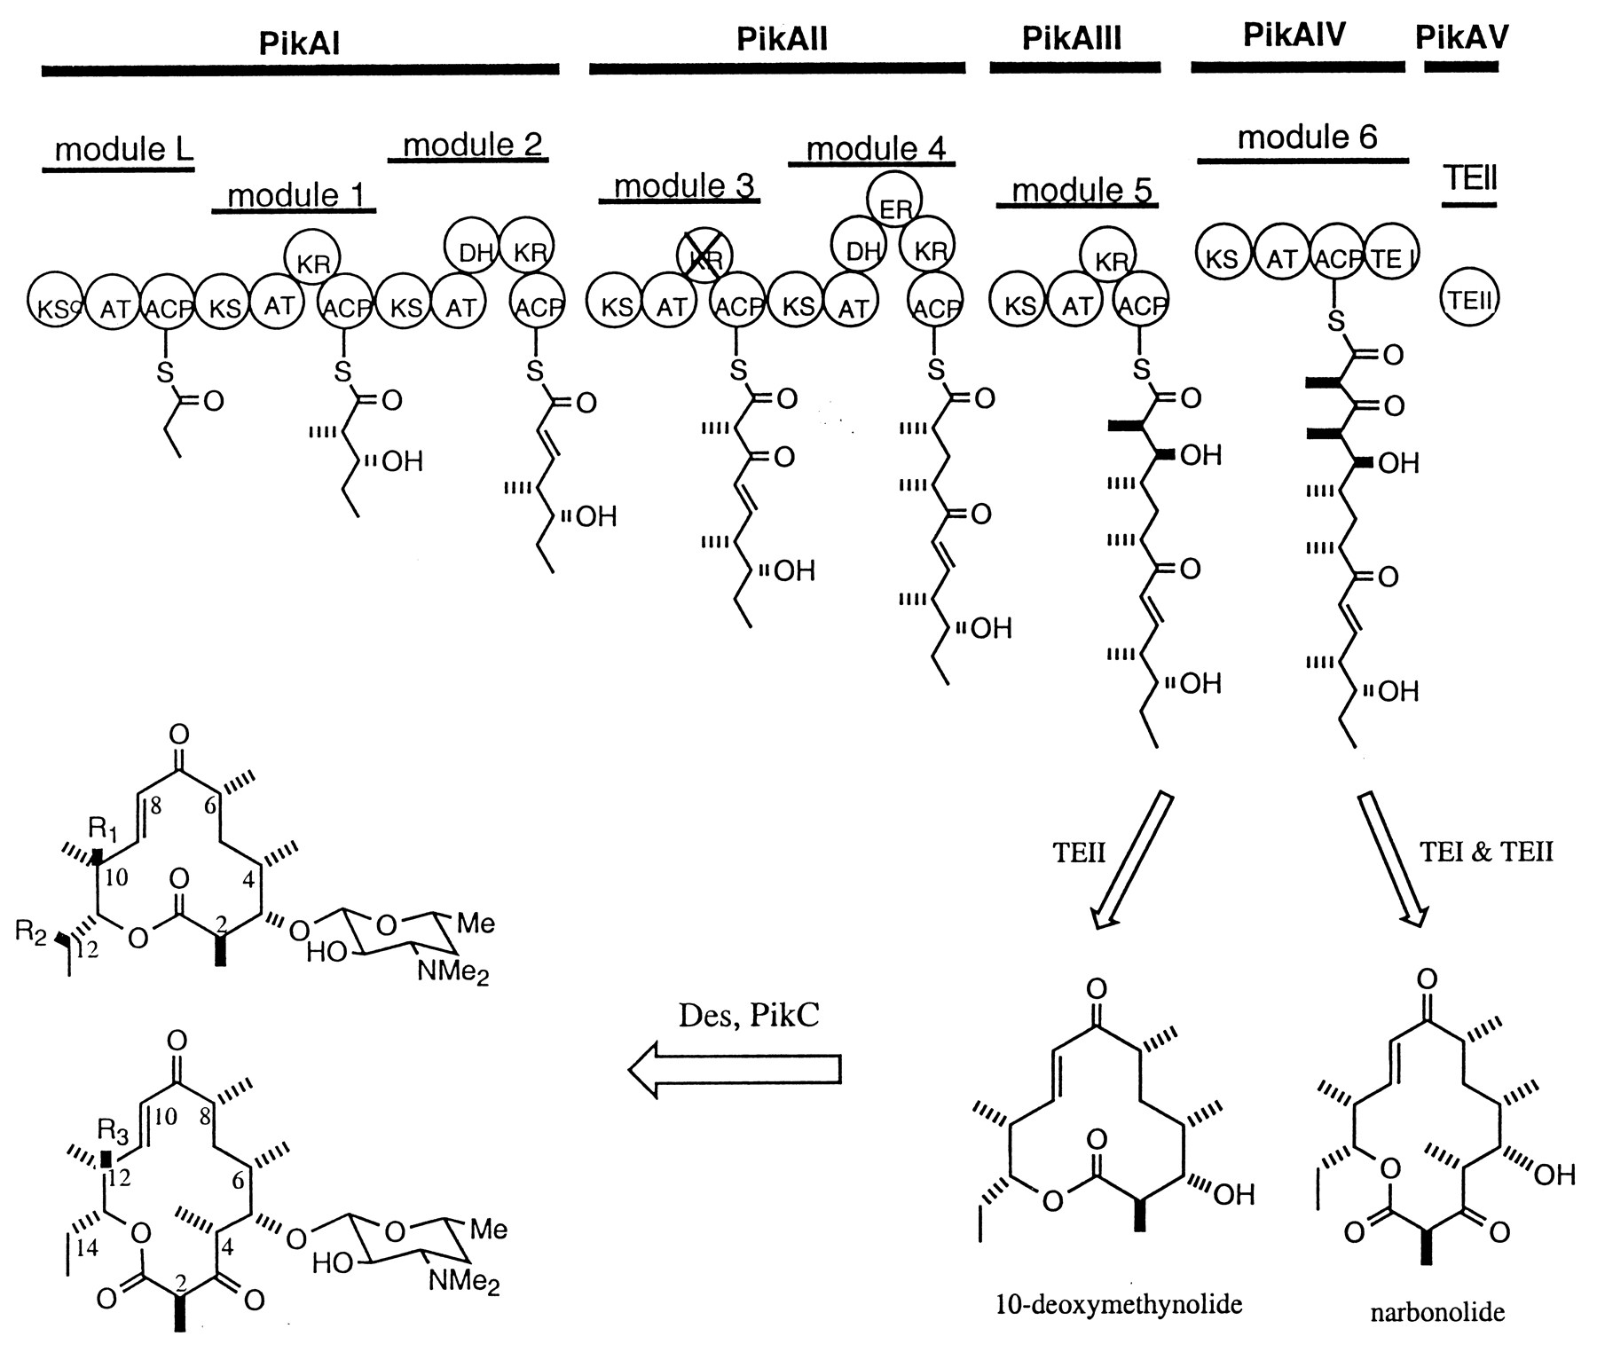
Polyketide Synthesis (PKS)
Xue et. al., 1998

Slide 8
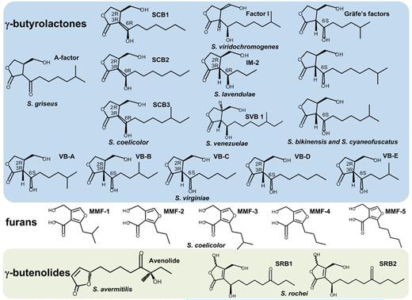
Terminal lactone biosynthesis
A-factor like synthases (AfsA)
Similar reactant to PKS
Afsa is only necessary gene (Kato et. al., 2007)
Adapted from Morin et. al., 2012
Niu et. al., 2016

Slide 9
Hypothesis
AfsA fused with PKS gene in Streptomyces -> acetogenins
PKS-AfsA hybrids exist elsewhere
Module 1
Module 2
Module 3
AfsA homologue
https://www.ebi.ac.uk/interpro/entry/IPR005509/proteins-matched?ida=20909

Slide 10
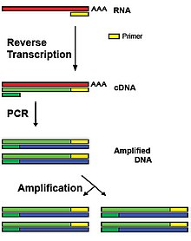
Amplify PKS-AfsA from Annonaceae
Adapted from Kroiss et. al., 2012
Reverse transcription-PCR (RT-PCR)
Why?
RNA benefits
First strand synthesis AfsA r-primers
PCR:
f-primer PKS (KS domain)
r-primer AfsA
atpD housekeeping gene (control)
By Jpark623 at English Wikipedia, CC BY-SA 3.0, https://commons.wikimedia.org/w/index.php?curid=73437170

Slide 11
Results
Electrophoresis visualization of bands:
Control results (466 bp band)
Poly-A depletion, rRNA depletion
Sampling at different seasons/growth phases
Experimental results (2-6 kb band(s))
False Negative
Transcript too low
Primer issues
Need for internal standard (artificial PKS-AfsA)
False Positive
Operons
Non-specific amplification

Slide 12
Alternative Hypothesis
Tetronate Biosythesis in Streptomyces
Target “Glycerate utilization operon”
Adapted from Sun et. al., 2010

Slide 13
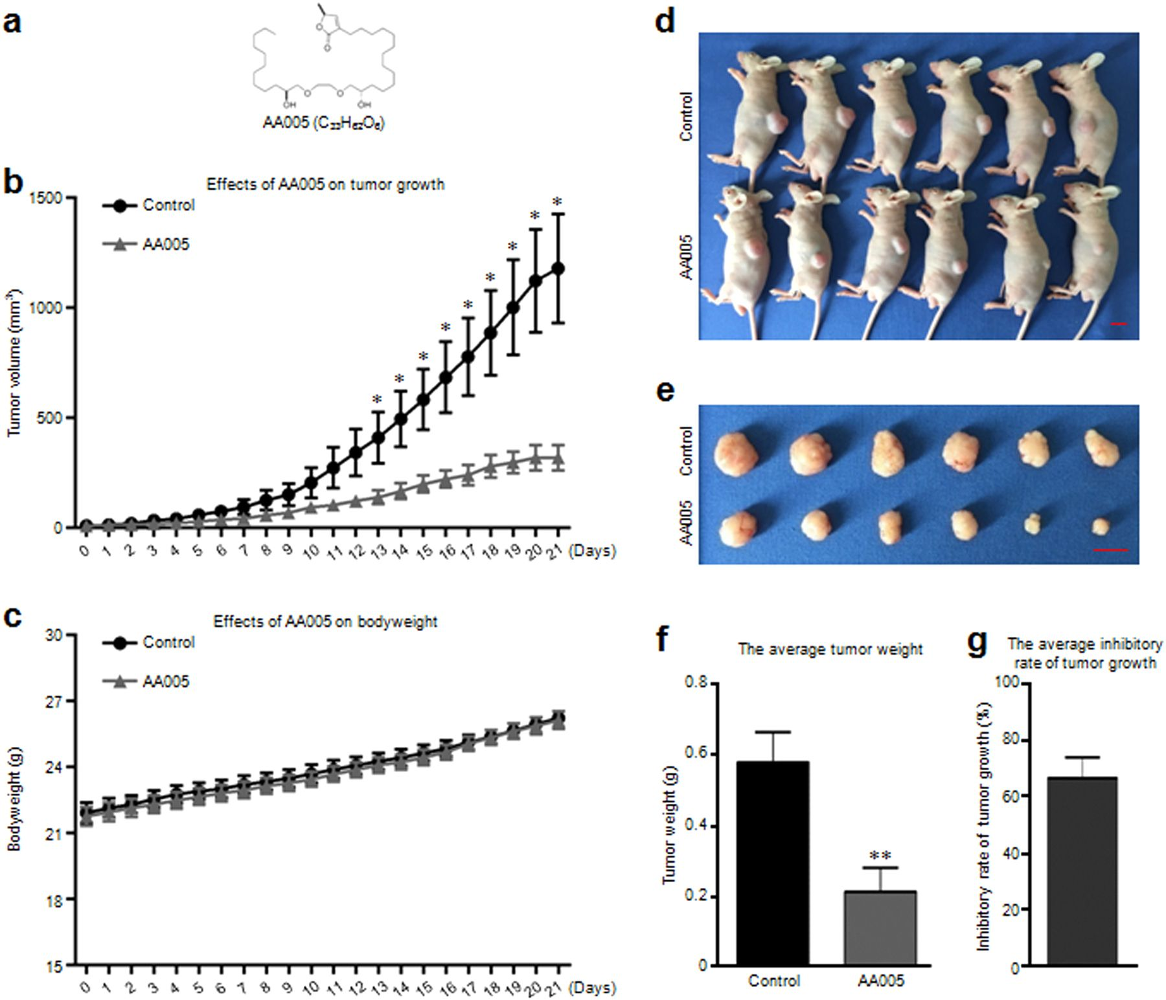
Han et. al., 2018

Slide 14
References
Feher M, Schmidt JM. Property Distributions: Differences Between Drugs, Natural Products, and Molecules from Combinatorial Chemistry. ChemInform. 2003;34.
Xue Y, Zhao L, Liu H-W, Sherman DH. A gene cluster for macrolide antibiotic biosynthesis in Streptomyces venezuelae: Architecture of metabolic diversity. Proceedings of the National Academy of Sciences. 1998;95:12111–6.
Newman DJ, Cragg GM. Natural Products as Sources of New Drugs from 1981 to 2014. Journal of Natural Products. 2016;79:629–61.
Taechowisan T, Singtotong C, Phutdhawong W. Antibacterial and Antioxidant Activities of Acetogenins from Streptomyces sp. VE2; An Endophyte in Vernonia cinerea (L.) Less. Journal of Applied Pharmaceutical Science. 2016;:067–72.
Niu G, Chater KF, Tian Y, Zhang J, Tan H. Specialised metabolites regulating antibiotic biosynthesis in Streptomyces spp. FEMS Microbiology Reviews. 2016;40:554–73.
Morin JB, Adams KL, Sello JK. Replication of biosynthetic reactions enables efficient synthesis of A-factor, a γ-butyrolactone autoinducer from Streptomyces griseus. Organic & Biomolecular Chemistry. 2012;10:1517.
Kroiss J, Kaltenpoth M, Schneider B, Schwinger M-G, Hertweck C, Maddula RK, et al. Symbiotic streptomycetes provide antibiotic combination prophylaxis for wasp offspring. Nature Chemical Biology. 2010;6:261–3.
Sun Y, Hahn F, Demydchuk Y, Chettle J, Tosin M, Osada H, et al. In vitro reconstruction of tetronate RK-682 biosynthesis. Nature Chemical Biology [Internet]. 2010;6:99–101
Han B, Cao Y-X, Li Z-M, Wu Z-X, Mao Y-Q, Chen H-L, et al. Annonaceous acetogenin mimic AA005 suppresses human colon cancer cell growth in vivo through downregulation of Mcl-1. Acta Pharmacologica Sinica. 2018

