Slide 1
Is the KLF4 gene or Heparanase a more productive punitive target in the gene silencing of Breast to Brain metastasis?
Hunter Freeman

Slide 2
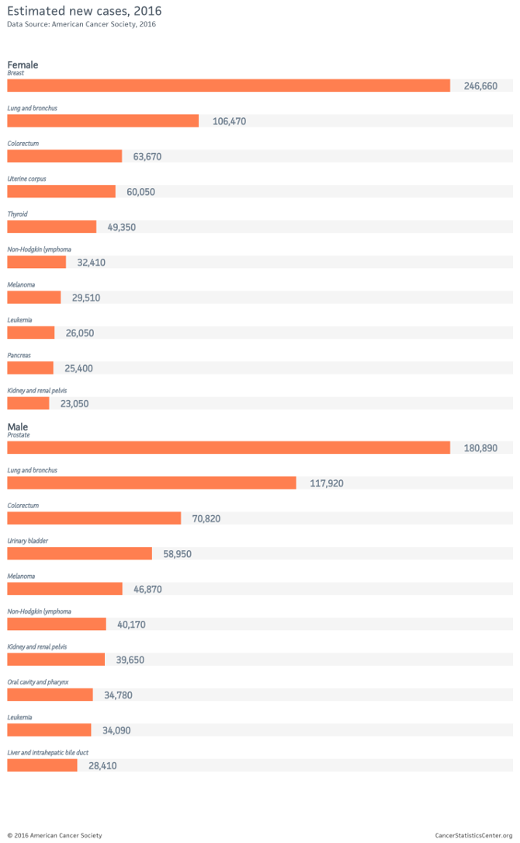
Breast cancer is the most frequent diagnosed cancer in America for women
Notes:
Cancer is the second leading cause of death in the United States. In 2018, an estimated 1.7 million people Americans will be diagnosed with cancer and roughly 600,000 Americans will die from this ailment ¹. It is estimated that 90% of cancer deaths happen when a cancer has metastasized. Metastasis is the process of a tumor spreading from its first site to a secondary site. Metastasis is also commonly known as being at or past stage 3 cancer, where a tumor has spread past the primary site.

Slide 3
How our body fights cancer
T cells
B cells
NK cells
Tumor suppressor genes
Oncogenes
Other small ways!

Slide 4
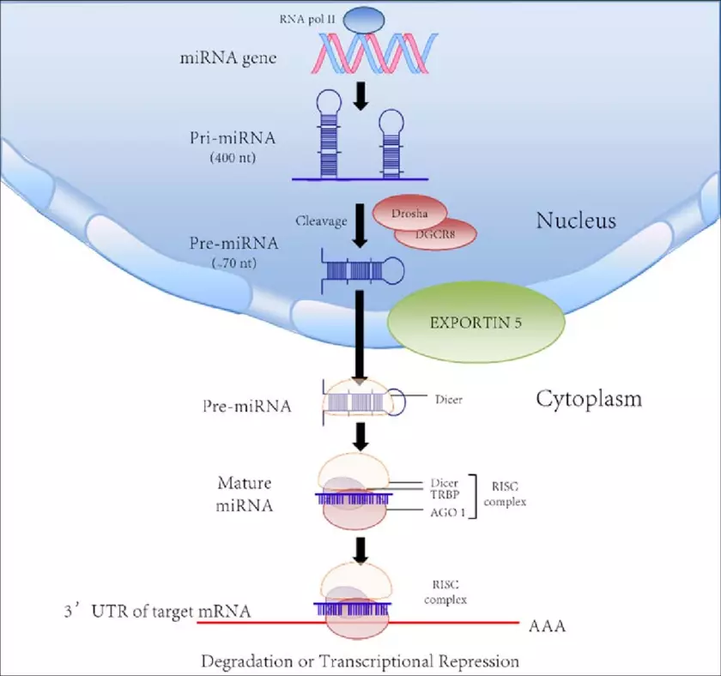
How microRNA is produced and used
Notes:
The creation of microRNA starts when the gene is read by RNA polymerase II. It is then clipped and trimmed by enzymes Drosha and Dicer that leave it at a final length, where it then can attached to the RISC complex where it is then used to attach to its target to regulate the gene.

Slide 5
Research Question
Is the KLF4 gene or Heparanase a more productive punitive target in the gene silencing of Breast to Brain metastasis?

Slide 6
What is KLF4?
KLF4 or Kruppel like factor 4, is a tumor suppression gene known to mediate in conjunction with the p53 gene, which controls the G1 to S phase of the cell cycle.
KLF4 is regulated by miRNA-7

Slide 7
What is Heparanase?
Heparanase is a pro-tumorigenic and pro metastatic enzyme in the extracellular matrix. When silenced it has been seen to inhibit cancer metastasis. This has made it a target for anti-cancer treatment. It is regulated by miRNA-1258.

Slide 8
Overview of my experiment
Injection of tumors into all groups of NSG mice
20 day study period of growth of cells
Removal of tumors and statistical analysis

Slide 9
Subjects in experiment
The NSG mice have the correct amount of genes silenced to be good candidates to promote and study tumor growth and spread.
B and T cells are depleted,
Lose their C5 complement(a protein made to fight pathogens)
Lower development of NK cells.

Slide 10
Breakdown of Experiment groups
Control Group- NSG Mice within statistical normalcy of miRNA-7 and miRNA-1258
Experiment group 1- NSG Mice with statistically significant amounts of MiRNA-7
Experiment group 2- NSG Mice with statistically significant amounts of MiRNA-1258

Slide 11
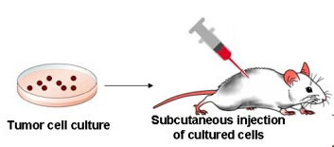
Injection of Tumor Cells

Slide 12
Possible results

Slide 13
Possible Problems/ Limitations
Tumors not metastasizing enough for a proper study
Logistics of mice blood tests
No significant difference in the control and the experimental group
Sample size is not actually reflective of the population

Slide 14
Questions?

Slide 15
References
Sng8. (2017, August 17). The Cell Cycle, Mitosis and Meiosis. Retrieved from https://www2.le.ac.uk/projects/vgec/highereducation/topics/cellcycle-mitosis-meiosis
KLF4 Kruppel like factor 4 [Homo sapiens (human)] - Gene - NCBI. (n.d.). Retrieved from https://www.ncbi.nlm.nih.gov/gene?cmd=Retrieve&dopt=full_report&list_uids=9314
Vlodavsky, I., Ilan, N., Naggi, A., & Casu, B. (n.d.). Heparanase: Structure, biological functions, and inhibition by heparin-derived mimetics of heparan sulfate. Retrieved from https://www.ncbi.nlm.nih.gov/pubmed/17627539
Puchalapalli, M., Zeng, X., Mu, L., Anderson, A., Glickman, L. H., Zhang, M., . . . Koblinski, J. E. (2016). NSG Mice Provide a Better Spontaneous Model of Breast Cancer Metastasis than Athymic (Nude) Mice. Plos One,11(9). doi:10.1371/journal.pone.0163521
Cancer Statistics. (n.d.). Retrieved from https://www.cancer.gov/about-cancer/understanding/statistics
Products. (n.d.). Retrieved from http://dinovapharma.com/products/

