Slide 1
Are ageing and age-related diseases treatable?
Panel Presentation by Daanish Fiaz
Notes:
GENERAL QUESTION

Slide 2
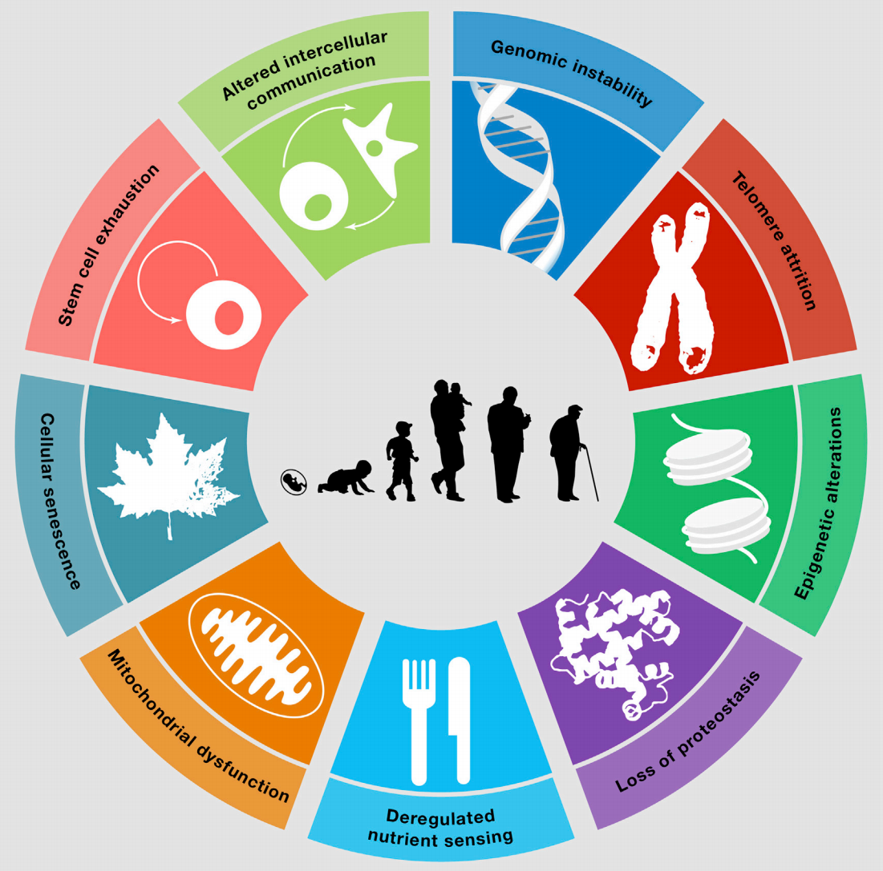
Cellular ageing/deterioration background
Cells do not retain their same capabilities and strength the more they replicate and the older they grow.
Like how humans generally aren’t as strong or aren’t capable of doing the same tasks as they grow older.
This leads to dysfunction in humans as we grow older. This dysfunction may take many forms.
Notes:
A little more specific on the question and the background

Slide 3
Ageing comes with higher odds of getting diseases
Alzheimer’s Disease
Chances exponentially increase with age
What is it?
Can we prevent or alter this?
Plausibly by treating cellular ageing?
Notes:
Although alzheimers is a brain cells’ death leading to the incapability of communication. This is partially genetically induced, however, people above a certain age have an increasing risk of getting alzheimers 1/14 for people above 65, ⅙ for people above 80. AN EXAMPLE OF AN AGE RELATED DISEASE

Slide 4
Although senescence is inevitable, there are suggestions in research that ageing and age-related diseases may be treated through secretory factors as well as molecules.
Notes:
This is where the authors come in.

Slide 5
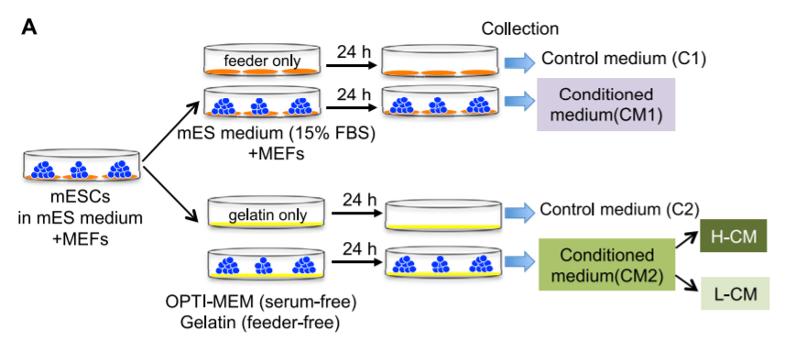
The authors prepared an experiment to see if they could use stem cells to expedite the wound healing process
Notes:
The authors question, they wanted to apply it to cardiovascular as well as neurodegenerative diseases. Two mediums, one with serum injected growth factors and feeder, one without. The control had no Stem cells and was just the medium. CM was split into H-CM and L-CM, respective higher activity and lower activity anti aging effect. As to why these groups resulted, they just mentioned that it occurred and not why??? Cross contamination wanted to be avoided so they proceeded onward after initial staining without cm1.

Slide 6
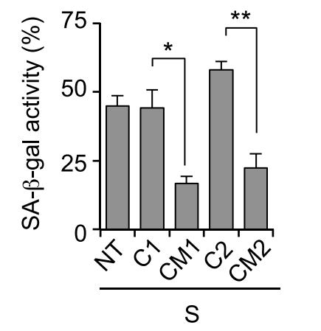
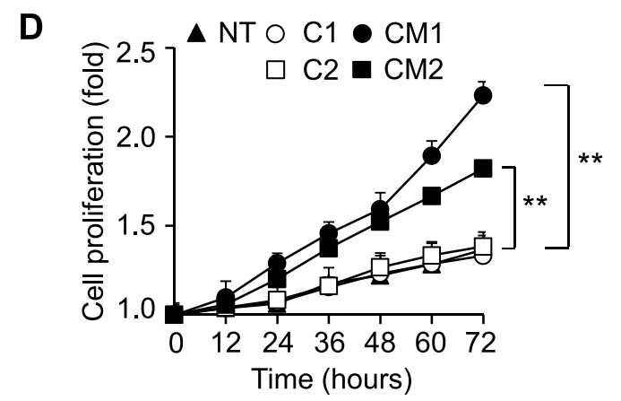
Protein and enzyme activity analysis
Notes:
For the left figure, the enzyme marks for beta galactisodase (staining shows blue for ageing). For figure D, they measure the Ki67 protein activity (a marker for cell proliferation) and then translated that into cell proliferation. One can see that these results from both graphs are significant.

Slide 7
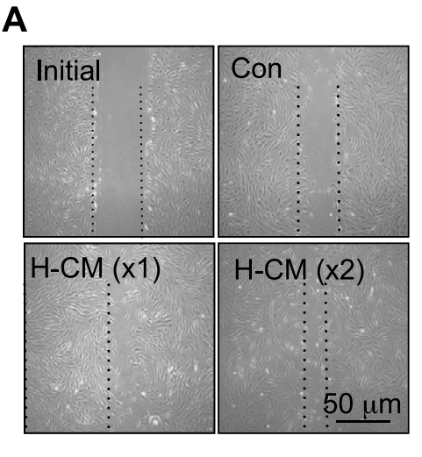
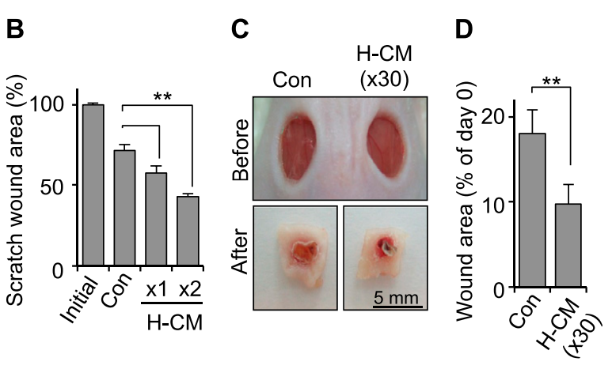
The results
In vivo (female mice injection)
In vitro scratch assay (glass tube)
Notes:
Principle of experiment. Explain how the wounds treated with the special medium healed faster thus leading to less wound area.

Slide 8
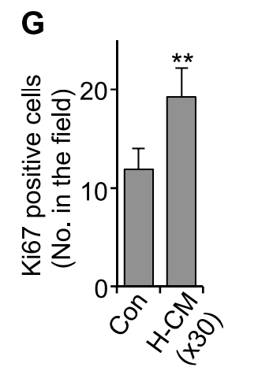
What all of this means
There’s a chance
Notes:
Direct conclusions.

Slide 9
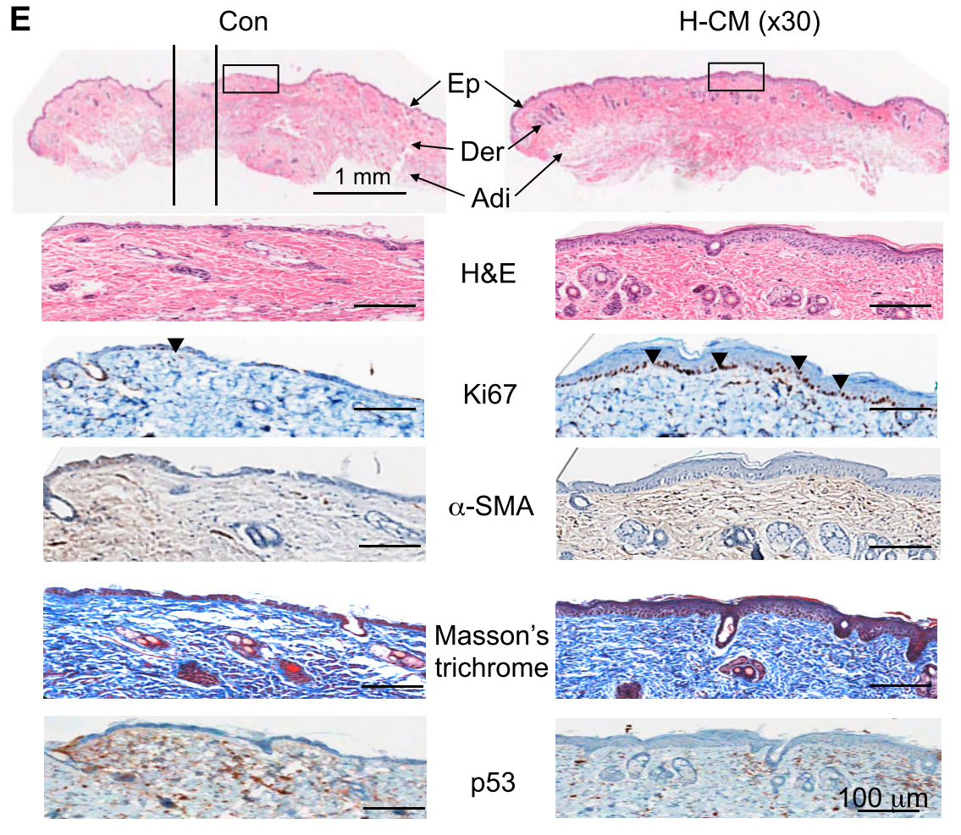
A chance for further research into regenerative medicine
This experiment supports that stem cells can be cultured in a manner to promote wound healing.
This takes us back to the grand question, how can we treat ageing and age-related diseases.
Although this experiment doesn’t directly treat ageing or diseases, it proposes a technique that can be utilized in treatment to heal wounds.
Notes:
Direct conclusions, connection back to the general question. Arrowheads indicate direct Ki67 expression in cells. Control(left), CM (right). Start with stem cells usage, relate to grand question, how it doesn’t directly relate,

Slide 10
Although human experimentation would be extensive, there is further research that can and will be done to utilize stem cells to treat aspects of ageing and age related diseases like wound healing thanks to the authors of this article and many more to come.

Slide 11
References
Bae, Y., Choi, J., Nagy, A., Sung, H., & Kim, J. (2016). Antisenescence effect of mouse embryonic stem cell conditioned medium through a PDGF/FGF pathway. FASEB Journal : Official Publication of the Federation of American Societies for Experimental Biology, 30(3), 1276-86.
Chun-Chi Liang, Ann Y Park, & Jun-Lin Guan. (2007). In vitro scratch assay: A convenient and inexpensive method for analysis of cell migration in vitro. Nature Protocols, 2(2), 329-33.
López-Otín, Blasco, Partridge, Serrano, & Kroemer. (2013). The Hallmarks of Aging. Cell, 153(6), 1194-12.

