Slide 1
Functional analysis of CMYA5 via CRISPR/Cas9 knockout

Slide 2
What is Schizophrenia?
https://www.quora.com/How-do-scientists-research-human-brain-given-that-they-cant-do-everything-they-need-to-with-a-live-person

Slide 3
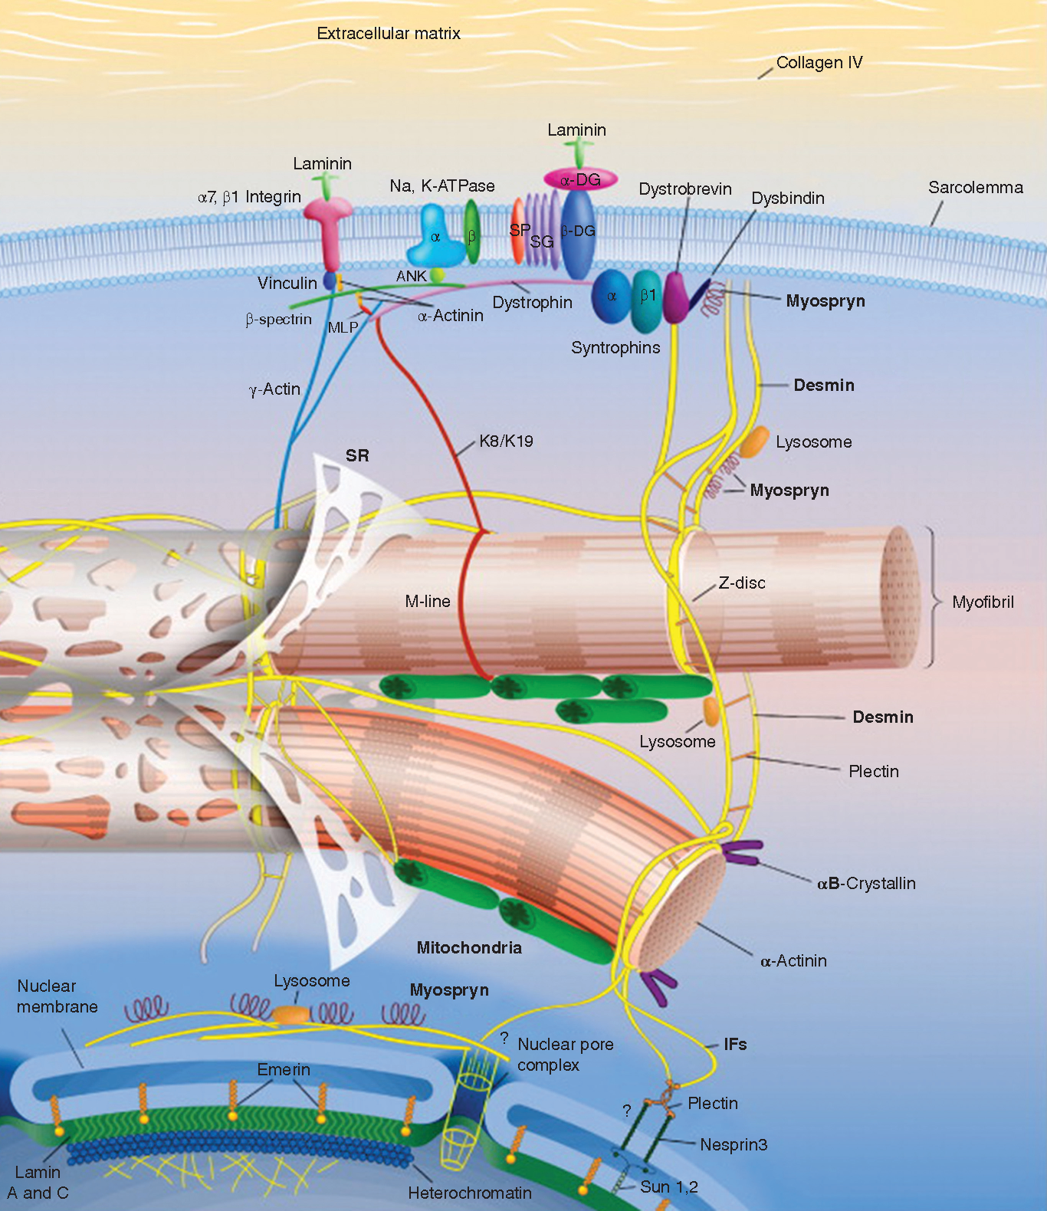
CMYA5 (cardiomyopathy associated 5)
Tsoupri E, Capetanaki Y. (2013). Μyospryn: a multifunctional desmin-associated protein. Histochem Cell Biol.140(1):55-63.

Slide 4
How CMYA5 relates to schizophrenia
Li M, Luo XJ, Zhang X, Yang ZH, Xiang K, Xiao X, Su B, Zhao YL, Shen Y, Xu Q, Chen , XN, Chen JC, Liu XY, Yin LD, Ma XY, Yang SY, et al. (2011). A common variant of the cardiomyopathy associated 5 gene (CMYA5) is associated with schizophrenia in Chinese population. Schizophr Res. 29(2-3):217-9.

Slide 5
https://en.wikipedia.org/wiki/Astrocyte

Slide 6
Desmin and Dysbindin
Tsoupri E, Capetanaki Y. (2013). Μyospryn: a multifunctional desmin-associated protein. Histochem Cell Biol.140(1):55-63.

Slide 7
What is CRISPR/Cas9?
Clustered Regularly Interspersed Short Palindromic Repeats
https://www.addgene.org/crispr/guide/

Slide 8
How can it be used for the experiment?

Slide 9
Left side = Control groups Right side = Dysbindin knockout groups
Ma, X., Fei, E., Fu, C., Ren, H., & Wang, G. (2011). Dysbindin-1, a schizophrenia-related protein, facilitates neurite outgrowth by promoting the transcriptional activity of p53. Molecular Psychiatry, 16(11), 1105-1116.

Slide 10
Designing gRNA
Sequence I chose for the spacer:

Slide 11
Creating knockout mice
Kherraf, Z., Conne, B., Amiri-Yekta, A., Kent, M. C., Coutton, C., Escoffier, J., . . . Ray, P. F. (2018). Creation of knock out and knock in mice by CRISPR/Cas9 to validate candidate genes for human male infertility, interest, difficulties and feasibility. Molecular and Cellular Endocrinology, 468, 70-80.

Slide 12
Extracting oocytes
Modzelewski, A. J., Chen, S., Willis, B. J., Lloyd, K. C., Wood, J. A., & He, L. (2018). Efficient mouse genome engineering by CRISPR-EZ technology. Nature Protocols, 13(6), 1253-1274.

Slide 13
Measurements

Slide 14
Discussion
Results
Short comings
Limitations to interpretation
Future experiments

