Slide 1
A HIF-Independent Mediator of Transcriptional Responses to Oxygen by Deprivation in Caenorhabditis Elegans
Translated By: Emaan Chaudry

Slide 2
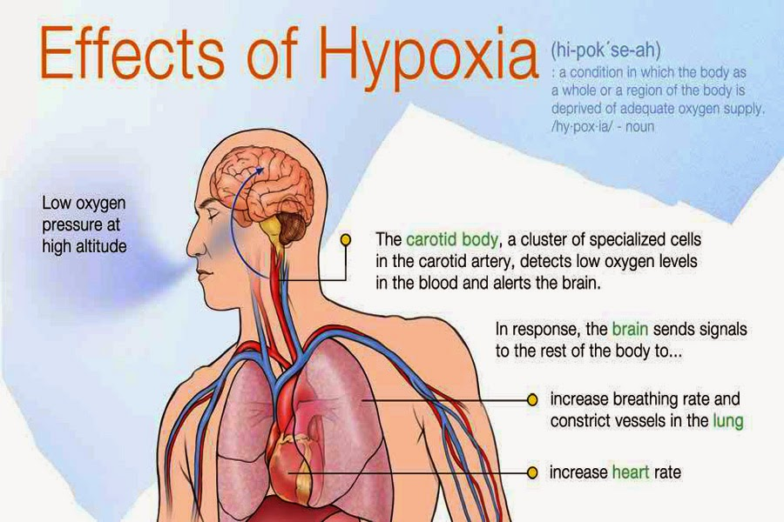
What is hypoxia?
Low-Oxygen Conditions
Differentiation of placental cells
Cardiovascular Diseases
Progressing the growth of tumors
HIF-1 Pathway
Notes:
http://medicalsolution2122.blogspot.com/2015/02/hypoxia-and-classify-of-hypoxia.html#.W_8mKHpKjR0

Slide 3
Mediator that Functions when the HIF-1 Pathway is Taken Away
F45D3.4

Slide 4
What can mimic hypoxic responses in round worms?
Cobalt Chloride mimics hypoxia treatment

Slide 5
Is the F45D3.4 gene simply being activated because it is responding to a general stressor?
Hypertonic shock (300 mM NaCl)
Heat shock (37 degrees for 6 hr)
Calcium Chelation (0.4.76 mM EGTA)
Reactive Oxygen Species (ROS)
Heavy Metal Exposure (0.02 mM NiCl2)
Starvation (12 hr)

Slide 6
What is causing the F45D3.4 gene to be expressed?
387 → 8 → 3

Slide 7
Is blmp-1 mediating hypoxic responsiveness?

Slide 8
How does blmp-1 affect round worms in vivo?

Slide 9
How does blmp-1 work?

Slide 10
Conclusion
F45D3.4
Cobalt Chloride
tbx-38, lin-40, blmp-1
blmp-1 → Acetylation
Notes:
http://www.si-hu.eu/en2/2016/07/01/summary-of-the-project-approved-within-the-1st-deadline-for-submission/

