Slide 1
Accounting for side-chain flexibility in protein-ligand docking: 3D Interaction Homology as an approach of quantifying side-chain flexibility of Tyrosine Rotamers

Slide 2
Homology modeling

Slide 3
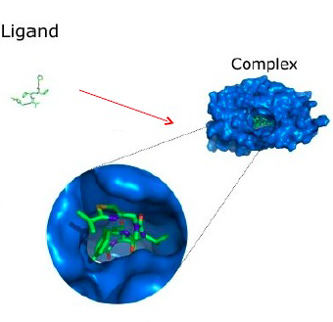
Protein-Ligand Docking

Slide 4
Conformational selection model

Slide 5
Conformational selection model

Slide 6
Amino Acid Rotamers

Slide 7
HINT
Hydropathy:
favorable polar (e.g., hydrogen bonding, Lewis acid-base, attractive Coulombic, etc.);
unfavorable polar (e.g., Lewis acid-acid and base-base, repulsive Coulombic, etc.);
favorable hydrophobic (hydrophobic-hydrophobic, p-stacking, etc.);
unfavorable hydrophobic (hydrophobic-polar, desol- vation, etc.).

Slide 8
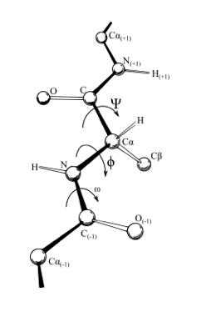
Ramachandran plots

Slide 9
HINT scoring and basis Map

Slide 10
Average Maps

Slide 11
Average Maps

Slide 12
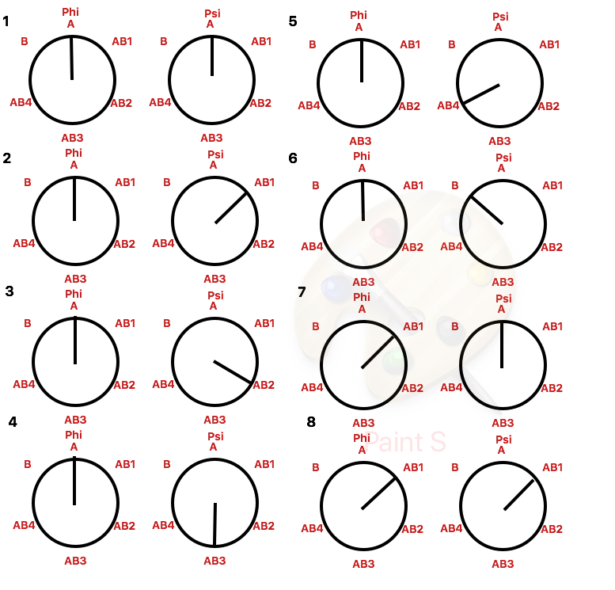
Conformational Analysis

Slide 13
Results

