Slide 1
KLF1 directly activates expression of the novel fetal globin repressor ZBTB7A/LRF in erythroid cells Laura J. Norton, Alister P.W. Funnell (2017).Blood Advances 1:685-692.
Wassal Alhammad

Slide 2
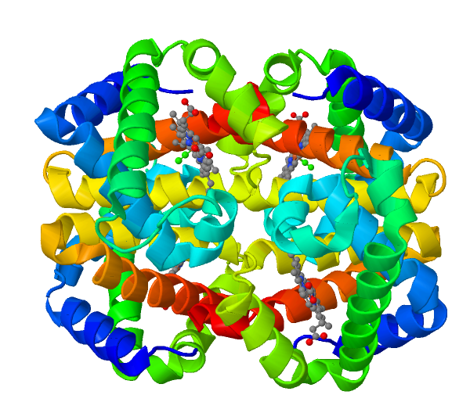
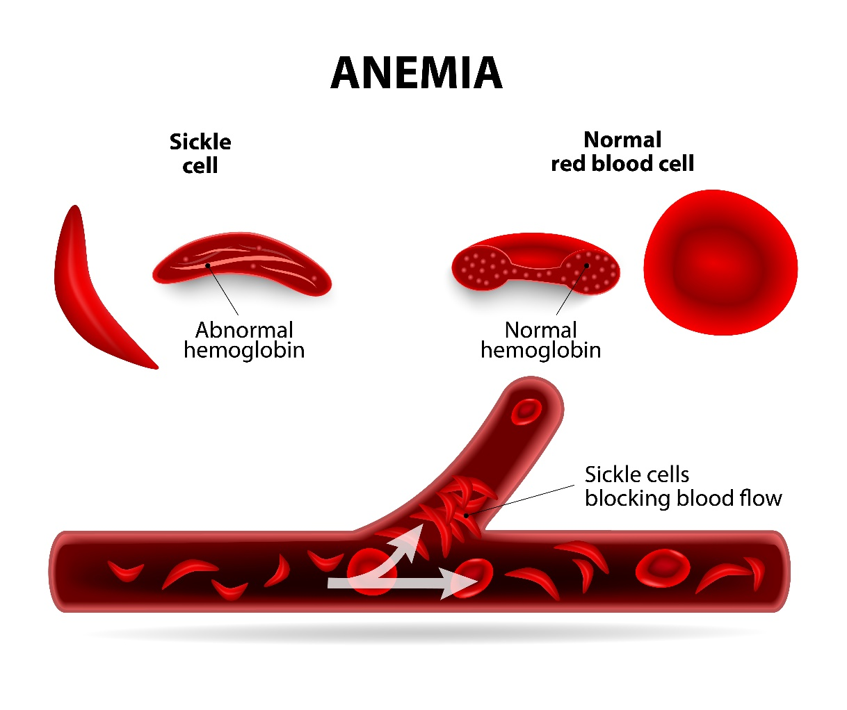
Fetal hemoglobin (HbF)

Slide 3
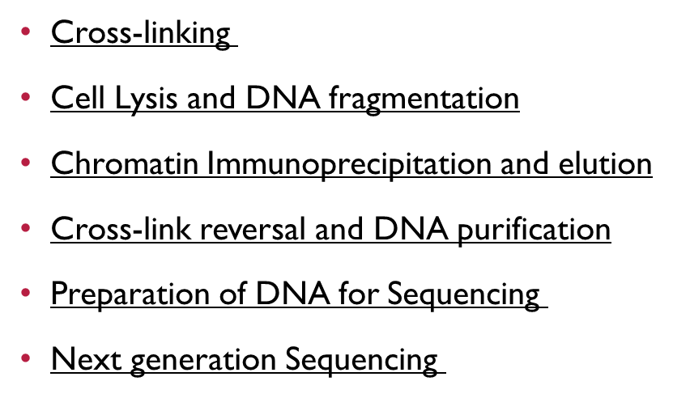
Chromatin Immunoprecipitation (ChIP) Followed by DNA sequencing ChIP-Seq

Slide 4
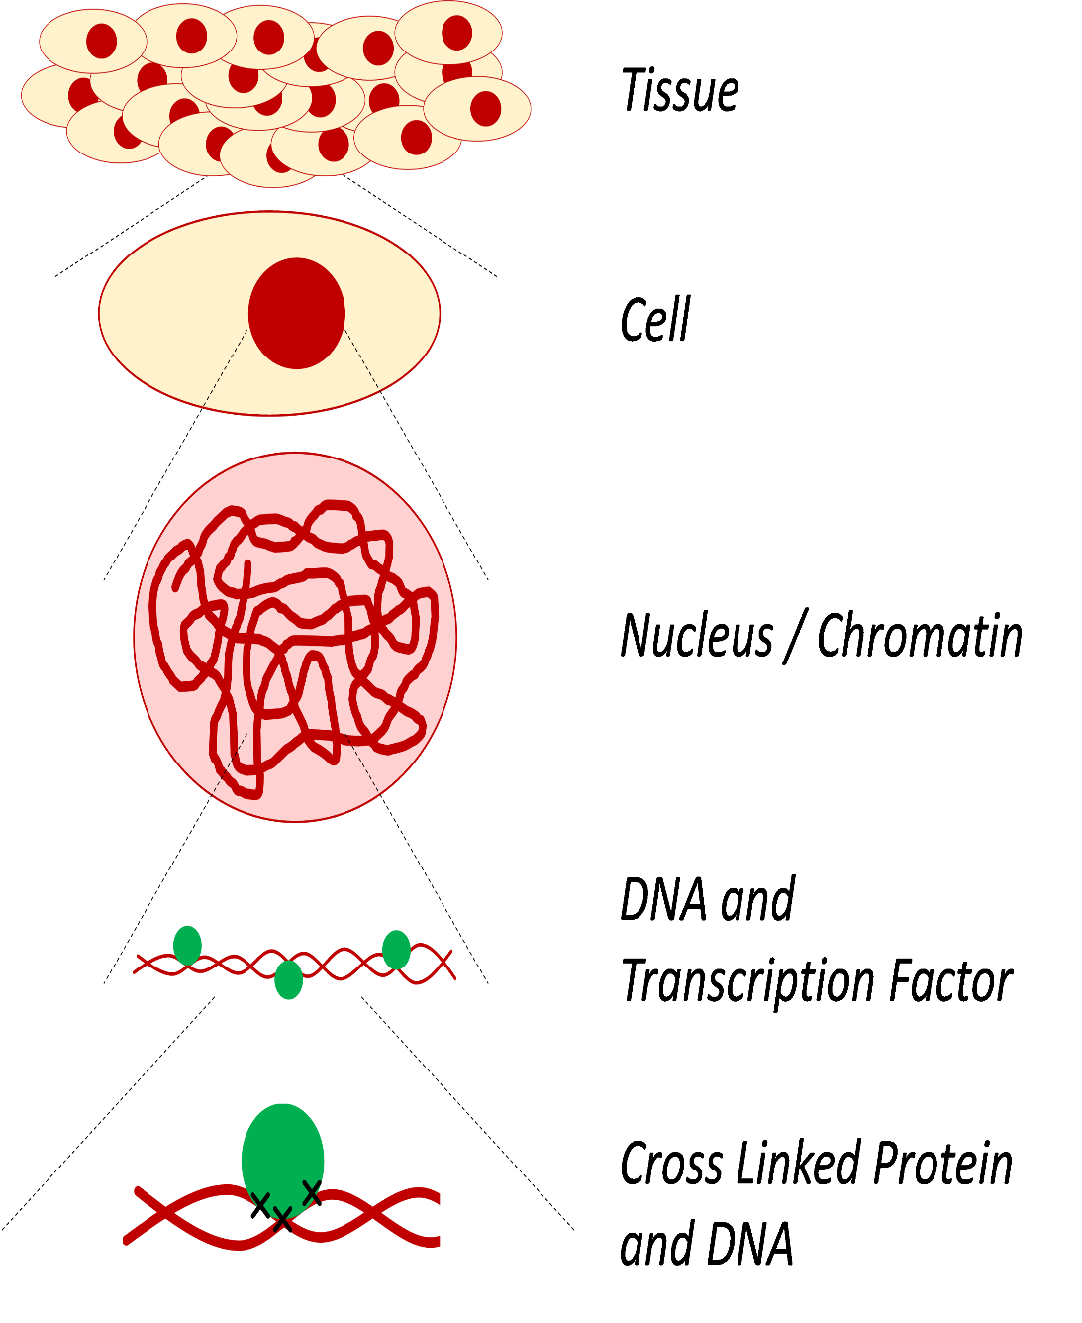
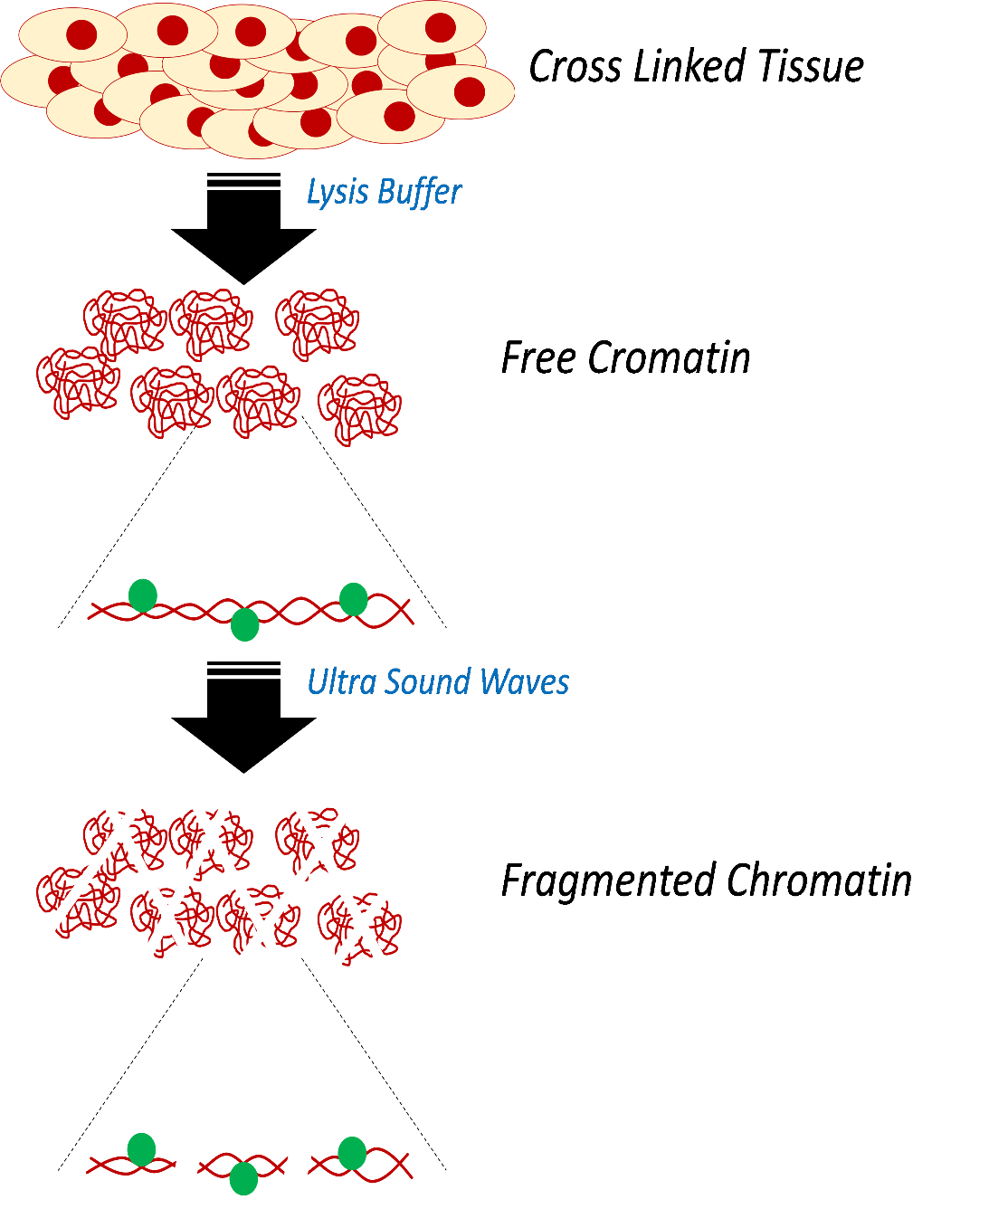
Cell Lysis and DNA fragmentation

Slide 5
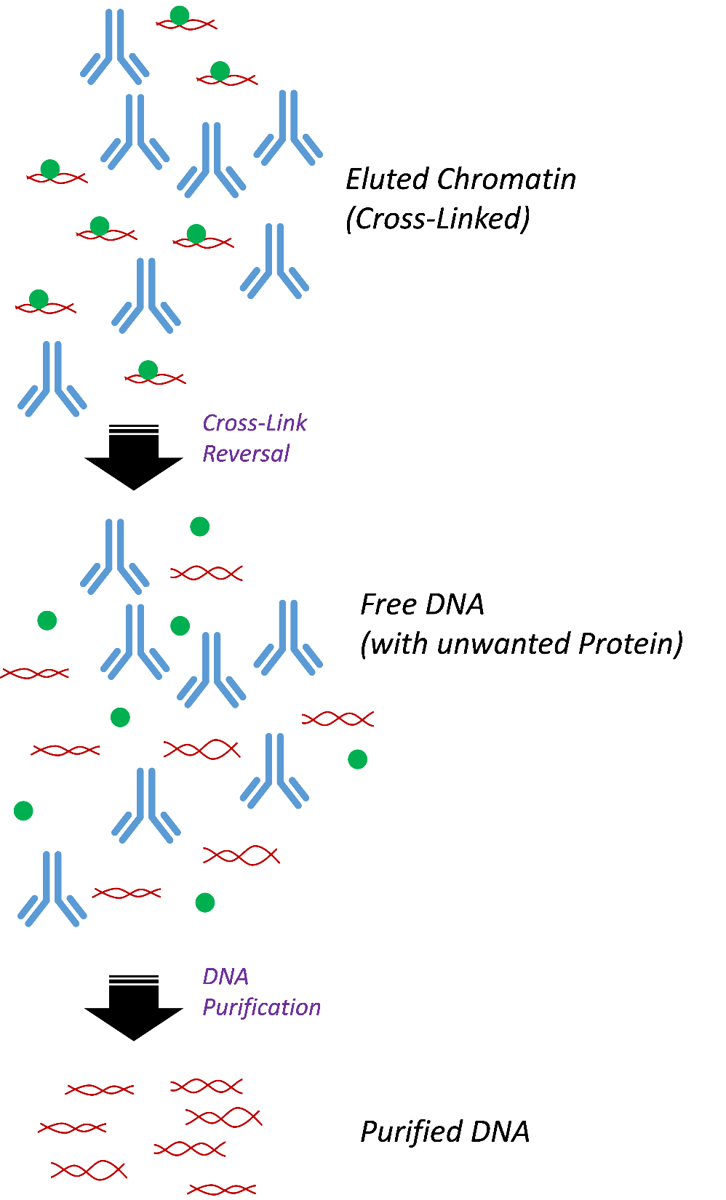
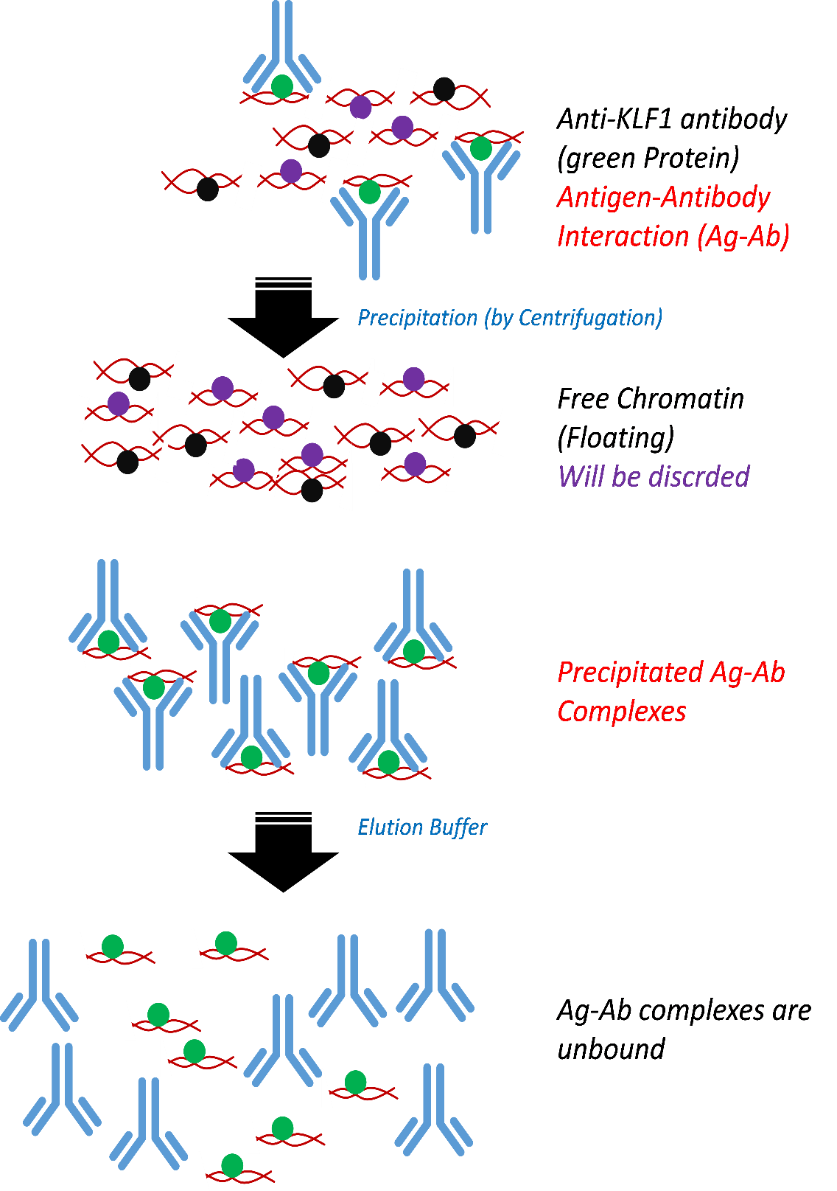
Chromatin Immunoprecipitation and elution
Cross-link reversal and DNA purification

Slide 6
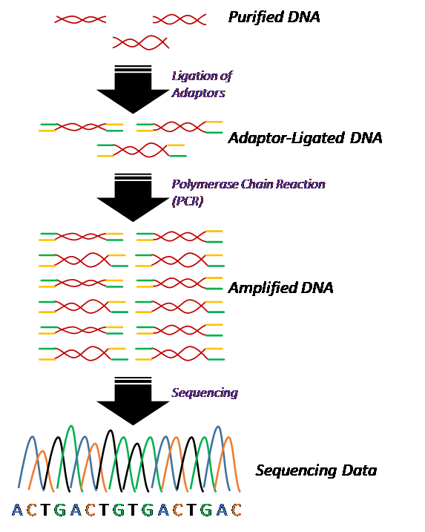
Preparation of DNA for Sequencing
Next generation Sequencing

Slide 8
