Slide 1
IS P53 MORE LIKELY TO TRIGGER APOPTOSIS OR CELLULAR SENESCENCE AS A RESPONSE TO A TUMOR OR DNA DAMAGE? Mailat Yonas BNFO 300

Slide 2
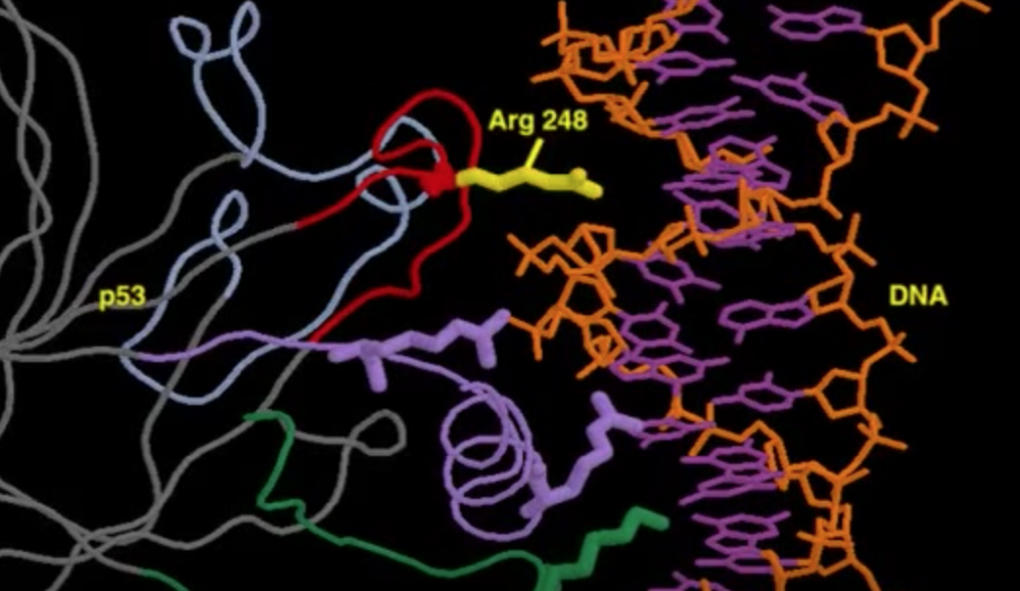
What is TP53?
Better known as p53
Codes for the regulation of the cell cycle preventing the progression of a tumor
P53 protects the integrity of the cell by regulating several cellular processes when triggered by stress signals

Slide 3
Cellular Senescence?
Irreversible arresting of cell proliferation
First studied by Hayflick and Moorhead in the 1960s, so still not fully understood.
Qualitatively equal to apoptosis in that it prevents the progression of cell proliferation.
Cells that are Pro-senescent are actively anti-apoptotic, and senescent cells are resistant to apoptosis.

Slide 4
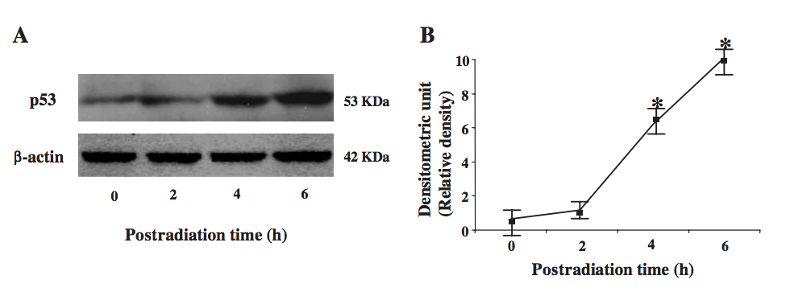
Hirao et al
Investigated the activation of p53 using Kinase Chk2.
They concluded that after exposing the cells to radiation there was an increase in levels of p53.
Taking a step further…
Instead of just activating p53 we want to see what mechanism it is more likely to be mediated.
Hypothesis: Apoptosis

Slide 5
How to begin…
Obtaining Cancerous cells
-Can be made artificially or collected from cancer patients
They must be at similar stages in development in order for the experiment to be comparative.
Also should be taken from similar patients if not the same patient
Dale et al work with susceptibility

Slide 6
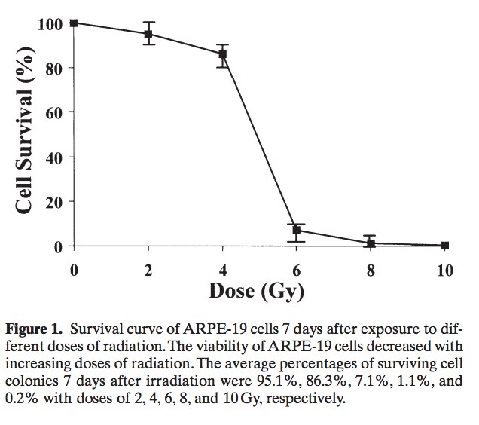
Ionizing Radiation
Damages the DNA using UV light, removing electrons from the atom, disrupting the DNA
Damage is dependent on the dose.
The dose must be enough to damage the DNA, but too strong that it destroys the nucleus.
Jiang et al

Slide 7
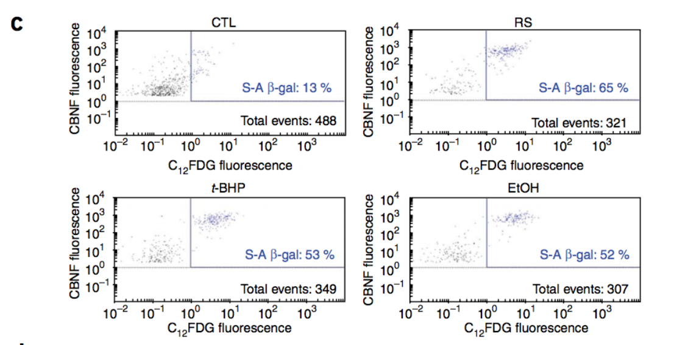
Sa-ß-Gal
Senescence-associated beta-galactosidase
Biomarker for Cellular Senescence
Using Protocols from Chainiaux et al
Using a cytochemical assay and substrate X-gal, produces a blue compound, that will enable us to count the number of blue stained cells in the total population.

Slide 8
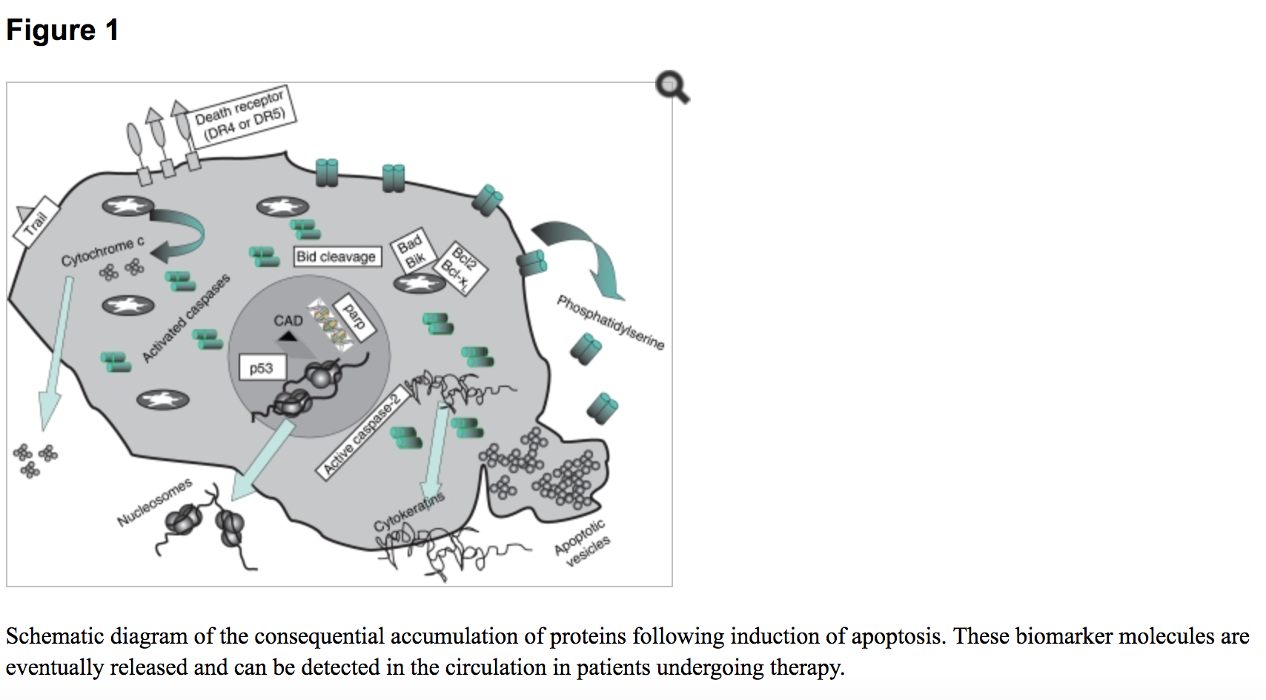
Release of Cytochrome C
Biomarker for Apoptosis
Is also a trigger for apoptosis but when found in the cytosol is telling that apoptosis has occurred.
Using a Releasing Apoptosis Assay Kit and Standard Western Blotting techniques we will be able to understand

Slide 9
Limitations
Ionizing Radiation may lead to apoptosis
p53 may not activate
p53 may not induce either Cellular Senescence or Apoptosis.
The tumor may not be effectively suppressed

Slide 10
Conclusion
We are looking to see that Cellular Senescence is more prevalent.
Senescence is a more protective mechanism
These cells are still stably viable
May have the ability to remodel cells favorably
Could lead to effective breakthroughs in cancer research
If we are able to manipulate cellular senescence more fitting result for cancer therapies

Slide 11
References:
1. “Activating p53 in Cancer Cells with Protein Therapy Shows Preclinical Promise.” PLoS Biology 2.2 (2004): e58. PMC. Web. 26 Nov. 2017. https://www.ncbi.nlm.nih.gov/pmc/articles/PMC340958/
2. A W Abu-Qare, M B Abou-Donia. “Biomarkers of Apoptosis: Release of Cytochrome c, Activation of Caspase-3, Induction of 8-Hydroxy-2'-Deoxyguanosine, Increased 3-Nitrotyrosine, and Alteration of p53 Gene.” Sigma-Aldrich: Analytical, Biology, Chemistry & Materials Science Products and Services., Journal of Toxicology and Environmental Health. Part B, Critical Reviews, 16 Aug. 2001, www.sigmaaldrich.com/catalog/papers/11503418.
3. Brooks, Christopher L, and Wei Gu. “New Insights into p53 Activation.” Nature, 20 Apr. 2010, https://www.nature.com/articles/cr201053
4. Childs, Bennett G et al. “Senescence and Apoptosis: Dueling or Complementary Cell Fates?” EMBO Reports 15.11 (2014): 1139–1153. PMC. Web. 26 Nov. 2017. https://www.ncbi.nlm.nih.gov/pmc/articles/PMC4253488/
5. Demaria, Marco, et al. “Cellular Senescence Promotes Adverse Effects of Chemotherapy and Cancer Relapse.” Cancer Discovery, American Association for Cancer Research, 1 Feb. 2017, cancerdiscovery.aacrjournals.org/content/7/2/165.
6. Dimri, Goberdhan. “What Has Senescence Got to Do with Cancer?” Cancer Cell, Cell Press, 13 June 2005, www.sciencedirect.com/science/article/pii/S1535610805001662.
7. Halama, A., et al. “Identification of Biomarkers for Apoptosis in Cancer Cell Lines Using Metabolomics: Tools for Individualized Medicine.” Journal of Internal Medicine, 16 Oct. 2013, onlinelibrary.wiley.com/doi/10.1111/joim.12117/full.
8. Hattis, Dale et al. “Age-Related Differences in Susceptibility to Carcinogenesis: A Quantitative Analysis of Empirical Animal Bioassay Data.” Environmental Health Perspectives 112.11 (2004): 1152–1158. PMC. Web. 26 Nov. 2017. https://www.ncbi.nlm.nih.gov/pmc/articles/PMC1247474/
9. Hirao A, Kong Y-Y, Matsuoka S, Wakeham A, Ruland J, Yoshida H, Liu D, Elledge SJ, Mak TW: DNA damage-induced activation of p53 by the checkpoint kinase Chk2. Science 2000, 287:1824-1827.
10. Jiang, Y L, et al. “Ionizing Radiation Induces a p53-Dependent Apoptotic Mechanism in ARPE-19 Cells.” Japanese Journal of Ophthalmology., U.S. National Library of Medicine, www.ncbi.nlm.nih.gov/pubmed/15064971.
11. Kahlem, Pascal, et al. “Cellular Senescence in Cancer Treatment: Friend or Foe?” The Journal of Clinical Investigation, American Society for Clinical Investigation, 15 Jan. 2004, www.jci.org/articles/view/20784.
12. Martin, S J, and D R Green. “Apoptosis as a Goal of Cancer Therapy.” Current Opinion in Oncology., U.S. National Library of Medicine, Nov. 1994, www.ncbi.nlm.nih.gov/pubmed/7827175.
13. National Center for Biotechnology Information (US). Genes and Disease [Internet]. Bethesda (MD): National Center for Biotechnology Information (US); 1998-. The p53 tumor suppressor protein. Available from: https://www.ncbi.nlm.nih.gov/books/NBK22268/
14. Nimse, S B, et al. “Biomarker Detection Technologies and Future Directions.” The Analyst., U.S. National Library of Medicine, 7 Feb. 2016, www.ncbi.nlm.nih.gov/pubmed/26583164.
15. Ozaki, Toshinori, and Akira Nakagawara. “Role of p53 in Cell Death and Human Cancers.” Cancers 3.1 (2011): 994–1013. PMC. Web. 26 Nov. 2017. https://www.ncbi.nlm.nih.gov/pmc/articles/PMC3756401/
16. Piechota, Malgorzata et al. “Is Senescence-Associated Β-Galactosidase a Marker of Neuronal Senescence?” Oncotarget 7.49 (2016): 81099–81109. PMC. Web. 25 Nov. 2017.
17. Qian, Yingjuan, and Xinbin Chen. “Senescence Regulation by the p53 Protein Family.” SpringerLink, Humana Press, Totowa, NJ, 1 Jan. 1970, link.springer.com/protocol/10.1007/978-1-62703-239-1_3.
18. Ward, T H, et al. “Biomarkers of Apoptosis.” British Journal of Cancer, Nature Publishing Group, 16 Sept. 2008, www.ncbi.nlm.nih.gov/pmc/articles/PMC2538762/.

