Slide 1
Measurement of Protein Aggregation Levels in Mutant scs2 Gene of Yeast to Determine whether the Ubiquitination Proteasome System of the Unfolded Protein Response can be Inhibited
Keerthana Vishwanath

Slide 2
Amyotrophic Lateral Sclerosis (ALS)
What is ALS?
What are the two types of ALS?
ALS is typically caused by mutation
Notes:
1. Amyotrophic Lateral Sclerosis—progressive neurodegenerative disease—characterized by aggregation of protein (protein accumulation)—that affects motor neurons in both brain and brain stem/spinal cord areas. Paralysis (often fatal) and other losses of function often appear as disease progresses. People often diagnosed with ALS die within 3-5 years of diagnosis—average age of onset is around 55 years.
2. Sporadic (90%)—random mutation sparks onset; Familial (10%)—hereditary and often passed down by one parent who was a carrier
3. The mutations are various but they usually cause aggregation of protein in the area in which the protein resides

Slide 3
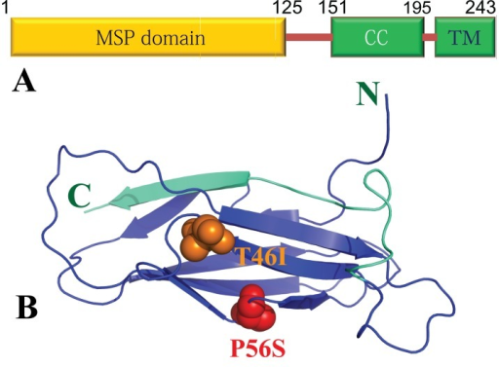
Vesicle Associated Membrane Protein Associated Protein B (VAPB)
Integral Protein in Endoplasmic Reticulum (ER)
Functions
Unfolded Protein Response (UPR)
Detection of misfolded/unfolded proteins
Degrades via ubiquitination proteasome system (UPS)
Correction via increased production of molecular chaperones
https://openi.nlm.nih.gov/imgs/512/245/3869494/PMC3869494_f1000research-2-1260-g0002.png?keywords=amyotrophic+lateral+sclerosis
https://ghr.nlm.nih.gov/gene/VAPB/location.png
Notes:
The VAPB protein is an integral membrane protein located in the endoplasmic reticulum (ER). It has many functions including protein folding, lipid transport, vesicle movement between cells, as well as the unfolded protein response (UPR) which detects the unfolded/misfolded proteins, degrades the misfolded proteins^{[3]} via the ubiquitination proteasome system (UPS)^{[11]}, and attempts to correct the proteins by increasing the production of molecular chaperones which are involved in protein folding

Slide 4
Known Mutations of VAPB
P56S-–Proline at codon 56 to Serine
T46I—Threonine at codon 46 to Isoleucine
Both cause UPR pathway to not be activated
Aggregates accumulate
Results in cell death
Notes:
There are two known mutations of VAPB
P56S—forms aggregates in the cytosol of the ER—insoluble; also causes SPAMAD (Spinal Muscular Atrophy, proximal, adult, and autosomal dominant)
T46I—mainly causes protein aggregation and accumulation in the ER

Slide 5
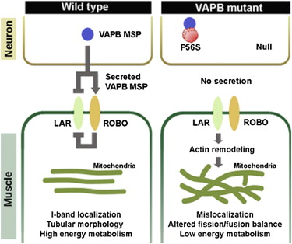
Familial ALS8
ALS8 is a type of fALS
Caused by mutation in vesicle associated membrane protein associated protein B (VAPB)
It is hereditary—first discovery made by Nishimura et al (2004)
Large Brazilian family (both males and females) had ALS8 all caused by one of the two mutations known in VAPB—P56S
http://www.cell.com/cms/attachment/2021787539/2041707744/fx1.jpg

Slide 6
Yeast Homologue of VAPB—scs2
What is scs2?
Why use scs2?
The function is essentially the same
Mutations in this gene produces the same/similar results as mutations in the VAPB gene
Notes:
Scs2 is the yeast homologue of VAPB—it regulates intracellular lipid traffic—functions are mostly similar to VAPB (protein which is in humans)

Slide 7
Central Question
Does the level of protein aggregation caused by different mutations in scs2 (the homologue to VAPB in humans) affect the UPS of the UPR in the protein?
Can the UPS be inhibited to interfere with the function of the UPR of the protein? If so, what is the level at which the protein aggregation accomplishes this?
According to Qiu et al (2012), the levels of aggregation do not affect the overall function of the UPR/UPS system in P56S.
Overcome this by testing aggregation levels in new mutations that would be created.

Slide 8
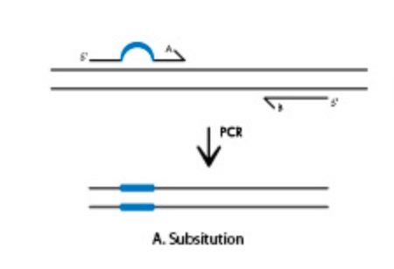
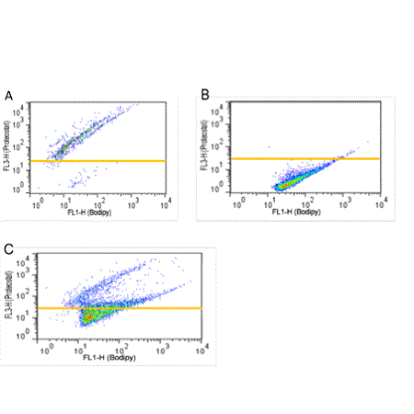
Goals of the Experiment
www.idtdna.com/pages/decoded/decoded-articles/core-concepts/decoded/2012/01/10/methods-for-site-directed-mutagenesis.
Create a library of scs2 mutants
Using Polymerase Chain Reaction (PCR)
Measure the protein aggregation caused by each mutation
Fluorescent dye ProteoStat (or just ProteoStat)
http://www.enzolifesciences.com/ENZ-51023/proteostat-protein-aggregation-assay/
Examples of how ProteoStat works:
Notes:
ProteoStat allows for a homogenous assay—monitoring the aggregation within a solution—related to traditional technique of Thioflavin T (ThT), which is another type of fluorescent dye (attaches itself to crevices in beta sheets—there aren’t too many beta sheet crevices available in all proteins—readings are less brighter, may miss some of the aggregation level)
-ProteoStat—has a much broader range of detection as the signal is brighter and can detect much smaller levels of concentration changes in the solution where only a small amount/difference is there.

Slide 9
Results and Possible Issue(s)
Result—Protein aggregation levels of mutant scs2 gene strains will be higher than those of the original scs2 gene
Why is this important?
Possible Issue(s)—
1. scs2 is a yeast homologue of VAPB
Why is this an issue?
Notes:
This would confirm that an interference has occurred and the UPS of the UPR is not properly degrading the proteins that are accumulating. Using these results, I could potentially state that due to the interference of the protein aggregates in the UPS of the UPR system of the mutant scs2 gene, the onset of ALS8 would occur.
Although proteins are primarily conserved and functions are essentially the same, they are still two different proteins and could have slightly different properties/characteristics that skew results. Also, I would never get to see how this would contribute to the development of motor neuron dysfunction or survival in ALS8 patients—gene is in yeast and VAPB is in humans.

Slide 10
References
1. Chen, S., Sayana, P., Zhang, X., & Le, W. (2013). Genetics of amyotrophic lateral sclerosis: an update. Retrieved from https://www.ncbi.nlm.nih.gov/pmc/articles/PMC3766231/
2. Amyotrophic lateral sclerosis - Genetics Home Reference. (2016). Retrieved from https://ghr.nlm.nih.gov/condition/amyotrophic-lateral-sclerosis#statistics
3. VAPB gene - Genetics Home Reference. (2016). Retrieved November, from https://ghr.nlm.nih.gov/gene/VAPB
4. Nishimura, Agnes L., et al. “A common founder for amyotrophic lateral sclerosis type 8 (ALS8) in the Brazilian population.” SpringerLink, Springer-Verlag, 27 Sept. 2005, https://link.springer.com/article/10.1007%2Fs00439-005-0031-y.
5. Suzuki, H, et al. “ALS-Linked P56S-VAPB, an aggregated loss-of-Function mutant of VAPB, predisposes motor neurons to ER stress-Related death by inducing aggregation of co-Expressed wild-Type VAPB.” Journal of neurochemistry., U.S. National Library of Medicine, Feb. 2009, www.ncbi.nlm.nih.gov/pubmed/19183264/.
6. Larroquette, F, et al. “Vapb/Amyotrophic lateral sclerosis 8 knock-in mice display slowly progressive motor behavior defects accompanying ER stress and autophagic response.” Human molecular genetics., U.S. National Library of Medicine, 15 Nov. 2015, www.ncbi.nlm.nih.gov/pubmed/26362257/.
7. “SCS2.” SCS2 | SGD, 2000, www.yeastgenome.org/locus/SCS2.
8. Blokhuis, Anna M., et al. “Protein aggregation in amyotrophic lateral sclerosis.” Acta Neuropathologica, Springer-Verlag, June 2013, www.ncbi.nlm.nih.gov/pmc/articles/PMC3661910/.
9. Gregoire, Simpson, et al. “Techniques for Monitoring Protein Misfolding and Aggregation in Vitro and in Living Cells.” The Korean journal of chemical engineering, U.S. National Library of Medicine, June 2012, www.ncbi.nlm.nih.gov/pmc/articles/PMC3615250/.
10. Qiu, Linghua, et al. “Widespread aggregation of mutant VAPB associated with ALS does not cause motor neuron degeneration or modulate mutant SOD1 aggregation and toxicity in mice.” Molecular Neurodegeneration, BioMed Central, 2013, www.ncbi.nlm.nih.gov/pmc/articles/PMC3538568/.
11. Ding, Wen-Xing, et al. “Linking of Autophagy to Ubiquitin-Proteasome System Is Important for the Regulation of Endoplasmic Reticulum Stress and Cell Viability.” The American Journal of Pathology, American Society for Investigative Pathology, Aug. 2007, www.ncbi.nlm.nih.gov/pmc/articles/PMC1934546/.
12. Genevini, Paola, et al. “Amyotrophic Lateral Sclerosis-Linked Mutant VAPB Inclusions Do Not Interfere with Protein Degradation Pathways or Intracellular Transport in a Cultured Cell Model.” PLoS ONE, Public Library of Science, 2014, www.ncbi.nlm.nih.gov/pmc/articles/PMC4237408/.
13. “PROTEOSTAT® Protein aggregation assay.” PROTEOSTAT® Protein aggregation assay - ENZ-51023 - Enzo Life Sciences, 14 Nov. 2016, www.enzolifesciences.com/ENZ-51023/proteostat-protein-aggregation-assay/.
14. Yang, Bin, et al. “Widespread aggregation of mutant VAPB associated with ALS does not cause motor neuron degeneration or modulate mutant SOD1 aggregation and toxicity in mice.” Molecular Neurodegeneration, BioMed Central, 3 Jan. 2013, https://molecularneurodegeneration.biomedcentral.com/articles/10.1186/1750-1326-8-1.
15. Sabel, Jaime, and Nicola Brookman-Amissah. “Integrated DNA Technologies.” Methods for site-Directed mutagenesis, IDT, www.idtdna.com/pages/decoded/decoded-articles/core-concepts/decoded/2012/01/10/methods-for-site-directed-mutagenesis.

