Slide 1
The Upregulation of Ceramide Synthase 3 to Increase Production of Ultra Long Chain (ULC) Ceramides in Psoriatic Epidermal Keratinocytes
Mouni Talari

Slide 2
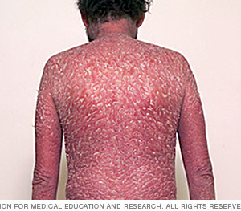
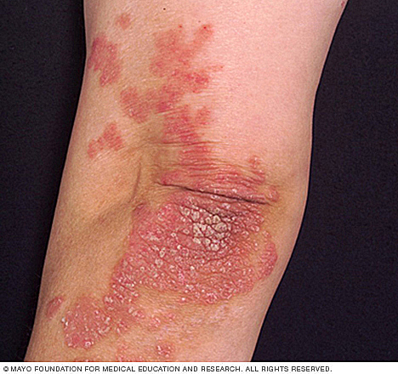
Psoriasis Overview
Chronic autoimmune inflammatory disease
Build up of skin cells
Notes:
Psoriasis is a chronic autoimmune inflammatory disease that affects more than 100 million people worldwide. It occurs when skin cells are prematurely replaced with new ones, which cause buildup on the surface of the skin. This build up forms scale-like rashes which can cause itching, irritation, and pain.

Slide 3
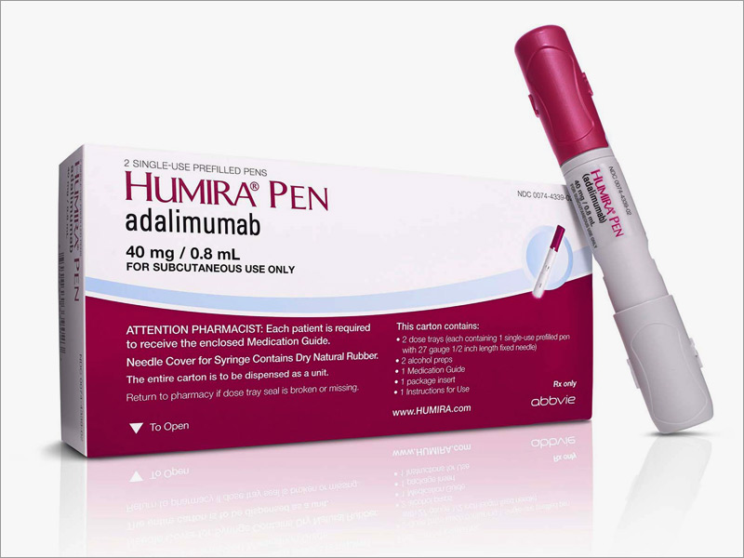
Current Treatments
Topical corticosteroids
Anthralin (Vitamin D analogue)
Phototherapy
Biologics
HUMIRA, STELARA, ENBREL
Notes:
Current treatments for psoriasis are centered on topical corticosteroids which treat psoriasis symptomatically. They help alleviate any burning, itching, or soreness. Anthralin is a vitamin D analogue which helps slow skin cell growth. However, both of these treatments only help with mild to moderate forms of psoriasis. Phototherapy exposes skin to artificial UV light to help slow the growth of skin cells, but exposing skin to UV radiation can cause skin cancer in the long term. Biologics alter the immune system, and can help treat moderate to severe psoriasis. However, these drugs slow down the immune system, making patients prone to other diseases and infections.

Slide 4
Ceramides
Lipid molecule consisting of a sphingosine and fatty acid that varies in length
Functions
Cell signaling, differentiation, and programmed cell death (PCD)
Make up 50% of the stratum corneum layer of human epidermis
Help with barrier function
Notes:
Ceramides are lipid molecules that consist of a sphingosine and fatty acid that varies in length. Their functions include cell signaling, differentiation, and PCD. One of the most studied functions of ceramide molecules is its role as a proapoptotic molecule and its function as a chemotherapeutic agent. However, ceramides also make up 50% of the stratum corneum layer of the human epidermis and help with barrier function and water impermeability. They act as a protective layer against the epidermis.

Slide 5
Ceramide Synthase
Notes:
Mammalian ceramides are synthesized by 6 known ceramide synthases. Of the six, ceramide synthase 3 synthesizes ceramides that have long carbon chains, known as ultra long chain ceramides. This ceramide synthase is found mostly epidermal keratinocytes and assist with differentiation. They are also found in the testis. The gene for ceramide synthase 3 is found on chromosome 15 in humans.

Slide 6
Interferon-γ (IFNγ)
Cytokine produced by immune cells which results in decreased production of ceramide synthases
Chisato et al study
Increased IFNγ = decreased CerS3 levels by 52%
Very few levels of ULC ceramides
Notes:
Interferon gamma is a cytokine which is produced by immune cells which results in decreased production of ceramide synthase. Psoriatic models were found to have increased IFNγ levels, which decreased expression of Ceramide Synthase 3. A Chisato et al study showed that in psoriatic skin cell models, there were increased levels of IFNγ which resulted in a decrease of CerS3 levels by almost 52%. The study also showed that psoriatic skin cell models had ceramides, but not the ultra long chain ceramides. Healthy skin cells had normal ceramide levels.

Slide 7
Can we increase IFNγ to help prevent psoriasis?
Yes and no
Theoretically yes but…
IFNγ homeostasis should not be disrupted
So if IFNγ cannot be manipulated, what can?
Ceramide synthase 3
Notes:
IFNγ has a very sensitive homeostatic nature, and increasing or decreasing the expression of the encoding gene can result in multiple unwanted effects on the immune system. So instead of manipulating IFNγ, we can manipulate the expression of ceramide synthases.

Slide 8
PPARγ
Peroxisome Proliferator-activated Receptor γ
Mizutani et al study
Eight receptors tested
PPARγ upregulates CerS3
Used Troglitazone as an agonist
Agonists for this experiment
Pioglitazone, INT131, S26948
Notes:
In a study by Mizutani et al, eight different nuclear receptors were tested to determine which one would increase the regulation of CerS3. Of the 8, PPARγ upregulated CerS3 the most by inducing the highest expression levels of the CerS3 mRNA. The agonist used in the study was Troglitazone, which was an anti-diabetic drug. However, it was withdrawn from markets after it was found to cause hepatotoxicity as well as CHF and fluid retention. The agonists that will be used in this experiment are Pioglitazone, INT131, and S26948, which are all currently in preclinical or Phase I of clinical trials, but have so far not caused any hepatotoxicity and have had decreased levels of fluid retention and edema.

Slide 9
Experiment
Evaluate the efficacy of 3 agonists at the PPARγ receptor in decreasing the inflammatory effects of psoriasis.
Notes:
The primary goal of the experiment is to evaluate the efficacy of 3 agonists at the PPARγ receptor in decreasing the inflammatory effects of psoriasis. The three agonists which are pioglitazone, INT131, and S26948, will be used at a control dose in psoriatic epidermal keratinocytes of mice. Then, a serial analysis of gene expression (SAGE) will be run to analyze the levels of the CerS3 mRNA. SAGE will also be run prior to administration of the three agonists so as to determine the pre-administration levels of the CerS3 mRNA. If the CerS3 mRNA levels are increased, then the agonist with the highest increase in CerS3 mRNA levels can be used in a mouse xenograft model of psoriasis. This will help determine whether or not increasing CerS3 expression reduces the effects of psoriasis, thereby presenting a potential new treatment to the disease.

Slide 10
Step 1
Run a serial analysis of gene expression (SAGE) on psoriatic epidermal keratinocytes of mice to determine expression levels of the CerS3 gene
Step 2
Administer a control dose of each of the agonists separately to keratinocytes
Step 3
Run SAGE again to see how expression levels of CerS3 have changed after agonist administration
Step 4
Determine which of the 3 agonists was most effective
Step 5
Future study
Use this agonist in a mouse xenograft model of psoriasis
Notes:
The primary goal of the experiment is to evaluate the efficacy of 3 agonists at the PPARγ receptor in decreasing the inflammatory effects of psoriasis. The three agonists which are pioglitazone, INT131, and S26948, will be used at a control dose in psoriatic epidermal keratinocytes of mice. Then, a serial analysis of gene expression (SAGE) will be run to analyze the levels of the CerS3 mRNA. SAGE will also be run prior to administration of the three agonists so as to determine the pre-administration levels of the CerS3 mRNA. If the CerS3 mRNA levels are increased, then the agonist with the highest increase in CerS3 mRNA levels can be used in a mouse xenograft model of psoriasis. This will help determine whether or not increasing CerS3 expression reduces the effects of psoriasis, thereby presenting a potential new treatment to the disease.

Slide 11
Notes:
Genes are transcribed and spliced to produce mature mRNA transcripts. mRNA is extracted and reverse transcriptase is used to copy the mRNA into stable double stranded cDNA.
The double stranded cDNA is digested by restriction enzymes to produce fragments which are concatenated and sequenced using Sanger Sequencing.
The sequences are then ordered to find frequencies of each sequence
The frequencies can be used to see the expression levels of each gene that produces those sequence fragments.

Slide 12
Limitations
CerS3 is highly expressed in testis
PPARγ agonist side effects
Administration of agonists may not increase CerS3 expression
Goals
Find a new treatment of psoriasis that can be used for more severe forms of the disease.
Determine if ceramides regulate the disease
Gene therapy cure for psoriasis
Notes:
Upregulating CerS3 may result in unwanted side effects in human testis, as this is another site of highly expressed CerS3. It might bring about changes in testicular maturation.
Another limitation is that PPARγ agonists are all still in preclinical or phase I of clinical trials, so their side effects are not too well known. Some of them already cause minor fluid retention/edema.
Above all of this, administration of agonists may not even increase CerS3 expression, which would be a major downfall in this experiment.
However, many previous studies have shown that the activation of the PPARγ receptor increases ceramide levels, and other studies have consistently claimed that these three ligands are all full agonists at the receptor.

Slide 13
References
Gordon, K. B., Feldman, S. R., Koo, J. Y., Menter, A., Rolstad, T., & Krueger, G. (2005). Definitions of Measures of Effect Duration for Psoriasis Treatments. Archives of Dermatology, 141(1). doi:10.1001/archderm.141.1.82
Krueger, G. G., Feldman, S. R., Camisa, C., Duvic, M., Elder, J. T., Gottlieb, A. B., . . . Day, R. M. (2000). Two considerations for patients with psoriasis and their clinicians: Journal of the American Academy of Dermatology, 43(2), 281-285. doi:10.1067/mjd.2000.106374
Motta, S. (1994). Abnormality of water barrier function in psoriasis. Role of ceramide fractions. Archives of Dermatology, 130(4), 452-456. doi:10.1001/archderm.130.4.452
Levy M, Futerman AH. Mammalian ceramide synthases. IUBMB life. 2010. 62:347–356. doi: 10.1002/iub.314.
M.S. Wegner, S. Schiffmann, M.J. Parnham, G. Geisslinger, S. Grosch. The enigma of ceramide synthase regulation in mammalian cells. Progress in Lipid Research, 63 (2016), pp. 93-119
Tawada, C., Kanoh, H., Nakamura, M., Mizutani, Y., Fujisawa, T., Banno, Y., & Seishima, M. (2014). Interferon-γ Decreases Ceramides with Long-Chain Fatty Acids: Possible Involvement in Atopic Dermatitis and Psoriasis. Journal of Investigative Dermatology, 134(3), 712-718. doi:10.1038/jid.2013.364
Garidel P, Fölting B, Schaller I, Kerth A (2010). "The microstructure of the stratum corneum lipid barrier: mid-infrared spectroscopic studies of hydrated ceramide:palmitic acid:cholesterol model systems". Biophysical Chemistry. 150 (1–3): 144–156. doi:10.1016/j.bpc.2010.03.008.
Feingold KR (2007). "Thematic review series: skin lipids. The role of epidermal lipids in cutaneous permeability barrier homeostasis". Journal of Lipid Research. 48 (12): 2531–2546. doi:10.1194/jlr.R700013-JLR200.
Duan, J., Sugawara, T., Hirose, M., Aida, K., Sakai, S., Fujii, A., & Hirata, T. (2012). Dietary sphingolipids improve skin barrier functions via the upregulation of ceramide synthases in the epidermis. Experimental Dermatology, 21(6), 448-452. doi:10.1111/j.1600-0625.2012.01501.x
Mizutani, Y., Sun, H., Ohno, Y., Sassa, T., Wakashima, T., Obara, M., . . . Igarashi, Y. (2013). Cooperative Synthesis of Ultra Long-Chain Fatty Acid and Ceramide during Keratinocyte Differentiation. PLoS ONE, 8(6). doi:10.1371/journal.pone.0067317
Rabionet M, van der Spoel AC, Chuang CC, von Tümpling-Radosta B, Litjens M, Bouwmeester D, Hellbusch CC, Körner C, Wiegandt H, Gorgas K, Platt FM, Gröne HJ, Sandhoff R (2008). "Male germ cells require polyenoic sphingolipids with complex glycosylation for completion of meiosis: a link to ceramide synthase-3". J. Biol. Chem. 283 (19): 13357–69. doi:10.1074/jbc.M800870200.
Grygiel-Górniak, B. (2014). Peroxisome proliferator-activated receptors and their ligands: nutritional and clinical implications - a review. Nutrition Journal, 13(1). doi:10.1186/1475-2891-13-17
FDA August 4, 2011. FDA Drug Safety Communication: Updated drug labels for pioglitazone-containing medicines.
Ramot, Y., Mastrofrancesco, A., Camera, E., Desreumaux, P., Paus, R., & Picardo, M. (2015). The role of PPARγ-mediated signalling in skin biology and pathology: new targets and opportunities for clinical dermatology. Experimental Dermatology, 24(4), 245-251. doi:10.1111/exd.12647
Yew, T., Toh, S., & Millar, J. S. (2012). Selective Peroxisome Proliferator-Activated Receptor-γ Modulation to Reduce Cardiovascular Risk in Patients with Insulin Resistance. Recent Patents on Cardiovascular Drug Discovery, 7(1), 33-41. doi:10.2174/157489012799362359
Gudjonsson, J. E., Johnston, A., Stoll, S. W., Riblett, M. B., Xing, X., Kochkodan, J. J., . . . Elder, J. T. (2010). Evidence for Altered Wnt Signaling in Psoriatic Skin. Journal of Investigative Dermatology, 130(7), 1849-1859. doi:10.1038/jid.2010.67

