Slide 1
Role of hydrophobicity in amino acid substitutions of DNA gyrase subunit A-encoding gyrA

Slide 2
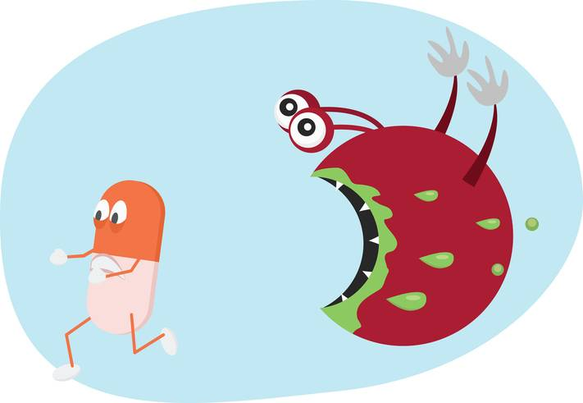
Antibiotic resistance
Problem in healthcare and food industry
25,000 people in Europe die every year
Antibiotics in livestock can pass on resistant strains

Slide 3
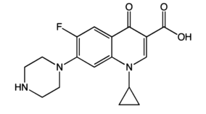
Quinolones
Widely used class of antibiotics today
Ciprofloxacin
Resistance observed in every species treated
Target DNA replication by acting on DNA gyrase
Ciprofloxacin
Aldred et. al, 2017

Slide 4
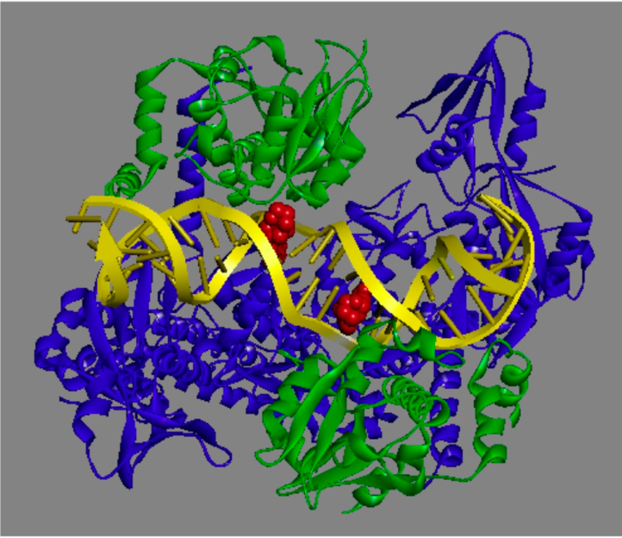
DNA Gyrase
Bacterial type-II topoisomerase
Double stranded breaks to remove supercoiling
Quinolones block religating of DNA
Breaks apart genome
DNA-Quinolone-topoisomerase complex
Aldred et. al, 2017

Slide 5
Role of Ser-83 residue
Highly conserved residue in gyrase A subunit
Mutation often found in resistant strains
Conservation of Ser-83

Slide 6
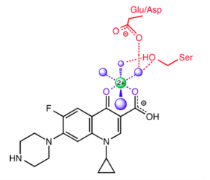
Hydrophobicity in Ser-83 substitutions
Van der Waals forces (Madurga et. al, 2008)
Water-metal ion bridge (Aldred et. al, 2017)
Water-metal ion bridge
Aldred et. al, 2017

Slide 7
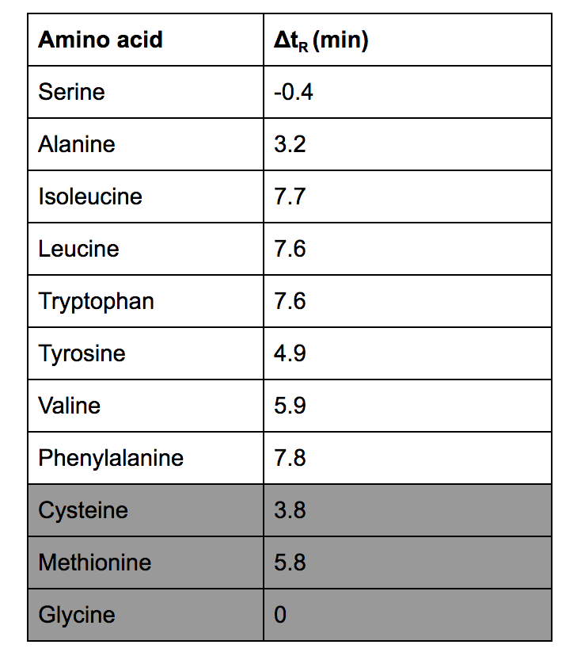
Hydrophobic amino acids
Monera et. al 1995 determined relative hydrophobicities
Reverse phase chromatography
Resistance-conferring mutations in literature were more hydrophobic than Serine
Cysteine, Methionine, and Glycine
Relative hydrophobicities
Monera et. al 1995

Slide 8
Overview of experiment
Goal: test if S83C, S83M, and S83G confer resistance
How: supercoiling assay with mutated proteins

Slide 9
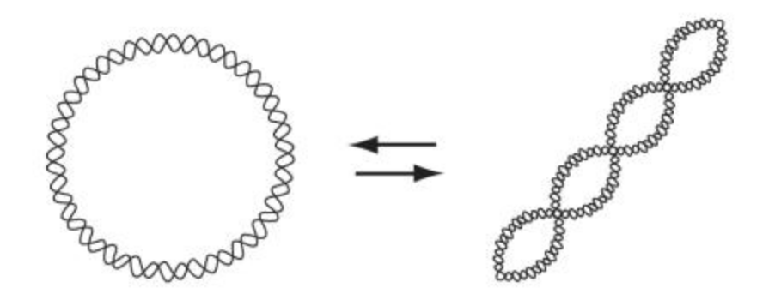
Supercoiling assay
Gyrase can supercoil relaxed DNA
Supercoiled DNA travels farther on gel (more compact)
Can measure gyrase function in presence of quinolones to determine resistance
Supercoiling of DNA
Nitiss et. al 2012

Slide 10
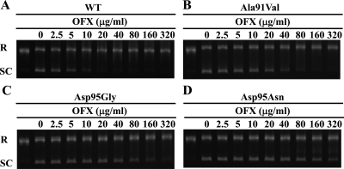
Supercoiling assay cont.
Solution containing:
Gyrase A subunit (mutated)
Gyrase B subunit
ATP
Relaxed DNA
Buffer
Allowed to incubate
Run on agarose gel
Supercoiling results
Yokoyama et. al 2011

Slide 11
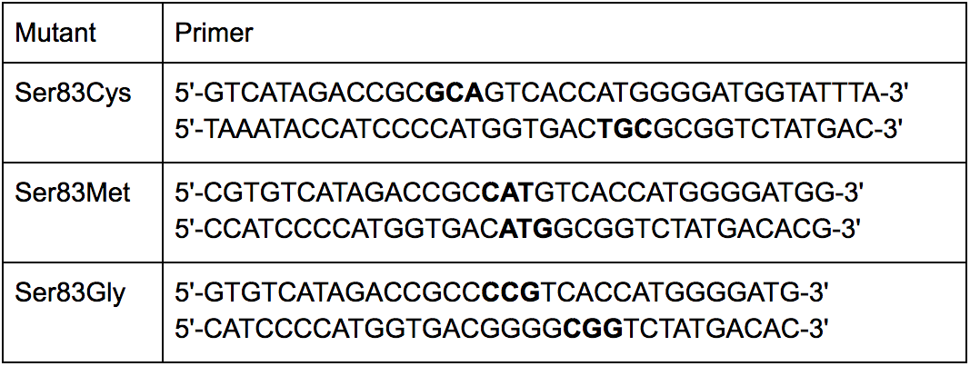
Mutant protein synthesis and purification
PCR with mutagenesis primers on cloned gyrA expression plasmid
6x Histidine tags
Transform expression plasmid into E. coli
Sonic lysis
Affinity chromatography to purify (with Histidine tags)
Mutagenesis primers
Made with Aligent QuikChange Primer Design

Slide 12
Potential results
Mutant gyrases have supercoiling activity at higher drug concentrations
Support Madurga et. al (2008) and Aldred et. al (2017)
Mutant gyrases have supercoiling activity at similar concentrations as wild-type
Ser-83 mutation may not be enough to confer resistance on its own
Or contradict Madurga et. al (2008) and Aldred et. al (2017)

Slide 13
Limitations
Special property of cysteine to form disulfide bridges

