Slide 1
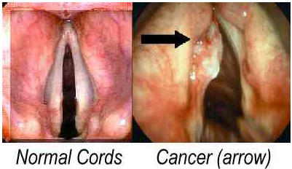
Treating Head & Neck Squamous Cell Carcinoma (HNSCC) in Immune Competent Mice by Blocking Interleukin 10 (IL-10) Dependent STAT 1, 3, & 5 signaling With an IL-10 Antagonist Chris Rowe
An instance of SCC on vocal cords (Cancers of the vocal cords).

Slide 2
IL-10 Promotion in Regulatory (T_{r1}) T Cells in LSCC Immune Response
Cancer cells can present antigens to antigen presenting dendritic cells (APDCs) which subsequently induce intensive IL-10 secreting T_{r1} cells(Tolerogenic Dendritic Cells).

Slide 3
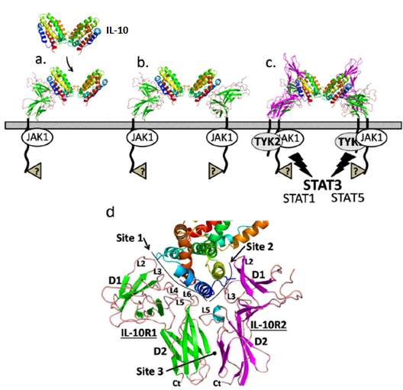
IL-10
(Mark R. Walter)
Binding of IL-10R2 to the 1:1 IL-10/IL-10R complex forms the 1:1IL-10/IL-10R/IL-10R2 complex.
This uses TYK2 & JAK1 signal messengers to phosphorylate latent signal transducers and activators of transcription (STATs) 1,3, & 5 into active states; where they can be imported though the nuclear membrane pores.
STAT signaling
1:1IL-10/IL-10R/IL-10R2 Complex

Slide 4
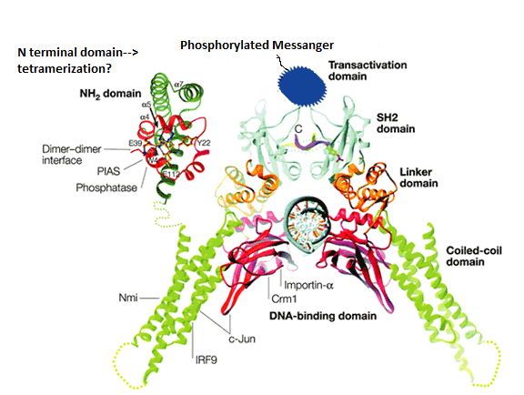
STATs in the Nucleus
*Importin-α is involved with nuclear pore import of STAT
* Transactivation Domain recruits histone acetyltransferase for association with transcription factors.
*(SH2) domain is the site of phosphate dependent activation of latent STAT by IL-10 signal messengers.
*(H2) helps the Linker Domain 0f STAT dimmers to form tetramers.
*Coiled-coil domains are similar to cytoskeletal filaments.
*DNA binding domain determines binding affinity to DNA sequence in genes, once the exterior of STAT has been assimilated into the genes transcription complex?
Genes targets vary from apoptosis associated to mitosis associated & could include more
STAT
Citations: ((Levy & Darnelle),(Ehret, Georg B., et al.),(Filippakopoulos, Panagis, et al.),(Paulson, Matthew, et al.),(Shougang Zhuang),(Yahwardiah Siregar),(Wojciak, Jonathan M, et al)

Slide 5
Blocking IL-10 in toll-like receptor 4 (TLR-4) functional C3H/HeN mice Infected with Murine Squamous Cell Carcinoma Cell Line VII(SCC VII)
An immunocompetent mouse model of SCC VII cell line for HNSCC is necessary because treating xenografted mice with IL-10, an anti inflammatory mediator, would likely cause death by acute tissue rejection. No human in vitro germinal center exists to test immune system in combination with human tissue graft.
The mice used for this experiment will be categorized as:
Control Group: (SCC VII)⁻ , IL-10 antagonist not added
Treatment Control Group: (SCC VII)⁻ , IL-10 antagonist added
Null Treatment Group: (SCC VII)⁺ , IL-10 antagonist not added
Treatment Group : (SCC VII)⁺ ,IL-10 antagonist added

Slide 6
Experiment
The experiment takes the following steps:
I) Engraftment of SCC VII to C3H/HeN mice of the Null Treatment Group and Treatment Group
II) IL-10 antagonist treatment to Treatment Group & Treatment Control Group
III) Histological count of amount of SCC VII left in area after surgical removed SCC VII tumor, to see if antagonizing IL-10 dependent STAT signaling induces immune clearance of left over cancer cells.

Slide 7
Discussion
Some expected results are decrease in SCC cells but increase in dysregulated inflammation. If IL-10 is involved in maintaining thymus’ development of self tissue tolerance then eventual self tissue rejection could occur.

Slide 8
References
Cancers of the vocal cords, www.aboutcancer.com/throat2_image.htm.
David E. Levy & J. E. Darnell JR, Signalling: STATs: transcriptional control and biological impact, Nature Reviews Molecular Cell Biology 3, 651-662(2002), doi:10.1038/nrm909
Ehret, Georg B., et al. “DNA Binding Specificity of Different STAT Proteins
COMPARISON OF IN VITRO SPECIFICITY WITH NATURAL TARGET SITES” Journal of Biological Chemistry, 2 Mar. 2001, www.jbc.org/content/276/9/6675.full#F2.
Filippakopoulos, Panagis, et al. “SH2 domains: modulators of nonreceptor tyrosine kinase activity.” Current Opinion in Structural Biology, Elsevier Science, Dec. 2009, www.ncbi.nlm.nih.gov/pmc/articles/PMC2791838/.
Mark R. Walter, The Molecular Basis of IL-10 Function: From Receptor Structure to the Onset of Signaling, Curr Top Microbiol Immunol. 2014 ; 380: 191-212. doi: 10.1007/978-3-662-43492-5_9
Paulson, Matthew, et al. “Stat Protein Transactivation Domains Recruit p300/CBP through Widely Divergent Sequences” Journal of Biological Chemistry, 3 Sept. 1999, www.jbc.org/content/274/36/25343.full.
Shougang Zhuang, Regulation of STAT signaling by acetylation, In Cellular Signalling, Volume 25, Issue 9, 2013, Pages 1924-1931, ISSN 0898-6568, https://doi.org/10.1016/j.cellsig.2013.05.007.
“Tolerogenic Dendritic Cells.” Tolerogenic Dendritic Cells | Annual Review of Immunology, www.annualreviews.org/doi/full/10.1146/annurev.immunol.21.120601.141040?url_ver=Z39.88-2003&rfr_id=ori%3Arid%3Acrossref.org&rfr_dat=cr_pub%3Dpubmed.
Yahwardiah Siregar, Oncogene and Cancer - From Bench to Clinic, ISBN 978-953-51-0858-0, 496 pages, Publisher: InTech, pg. 458 , (2013) DOI: 10.5772/3217
Wojciak, Jonathan M, et al. “Structural basis for recruitment of CBP/p300 coactivators by STAT1 and STAT2 transactivation domains.” The EMBO Journal, Nature Publishing Group, 8 Apr. 2009, www.ncbi.nlm.nih.gov/pmc/articles/PMC2670858/.

