Slide 1
5-HT1B-receptor regulation by p-GSK3B due to acute ethanol exposure on mice
Akhil Ramaswamy
Notes:
My proposal

Slide 2
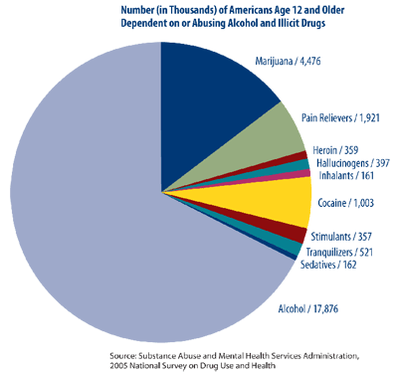
Alcohol
Highly addictive CNS depressant
Addictive nature stems from withdrawal properties
Notes:
As you can see from the figure alcohol is more prone to abuse than

Slide 3
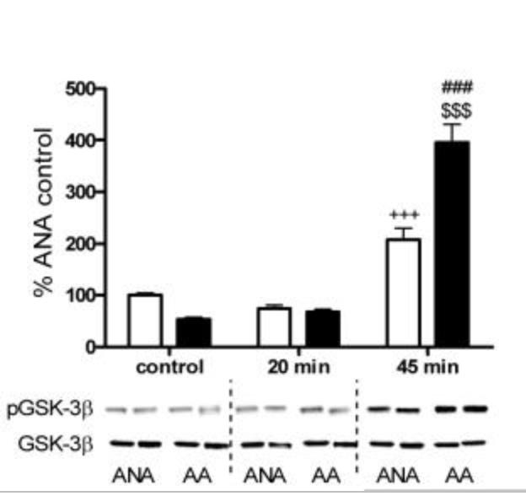
GSK3B
Serine/Threonine Protein Kinase
Can phosphorylate and be phosphorylated itself
Auto phosphorylation occurs on Tyr216
Found in areas of the Cerebral cortex
PFC in frontal lobe
Involved in a multitude of CNS regulatory pathways
So much is unknown
Acute ethanol causes increase in drinking behavior in mice while phosphorylating GSK3B (Neznova et al. 2009)
Notes:
There are 3 parts to my proposal that are key to understand that I will go over breifly. My proposal revovles around a protien known as GSK3B.IT is a serine threionin protein kinase. Protein kinases are responsible for regulating that activiation of other molecules through phosphoryalation. GSK3B can also be phophsroylted itself. It is involved in a variety of regulatory pathways including cellualr apoptosis, differentiation, and most importanly nuerphiloygical pathways as well. Gsk3B is found in high concentrations within nuerons of the CNS. Due to its vast coverage a lot of its reugaltory properities are unkown. However research has sugessted that GSK3B is inolved in regulating alcohol consumption. Neznova demonstrated that acute ethanol doses to mice phospho the GSK3B along with increasing their average consumption. The figure to here shows

Slide 4
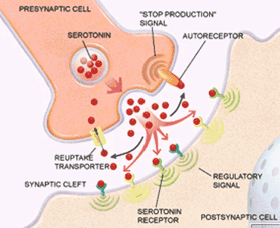
Serotonin and Alcohol
Serotonin
GSK3B exit in serotonin neurons as well
Neurotransmitter involved in regulation of mood and social behavior
Regulated by 5-HT Receptors
Multiple subclasses
5HT1 is an inhibitory subclass
Alcohol increases serotonin concentration within synapse of the brain (Lovinger, 1997)
Addiction occurs due to withdrawal
Sudden burst of serotonin entering synapse causes feeling of euphoria which depletes as time goes on
Theoretically this change in mood causes increased consumption of alcohol

Slide 5
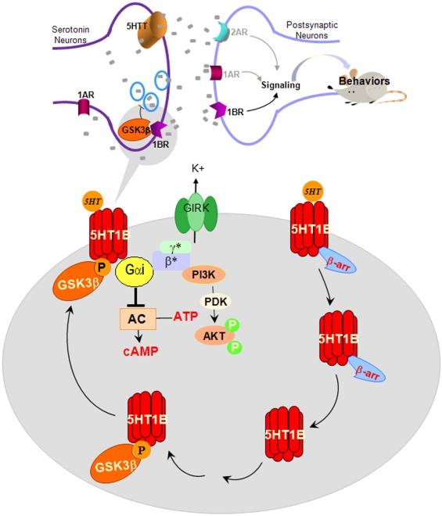
Zhou et al 2012
Showed GSK3B regulation of the 5-HT1B inhibitory effects
As serotonin in synapse increases; GSK3B is phosphorylated resulting in binding of it to 5-HT1B
BUT
Where does this phosphorylation occur?
How come mice drink more ethanol and have elevated serotonin levels despite this regulation?
Notes:
As I stated in the previous slide GSK3B is responsible for

Slide 6
Does ethanol act to phosphorylate the tyrosine site of GSK3B causing an excitatory response and prevents binding with 5-HT1B?

Slide 7
Overview of experiment
Three groups
Tyr216 mutated
Ser9 mutated
No mutation
All three will be given alcohol
Separate fourth group will be used to determine basal serotonin levels for comparison purposes

Slide 8
Site-Specific mutagenesis
Mutation of a particular base in the DNA sequence of protein molecule
For this experiment Ser9 and Tyr216 will be replaced with alanine residues
Most common SSM for GSK3B from literature

Slide 9
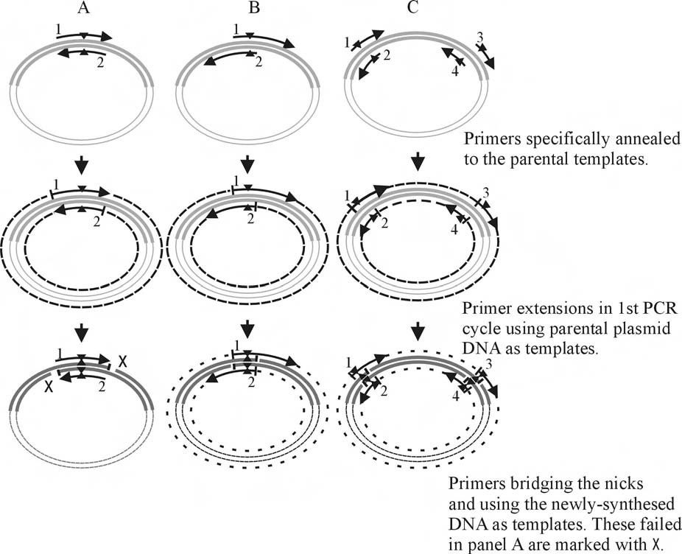
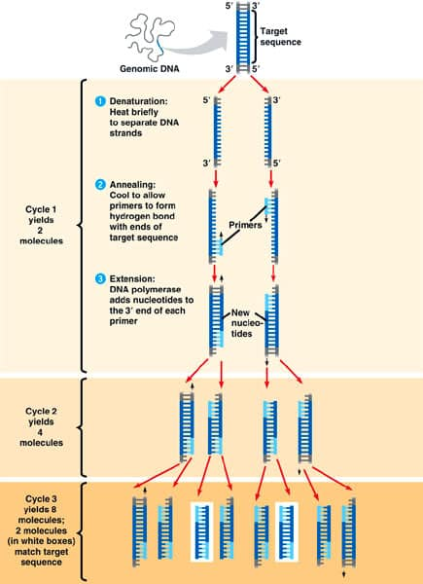
Protocol (Liu et Naismith, 2008)
Step 1
Create 2 primers complementary to artificially created desired DNA seq (found in plasmid)
Primer contains desired point mutation
Both Primer will anneal to template strand
Step 2
PCR allows for separation and replication of Primer and plasmid
Amplification of a target sequence of DNA
After several rounds of PCR you can insert this into a mouse embryo

Slide 10
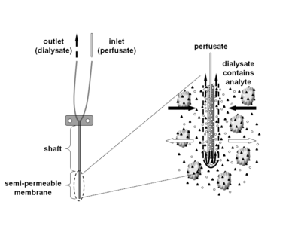
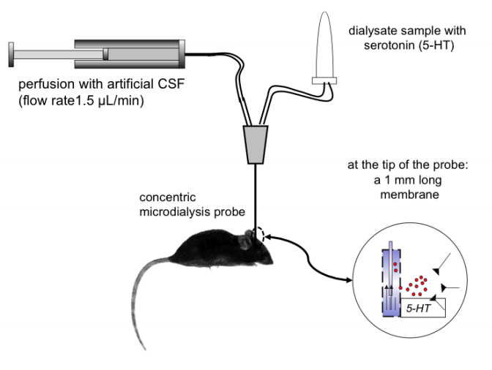
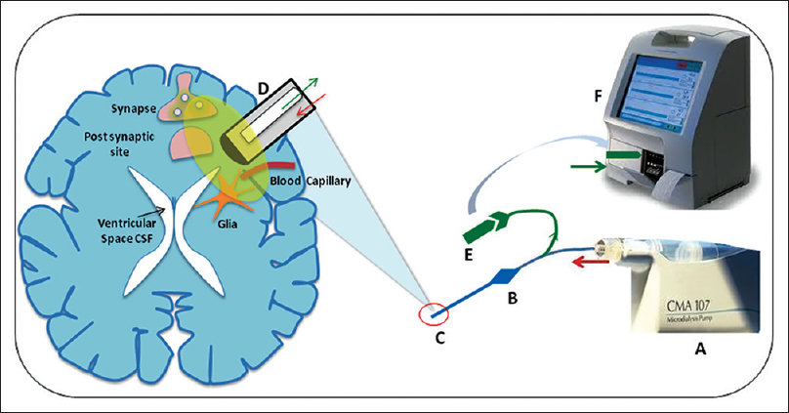
Conventional Intra-Cerebral micro dialysis
Notes:
Probe read via HPLC (identifies concentration and identity of solute that is inserted)

Slide 11
Results and Discussion
What to expect:
Ser9 and control mutated mice should show high readings of serotonin
Ser9 will have no Ser site for phosphorylation resulting in build up of serotonin
Tyr216 mutated mice should show basal readings of serotonin
Ethanol cannot bind due to no Tyr216 site so readings should be similar to basal levels

Slide 12
References
Polter, Abigail M. et al. “Functional Significance of Glycogen Synthase Kinase-3 Regulation by Serotonin.” Cellular signalling 24.1 (2012): 265–271. PMC. Web. 10 Nov.
Polter, Abigail M., and Xiaohua Li. “Glycogen Synthase Kinase-3 Is an Intermediate Modulator of Serotonin Neurotransmission.” Frontiers in Molecular Neuroscience 4 (2011): 31. PMC. Web. 14 Nov. 2017.
Zhou W, Chen L, Paul J, Yang S, Li F, et al. (2012) The Effects of Glycogen Synthase Kinase-3beta in Serotonin Neurons. PLoS ONE 7(8): e43262. doi:10.1371/journal.pone.0043262
Liu, Huanting, and James H Naismith. “An Efficient One-Step Site-Directed Deletion, Insertion, Single and Multiple-Site Plasmid Mutagenesis Protocol.” BMC Biotechnology, vol. 8, no. 91, 4 Dec. 2008, doi:10.1186/1472-6750-8-91.
Neznanova, O. et al. “Acute Ethanol Challenge Inhibits Glycogen Synthase Kinase-3 Beta in the Rat Prefrontal Cortex.” The international journal of neuropsychopharmacology / official scientific journal of the Collegium Internationale Neuropsychopharmacologicum (CINP) 12.2 (2009): 275–280. PMC. Web. 26 Nov. 2017.
Prescription Drug Abuse: A Fast-Growing Problem | NIH MedlinePlus the Magazine." U.S National Library of Medicine. U.S. National Library of Medicine, n.d. Web. 05 June 2016. <https://www.nlm.nih.gov/medlineplus/magazine/issues/fall11/articles/fall11pg21.html>. (Citation for Figure 1)
Lovinger, D.M. (1997) Serotonin’s role in alcohol’s effects on the brain. Alcohol Health Res World 21, 114–120.
Gardier, Alain. (2013). Antidepressant activity: Contribution of brain microdialysis in knock-out mice to the understanding of BDNF/5-HT transporter/5-HT autoreceptor interactions. Frontiers in pharmacology. 4. 98. 10.3389/fphar.2013.00098.
Bax B et al. The structure of phosphorylated GSK-3 beta complexed with a peptide, FRATtide, that inhibits beta-catenin phosphorylation. Structure 2001, 9, 1143–115210.1016/S0969-2126(01)00679-7.

