Slide 1
Mapping the Protein-Protein Interactions of LapA in LPS Assembly
Aarthi Prakash
December 1, 2017

Slide 2
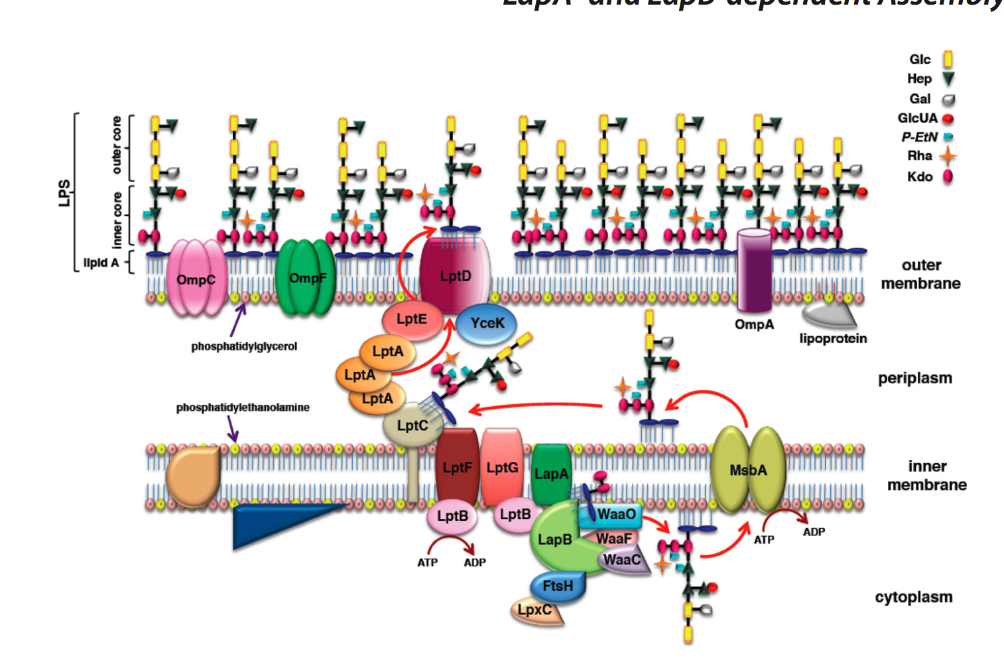
Lipopolysaccharide
Outer membrane of E. Coli
LPS
6 Fatty Acyl Side Chains with many sugars attached
LPS bind together
Provides gel like barrier
Ability to survive a harsh climate
Virulence determinant
Important for therapeutic interventions
Domains: Lipid A, core oligosaccharide, and highly variable O-antigen
Individually very cytotoxic

Slide 3
LPS
Assembled from inner membrane to outer membrane
Synthesis well characterized but not transport
Lipopolysaccharide Assembly Protein A
Lap A
Inner membrane protein
Not functionally determined well
Synonymous with yciS
Notes:
Image from Mahalakshmi et al. 2014
LapB, LptG, LptB, LptF, LpxC, LptC

Slide 4
Experimental Flow
Site Directed Mutagenesis
Gateway Cloning
Co-transformation
Bacterial Two-Hybrid Screening

Slide 5
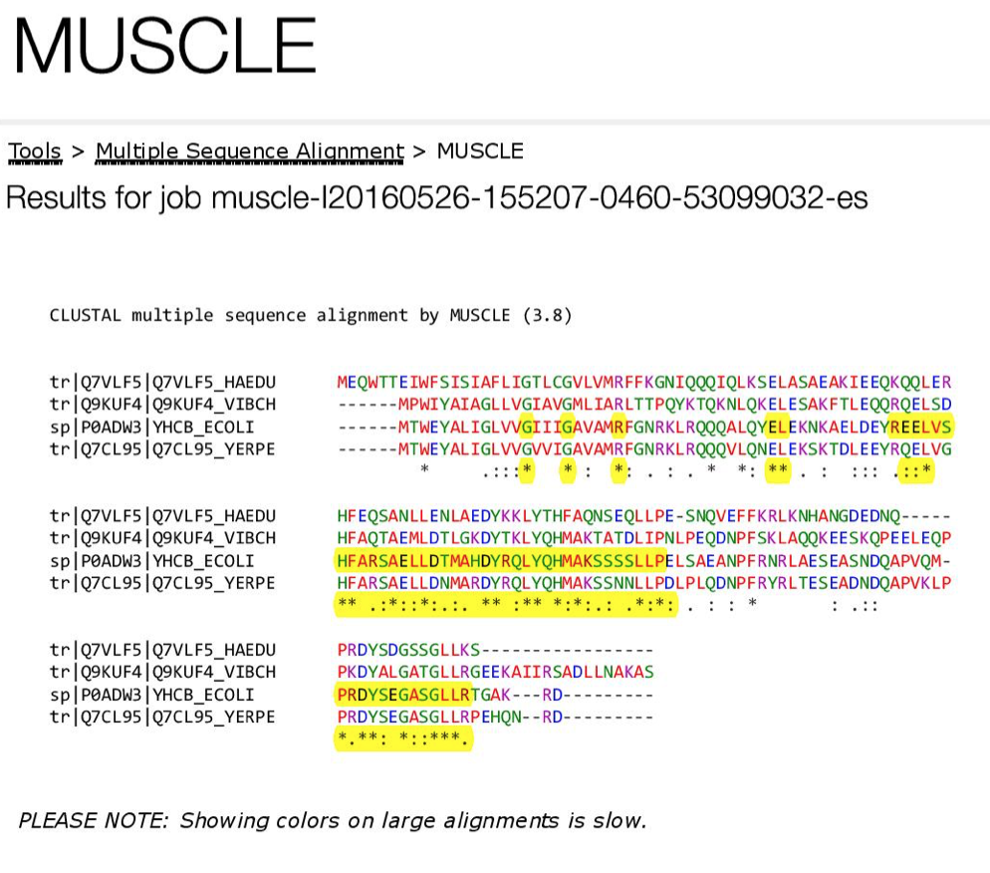
Site Directed Mutagenesis
Mutate particular residues that could possibly cause conformational changes
Based on physical structure

Slide 6
Gateway Cloning
Notes:
https://www.embl.de/pepcore/pepcore_services/cloning/cloning_methods/recombination/gateway/gateway05.gif

Slide 7
Co-Transformation
Notes:
https://www.researchgate.net/profile/Manfred_Auer2/publication/301287796/figure/fig5/AS:362099353112577@1463342621124/Fig-1-Methods-overviewA-Co-transformation-cloning-2-3-The-two-homology-regions.png

Slide 8
Bacterial Two-Hybrid Screening
Notes:
LapB, LptG, LptB, LptF, LpxC, LptC

Slide 9
Discussion
Goal: To determine amino acid residues key to LapA interaction and function
Limitations: Doesn’t give the full picture of the interactions
Troubleshooting will definitely be required
Major Issue: Not getting the transformation or the gene inserted properly to vectors
Future
Better understand the protective mechanism of bacteria
Possibly lead to a target for antibiotic therapy

Slide 10
Questions?

Slide 11
References
Freinkman, E., Chng, S., & Kahne, D. (2011). The complex that inserts lipopolysaccharide into the bacterial outer membrane forms a two-protein plug-and-barrel. Preceedings of the National Academy of Sciences, 108(6), pp. 2486-2491. doi: 10.1073/pnas.1015617108
Frirdich, E., & Whitfield C. (2005). Lipopolysaccharide inner core oligosaccharide structure and outer membrane stability in human pathogens belonging to the Enterobacteriaceae. Journal of Endotoxin Research, 11(3), pp. 133-144. doi: 10.1179/096805105X46592
Gronow, S., & Brade, H. (2001). Lipopolysaccharide biosynthesis: which steps do bacteria need to survive?. Journal of Endotoxin Research, 7(1), pp. 3-22.
Klein, G., Kobylak, N., Lindner, B., Stupak, A., & Raina, S. (2014). Assembly of Lipopolysaccharide in Escherichia coli Requires the Essential LapB Heat Shock Protein. Journal of Biological Chemistry, 289(21), pp. 14829-14853. doi: 10.1074/jbc.M113.539494
Kotra, L.P., Golemi, D., Amro, N.A., Liu, G., Mobashery, S. (1999). Dynamics of Lipopolysaccharide Assembly on the Surface of Escherichia coli. Journal of American Chemical Society, 121(38), pp. 8707-8711. doi: 10.1021/ja991374z
Mahalakshmi, S., Sunayan, M.R., SaiSree, L., & Reddy, M. (2014). yciM is an essential gene required for regulation of lipopolysaccharide synthesis in Escherichia coli. Molecular Microbiology, 91(1), pp. 145-157. doi: 10.1111/mmi.12452
Missiakas, D., Betton, J.M., & Raina, S. (1996). New components of protein folding in extracytoplasmic compartments of Escherichia coli SurA, FkpA, and Skp/OmpH. Molecular Microbiology, 21(4), pp. 871-884. doi: 10.1046/j.1365-2958.1996.561412.x
Polissi, A., & Sperandeo, P. (2014). The Lipopolysaccharide Export Pathway in Escherichia coli: Structure, Organization and Regulated Assembly of the Lpt Machinery. Marine Drugs, 12, pp. 1023-1042. doi: 10.3390/md12021023
Raetz, C.R.H., & Whitfield, C. (2002). Lipopolysaccharide Endotoxins. Annual Review of Biochemistry, 71, pp. 635-700. doi: 10.1146/annurev.biochem.71.1106001.135414
Ruiz, N., Kahna, D., & Silhavy, T.J. (2009). Transport of lipopolysaccharide across the cell envelope: the long road of discovery. Nature Reviews Microbiology, 7(9), pp. 677-683. doi: 10.1038/nrmicro2184
Sampson, B.A., Misra, R., & Benson, S.A. (1989). Identification and Characterization of a New Gene of Escherichia Coli K-12 Involved in Outer Membrane Permeability. Genetics, 122(3), pp. 491-501.

