Slide 1
Comparison of Phenylalanine v. Tyrosine rotamers using 3D modeling software
Sam Portillo
BNFO 300

Slide 2
PDB Statistics¹
Table 1¹

Slide 3
PDB Statistics¹

Slide 4
Ahmed et al (2015) uses “hint!” (hydropathic intactions)
Fig. 1^{4,5}

Slide 6
Ahmed et al (2015) used hint! to analyze 30,000 tyrosines
Fig. 2^{1,4}

Slide 7
Fig. 3⁶

Slide 8
Fig. 2^{4,5}

Slide 9
Clusters found in square a1¹
Fig. 3⁴

Slide 10
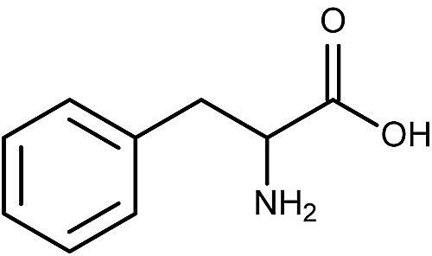
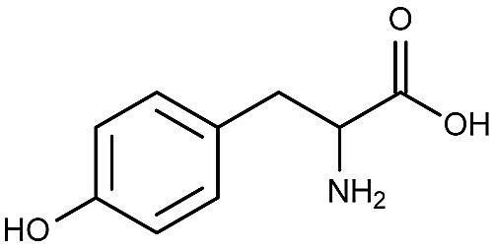
The Experiment
Fig. 4⁷
Phenylalanine
Tyrosine

Slide 11
Fig. 2^{4,5}

Slide 12
Tables 2,3⁴
Residue phi
psi a b c d e f g h N-term
Tyr 1 631 2240 713 46 0 3 5 0 0
2 2 22 13 1 0 13 0 0 1
3 1 24 36 31 2 7 6 0 1
4 6 228 2888 5376 3 21 7 1 6
5 5 700 2449 250 2 85 157 1 2
6 13 345 232 0 1 414 26 0 0
7 20 710 585 21 2 36 8 0 6
8 332 5301 4005 854 1 4 4 0 17
C-term 12 95 55 0 0 3 0 1
Residue phi
psi a b c d e f g h N-term
Phe 1 735 2150 724 44 0 1 0 1 4
2 3 16 19 1 0 8 2 0 1
3 4 42 33 27 11 4 0 1 7
4 6 190 3438 6364 4 5 14 0 16
5 4 679 2410 276 0 81 64 0 9
6 8 375 362 2 0 349 19 0 14
7 31 745 777 18 0 12 1 1 26
8 385 5118 4603 787 1 2 9 2 27
C-term 23 98 76 2 1 6 0 0

Slide 13
Ulmschneider Study
Fig. 5⁸

Slide 14
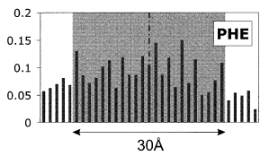
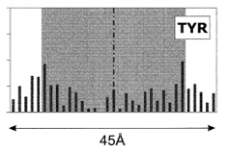
Fig. 6⁸

Slide 15
Best Case Scenario

Slide 16
References
Berman, H. M., Westbrook, J., Feng, Z., Gilliland, G., Bhat, T. N., Weissig, H., … Bourne, P. E. (2000). The Protein Data Bank. Nucleic Acids Research, 28, 235–242. Retrieved from https://www.rcsb.org/pdb/statistics/holdings.do
Salzberg, S. L., Searls, D. B., & Kasif, S. (1998). Grand Challenges in Computational Biology. In Computational Methods in Molecular Biology (pp. 3–10). Elsevier Science B.V. Retrieved from https://app.knovel.com/web/view/khtml/show.v/rcid:kpCMMB0001/cid:kt00BYFA5K/viewerType:khtml/root_slug:1-grand-challenges-in-computational-biology/url_slug:grand-challenges-in-computational?b-toc-cid=kpCMMB0001&b-toc-root-slug=&b-toc-url-slug=grand-challe
Huang P-S, Boyken SE, Baker D. The coming of age of de novo protein design. Nature. 2016;537(7620):320-327. doi:10.1038/nature19946.
Ahmed, M. H., Koparde, V. N., Safo, M. K., Neel Scarsdale, J., & Kellogg, G. E. (2015). 3D interaction homology: The structurally known rotamers of tyrosine derive from a surprisingly limited set of information-rich hydropathic interaction environments described by maps. Proteins: Structure, Function and Bioinformatics, 83(6), 1118–1136. https://doi.org/10.1002/prot.24813
Ramachandran GN, Ramakrishnan C, Sasisekharan V. Stereochemistry of polypeptide chain configurations. J Mol Biol. 1963;7(1):95-99. doi:10.1016/S0022-2836(63)80023-6.
Peptide Bonds and Protein Backbones.
Helmenstine, A. M. (2017). Amino Acid Structures. Retrieved from https://www.thoughtco.com/amino-acid-structures-4054180
Ulmschneider, M. B., & Sansom, M. S. P. (2001). Amino acid distributions in integral membrane protein structures. Biochim Biophys Acta, 1512(1), 1–14. https://doi.org/10.1016/S0005-2736(01)00299-1

