Slide 1
How does CagA in H. pylori contribute to apoptosis in gastric cancer cells?
Angela Michalak

Slide 2
Gastric Cancer
Why should we care?
Notes:
-Gastric cancer is the second leading cause of cancer-related deaths worldwide and it is estimated that 10,960 people will die from gastric cancer this year.
- Cancer in general is caused by either a decrease in apoptosis (cell death) or an increase in cell proliferation.
- In people who do not have cancer, apoptosis will occur which is when cells will trigger a series of events in order to make room for newer cells, eliminate unhealthy cells, or to get rid of unnecessary cells (Apoptosis, 2016). In cancerous cells, apoptosis can be hindered or completely evaded which can lead to uncontrolled cell division

Slide 3
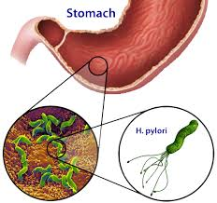
One of the biggest contributors to gastric cancer: Helicobacter pylori
Notes:
H. pylori- a gram negative bacteria with a spiral shape that is grown in the digestive tract.
In most cases it is harmless however, in some cases it has been known to cause diseases such as peptic ulcers and gastric cancer when penetrating the stomach lining.
Is recognized as a group 1 carcinogen

Slide 4
CagA (Cytotoxin- associated gene A) : is injected into the cytoplasm of the host cell
Notes:
There are two strains of H. pylori, CagA-positive and CagA-negative.
When H. pylori CagA positive bacteria come in contact with gastric host cells, CagA is injected into the cytoplasm of the host cell.
CagA is a protein encoded on the Cag pathogenicity island that has been hypothesized by Ohnishi et al to be an oncoprotein, however, researchers do not know exactly how CagA affects apoptosis of gastric cancer cells.

Slide 5
Obtain gastric cancer cell lines (ATCC)
Grow and replicate H. pylori on two separate plates - one plate with CagA positive H. pylori and one with CagA negative H .pylori
Experiment:
Testing: How does CagA in H. pylori contribute to apoptosis in gastric cancer cells?
Gastric Cancer cell lines
Gastric Cancer cell lines
H. pylori- CagA +
H. pylori- CagA -

Slide 6
3. The H. pylori CagA- strain is split into two CagA - strains.
H. pylori-
CagA +
Notes:
Keep in mind that all of the bacteria in H. pylori-CagA- strain are identical, assuming no mutation.
And all of the bacteria H. pylori-CagA+ strain are identical. But the bacteria on these two plates may not be identical. Keep this in the back of your mind as we continue through the experiment.

Slide 7
4. PCR is used to replicate the CagA gene from H. pylori-Cag+ strain
Plasmid
CagA

Slide 8
5. The CagA genes need to be inserted into one of the CagA - cultures. The now CagA + cultures needs to be inserted into the G.C.C lines.
+
gastric cancer cell lines
CagA
Plate 1
Plate 2
gastric cancer cell lines

Slide 9
6. Leave to incubate
G.C.C with H. pylori- Cag +
G.C.C with H. pylori- Cag -

Slide 10
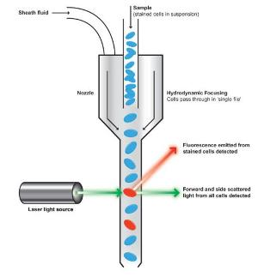
7. Prepare a solution from the G.C.C lines to put through flow cytometer
Notes:
-When cells undergo apoptosis the cells undergo a morphological change that is able to be measured by flow cytometry.
- when performing flow cytometry when light interacts with the cells, light is scattered in both the forward and lateral/side direction. During apoptosis there is an initial increase in side and forward scatter followed by a decrease in forward and side scatter during later stages of apoptosis.

Slide 11
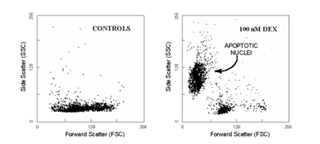
8. Visualize the results from a graph produced from the flow cytometer
Notes:
we then compare the graphs that we get from the CagA - plate and the plate with CagA to determine if CagA has an effect on apoptosis.
We can assume that any change that we visualize between the two plates is due to the CagA since the gastric cancer cell lines are exactly the same and the H. pylori bacteria are exactly the same other than that once contains CagA and one doesn’t

Slide 12
Based on the results, future research will need to be done.

Slide 13
References:

