Slide 1
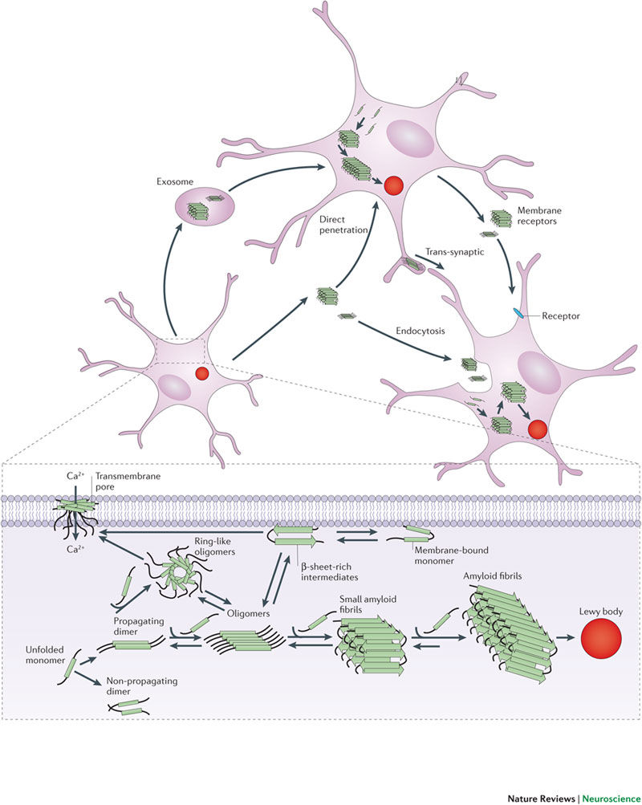
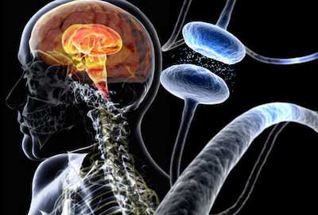
Inhibition of alpha-synuclein using promazine derivatives
Shwetha Kochi

Slide 2
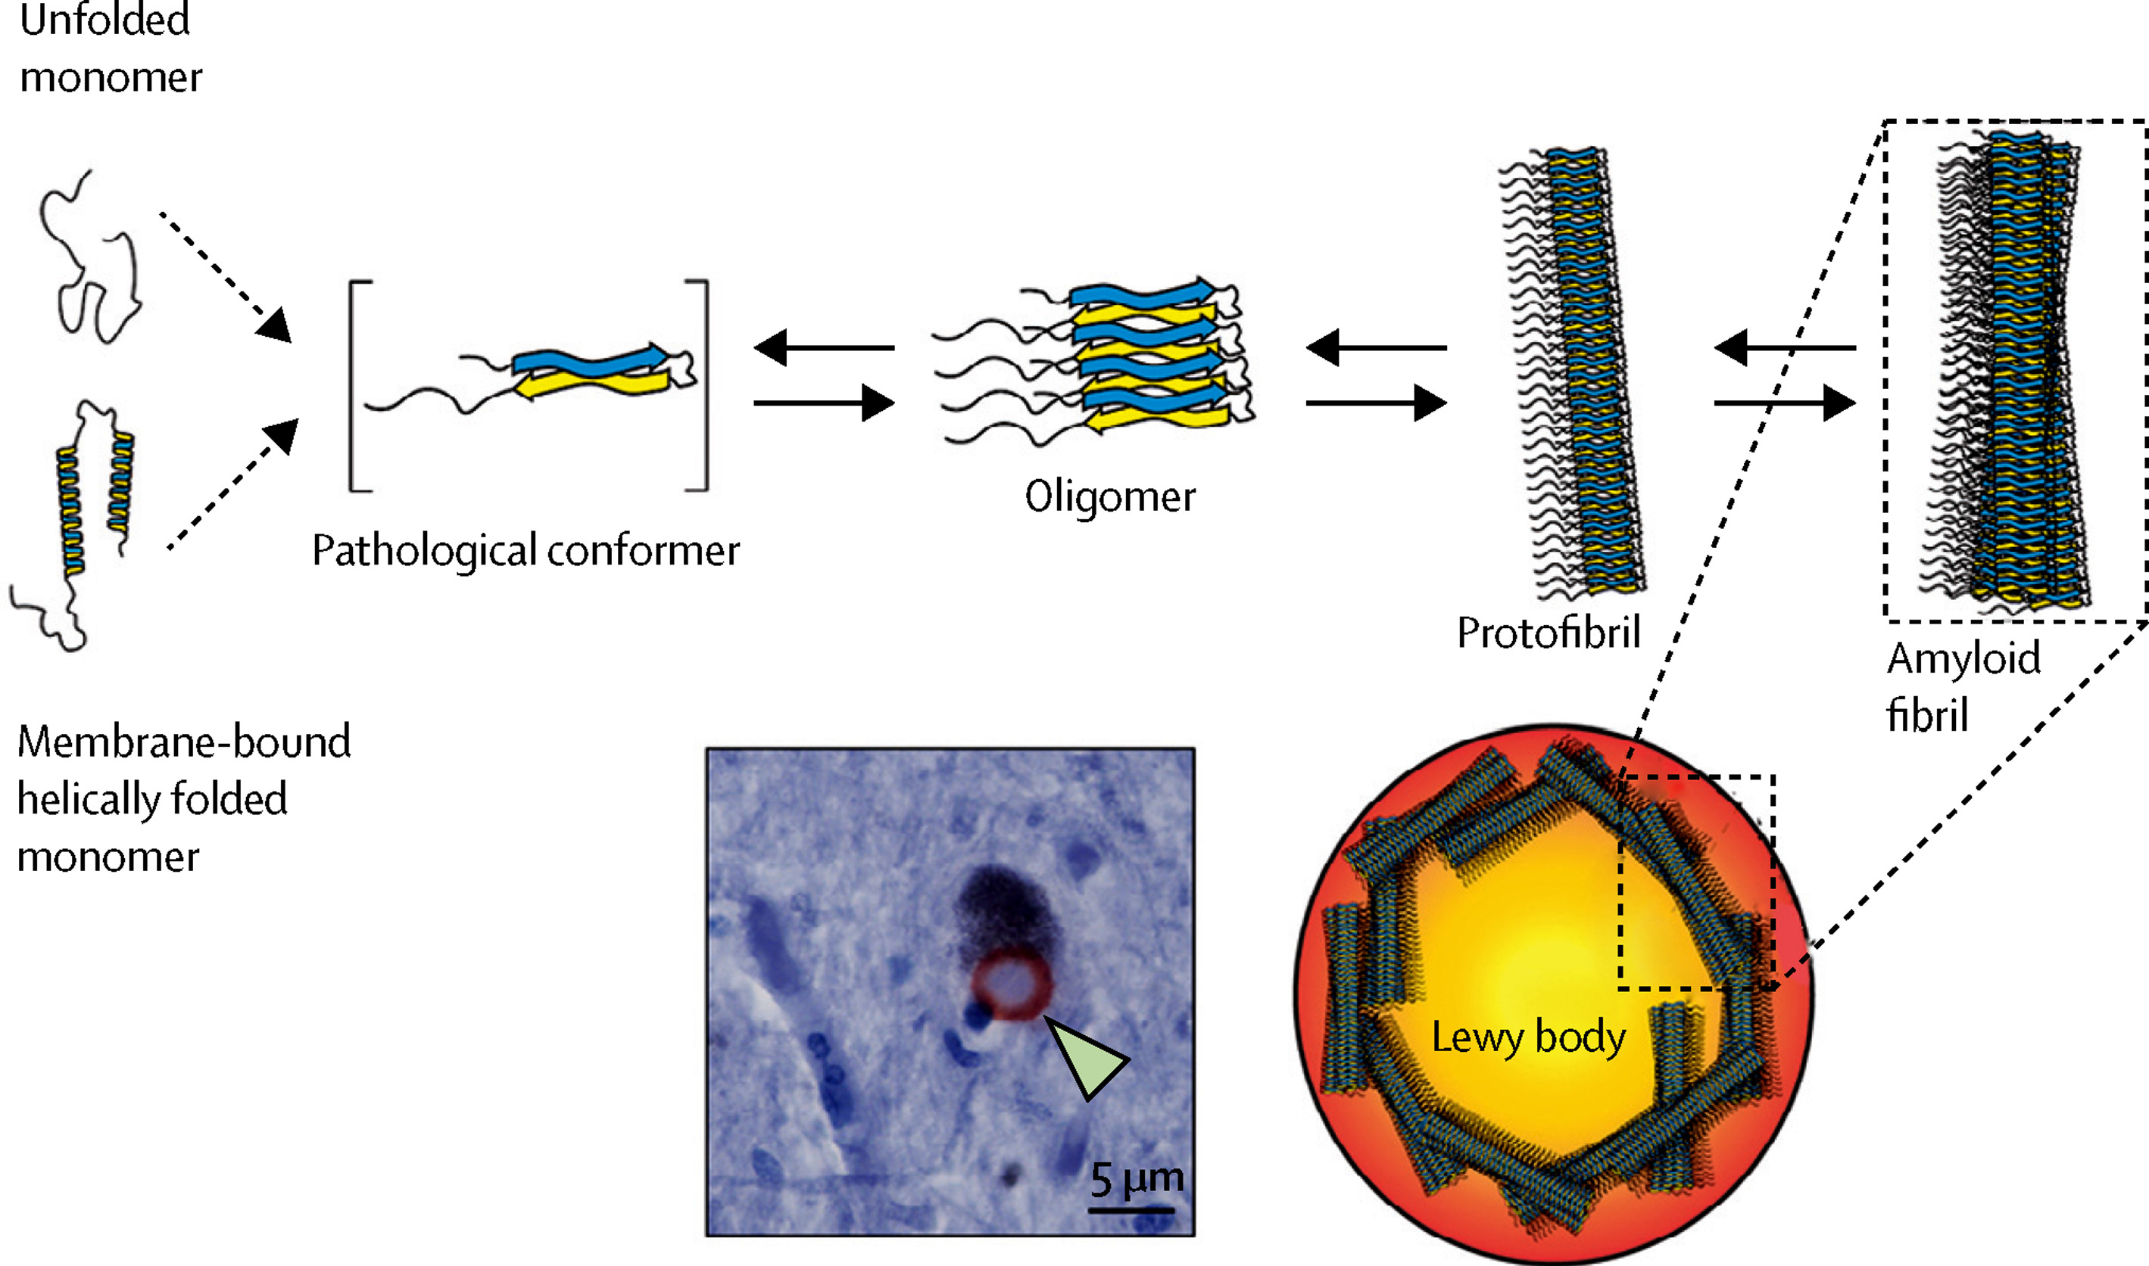
Aggregated Alpha-Synuclein: Key Player of Parkinson’s Disease
Notes:
Conformational change of alpha-synuclein that leads to dysfunction of the protein. Nobody knows why alpha-synuclein misfolds or undergoes this conformational change but these are the two most common theories:
Oxidative stress
Familial parkinson’s disease genetic mutations

Slide 3
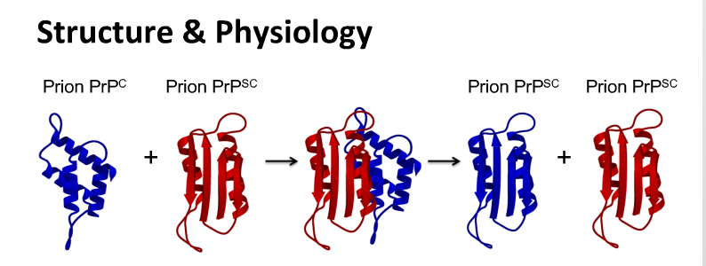
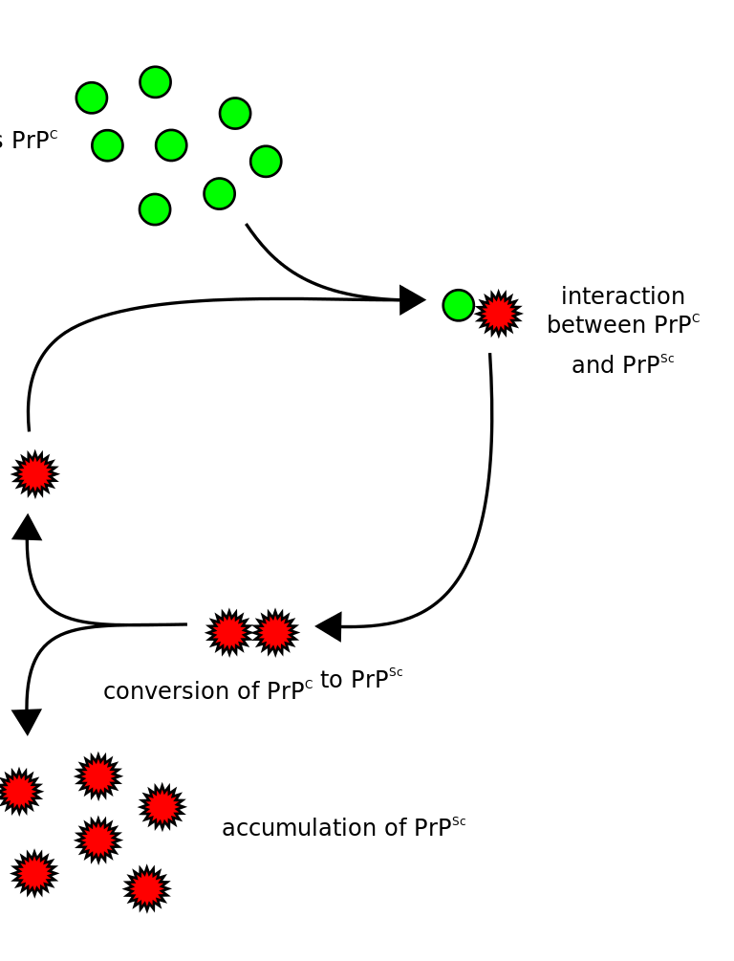
Conformational Change -> Prion Effect
Notes:
After conformational change, prion effect occurs
What is a prion
Most commonly studied prion is PrP^{Sc} due to its appearance in CJD (Creutzfeldt-jakob disease)
Show the structure of PrP^{Sc}
Compare structure of misfolded alpha synuclein with the structure of PrP^{Sc} and explain that PrP^{Sc} has similar biochemical properties of the aggregated alpha-synuclein and undergoes the same misfolding cascade
Both have beta sheets and are formed into amyloid fibrils

Slide 4
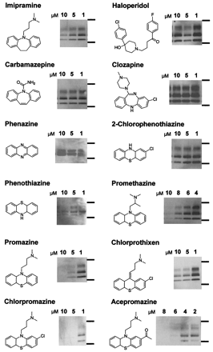
Problem: Aggregation Solution: Inhibition!
Neuroblastoma cells infected with scrapie prions → Cell Culturing
Cells lysed after 80% confluency → Proteinase K digestion
Inhibitors introduced after culturing → Incubation
SDS-PAGE + ECL → Results Shown!
But this was for PrP^{Sc}…How about alpha-synuclein?
Notes:
Many inhibitors have been tested on PrP^{Sc} in hopes of resisting this prion. The three most potent inhibitors that also cross the BBB are from a study (explain the study that was done) are promazine, chlorpromazine, and acepromazine
However, no potent inhibitors that can cross the BBB have been tested on alpha-synuclein.

Slide 5
CENTRAL QUESTION
Will these promazine derivatives that inhibited PrP^{Sc} also inhibit aggregated alpha-synuclein?

Slide 6
Strategy
1: PMCA Cell Line Creation
2: Thioflavin T Assay x2 (beginning of reaction and after 30-min incubation)
3: Proteinase K Digestion
4: SDS-PAGE & ECL
Notes:
Give summary of strategy:
PMCA cell line creation
ThT Assay at the beginning of reaction (to get baseline in which to normalize data)
30-minute incubation
ThT Assay after the 30 minutes (to get quantitative results on inhibition)
PK Digestion (beta sheet rich conformations are resistant to PK digestion)
SDS-PAGE (to get qualitative results on inhibition)

Slide 7
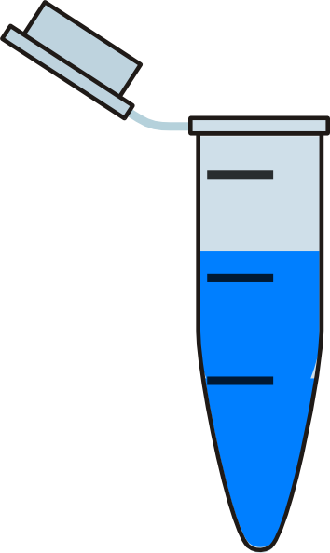
Step 1: Protein Misfolding Cyclic Amplification (PMCA)
4 cycles of:
20 second Sonication
30-minute Incubation
1,2: Promazine Inhibitor + Alpha-Synuclein (2 or 10 μM)
3.4: Chlorpromazine Inhibitor + Alpha-Synuclein (2 or 10 μM)
5,6: Acepromazine Inhibitor + Alpha-Synuclein (2 or 10 μM)
7: Alpha-Synuclein (control)
8: DMSO + Alpha-Synuclein (control)
1
2
3
4
5
6
7
8
Notes:
Step 1: Buy Recombinant Wild-Type Alpha-synuclein cell lines and create PMCA Cell lines so that we can have chronically aggregated alpha-synuclein
Subject recombinant wild type alpha synuclein to repeated cycles of sonication and incubation. First dilute the wild type alpha-synuclein in conversion buffer (triton X, NaCl, Complete Protease Inhibitor Mixture). Transfer 15 aliquots into test tubes. Subject aliquots to 4 cycles of 20 second sonication and 30-min incubation periods. 15 aliquots were prepared because there are five different groups, each in triplicate
Group 1: Promazine inhibitor
Group 2: Chlorpromazine inhibitor
Group 3: Acepromazine inhibitor
Control 1: No inhibitor (Just aggregated alpha-synuclein)
Control 2: Alpha-synuclein w/ DMSO (in order to establish that the DMSO that was used to dilute the inhibitors would not affect the alpha-synuclein)
Before inhibitors were added, they were diluted in DMSO at two different concentrations (2 microMolars and 10 microMolars)
Anti-alpha-synuclein antibodies were also added for future immunoblotting
2 microliters of each inhibitor were added into the respective aliquots created before

Slide 8
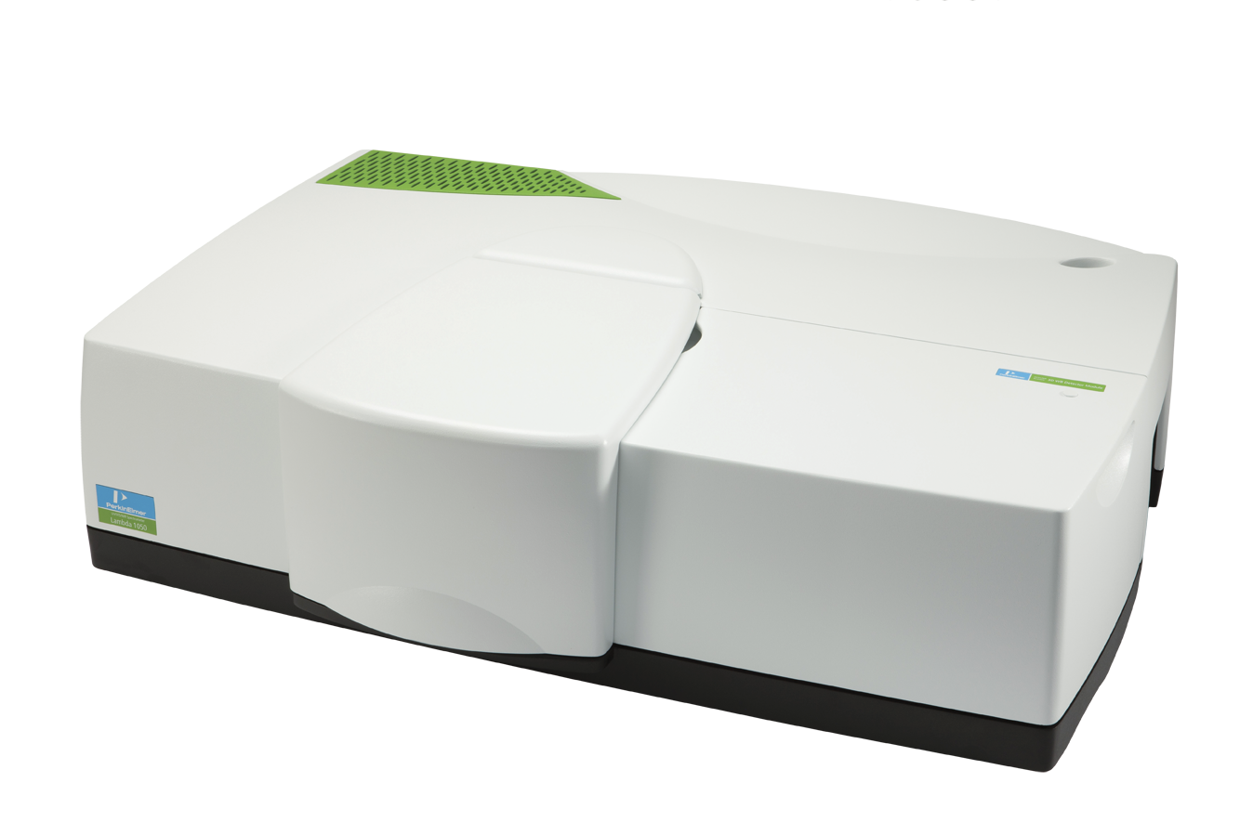
Step 2: Thioflavin T Assay
Thioflavin T → stain that binds to amyloid fibrils and fluoresces with binding (oh wait…alpha-synuclein has amyloid fibrils when aggregated!)
Relationship: Fluorescence = concentration of aggregated alpha-synuclein
Quantitative Measure done twice: at beginning of reaction & after 30-minute incubation
Notes:
Step 2: Thioflavin T Assay – Thioflavin T is a stain that binds preferentially to amyloid fibrils and fluoresces after binding
We can measure the fluorescence of the thioflavin stain in order to get a quantitative measure of alpha synuclein amyloid fibrils
The higher the fluorescence, the more aggregated alpha-synuclein is in the tube
We perform this assay twice: once at the beginning of the reaction when inhibitors have just been added, and once after a 30-minute incubation period.
We perform the assay at the beginning of the reaction in order to get baseline results which we can use to normalize the data
For each sample, we add 5 microliters of the standard ThT solution (more information about the solution can be understood with any ThT Kit that is bought – the most commonly bought kit is through Sigma Aldrich). Fluorescence is measured with a spectrophotometer

Slide 9
Step 3 & 4: Proteinase K Digestion and SDS-PAGE/ECL
Proteinase K Digestion → degrades any contaminant proteins, but is resistant to beta-sheet rich conformations (which is exactly what alpha-synuclein is composed of!)
Reduces chances for artifacts in gel results
SDS-PAGE → separates protein by molecular size, so if we know what the size of alpha-synuclein is (which we do), we can determine if there is any present in the sample
ECL → immunofluorescence, helps detect small amounts of protein with minimal “background” or artifact
Qualitative results that are done to supplement or bolster the quantitative results we collected earlier!
Notes:
Step 3 and 4: PK Digestion and SDS PAGE
Proteinase K digestion is done in order to degrade any contaminant proteins, but is resistant to beta sheet rich conformations. In this way, we are left with just aggregated alpha-synuclein and all the contaminants or inhibitor bound alpha-synuclein can be degraded down. We do this because when inhibitors are added to the alpha-synuclein cell line, we expect them to bind to the aggregated alpha-synuclein and inhibit it from continuing the misfolding cascade. If we take SDS-PAGE gel results without having done PK digestion, we have a high chance of getting artifacts or contaminants in the results, skewing our data, and making it less likely to reach a sound conclusion.
Aliquots of each sample are incubated for 30 minutes in conversion buffer with 100 micrograms/milliliter of proteinase K. Any unwanted enzymatic reactions were terminated by added loading buffer and heating it at 95 degrees Celsius. Samples were loaded onto gels and a molecular mass standard was also added to figure out the sizes of each sample after it has run. The gels were stained with Coomassie Blue and chemiluminescence was induced by ECL reaction. ECL western blotting helps detect small amounts of protein with minimal “background” or artifact. It makes seeing the qualitative results much clearer.

Slide 10
Analysis of Results
CENTRAL QUESTION: Do the promazine derivatives inhibit alpha-synuclein’s aggregation?
Two types of data were collected: Quantitative (% ThT Signal) and Qualitative (SDS-PAGE/ECL)
Two different scenarios can occur: Inhibitors work or the Inhibitors don’t work
Notes:
Explain what the central question is again. Explain how we planned on finding the answer to this question
Remember that the ThT fluorescence signal was the quantitative result and the SDS-PAGE gel was the qualitative result showing the same thing
We want to see that the level of aggregated alpha-synuclein has decreased, or in other words, the inhibitors have successfully bound to the alpha-synuclein, stopping them from continuing the misfolding cascade
This means that we want to see a lower concentration of alpha synuclein than we started with
The results we expect (show a picture of the small inhibition study that was done by the people that created PMCA in order to see if PMCA was sensitive enough for inhibitor studies)
Explain the graphs that are shown and the SDS-PAGE gel results and explain what we want to see assuming all the inhibitors do their jobs
Explains what we would see if they didn’t do their jobs

Slide 11
Problems and Progress
CENTRAL QUESTION: Do the Promazine derivatives inhibit alpha-synuclein aggregation?
Did we answer the question? Think back to the results on the previous slide…
Problems that might occur:
Thioflavin T staining might interact with the alpha-synuclein during the 30-min incubation period
Artifact may present itself in the SDS-PAGE gel results
Progress that can be made:
Mechanism of inhibition
Drug studies using these derivatives as “main ingredients”
Notes:
Synthesis and Discussion
Return back to the central question and see if it was answered
Any problems that might occur
How can we progress from here after we get the answer to this question?

Slide 12
References
Olanow, C. W., & Brundin, P. (2013). Parkinsons Disease and Alpha Synuclein: Is Parkinsons Disease a Prion-Like Disorder? Movement Disorders, 28(1), 31-40. doi:10.1002/mds.25373
Brundin, P., & Melki, R. (2017). Prying into the Prion Hypothesis for Parkinsons Disease. The Journal of Neuroscience, 37(41), 9808-9818. doi:10.1523/jneurosci.1788-16.2017
Prusiner, S. B. (2012). A Unifying Role for Prions in Neurodegenerative Diseases. Science,336(6088), 1511-1513. doi:10.1126/science.1222951
Bartels, T., Choi, J. G., & Selkoe, D. J. (2011). α-Synuclein occurs physiologically as a helically folded tetramer that resists aggregation. Nature,477(7362), 107-110. doi:10.1038/nature10324
Korth, C., May, B. C., Cohen, F. E., & Prusiner, S. B. (2001). Acridine and phenothiazine derivatives as pharmacotherapeutics for prion disease. Proceedings of the National Academy of Sciences,98(17), 9836-9841. doi:10.1073/pnas.161274798
Cornford, E. M., Young, D., & Paxton, J. W. (1992). Comparison of the blood-brain barrier and liver penetration of acridine antitumor drugs. Cancer Chemotherapy and Pharmacology,29(6), 439-444. doi:10.1007/bf00684844
Herva, M. E., Zibaee, S., Fraser, G., Barker, R. A., Goedert, M., & Spillantini, M. G. (2014). Anti-amyloid Compounds Inhibit α-Synuclein Aggregation Induced by Protein Misfolding Cyclic Amplification (PMCA). Journal of Biological Chemistry, 289(17), 11897-11905. doi:10.1074/jbc.m113.542340
Jakes, R., Spillantini, M. G., & Goedert, M. (1994). Identification of two distinct synucleins from human brain. FEBS Letters, 345(1), 27-32. doi:10.1016/0014-5793(94)00395-5

