Slide 1
The Role of G_{αs} and G_{βγ} in Opioid Tolerance and Withdrawal
Shahzeb Hasan
11/28/2017

Slide 2
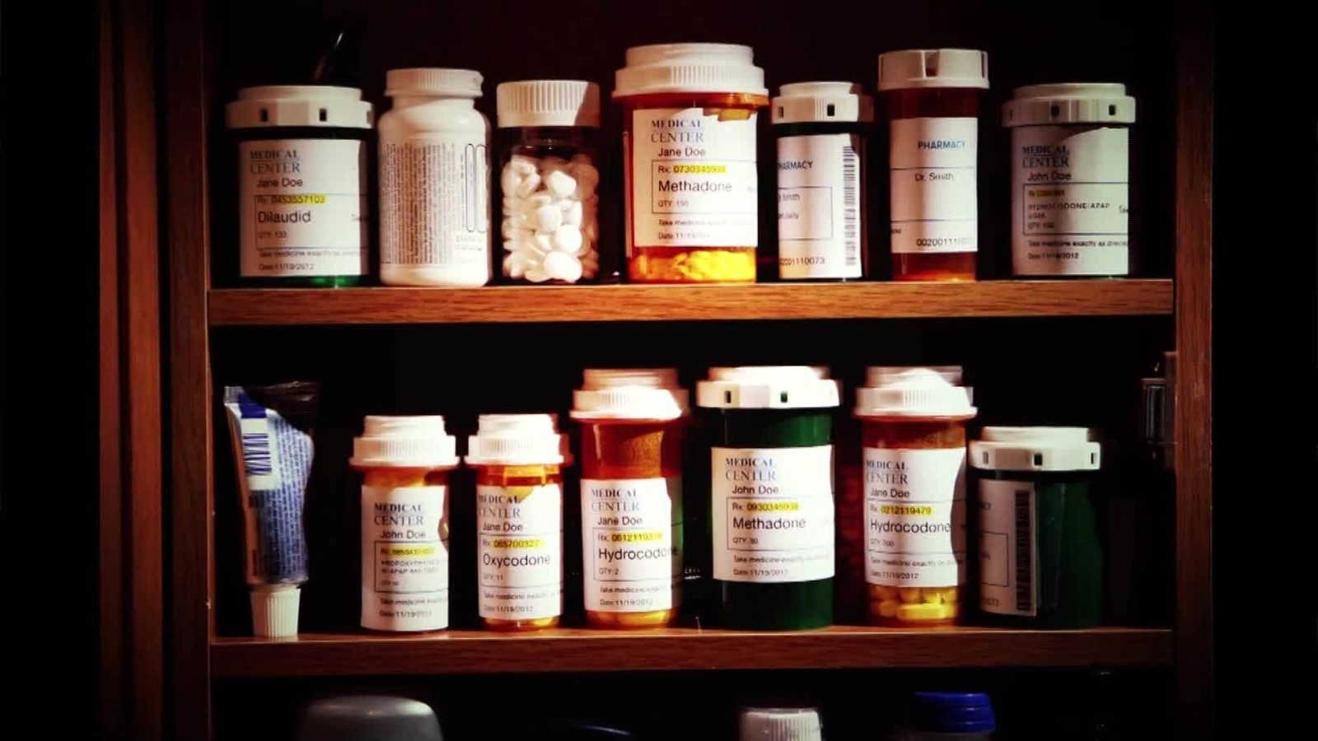
Brief History of Opioids
Cultivated for thousands of years from opium, a gummy substance found in the seed pods of opium poppy flowers to be used for pain relief, euphoria, sedation, and relief from diarrhea.
Main pain reliving medication prescribed in the United States
http://cdn.cnn.com/cnnnext/dam/assets/160505183221-opioids-addiction-orig-nws-00000613-full-169.jpg
Notes:
For millennia, opioids have been used in various forms ranging from opium, morphine, to more recently heroin for their analgesic, euphoric, and sedative effects.
Opioids are now the main pain relieving medication prescribed to those with chronic or severely debilitating pain. Prior to this, opioids were only given to terminally ill cancer patients.

Slide 3
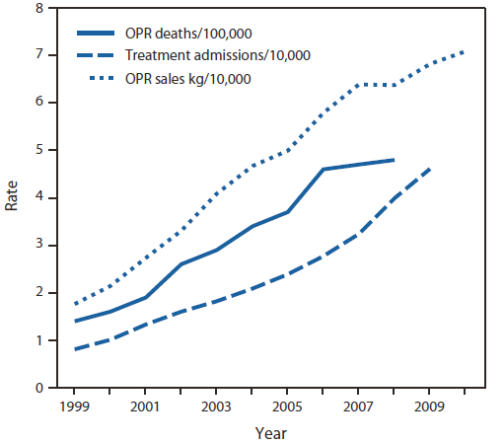
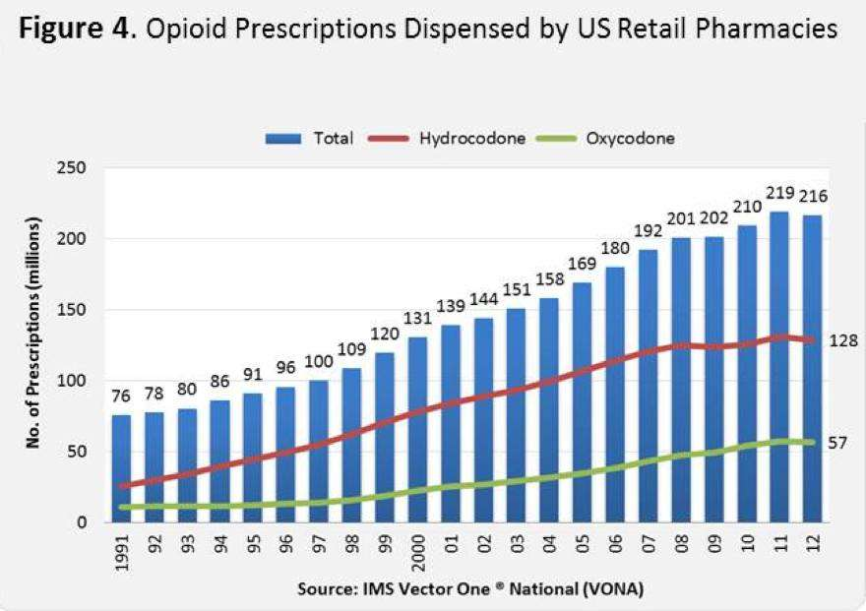
Current Opioid Epidemic
https://www.drugabuse.gov/about-nida/legislative-activities/testimony-to-congress/2015/harnessing-power-science-to-inform-substance-abuse-addiction-policy-practice
https://www.cdc.gov/mmwr/preview/mmwrhtml/mm6043a4.htm
Notes:
The current opioid epidemic in the U.S. has been much discussed both in class and in current events. According to the National Institute on Drug Abuse, drug overdose is now the leading cause of accidental death in the US, with 32,000 of those deaths related to opioids.
US prescription rates have risen 600% from 1997 to 2007 according to the CDC.

Slide 4
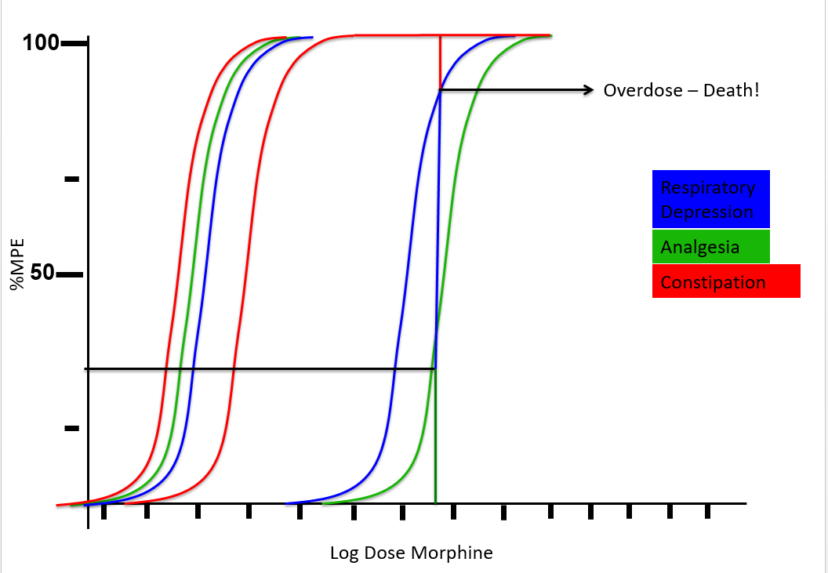
Opioid Tolerance
Notes:
The graph above is %MPE vs Log Dos Morphine showing three effects of opioids and how their tolerance rates build in relation to each other. Constipation builds tolerance the slowest, meaning the constipative effects of opioids are pretty much the same even after weeks of chronic use. Analgesia builds tolerance the fastest, meaning the dose required to get the pain relieving effects increases with chronic morphine use. Respiratory Depression builds tolerance slower than analgesia and is the cause of overdose deaths. Individuals will take high doses of morphine to achieve euphoria and analgesia, but the respiratory depression 100% MPE will be reached first and respiration stops leading to death.

Slide 5
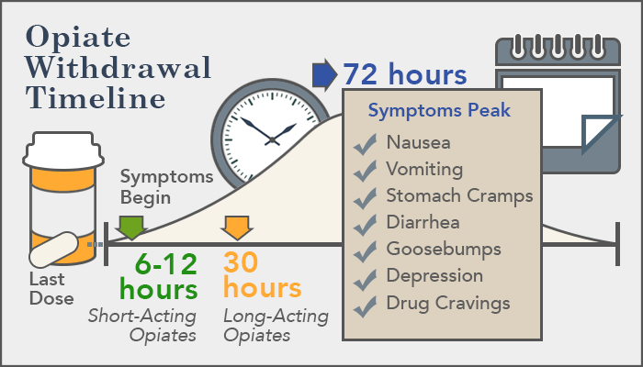
Opioid Withdrawal
Symptoms of Withdrawal
Vomiting
Diarrhea
Sweating
Muscle Aches and Convulsions
Hypersensitivity
Suicidal Ideation
https://americanaddictioncenters.org/withdrawal-timelines-treatments/opiate/
Notes:
Withdrawal symptoms include those listed above and more. Symptoms usually peak 2-3 days after the last opioid dose and subside 7-10 days after the last opioid dose.
The combination of tolerance and withdrawal drive those exposed to opioids to abuse the drug in higher and higher doses. In combination with over prescription, illegal access to opioids, opioid abuse has become a U.S. epidemic.

Slide 6
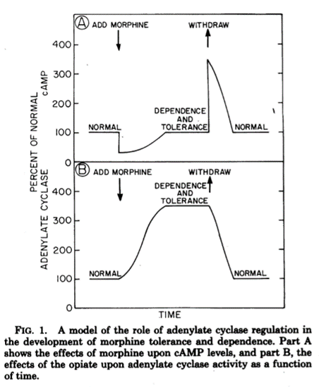
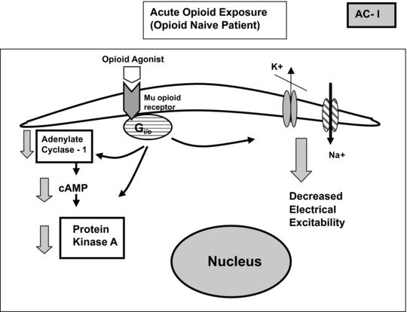
Mechanism of Tolerance and Withdrawal
https://www.cambridge.org/core/books/acute-pain-management/acute-pain-management-in-patients-with-opioid-dependence-and-substance-abuse/F2B1FE2EBB45C17E8E07DD1A4C67731D
Sharma, S K, W A Klee, and M Nirenberg. “Dual Regulation of Adenylate Cyclase Accounts for Narcotic Dependence and Tolerance.” Proceedings of the National Academy of Sciences of the United States of America 72.8 (1975): 3092–3096. Print. https://www.ncbi.nlm.nih.gov/pmc/articles/PMC432926/
Notes:
So how does opioid tolerance build and by what mechanism do opioid withdrawals affect the body?
One of the main expected culprits is the cAMP/PKA pathway. When morphine binds to the mu opioid receptor, the Gi and Go subunits (AC inhibitors) are stimulated leading to inhibition of Adenylate Cyclase and thus a reduction in cAMP levels.
cAMP is a secondary messenger molecule used to activate PKA that is a kinase responsible for many downstream physiological mechanisms. However, over chronic morphine use, cAMP levels return to basal levels and once an antagonist is given or morphine is withdrawn, cAMP levels spike due to AC super activation. This spike in cAMP levels causes the physiological reactions we see as withdrawal symptoms.

Slide 7
Avidor-Reiss et al. 1996
Found that of the Go and Gi subunits (Gα₀, Gα_{i1}, Gα_{i2}, and Gαi₃) only knockout of Go prevented adenylate cyclase inhibition and thus adenylate cyclase super activation.
Notes:
Avidor-Reiss et al. found that the Go subunit from the Galpha subunit family is what actually causes inhibition of AC and was able to prevent AC inhibition and thus AC super activation. He also found that multiple AC types were mediated by multiple unknown mechanisms.

Slide 8
The Role of G_{αs} and G_{βγ} in Opioid Tolerance and Withdrawal
Considering the impact of the Galpha subunit class on Adenylate Cyclase inhibition, how are G_{βγ} and G_{αs} involved in mediating AC super activation after AC has already been inhibited by Go?
Notes:
G betta gamma is a dimeric subunit that when coupled to G alpha s, allows G alpha s to stimulate AC and begin cAMP production.

Slide 9
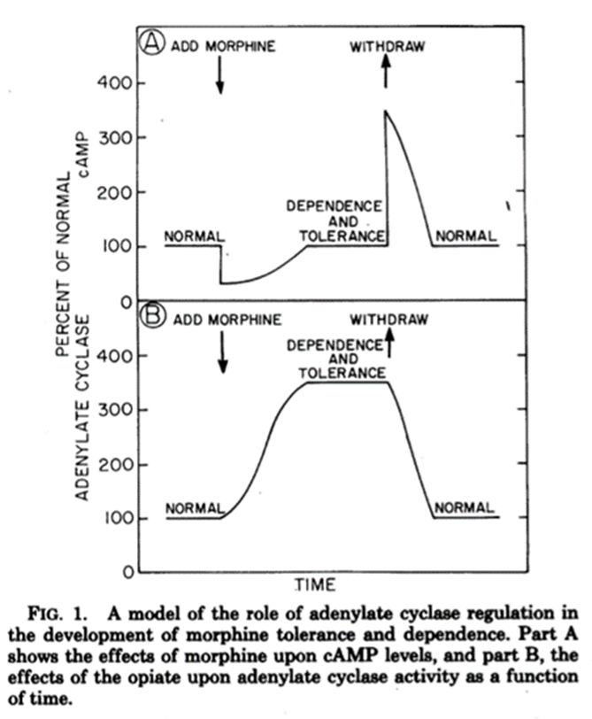
Experiment
Create a culture of G_{βγ} knockout cells similar to Avidor-Reiss and monitor cAMP levels over time to see if adenylate super activation is prevented upon withdrawal.
Control Group – cells exposed to morphine for 48 hours
Experimental Group – G_{βγ} knockout cells exposed to morphine for 48 hours
cAMP levels taken at regular intervals through a cAMP assay
Sharma, S K, W A Klee, and M Nirenberg. “Dual Regulation of Adenylate Cyclase Accounts for Narcotic Dependence and Tolerance.” Proceedings of the National Academy of Sciences of the United States of America 72.8 (1975): 3092–3096. Print. https://www.ncbi.nlm.nih.gov/pmc/articles/PMC432926/
Notes:
The aim of this experiment is to determine if adenylate cyclase super activation is mediated through G_{βγ} stimulation of G_{αs} following chronic opioid use and if inhibition of the G_{βγ} can cause attenuation of tolerance by preventing adenylate super activation and thus cAMP overshoot upon opioid withdrawal.

Slide 10
cAMP Assay
Gilman (1970) cAMP assay uses cAMP-dependent protein kinases to measure cAMP levels. After cAMP is eluted from the centrifuged cell culture, it is added to the assay, where it replaced [H_{3]}cAMP that is binded to cAMP-dependent protein kinases.
The displaced [H_{3]}cAMP is then measured and cross-referenced to a standard curve to find the amount of cAMP that was added from the cell culture.

Slide 11
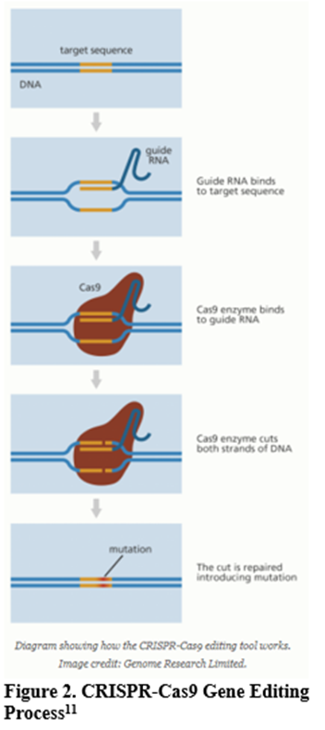
CRISPR/Cas9
The guide RNA is composed of RNA bases that are complementary to those of the target DNA sequence in the genome. Once the guide RNA is bound to the appropriate site, Cas9, an enzyme, splits the double stranded DNA so that the DNA can be edited in order to express an inactive form of G_{βγ.}
Need to target the dimerization gene in order to form inactive G_{βγ}
Notes:
The G_{βγ} knockout will be created the CRISPR/Cas9 genome editing to deactivate the selected G protein subunit, in this case G_{βγ.} This process is outlined in Figure 2. The guide RNA is composed of RNA bases that are complementary to those of the target DNA sequence in the genome. Once the guide RNA is bound to the appropriate site, Cas9, an enzyme, splits the double stranded DNA so that the DNA can be edited in order to express an inactive form of G_{βγ.}

Slide 12
Results and Conclusions
Essentially want to create a cAMP vs time graph that would show whether or not G_{βγ} knockout cells have attenuated adenylate cyclase super activation.
Limitations
Future Uses
Sharma, S K, W A Klee, and M Nirenberg. “Dual Regulation of Adenylate Cyclase Accounts for Narcotic Dependence and Tolerance.” Proceedings of the National Academy of Sciences of the United States of America 72.8 (1975): 3092–3096. Print. https://www.ncbi.nlm.nih.gov/pmc/articles/PMC432926/
Notes:
The G_{βγ} subunit is essential for the formation of heterotrimeric G protein through its association with the G_{α} subunit allowing the G proteins coupling to the GPCR. Therefore, any agent inhibiting the G_{βγ} subunits signaling effects must not interfere with the heterotrimeric G protein formation or G_{α}subunit signaling.
G_{βγ} expression is universal throughout almost all the cells of the body so any agent acting to inhibit this subunit could elicit numerous side effects.
Small molecule inhibitors that target the coupling of G_{βγ} to specific effectors and do not interfere with normal G protein cycling/ heterotrimeric formation, have the potential to work as therapeutic agents in treating some specific diseases.

Slide 13
References
1. National Institute on Drug Abuse. (2015). Drugs of Abuse: Opioids. Bethesda, MD: National Institute on Drug Abuse. Available at http://www.drugabuse.gov/drugs-abuse/opioids.
2. National Institute on Drug Abuse. (2014). Drug Facts: Heroin. Bethesda, MD: National Institute on Drug Abuse. Available at http://www.drugabuse.gov/publications/drugfacts/heroin.
3. Centers for Disease Control and Prevention Grand rounds: Prescription Drug Overdoses: A U.S. Epidemic. http://www.cdc.gov/mmwr/preview/mmwrhtml/mm6101a3.htm
4. Fortuna RJ, Robbins BW, Caiola E, Joynt M, Halterman JS. Prescribing of controlled medications to adolescents and young adults in the United States. Pediatrics. 2010;126(6):1108-1116. https://www.ncbi.nlm.nih.gov/pubmed/21115581
5. Bie, B et al “CAMP-Mediated Mechanisms for Pain Sensitization during Opioid Withdrawal.” Journal of Neuroscience 25.15 (2005): 3824–3832. doi:10.1523/jneurosci.5010-04.2005. https://www.ncbi.nlm.nih.gov/pubmed/15829634
6. U.S. National Library of Medicine: MedlinePlus. (2016). Opiate and Opioid Withdrawal. https://medlineplus.gov/ency/article/000949.htm
7. Sharma, S K, W A Klee, and M Nirenberg. “Dual Regulation of Adenylate Cyclase Accounts for Narcotic Dependence and Tolerance.” Proceedings of the National Academy of Sciences of the United States of America 72.8 (1975): 3092–3096. Print. https://www.ncbi.nlm.nih.gov/pmc/articles/PMC432926/
8. Avidor-Reiss, Tomer, et al. “Chronic Opioid Treatment Induces Adenylyl Cyclase V Superactivation.” Journal of Biological Chemistry, vol. 271, no. 35, 1996, pp. 21309–21315., doi:10.1074/jbc.271.35.21309. https://www.ncbi.nlm.nih.gov/pubmed/8702909
9. Gilman, Alfred G. “A Protein Binding Assay for Adenosine 3′:5′-Cyclic Monophosphate.” Proceedings of the National Academy of Sciences of the United States of America 67.1 (1970): 305–312. Print. https://www.ncbi.nlm.nih.gov/pmc/articles/PMC283204/
10. Feng, Yuan et al. “Current Research on Opioid Receptor Function.” Current Drug Targets 13.2 (2012): 230–246. Print. https://www.ncbi.nlm.nih.gov/pmc/articles/PMC3371376/
11. “What Is CRISPR-Cas9?” YourGenome, The Public Engagement Team at the Wellcome Genome Campus, 19 Dec. 2016, www.yourgenome.org/facts/what-is-crispr-cas9

