Slide 1
Tbx5 Dominant Negative Protein Inhibiting Myocardial Regeneration in Zebrafish
Joshua Fung
BNFO300
12/1/17

Slide 2
Introduction
610,000 people die of cardiovascular disease per year
Possible solution: Heart Regeneration
Zebrafish: one of few organisms that possess this ability
Tbx5: expressed in heart development

Slide 3
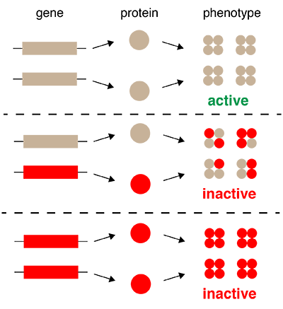
Dominant Negative Mutation
mutation that alters protein so it interferes with function of wild-type protein produced by other allele

Slide 4
Methods
Tbx5 Dominant Negative construction
Transgenic line: Tg(bactin2:loxP-mTagBFP-STOP-loxP-mCherry-2a-EnR-tbx5dn)
CreLox Recombination

Slide 5
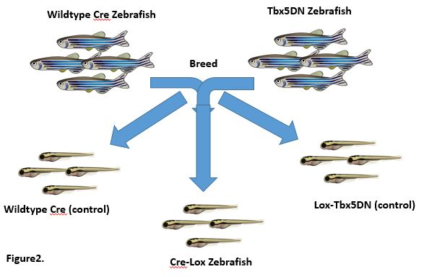
Methods

Slide 6
Cre
Er
Hsp90
Cmlc2 (promoter, regulatory DNA sequences)
restricts the Cre only to the heart
cmlc2
CreEr
4HT
Hsp90
Knocked off by 4HT hormone
(4-hydroxytamoxifen)
Hormone that allows CreEr
to go to nucleus
NUCLEUS
β-actin
STOP
BFP (blue)
mCherry (red)
Tbx5 DN
loxP
loxP
Transgenic line: Tg(bactin2:loxP-mTagBFP-STOP-loxP-mCherry-2a-EnR-tbx5dn)

Slide 7
After cre has removed BFP-STOP cassette
β-actin
mCherry (red)
Tbx5 DN
loxP
BFP (blue)
STOP
loxP

Slide 8
Methods continued
Ventricular resection surgery- surgical injury
Allow for regeneration or scarring
Euthanization- immersion in tricaine
Perfusion- phosphate buffered formalin
Cryosectioning- slide preparation
Acid Fuchsin-Orange G Staining

Slide 9
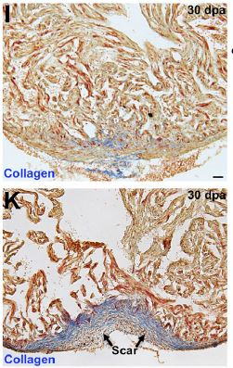
Results
if all goes well, one of two things can happen:
Resected hearts scar or regenerate
- Scarring indicates tbx5DN inhibits regeneration and that tbx5 is necessary
- Successful regeneration indicates that tbx5 is not necessary for heart regeneration
Figure5. Gupta et al, 2013

Slide 10
Synthesis and recap
Expressing tbx5DN vs conditional knockout
If conditional knockout approach was used, which would be the “real” results

