Slide 1
Examining the Role of Diacylglycerol in the Protein Kinase C Pathway in Lipid-Induced Insulin Resistance
By Samhitha Dhandamudy

Slide 2
Goal of Experiment:
To test whether the presence or absence of calcium ions by blocking the calcium ion channel with statin will impact diacylglycerol’s ability to activate the protein kinase C pathway, which will lead to hepatic insulin resistance.
To find insulin resistance by glucose level and insulin levels.
If it does still lead to insulin resistance than anti diabetic drugs must be taken to fight it otherwise statins can be taken to fight insulin resistance.

Slide 3
Type 2 Diabetes
Diabetes is a disease which makes blood sugar levels in the body rise to higher than normal levels.
Diabetes is also called hyperglycemia.
Type 2 Diabetes is the most common type of diabetes and in this type of diabetes, the body does not know how to properly utilize insulin.
Insulin is a hormone produced by the pancreas to regulate blood glucose levels.
The inability to properly utilize insulin is called insulin resistance.
The pancreas is the organ that is responsible for making insulin but overtime, it is unable to keep up and cannot make enough insulin to regulate homeostasis of blood sugar levels.
Obese people are more likely to develop type 2 diabetes.

Slide 4
Insulin Resistance Mechanism
Happens before beta cells start to deteriorate.
Blood sugars rise above normal range.
Creates presence of many free-floating insulin and glucose as amount of insulin receptors on the cell is very low.
This prevents glucose from being absorbed by the cells and causes glucose levels to rise in the bloodstream.
As beta cell dysfunction and insulin resistance become worse, hyperglycemia becomes a bigger problem and that makes type 2 diabetes continue.
Beta cells are responsible for storing and releasing insulin, when glucose levels get too high in the bloodstream, beta cells release insulin to regulate glucose levels in the bloodstream. They secrete insulin while simultaneously producing insulin at the same time.
Elevated plasma free fatty acid levels are responsible for most of the insulin resistance that is there in obese subjects.
An accumulation of DAG molecules is strongly associated with beta cell dysfunction and insulin resistance.
In a study published in 2002, around 32.2% of the population is insulin resistant.
Notes:
Gutch, M., S. Kumar, S. M. Razi, K. K. Gupta and A. Gupta (2015). "Assessment of insulin sensitivity/resistance." Indian journal of endocrinology and metabolism 19(1): 160.
Samuel, V. T. and G. I. Shulman (2012). "Mechanisms for insulin resistance: common threads and missing links." Cell 148(5): 852-871.
Schmitz-Peiffer, C. and T. J. Biden (2008). "Protein kinase C function in muscle, liver, and β-cells and its therapeutic implications for type 2 diabetes." Diabetes 57(7): 1774-1783.
Itani, S. I., N. B. Ruderman, F. Schmieder and G. Boden (2002). "Lipid-induced insulin resistance in human muscle is associated with changes in diacylglycerol, protein kinase C, and IκB-α." Diabetes 51(7): 2005-2011.

Slide 5
Mechanism Figure 1 (Schmitz-Peiffer and Biden 2008)
Notes:
An increase in glucose concentration, increases DAG and that activates PKC which causes insulin resistance.

Slide 6
Steps
1.) Record glucose levels of the mice after the time intervals (15, 30, 60, and 120 minutes) for both groups (experimental and control), then also record down insulin levels after the insulin assay for every interval for both groups (experimental and control)
2.) Inhibit Calcium ion channel with statins in both groups
3.) Then do the in-vitro assay to see relation between DAG and PKC if it is direct cause and effect and measure PKC activation.
5.) Do the HOMA-IR test to check for insulin resistance if PKC gets activated by DAG.

Slide 7
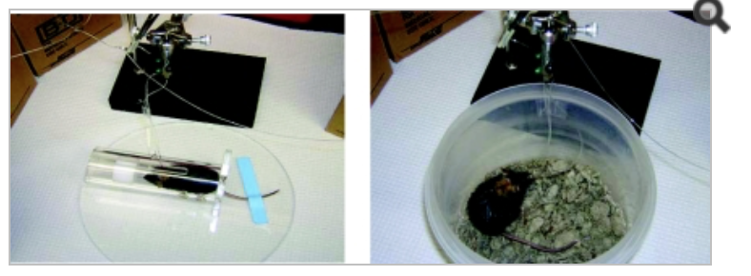
1.) Record glucose levels (mg/dL) of the mice after the time intervals (15, 30, 60, and 120 minutes)
The volume of the injected 20% glucose solution will be calculated by ten times the body weight of the mice in grams.
Do an insulin assay (mIU/L) to measure the levels of insulin and record down the values after the time intervals.

Slide 8
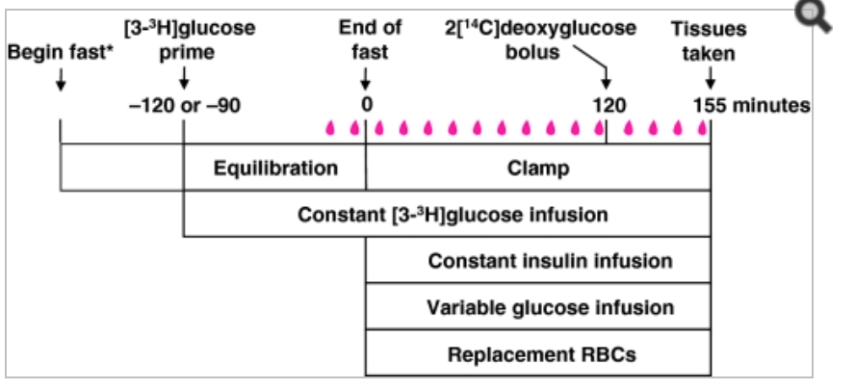

Slide 9
2.) Inhibit Calcium ion release with statins
If PKC gets activated still despite calcium channels being inhibited (experimental) by statins, then euthanize the mice and prepare them for the PKC Assay.

Slide 10
After recording down glucose and insulin levels and inhibiting Calcium ion release…
Euthanize the mice and prepare them for the PKC Assay.
Extract the liver from the mice and submerge them in a buffer solution
Conduct an in vitro assay of the mice liver to see if there is a direct cause and effect relationship between DAG and PKC activation and measure the PKC activation.

Slide 11
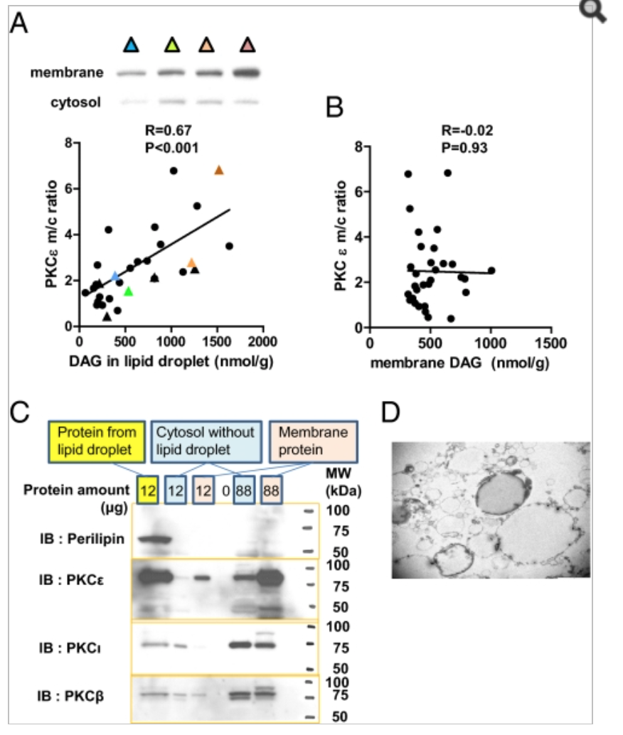
3.) Do the in-vitro assay to see the relation between DAG and PKC if it is direct cause and effect.
Notes:
These graphs show PKC activation which strongly correlates with DAG content in lipid droplets.
Kumashiro, N., Erion, D. M., Zhang, D., Kahn, M., Beddow, S. A., Chu, X., … Shulman, G. I. (2011). Cellular mechanism of insulin resistance in nonalcoholic fatty liver disease. Proceedings of the National Academy of Sciences of the United States of America, 108(39), 16381–16385. http://doi.org/10.1073/pnas.1113359108

Slide 12
Steps
Step 1: Add kinase and ATP; kinase reaction
Step 2: Add phospho-substrate antibody
Step 3: Add secondary antibody-HRP (horseradish peroxidase) conjugate
Step 4: Add TMB Substrate (3,3’,5,5’-Tetramethylbenzidine)
Step 5: Measure absorbance at 450 nm

Slide 13
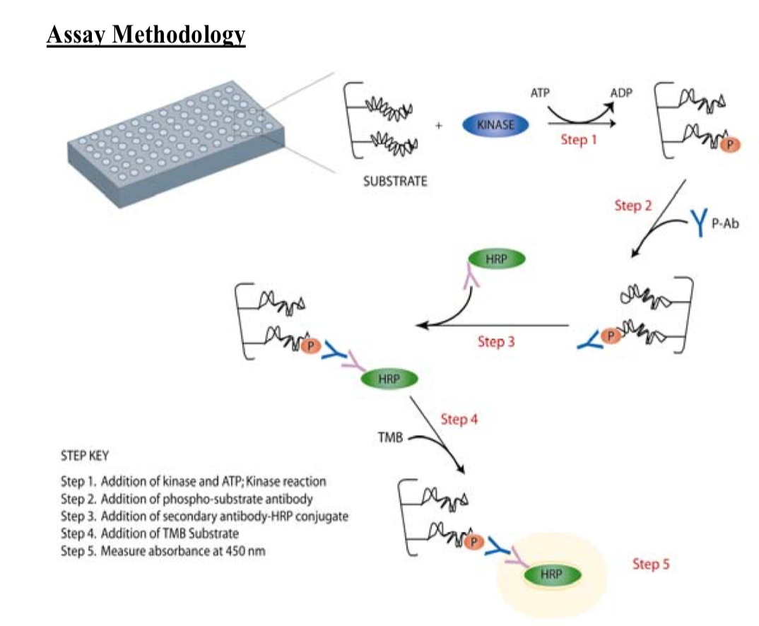
4.) Measure PKC activation through the in vitro assay
Notes:
http://search.cosmobio.co.jp/cosmo_search_p/search_gate2/docs/asd_/eks420a.20090728.pdf
Step 1: Add kinase and ATP; kinase reaction
Step 2: Add phospho-substrate antibody
Step 3: Add secondary antibody-HRP conjugate
Step 4: Add TMB Substrate
Step 5: Measure absorbance at 450 mm

Slide 14
5.) Do HOMA-IR test to check for insulin resistance
Fasting insulin mIU/L x fasting glucose ug/dL divided by 405
The insulin resistance range:
Normal <3
Borderline 3-5
Severe insulin resistance IR >5

Slide 15
References
Kumashiro, N., Erion, D. M., Zhang, D., Kahn, M., Beddow, S. A., Chu, X., … Shulman, G. I. (2011). Cellular mechanism of insulin resistance in nonalcoholic fatty liver disease. Proceedings of the National Academy of Sciences of the United States of America, 108(39), 16381–16385. http://doi.org/10.1073/pnas.1113359108
Gutch, M., S. Kumar, S. M. Razi, K. K. Gupta and A. Gupta (2015). "Assessment of insulin sensitivity/resistance." Indian journal of endocrinology and metabolism 19(1): 160.
Samuel, V. T. and G. I. Shulman (2012). "Mechanisms for insulin resistance: common threads and missing links." Cell 148(5): 852-871.
Schmitz-Peiffer, C. and T. J. Biden (2008). "Protein kinase C function in muscle, liver, and β-cells and its therapeutic implications for type 2 diabetes." Diabetes 57(7): 1774-1783.
Itani, S. I., N. B. Ruderman, F. Schmieder and G. Boden (2002). "Lipid-induced insulin resistance in human muscle is associated with changes in diacylglycerol, protein kinase C, and IκB-α." Diabetes 51(7): 2005-2011.
Yamamoto, T., K. Watanabe, N. Inoue, Y. Nakagawa, N. Ishigaki, T. Matsuzaka, Y. Takeuchi, K. Kobayashi, S. Yatoh and A. Takahashi (2010). "Protein kinase Cbeta mediates hepatic induction of sterol-regulatory element binding protein-1c by insulin." Journal of lipid research 51(7): 1859-1870.
Saini, V. (2010). "Molecular mechanisms of insulin resistance in type 2 diabetes mellitus." World journal of diabetes 1(3): 68.
Perry, R. J., V. T. Samuel, K. F. Petersen and G. I. Shulman (2014). "The role of hepatic lipids in hepatic insulin resistance and type 2 diabetes." Nature 510(7503): 84-91.
Gerich, J. E. (2000). "Insulin resistance is not necessarily an essential component of type 2 diabetes." The Journal of Clinical Endocrinology & Metabolism 85(6): 2113-2115.

