Slide 1
Discovery of possible connection between cln3 and cisd2 gene through notch signaling
Rebecca Culpepper

Slide 2
Genetic Diseases
Mutations
Deadly, Debilitating
CISD2
CLN3

Slide 4
What connects one genes function to another genes function?
Notch Signaling
JNK Signaling
Synthesis of Sphingolipids

Slide 5
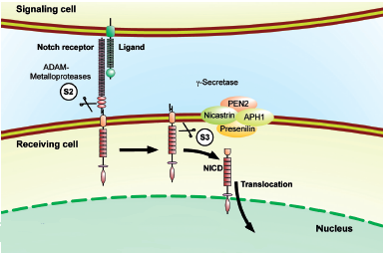
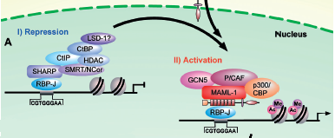
Notch signaling
Refurbished/edited fig 1 graphic from paper Borggrefe, T., & Oswald, F. (2009). The Notch signaling pathway: Transcriptional regulation at Notch target genes. Cellular and Molecular Life Sciences, 66(10), 1631-1646.

Slide 6
How are these genes connected
Is there a connection of CLN3 gene and CISD2 gene through the notch signaling pathway?
CISD2
CLN3
Notch signaling

Slide 7
How are these genes connected
Knockdown CLN3 signaling
CISD2

Slide 8
Gene Manipulation
Gal4-UAS system
Refurbished/edited fig 1 graphic from paper Brand, A.H. and Perrimon, N. (1993). Targeted gene expression as a means of altering cell fates and generating dominate phenotypes. Development, 118, 401-415.

Slide 9
Gene Manipulation
RNAi transgenes
Refurbished/edited fig 1 & fig 3 graphic from paper Pratt, A., & Macrae, I. (2009). The RNA-induced Silencing Complex: A Versatile Gene-silencing Machine. Journal Of Biological Chemistry, 284(27), 17897-17901.

Slide 10
Notch signaling a connection for genes
If phenotype worse, notch part of signal
If phenotype not worse, notch not part of signal
Refurbished/edited fig 3 graphic from paper Jones, M., Amr, S., Ferebee, A., Huynh, P., Rosenfeld, J., Miles, M., . . . Grotewiel, M. (2014). Genetic studies in Drosophila and humans support a model for the concerted function of CISD2, PPT1 and CLN3 in disease. Biology Open, 3(5), 342-52.

Slide 11
Connections between genes
Test different genes with functions to see changes
Understand better the functional connections between genes to add to knowledge about genes and the diseases they cause.

