Slide 1
Do Higher Levels of EPA in C. elegans Affect NPR-1’s regulation of AFT?
By; Oluchi Chigbu

Slide 2
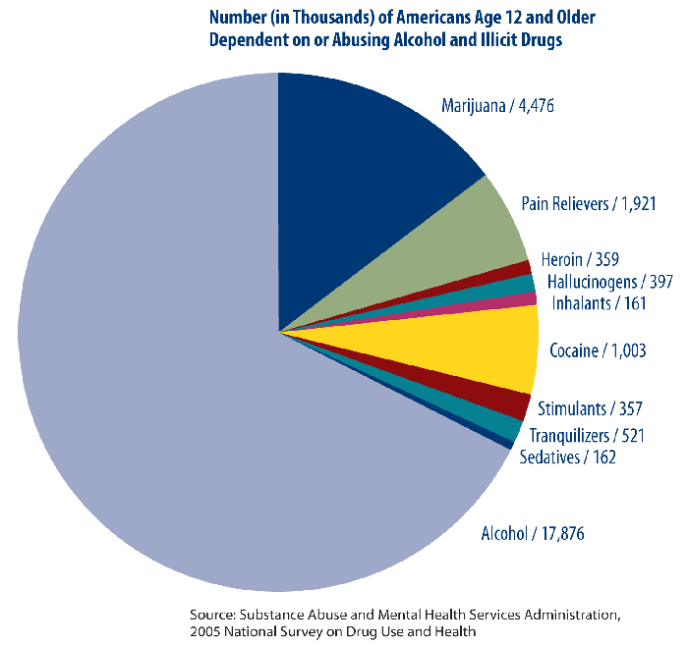
Alcohol Abuse
Notes:
about 17,000 americans abuse alcohol
it would be great if we could understand the mechanisms underlying the development of tolerance to alcohol
the molecular nature of acute response to ethanol is not well known. Lots of research has been conducted on ethanol regulation and the mechanisms involved, but there is still a lot to be discovered.
This proposal is based on research done on C. elegans’s response to alcohol. Because alcohol consumption alters behaviors in C. elegans as it does in mammals.

Slide 3
Acute Functional Tolerance
Notes:
Is thought to be a neuronal response to the depressive effects of alcohol on locomotion.
AFT occurs in C. elegans exactly as depicted in the graph. As the time of exposure increases, locomotion increases. At 10 mins of exposure,
At 30 minutes after exposure, AFT shows up as an increase in locomotion.
In other words, AFT is an adaptation to the presence of alcohol in the system

Slide 4
Eicosapentaenoic Acid
Notes:
EPA is a fatty acid present in C.elegans and mammals that was discovered to be necessary for the development of AFT in C. elegans and is also present in mammals
fat-1 is the gene that encodes the information for the formation of EPA.
The graph above shows the speed of fat-1 mutants which are not able to develop AFT compared with N2 Wild Type C. elegans, which have normal levels of EPA and are able to develop AFT.

Slide 5
NPR-1
NPR-1 is a protein that suppresses the development of ethanol tolerance in C. elegans
Notes:
It was found that at normal levels of NPR-1 in C. elegans, AFT developed at a normal rate. But when higher levels of NPR-1 were intorduced into the worms, NPR-1 suppressed the development of AFT
The graph shows the speed of the animals with higher levels of NPR-1, compared with that of the Wild Type. At the 30 minute time point, the speed of the animals with higher NPR-1 decreased, showing that NPR-1 suppresses the development of AFT

Slide 6
Do EPA and NPR-1 Work Through Each Other?
Normal EPA | No EPA
Wild Type AFT | No AFT
Normal NPR-1 | More NPR-1
Wild Type AFT | Lower AFT
Notes:
What we know so far is that EPA aids in the development of AFT and NPR-1 acts to suppress the development of AFT. These two things have opposing functions relating to tolerance. So through this experiment, I would like to find out if EPA works through or with NPR-1

Slide 7
Experiment
EPA levels
npr-1 mRNA levels
Notes:
For this experiment, a WT strain of C. elegans will be used. Firstly, the worms will be fed dietary supplements of EPA, resulting in the accumulation of greater than WT levels of EPA. To check for a change in NPR-1 function levels, reverse transcription polymerase chain reaction will be used. cDNA will be derived from worms treated with EPA by isolating the mRNA from the npr-1 gene. The cDNA will then be amplified using PCR. The level of npr-1 mRNA will then be observed.
It is expected that higher levels of EPA might produce higher levels of npr-1 mRNA to compensate for the increase in the development of AFT.

Slide 8
Discussion
Notes:
If there is an increase in the levels of npr-1 mRNA as predicted, we can make the observation that EPA does act through NPR-1, and as the development of AFT increases, so does the level of NPR-1
However, if the levels of npr-1 mRNA remain unchanged, we can make the observation that these two mechanisms of ethanol tolerance are independent of each other.

