Slide 1
Disruption of NDEL1 via knockout of DISC1 stunts dendritic spine formation in hippocampal region of mice
Amanda Atrash
Notes:
.5 s

Slide 2
Notes:
Schizophrenia - 1% of population, about 2.2 million people, costs the state upwards of $62 billion/year bc of homelessness, violence, and suicide
Symptopms: positive, negative, cognitive
Drug therapy: only benefits positive and does very little for neg and cognitive symp. Which predict poor prognosis
The limitations of the presently available drugs underscore the need for identification of new antipsychotic compounds aiming at new molecular targets.
30s

Slide 3
DISC1 NDEL1
Disrupted-In-Schizophrenia-1
Protein
Gene susceptibility for mental disorders
Interacts with a variety of proteins
Nuclear Distribution Element-like 1
Protein
Involved in neuroplasticity
Relationship with DISC1
Notes:
Disrupted-in-Schizophrenia-1, a gene-encoding protein
genetic risk factor across a spectrum of psychiatric disorders.
DISC1 binding a number of other proteins together, one of which being NDEL1
Recent studies have suggested a link between DISC1 genotypes and elements of neurocognitive function
NDEL1 is a centrosomal protein that is involved in mitosis + neuroplasticity,
Neural plasticity refers to the brain’s ability to make changes to itself throughout its lifetime.
A recent study has demonstrated that NDEL1 expression is decreased in the hippocampus region of those suffering with schizophrenia
Neural plasticity causes cognitive symptoms
As well, an intact NDEL1-DISC1 interaction has been shown to be critical to multiple developmental processes such as neural outgrowth - again outgrowth
Both of these aspects suggest the importance of NDEL1 and DISC1 in understanding a new aspect and relationship in schizophrenia.
Overview Method of experiment (~20-30s)

Slide 4
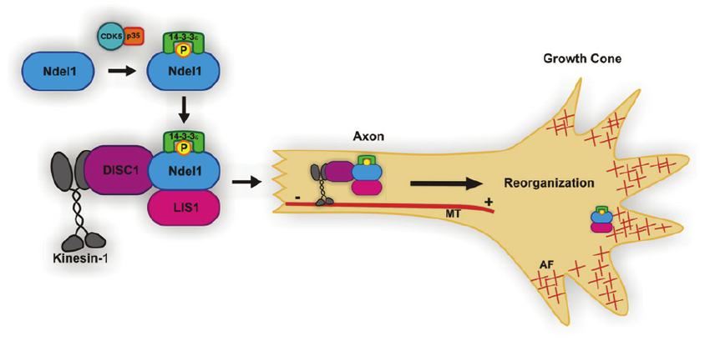
NDEL1 + DISC1 binding
https://www.researchgate.net/figure/228447593_fig1_Figure-1-The-Ndel1Lis114-3-3-e-Protein-Complex-for-Neurite-Outgrowth-14-3-3-e-binds
Notes:
As well, an intact NDEL1-DISC1 interaction has been shown to be critical to multiple developmental processes such as neural outgrowth - again outgrowth
Dendrite formation
Dednritic spines - receive inputs from the cell, important in memory and learning
serve as a storage site for synaptic strength and help transmit electrical signals to the neuron's cell body.

Slide 5
How does knockout of DISC1 disrupt NDEL1?
Does this knockdown create schizophrenic-like symptoms?
Notes:
Disruption of DISC1 via knockout of NDEL1 stunts spine formation in the hippocampus region of mice

Slide 6
Overview of Experiment
Knockout DISC1
Inject experimental mixture into embryonic mice
Compare results of dendritic spine formation between experimental and control group

Slide 7
Are proteins bound together?

Slide 8
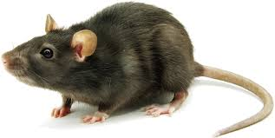
Incubated
anti-DISC1 antibody [EPR14684] (ab192258)
Adult mice
Hippocampus - solubilized with a buffer
Molecular level:
Incubate anti-DISC1 antibody [EPR14684] (ab192258)
w/ protein beads
Protein beads
DISC1
DISC1
antibody
NDEL1
NDEL1
Notes:
Co-IP works by selecting an antibody that targets a known protein that is believed to be a member of a larger complex of proteins. By targeting this known member with an antibody it may become possible to pull the entire protein complex out of solution and thereby identify unknown members of the complex.
Polyclonal Antibodies - secreted by multiple beta-cells
Large quantities of polyclonal antibody are relatively quick and inexpensive to produce compared to monoclonal antibodies. They are non specific in that they are capable of recognising multiple epitopes on any one antigen. This capability provides many advantages:
Can help to increase the signal produced by the target protein as the antibody will bind to more than one epitope
Less sensitive to antigen changes than monoclonal antibodies
Useful when the nature of the antigen is unknown
More robust detection due to multiple epitopes
Monoclonal Antibodies- single beta cell
Hybridomas provide an immortal cell line with the ability to produce unlimited quantities of highly specific antibodies
All batches will be identical and specific to just one epitope a particular advantage when manufacturing procedures must be standardised e.g. clinical tests and therapeutic treatments
The high specificity of monoclonal antibodies decreases background noise and cross-reactivity, helps provide reproducible results and ensures efficiency in affinity purification
In the following experiment, similar anti-body tags will be used for the proteins: DISC1 and NDEL1. In Kayima et al. (2006), the antibodies used against DISC1 were raised in rabbits against amino acids 360-374 of rodent DISC1 and affinity-purified. The antibody for DISC1, then, would be rabbit polyclonal anti-DISC1 antibody and the antibody for NDEL1 is mouse monoclonal antibody, clone OTI1G10. Both of these can be purchased online for the purposes of this experiment. For this experiment, this would first occur in tissue cells, starting with anti-HA and anti-Myc antibodies then done again in the mouse brain with anti-DISC1 and anti-NDEL1 antibodies.

Slide 9
Process of Immunoprecipitation, https://goo.gl/images/R0BoLG
Notes:
Want to talk about protein A/G beads here

Slide 10
2. SDS-Page
3. Transfer of gel to begin probing
Extraction of proteins - washing the precipitate
Filter Papers/ Sponge
GEL
MEMBRANE
4. Probing
Filter Papers/Sponge
Western Blotting
Notes:
electroelution or electrophoretic transfer because of its speed and transfer efficiency
Electrophoretic transfer of proteins involves placing a protein-containing polyacrylamide gel in direct contact with a piece of nitrocellulose or other suitable, protein-binding support and "sandwiching" this between two electrodes submerged in a conducting solution. The process involves the use of porous pads and filter paper to facilitate the transfer. When an electric field is applied, the proteins move out of the polyacrylamide gel and onto the surface of the membrane, where the proteins become tightly attached. The result is a membrane with a copy of the protein pattern that was originally in the polyacrylamide gel.
Membrane is easier to use

Slide 11
4i. Probing - Blocking
4ii. Probing - Primary Antibody
4iii. Probing - Secondary Antibody
MEMBRANE
MEMBRANE
MEMBRANE
Enzyme
Secondary antibody
Primary antibody
Take to the dark room, take a picture
Western Blotting
Notes:
Blocking - using dry milk and some detergant
Primary - will directly bind to the target protein, but it will not show us the result - not a reporter!
Secondary - acts as a reporter
Enzyme - will generate light as a byproduct
Tells us where the target protein is present in the picture of SDS page

Slide 12
Knockout DISC1
Problems

Slide 13
DISC1
LBD
Non-functional protein
Tamoxifen metabolizes
LBD
tamoxifen
DISC1
Functional protein that is expressed in the cells
Knockout of DISC1

Slide 14
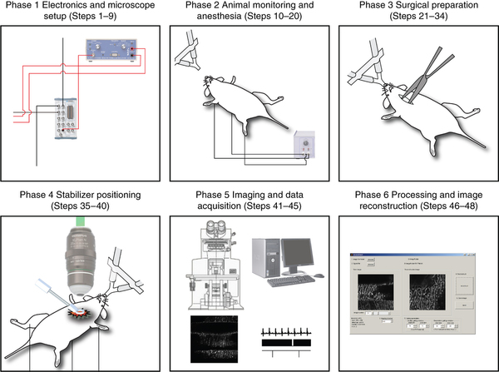
Confocal Imaging
Vinegoni et al. (2015)
Notes:
Slice the region of the brain
Randomly pick neurons
Use a program to then analyze
Use a confocal microscope for images

Slide 15
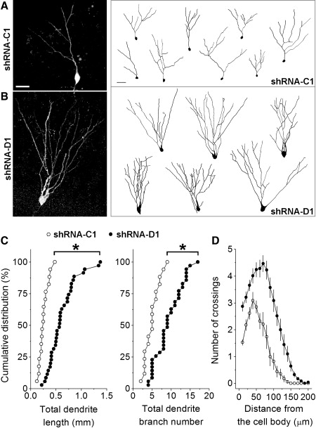
Golden et al. (2013), results
Notes:
Dendrite formation
Dednritic spines - receive inputs from the cell, important in memory and learning
serve as a storage site for synaptic strength and help transmit electrical signals to the neuron's cell body.

Slide 16
Spine Formation → Schizophrenia Drug Treatment
Notes:
Should the results be positive, then it were to suggest that targetting this interaction and making sure it stays intact could help treat schizophrenic symptoms

Slide 17
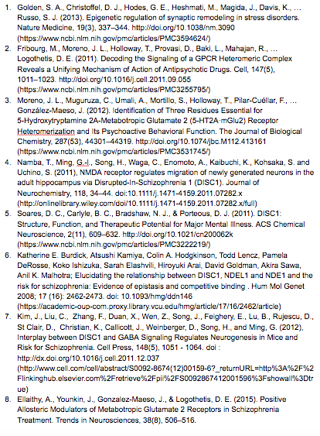
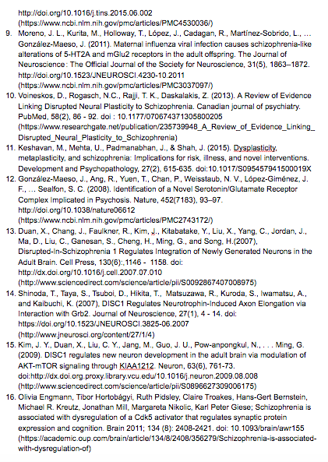
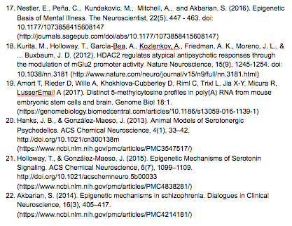
References

