Slide 1
AEG-1 alters methylation status of IGFBP7 promoter via activation of the Wnt/β-catenin signaling pathway in HCC
Ayshah Asmat

Slide 2
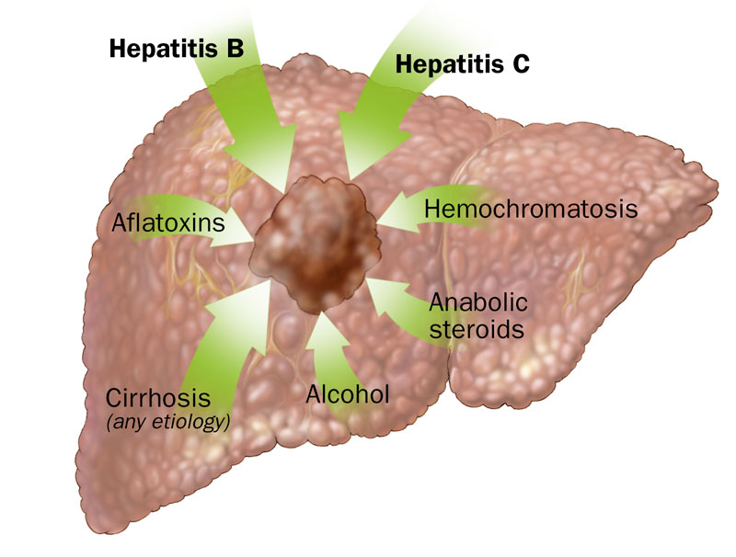
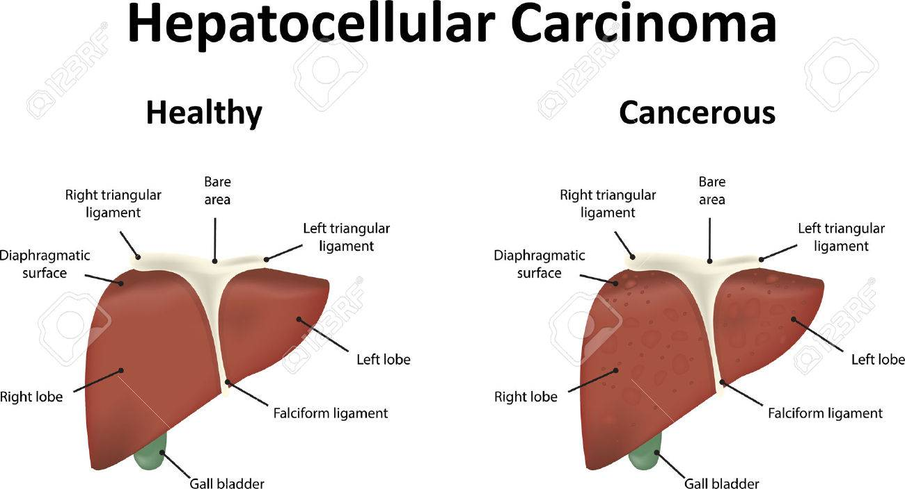
Hepatocellular Carcinoma
A common malignancy of the liver
Treatment Options – Surgery?
What other options are there?...
Notes:
HCC is a common malignancy of the liver and is now the third leading cause of cancer deaths worldwide, with over 500,000 people affected. In most cases, liver cancer can lead to long-term damage and cirrhosis (scarring of liver and poor liver function). Common causes of HCC are Hepatitis B or C and alcohol abuse. Hep B/C are irritation and swelling of the liver due to their corresponding viruses.
Treatments:
Surgery is an option, but less than one-third of patients qualify as surgical candidates’ due to various limiting factors, such as severe
impairment of reserve hepatic function, bilobar tumor distribution and extrahepatic (originating outside of the liver) metastasis (spreads to different part of body than where it started).

Slide 3
Insulin-growth factor binding protein-7
A secreted protein
IGF axis has major roles in growth, differentiation, and proliferation
Consists of two growth factors - IGF-I and IGF-II (and corresponding receptors)
Chen et al. 2013 – Showed potential tumor suppressive activity and downregulation by the oncogene AEG-1
Notes:
Chen et al. 2013 showed IGFBP7 has potential tumor suppressive activity; downregulation of IGFBP7 as the tumor progresses.
Although this possible tumor suppressor exists, the malignancy of HCC continues due to the presence of astrocyte elevated gene-1 (AEG1) which acts as an oncogene and helps with progression and development of HCC.

Slide 4
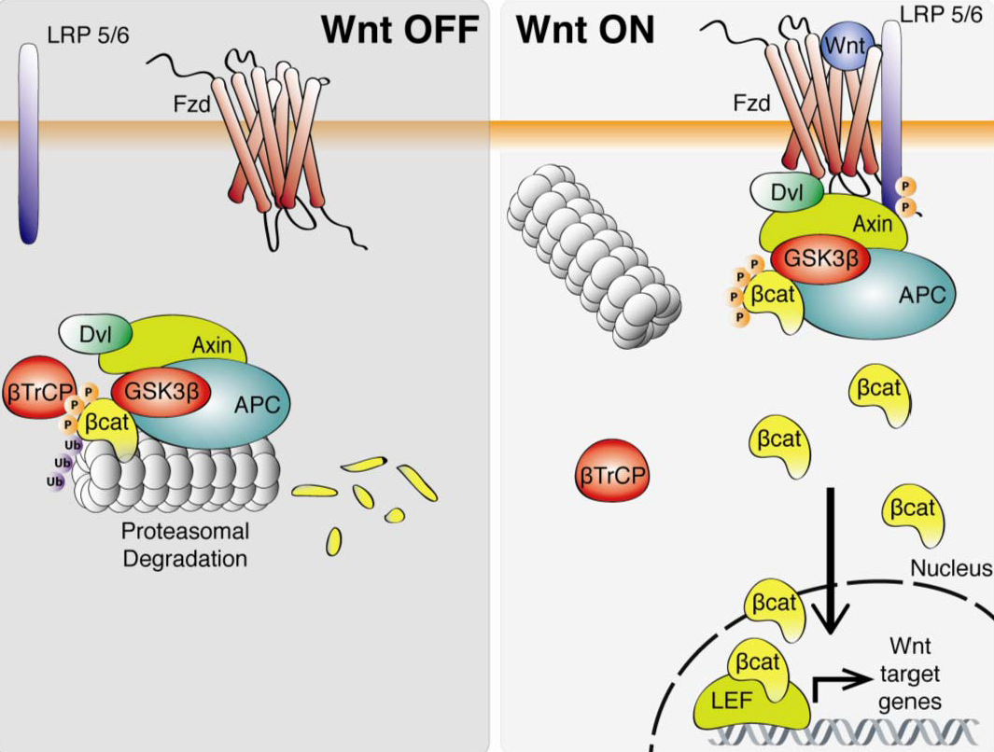
aSTROCYTE-elEVATED gENE-1
Oncogene
AEG-1 overexpression can be accounted for by?
Multiple pathways, such as the Wnt/β-catenin signaling pathway
Notes:
AEG-1 helps with the progression of HCC.
Previous studies demonstrate that AEG1 was significantly overexpressed in various malignant cells and plays a major role in tumorigenesis, proliferation, invasion and metastasis.
This oncogene is located on chromosome 8q22 and this region is intensified among multiple cancers, including HCC; also, nearly 90% of HCC patients display the overexpression of this oncogene.
The overexpression of AEG1 can be accounted for due to a number of pathways, including MAPK, P13K/Akt/mTOR pathway, NF –kB pathway, and the Wnt/β-catenin signaling pathway. These pathways can be used in studying different types of HCC.
Focus on the Wnt signaling pathway for its close association with various processes involved in tumor development, proliferation and invasion.
- The Wnt signaling pathway affects the activated site of multiple downstream effector molecules. β-catenin is the main downstream effector of this signaling pathway. When the pathway is activated, β-catenin accumulates in the cytosol at high levels, binds to enhancer factors, and shifted to the nucleus. Once in the nucleus, it induces expression of target genes. The high level of β-catenin in the nucleus acts as an indicator of an active Wnt signaling pathway.

Slide 5
Experiment
Evaluate if AEG1 overexpression causes for decreased expression of IGFBP7 in HCC
Notes:
In order to determine if AEG1 will activate the Wnt/ β-catenin signaling pathway while downregulating IGFBP7 in human HCC, an in vitro experiment focused on effects of AEG-1 silencing will be performed.
HCC cell lines will be grown, maintained, and separated into two different experimental groups.
- The first group will be the Lenti-AEG-1, consisting of Lenti-AEG-1 infected cells, and the second group will be the Lenti-control-infected cells

Slide 6
Step 1: Cell Culture and Colony-Formation
Will use HCC cells
Check viability through MTT Assay
Divided into two groups - Lenti-AEG-1 group and Lenti-control group
AEG-1 targeted by sequence of short-hairpin RNA (shRNA) containing the lenti-viral vector
‘5’-AACTTACAACCGCATCATT-3’
Notes:
Primary rat hepatocytes will be isolated and cultured. SNU-423 HCC cells will be obtained from ATCC and used for this experiment.
- MTT assay will be done in order to act as an indicator of cellular metabolic activity. The assay depends on the reduction of MTT, a yellow water-soluble tetrazolium dye via mitochondrial dehydrogenases, into purple formazan crystals. The product of formazan crystals can be measured spectrophotometrically at 550nm after its dissolution in DMSO. DMSO gives an approximation of the extent of toxicity to the cells
- The HCC cell lines will be supplemented with 10% fetal bovine serum (FBS) due to its high content of growth factors, along with antibodies, 100 IU/mL penicillin, and 100mg/mL streptomycin, in 5% CO₂ at 37˚C.

Slide 7
STEP 2: Methylation-Specific Polymerase Chain Reaction (MS-PCR) and Bisulfite Genomic Sequencing (BGS)
Genomic DNA will be isolated from HCC cell lines
Applied to bisulfite conversion
MS-PCR
Analyze DNA methylation patterns in CpG islands
BGS
Determine pattern of methylation
PCR products will be visualized
Notes:
The genomic DNA will be isolated from the HCC cell lines. Two micrograms of the genomic DNA will be applied to bisulfite conversion and purified by EpiTect Fast Bisulfite Conversion Kit (QIAGEN). The kit will allow for the conversion of unmethylated cytosine to uracil.
MS-PCR and bisulfite genomic sequencing (BGS) will be performed. A total of 80 ng of bisulfite-modified DNA will be used in Methylation-Specific PCR (MS-PCR) and bisulfite genomic sequencing (BGS).
MS-PCR allows for the analysis of DNA methylation patterns in CpG islands.
CpG islands are focused on the regulation of gene expression in mammalian cells, and the excess methylation of CpG dinucleotides in a promoter represses gene expression. In cancers, gene silencing is occurred through methylation in the promoter of tumor suppressor genes.
BGS uses bisulfite treatment of DNA in order to determine the pattern of methylation.
Bisulfite is used for its deamination capabilities to unmethylated cytosine, causing for chemical conversion to uracil.
The methylated and unmethylated specific-PCR conditions for IGFBP-7 will be performed as denature at 95°C for 15 min followed by 35 cycles at 95°C for 30 sec, 60°C for 30 sec, 72°C for 30 sec and final elongation at 72°C for 5 min.
The PCR for the methylated and unmethylated products will be visualized and photographed on 2% agarose gel.

Slide 8
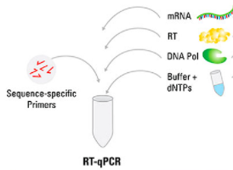
STEP 3: RNA Isolation and Reverse Transcription-Quantitative Polymerase Chain Reaction (RT-qPCR)
Total RNA extraction from HCC cells
E.Z.N.A
RT-QPCR
mRNA reversely transcribed into cDNA
GADPH reference gene
Multiple primers will be used
Notes:
- Total RNA will be extracted from the HCC cells using E.Z.N.A.
Allows for the isolation of both genomic DNA and total RNA from the same cells.
After doing so, mRNA will be reversely transcribed into cDNA, which is DNA synthesized from a single stranded RNA like mRNA or miRNA. RT-qPCR will be completed using SYBR Premix Ex Taq II; the following PCR machine will be used due to its high level of specificity. The thermocycling conditions will be set as noted: 95˚C for 30 seconds, then 39 cycles at 95˚C for 5 seconds, and 69˚C for 34 seconds. T
The experiment will utilize GADPH as the reference gene because it often brings good results and proves to be the most stable among genes with little to no variation between tissues.
Multiple primers will be used, including AEG-1 forward, AEG-1 reverse, APC forward, APC reverse, axin forward, axin reverse, GADPH forward, GADPH reverse, IGFBP7 forward, and IGFBP7 reverse.

Slide 9
STEP 4: Western Blotting
PVDF membrane
Primary antibodies: Rabbit anti-AEG-1, rabbit anti-c-Myc, rabbit anti-axin, rabbit anti-APC, and mouse anti-β-catenin
Detected using ECL
Notes:
HCC cells will be washed using ice-cold Phosphate buffered saline (PBS). PBS is a balanced salt solution and is commonly used in this method in order to maintain a constant pH and osmolarity of the cells. The cells will then be lysed using ice-cold RIPA buffer, phosphatase inhibitor sodium fluoride (NaF), and sodium orthovanadate (Na₃VO₄). NaF will be used in order to inactivate endogenous phosphatases and to protect protein phosphorylation. Following cell lysis, the proteins in the cell will undergo separation by 5-10% SDS-PAGE. SDS is a detergent that denatures proteins by altering their tertiary structure via unfolding them, after their binding of one SDS per two amino acids. This process charges the protein, causing for the protein to move down the polyacrylamide gel after an electric current is induced. And so, smaller proteins will move farther down the gel, towards the anode, whereas larger proteins will not move very far down the gel and remain towards the cathode.
The proteins will then be moved onto a PVDF membrane.
PVDF membranes are highly hydrophobic, so they will be treated with either methanol or ethanol prior to submersion in the transfer buffer. Then the polyacrylamide gel will be placed against the membrane between two sheets of porous polyethylene facing toward the cell, creating a transfer stack. The porous polyethylene is very rigid and can facilitate in handling, making it a better choice in comparison to the alternative of filter paper. Again, the use of an electric current will cause for the protein to transfer over to the membrane because of the negative charges of the proteins.
The membranes will then be blocked in 1xTBST (Tween-Tris buffered saline) with 5% skim milk for 1 hour and will be incubated with their corresponding antibodies overnight at 4˚C.
In this experiment, the primary antibodies include Rabbit anti-AEG1, rabbit anti-c-Myc, rabbit anti-axin, rabbit anti-APC, and mouse anti-β-catenin.
After incubation with the primary antibodies, the membranes will be washed with TBST 3 times and then incubated with the secondary antibody for 2 hours at room temperature. The secondary antibody will be used to probe the primary antibodies.
In this experiment, the secondary antibody is a goat anti-rabbit IgG-horseradish peroxidase or a goat anti-mouse IgG horseradish peroxidase.

Slide 10
Analysis of Results
Central Question: Does AEG1 overexpression cause for decreased expression of IGFBP7 in HCC?
Either AEG-1 will decrease expression of IGFBP7 or it will not
Notes:
From this experiment, the level of AEG1 mRNA expression could be higher or lower dependent on which experimental group it was placed in.
Lenti-AEG-1 group, the expression would be significantly lower compared to the Lenti-control group.
The effect of AEG-1 silencing on the activation of the Wnt/ β-catenin signaling pathway can be assessed.
The mRNA levels of axin and APC in the Lenti-AEG-1si group will be significantly higher compared to the Lenti-control group.
This would suggest that AEG-1 silencing inhibits the activation of the Wnt/ β-catenin signaling pathway.
Looking back to the IGFBP7 as mentioned previously, it is one of the most downregulated genes from the overexpression of AEG1.
Re-address the CQ and how this shows it: The purpose of this experiment was to show that AEG1 activates the Wnt/ β-catenin signaling pathway in HCC, thus causing for altered methylation of IGFBP7.
RT-qPCR:
If the RT-qPCR data of mRNA levels among APC and axin shows the Lenti-AEG-1 cells to be lower in expression than the Lenti-control cells, then this would demonstrate how AEG-1’s overexpression causes tumorigenesis.
Western Blot:
The western blot analysis shows the Lenti-AEG-1 cells to be darker than the control cells, then this would show the effect of AEG-1 silencing on the activation of the Wnt/β-catenin signaling pathway.
If these results show AEG-1 decreases expression, the connection to IGFBP7 can be made, where AEG-1 overexpression will decrease its expression.

Slide 11
Goals:
Determine if AEG-1 regulates HCC
Help in treatment of HCC by focusing on one pathway vs. multiple
Setbacks:
AEG-1 would not activate the Wnt/β-catenin pathway due to the current state of the disease’s progression
Infection of AEG-1 may not decrease IGFBP7 expression

Slide 12
References
Chen, D., Siddiq, A. et al. 2013. Insulin-like Growth Factor-binding Protein-7 (IGFBP7); A Promising Gene Therapeutic for Hepatocellular Carcinoma (HCC). Molecular Therapy. Volume. Pgs. 758-766. https://www.ncbi.nlm.nih.gov/pubmed/23319057
Tomimaru, Y., Eguchi, H. et al. 2012. IGFBP7 downregulation is associated with tumor progression and clinical outcome in hepatocellular carcinoma. International Journal of Cancer. Volume 130. Pgs.319-327. https://www.ncbi.nlm.nih.gov/pubmed/21328580
Chen, D., Yoo, B.K. et al. 2011. Insulin-like Growth Factor-Binding Protein-7 Functions as a Potential Tumor Suppressor in Hepatocellular Carcinoma. Human Cancer Biology. Pgs. 6693-6701. https://www.ncbi.nlm.nih.gov/pmc/articles/PMC3207018/
Yoo, B.K., Emdad, L. et al. 2009. Astrocyte elevated gene-1 regulates hepatocellular carcinoma development and progression. The Journal of Clinical Investigaation. Volume 119. Pgs. 465-477. https://www.ncbi.nlm.nih.gov/pubmed/19221438
Li, M, Dai, Y., Wang, L., and Li, L. 2017. Astrocyte elevated gene-1 promotes the proliferation and invasion of breast cancer cells by activating the Wnt/β-catenin signaling pathway. Oncology Letters. Volume 13. Pgs. 2385-2390. https://www.ncbi.nlm.nih.gov/pubmed/28454408
Zhao, J., Wang, W., Huang, Y., Wu, J., Chen, M., Cui, P., Zhang, W., Zhang, Y. 2014. HBx Elevates Oncoprotein AEG-1 Expression to Promote Cell Migration by Downregulating miR-375 and miR-136 in Malignant Hepatocytes. DNA and Cell Biology. Volume 33. Pgs. 715-722. https://www.ncbi.nlm.nih.gov/pubmed/25050974
Srivastava, J., Siddiq, A. et al. 2015. Astrocyte elevated gene-1 (AEG-1) and c-Myc cooperate to promote hepatocarcinogenesis. Hepatology. Volume 61. Pgs. 915-929. https://www.ncbi.nlm.nih.gov/pmc/articles/PMC4309751/
Goldman, A., Spelcher, D.W. 2016. Unit 10.7 Electroblotting and Polyacrylamide Gels. Curr Protein Protein Sci. Volume 82. Pgs.1-24. https://www.ncbi.nlm.nih.gov/pmc/articles/PMC4663689/
Xu, C., Kong, X., Wang, H., Zhang, N., Kong, X., Ding, X., Li, X., Yang, Q. 2014. MTDH Mediates Estrogen-Independent Growth and Tamoxifen Resistance by Down-Regulating PTEN in MCF-7 Breast Cancer Cells. Cellular Physiology and Biochemistry. Volume 33. Pgs. 1557-1567. https://www.ncbi.nlm.nih.gov/pubmed/24854844
Sarkar, D., Lebedeva, I.V., Su, Z., Park, E., Chatman, L., Vozhilla, N., Dent, P., Curiel, D.T., Fisher, P.B. 2007. Eradication of Therapy-Resistant Human Prostate Tumors Using a Cancer Terminator Virus. Cancer Research. Volume 61. Pgs. 5434-5442. https://www.ncbi.nlm.nih.gov/pubmed/17545625
Kozera, B., Rapacz, M. 2013. Reference genes in real-time PCR. J Appl Genetics. Volume 54. Pgs. 391-406. https://www.ncbi.nlm.nih.gov/pmc/articles/PMC3825189/
Nakamura, T., Hamada, F., Ishidate, T., Anai, K., Kawahara, K., Toyoshima, K., Akiyama, T.1998. Axin, an inhibitor of the Wnt signaling pathway, interacts with β-catenin, GSK-3β and APC and reduces the β-catenin level. Genes to Cells. Volume 3. Pgs. 395-403. https://www.ncbi.nlm.nih.gov/pubmed/9734785
Aoki, K., Taketo, M.M. 2007. Adenomatous polyposis coli (APC): a multi-functional tumor suppressor gene. Journal of Cell Science. Volume 120. Pgs. 3327-3335. https://www.ncbi.nlm.nih.gov/pubmed/17881494
Jiang, D., Cho, W., Li, Z., Xi, X., Qu, Y., Jiang, Z., Guo, L., Xu, G. 2017. MiR-758-3p suppresses proliferation, migration and invasion of hepatocellular carcinoma cells via targeting MDM2 and mTOR. Biomedicine and Pharmacotherapy. Volume 96. Pgs. 535-544. https://www.ncbi.nlm.nih.gov/pubmed/29032337
Imura, S., Yamada, S., Saito, Y., Iwahashi, S., Arakawa, Y., Ikemoto, T., Morine, Y., Utsunomiya, T., Shimada, M. 2017. miR-223 and Stathmin-1 Expression in Non-tumor Liver Tissue of Patients with Hepatocellular Carcinoma. Anticancer Research. Volume 37. Pgs. 5877-5883. https://www.ncbi.nlm.nih.gov/pubmed/28982915
Akiel, M., Guo, C. et al. 2017. IGFBP7 deletion promotes hepatocellular carcinoma. Cancer Research, Volume 77(15), Pgs. 4014–4025. https://www.ncbi.nlm.nih.gov/pubmed/28619711
Akiel, M., Rajasekaran, D., Gredler, R., Siddiq, A., Srivastava, J., Robertson, C., Jariwala, N., Fisher, PB., Sarkar, D. 2014. Emerging role of insulin-like growth factor-binding protein 7 in hepatocellular carcinoma. Journal of Hepatocellular Carcinoma. Pgs. 9-19. https://www.ncbi.nlm.nih.gov/pmc/articles/PMC4918263/

