Slide 1
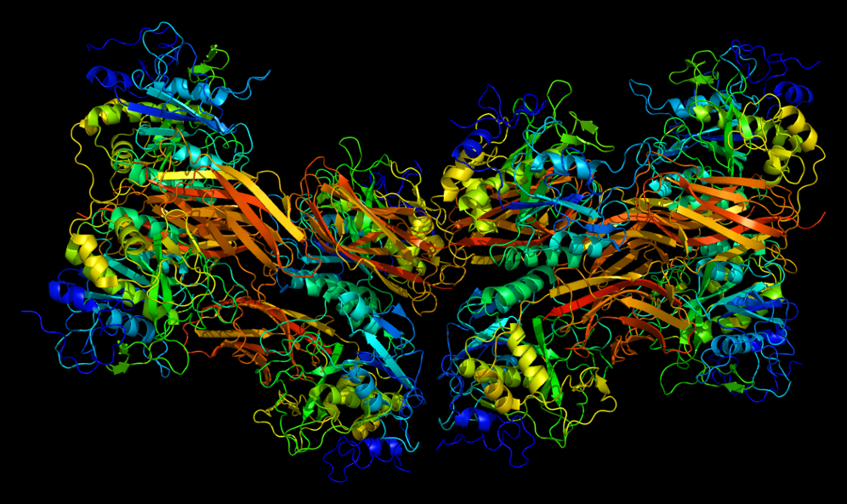
Furin deletion in B cells alters ADAM10 prodomain processing and the downstream effects on allergic asthma
Sharoon Arshad

Slide 2
Allergies/Asthma Anyone?
Notes:
-Asthma costs in the US are over $56 billion dollars annually.
-Approximately 1 in 12 adults has asthma
- There is No current cure for allergies and asthma
Steroids for asthma treatement have side effects: (glaucoma, osteoporosis, and cataracts)
The search for better treatments and even cures for asthma is essential
ADAM10 has been recently shown to be important in the regulation of allergic disease.

Slide 3
ADAM10
What is ADAM10?
Why is it important?
Notes:
-ADAM10 is a member of a family of metalloproteinases and disintergins that are responsible for the proteolytic processing of transmembrane receptors and ligands
(metalloprotease – protease enzyme whose catalytic mechanism involves a metal in this case its zinc)
-ADAM10 is also a zymogen so it will remain inactivate until its prodomain region is cleaved.

Slide 4
ADAM10 and ICOS workup
Recent Studies?
Relation to allergies?
ICOS/ICOSL (Inducible Costimulator) and its importance in regulating allergic disease
Notes:
-ADAM10 is most famous for cleavage of the substrate Notch. Notch is important in development and because of this, deleting ADAM10 in a mouse, completely, is lethal in the embryonic stage, so a drug to inhibit it completely is a risky prospect
-ADAM10’s deletion from the B cell’s has shown reduced airway symptoms when these mice are subjected to the mouse model of asthma.
-Inducible Costimulator (ICOS-on Tcells) ligand regulates T cell responses and antibody production that are essential for the devastating symptoms that result in a asthma attack. ADAM10 is the primary sheddase of ICOSL and when ADAM10 is inhibited, has been associated with high levels of ICOSL which leads to the downregulation of surface T cell ICOS expression (less Icos to bind to ICOSL(on b-cells)
-Down regulation of T cell ICOS is key to the reduction/severity of an allergic response

Slide 5
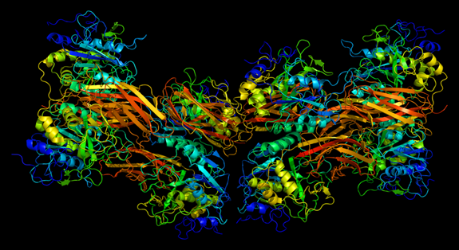
Furins role in this experiment
Furins inhibition/deletion in B-cells
Notes:
Furin is a proprotein convertase protein and is one of the convertases that activates ADAM10 through cleavage of the prodomain.
Since a deletion of Furin will result in a possible partial loss of ADAM10, it may possibly be a more beneficial drug target for asthma therapy. I propose that Furin deletion from B cells will result in the alleviation of airway hyperresponsiveness (AHR) in a mouse model of asthma through ADAM10 and ICOSL.

Slide 6
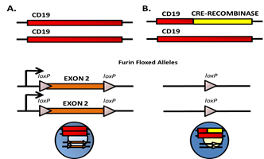
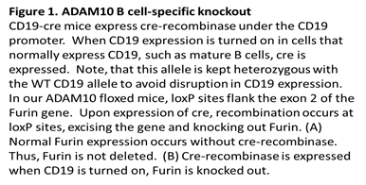
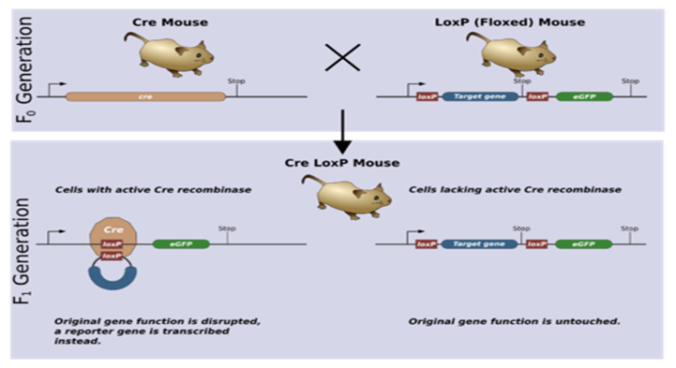
Overview of Experiment
Breeding furin knockout mice (Cre-Recombinase)
Breeding with CD-19 mice to knock out B-cell specific
Furin
Notes:
To being the experiment I will procure mice that have exon 2 of the furin gene flanked with lox-p sites
These lox-p sites will facilitate a looping out and deletion of exon 2 of the DNA in cells that express the protein cre-recombinase. This will essentially delete furin from those cells
Germline deletion of furin is embryonically lethal and therefore cell-specific functionality of furin is still being examined. These mice have been bred to mice expressing T cell-expressing cre-recombinase, but never B cell cre-recombinase (which is ofcourse the bases of my experiment)
I propose to breed these mice to CD19-cre mice. CD19 is a transmembrane glycoprotein which is a biomarker for B cells and is critical for B cell signaling

Slide 7
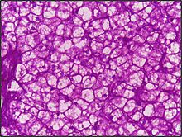
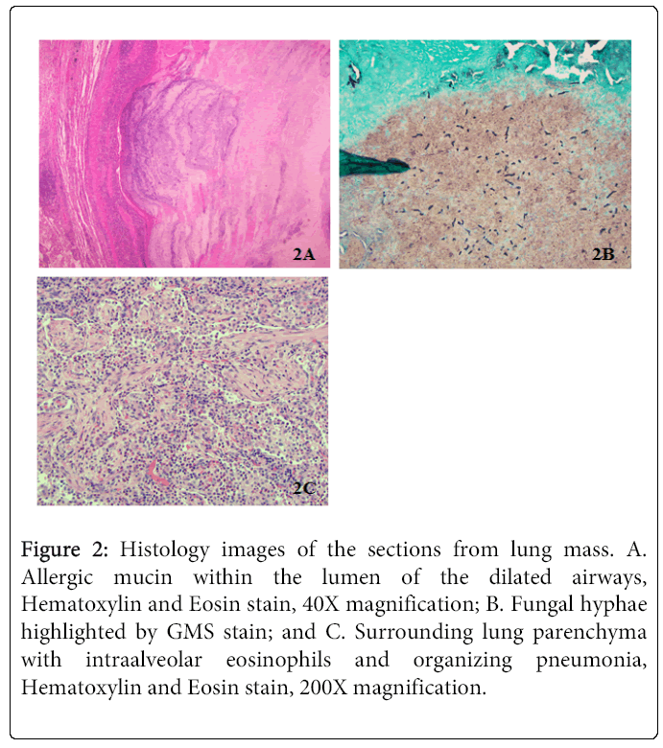
Experiment continued…..
Periodic acid-Schiff stain
Hematoxylin and eosin (top left) stained lung tissue
Notes:
-I propose to test these mice in a mouse model of airway hyperresponsiveness (AHR).
-In order to do this, first house dust mite (HDM) extract is intranasally administered daily for ten days with two, two day breaks (experimental group of mice)
-on the 14th day the mice will be subjected to a Flexivent apparatus that measures the responsiveness of the airway to methacholine which is a drug used to diagnose bronchial hyperreactivity.
-The drugs introduction results in bronchoconstriction and if the mice display a pre-existing hyperreactive airway, such as asthma, a lower dose of the methacholine is needed to stimulate a response
-This procedure can tell if the mice have developed restricted airways, as compared to control wild type mice , as well as to saline controls. In previous studies, ADAM10 inhibition significantly alleviated airway hyperreactivity proposing that increased ADAM10 activity may be a predisposing factor to allergic disease
-lungs will be removed from the mice after euthanasia and histology will be performed to measure the cell infiltration into airways and also the mucus production (with PAS stain (Periodic acid-Schiff) and (hematoxylin and eosin staining for cell infiltration)
-In addition, spleens will be removed and ICOSL levels will be examined by flow cytometry on B cells and ICOS levels on T cells. This will support the mechanism.
-(Periodic acid–Schiff (PAS) is a staining method used to detect polysaccharides such as glycogen, and mucosubstances such as glycoproteins, glycolipids and mucins in tissues. This will let us know the extent of damage/obstruction to alveoli in the lungs )

Slide 8
Results, Discussion, Pitfalls
Furin,PC-7 (proprotein convertase-7) and ADAM10
ICOS/ICOSL and ADAM10
Furin and ADAM8 in allergic airway inflammation
It is suspected that inhibiting furin will lead to a less severe allergic response.
Notes:
Evidence shows that suppressing ADAM10 will alleviate airway hyperactivity. PC7 is also a large factor that comes into play when studying allergies. PC7 has been found to cleave the prodomain of enough ADAM10 without involvement of furin.
The deletion of furin may not have a significant impact on ADAM10 to display the effects of asthma, though the studies may prove otherwise as the effects of furin inhibition have not been tested on ICOS/ICOSL levels though Future experimentation with the inhibition of furin and PC7 may lead to interesting results
ADAM10 was found to be a relevant ICOSL sheddase and resulted in an increase of ICOSL levels when not present in B cells. This also leads to the downregulation of T cell ICOS. Shedding of ICOSL is necessary for proper T cell responses. increased Bcell ICOSL = Down regulation of T-cell ICOS
I hypothesize that the inhibition of furin will lead to a similar regulation of ICOSL if sufficient amounts of ADAM10 remain inactivated
ADAM8 has recently been associated with allergic airway inflammation, furin inhibitors did not inhibit processing of ADAM8 and ADAM8 levels have been found to be increased in airway inflammatory cells in mice and human asthma patients
Although furin inhibition may lead to a decrease in ADAM10, ADAM8 is still a confounding variable that may have an unforeseen effect on inflammation.

Slide 9
References
Anders, A., Gilbert, S., Garten, W., Postina, R., & Fahrenholz, F. (2001). Regulation of the alpha-secretase ADAM10 by its prodomain and proprotein convertases. FASEB Journal : Official Publication of the Federation of American Societies for Experimental Biology, 15(10), 1837–9. Retrieved from http://www.ncbi.nlm.nih.gov/pubmed/11481247
Asthma Statistics | AAAAI. (n.d.). Retrieved October 22, 2017, from http://www.aaaai.org/about-aaaai/newsroom/asthma-statistics
Chaimowitz, N. S., Martin, R. K., Cichy, J., Gibb, D. R., Patil, P., Kang, D.-J., … Conrad, D. H. (2011). A disintegrin and metalloproteinase 10 regulates antibody production and maintenance of lymphoid architecture. Journal of Immunology (Baltimore, Md. : 1950), 187(10), 5114–22. https://doi.org/10.4049/jimmunol.1102172
Cooley, L. F., Martin, R. K., Zellner, H. B., Irani, A.-M., Uram-Tuculescu, C., El Shikh, M. E., & Conrad, D. H. (2015). Increased B Cell ADAM10 in Allergic Patients and Th2 Prone Mice. PloS One, 10(5), e0124331. https://doi.org/10.1371/journal.pone.0124331
David, Gibbs (2010). ADAM10 is a critical regulator of B cell development, antibody production,
and myeloidderived suppressor cell expansion: Effects of B cellspecific ADAM10 deletion and
overexpression in vivo (PHD thesis).
flexiVent | SCIREQ. (n.d.). Retrieved November 23, 2017, from http://www.scireq.com/flexivent
How Is Asthma Treated and Controlled? - NHLBI, NIH. (n.d.). Retrieved November 22, 2017, from https://www.nhlbi.nih.gov/health/health-topics/topics/asthma/treatment
Kim, M., Suh, J., Romano, D., Truong, M. H., Mullin, K., Hooli, B., … Tanzi, R. E. (2009). Potential late-onset Alzheimer’s disease-associated mutations in the ADAM10 gene attenuate {alpha}-secretase activity. Human Molecular Genetics, 18(20), 3987–96. https://doi.org/10.1093/hmg/ddp323
Knolle, M. D., & Owen, C. A. (2009). ADAM8: a new therapeutic target for asthma. Expert Opinion on Therapeutic Targets, 13(5), 523–40. https://doi.org/10.1517/14728220902889788
Lownik, J. C., Luker, A. J., Damle, S. R., Cooley, L. F., El Sayed, R., Hutloff, A., … Conrad, D. H. (2017). ADAM10-Mediated ICOS Ligand Shedding on B Cells Is Necessary for Proper T Cell ICOS Regulation and T Follicular Helper Responses. Journal of Immunology (Baltimore, Md. : 1950), 199(7), 2305–2315. https://doi.org/10.4049/jimmunol.1700833
Lownik, J. C., Luker, A., Martin, R., Damle, S., & Conrad, D. H. (2017). ADAM10 regulates the ICOS:ICOSL axis. The Journal of Immunology, 198(1 Supplement).
Methacholine. (2010). Retrieved from https://www.drugbank.ca/drugs/DB06709
Pesu, M., Watford, W. T., Wei, L., Xu, L., Fuss, I., Strober, W., … O’Shea, J. J. (2008). T-cell-expressed proprotein convertase furin is essential for maintenance of peripheral immune tolerance. Nature, 455(7210), 246–250. https://doi.org/10.1038/nature07210
Roebroek, A. J. M., Taylor, N. A., Louagie, E., Pauli, I., Smeijers, L., Snellinx, A., … Creemers, J. W. M. (2004). Limited redundancy of the proprotein convertase furin in mouse liver. The Journal of Biological Chemistry, 279(51), 53442–50. https://doi.org/10.1074/jbc.M407152200
Wang, K., Wei, G., & Liu, D. (2012). CD19: a biomarker for B cell development, lymphoma diagnosis and therapy. Experimental Hematology & Oncology, 1(1), 36. https://doi.org/10.1186/2162-3619-1-36
Why Pick PAS for Histology? - Bitesize Bio. (n.d.). Retrieved November 25, 2017, from https://bitesizebio.com/13413/why-pick-pas-for-histology/
Woodfolk, J. A. (2007). T-cell responses to allergens. Journal of Allergy and Clinical Immunology, 119(2), 280–294. https://doi.org/10.1016/j.jaci.2006.11.008
Zhang, L., Prietsch, S. O., & Ducharme, F. M. (2014). Inhaled corticosteroids in children with persistent asthma: effects on growth. In L. Zhang (Ed.), Cochrane Database of Systematic Reviews. Chichester, UK: John Wiley & Sons, Ltd. https://doi.org/10.1002/14651858.CD009471.pub2

