Slide 1
Immune response when ERAP2-N is introduced to Melanoma cell line MRN-1
Ashley Arora

Slide 2
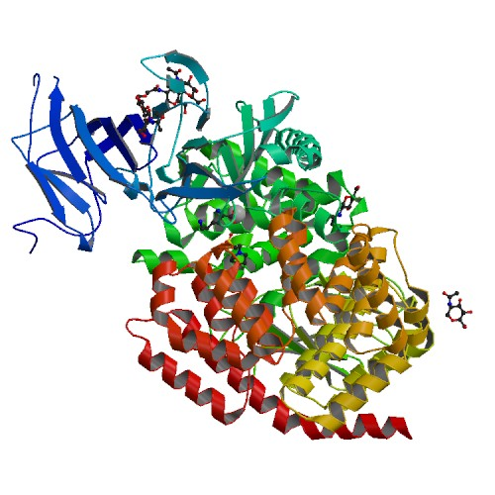
What is ERAP2?
Structure of ERAP2 protein
http://www.rcsb.org/pdb/explore.do?structureId=3se6
Notes:
-Endoplasmic Reticulum Aminopeptidase 2
-Responsible for peptide trimming in the N-terminal
-A gene and a protein
-The ERAP2 protein is encoded by the ERAP2 gene
-It is Essential for immune control
-It has not been proven yet but not having the ERAP2 protein present can lead cancer to grow

Slide 3
ERAP2 has two isoforms
http://www.rcsb.org/pdb/explore.do?structureId=3se6
Notes:
-ERAP2-N & ERAP2-K
-In most cells, ERAP2-K and ERAP2-N are present but majority of ERAP2 expresses the K isoform
-ERAP2-N is genetically present but the protein cannot be expressed

Slide 4
Melanoma cell line MRN-1
What is melanoma?
Fruci, D. et al (2006), http://www.jimmunol.org/content/176/8/4869.long
Notes:
-Melanoma is a type of skin cancer
It kills 10,130 people annually
- This figure shows MRN-1 expresses low amounts of ERAP2

Slide 5
The Experiment
Purpose of the experiment
Why this specific cell line for this experiment
Goal of this experiment
Notes:
-The purpose of this experiment is to introduce ERAP2-N into the cell line and see which isoform, between N and K, induces a better immune response
-An ideal cell line for this experiment would not express ERAP2, but no cell lines without ERAP2 have been found yet.
-That’s why this cell line is ideal for this experiment:
-It has low amounts of ERAP2
- Has a peptide transporter called TAP which helps make sure that the ERAP2 gene functions the way it needs by transporting the peptides to the endoplasmic reticulum to go through the final peptide processing prior to loading onto the HLA molecule
The goal of this experiment is to measure the lymphocytes in the melanoma cell line, MRN-1 and determine which isoform of the ERAP2 protein, N or K, induces a better immune response.
-

Slide 6
Procedures used in this experiment
Transfection
Western blotting
Lymphocyte activation assay
Flow cytometry
Notes:
-Transfection will be used because ERAP2-N is not expressed in the cell line so it will need to be introduced exogenously.
The western blot analysis will confirm the ERAP2 expression in MRN-1 and will also determine the amounts of K so the same amount of N can be introduced
Lymphoctye activation assay will be used to measure and compare the natural killer cells/T-cell activation level in ERAP2-N and ERAP-K expressed in MRN-1
Flow cytometry analysis will quantify lymphocyte activation and count all the activated NK and T-cells
NK CELLS: Kill cancer cells
T-CELLS: Help protect body from infection and may help fight cancer

Slide 7
Lymphocyte activation assay
What are lymphocytes?
Natural killer cells?
T-cells?
When does lymphocyte activation occur?
Notes:
Lymphocytes are white blood cells that are part of the immune system
Lymphocytes include natural killer cells, T-cells, and B-cells
Natural killer cells are immune cells that can kill cancer cells
T-cells can help the body fight cancer
Lymphocyte activation occurs when the body is trying to fight off an infection

Slide 8
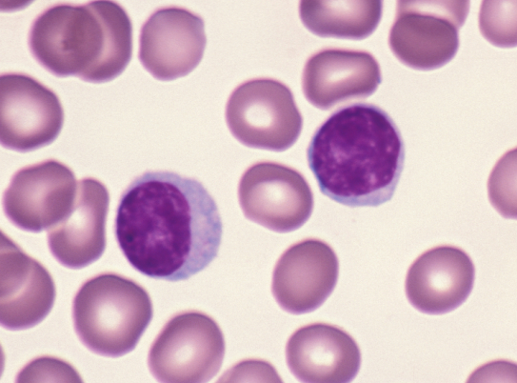
What is being measured?
http://www.pathologyoutlines.com/topic/bonemarrowlymphocytematuration.html
https://www.naturale-cell.com/nk-cells
Notes:
-Lymphocytes will be measured, but specifically only CD8+ T-cells and natural killer cells will be measured
NK and T-cells will be measured in ERAP2-N and compared with the NK and T-cells in ERAP2-k
Flow cytometry will quantify lymphoctye activation and only measure the activated NK cells and T-cells in MRN-1

Slide 9
Results?
Three possible results
Hypothesis
What can skew the results?
Notes:
-One result could be that the exogenously introduced ERAP2-N induces more NK and T-cells
-Another result could be that ERAP2-K induces more activated natural killer cells and T-cells
Or ERAP2-N and ERAP2-K have the same amounts of activated NK and T-cells.
To determine which isoform will induce a better immune response, the activated NK and T-cells will be counted, so more natural killer cells mean that more cancer cells are killed
ERAP2-N trims peptides at a fast rate, about 165 times more than ERAP2-K which can alter with the activation of NK and T-cells.
If ERAP2-N trims at a faster rate than ERAP2-K, it may provide a better immune response than ERAP2-K because if peptides are being trimmed at a faster rate that may trigger more NK and T-cells
Having ERAP-K in MRN-1 could maybe skew the results because having a cell line that doesn’t express both ERAP2 isoforms (K and N) would have been more ideal because then the cell line would go through each step for each isoform and the results would be more accurate

Slide 10
References
Lee E.D., Endoplasmic Reticulum Aminopeptidase 2, a common immunological link to adverse pregnancy outcomes and cancer clearance, In Placenta, Volume 56, 2017, Pages 40-43, http://www.sciencedirect.com/science/article/pii/S0143400417301972
Johnson, M. P. et al (2009). The ERAP2 gene is associated with preeclampsia in Australian and Norwegian populations. Human Genetics, 126(5), 655–666. https://www.ncbi.nlm.nih.gov/pmc/articles/PMC2783187/
Fruci, D. et al (2006). Expression of Endoplasmic Reticulum Aminopeptidases in EBV-B Cell Lines from Healthy Donors and in Leukemia/Lymphoma, Carcinoma, and Melanoma Cell Lines. Journal of immunology. 176. 4869-79. 10.4049/jimmunol.176.8.4869. http://www.jimmunol.org/content/176/8/4869.long
Alistair J. et al. Westwood, Inhibition of antigen transport by expression of infected cell peptide 47 (ICP47) prevents cell surface expression of HLA in choriocarcinoma cell lines, In Journal of Reproductive Immunology, Volume 50, Issue 1, 2001, Pages 19-40, http://www.sciencedirect.com/science/article/pii/S0165037800000887
Andrés, Aida M. et al. “Balancing Selection Maintains a Form of ERAP2 That Undergoes Nonsense-Mediated Decay and Affects Antigen Presentation.” Ed. Takashi Gojobori. PLoS Genetics 6.10 (2010): e1001157. PMC. Web. 26 Nov. 2017. https://www.ncbi.nlm.nih.gov/pmc/articles/PMC2954825/
Evnouchidou, I. et al. “A Common SNP in ER Aminopeptidase 2 Induces a Specificity Switch That Leads to Altered Antigen Processing.” Journal of immunology (Baltimore, Md. : 1950) 189.5 (2012): 2383–2392. PMC. Web. 26 Nov. 2017. https://www.ncbi.nlm.nih.gov/pmc/articles/PMC3530405/
Vanhille, D. L. et al (2013). A novel ERAP2 haplotype structure in a Chilean population: implications for ERAP2 protein expression and preeclampsia risk. Molecular Genetics & Genomic Medicine, 1(2), 98–107. https://www.ncbi.nlm.nih.gov/pmc/articles/PMC3769221/
Saveanu, L., et al., Concerted peptide trimming by human ERAP1 and ERAP2 aminopeptidase complexes in the endoplasmic reticulum. Nat Immunol, 2005. 6(7): p. 689-97.https://www.nature.com/articles/ni1208
May, L., et al., Performance of the whole-blood stimulation assay for assessing innate immune activation under field conditions. Cytokine, 2009. 45(3): p. 184-9. http://www.sciencedirect.com/science/article/pii/S1043466608008363?via%3Dihub
Tanioka, T., et al., Human leukocyte-derived arginine aminopeptidase. The third member of the oxytocinase subfamily of aminopeptidases. J Biol Chem, 2003. 278(34): p. 32275-83. 13. http://www.jbc.org/content/278/34/32275.long

Slide 11
THANK YOU!

