Slide 1
ERAP2N and Spontaneous Terminal Pregnancies
Shradda Adhikari
Mentor: Eun D. Lee

Slide 2
Spontaneous Miscarriages
Most common type of pregnancy loss- more than 3 billion cases per year in the US alone
Possible reason: immune system imbalance
TNF= Tumor neurosis Factors- induced by the lymphocytes that is known to be a factor in repeated miscarriages (1)
NKCs (CD16 and CD56) (2)
https://www.google.com/search?biw=1242&bih=611&tbm=isch&sa=1&ei=nqchWuLMA4Wqggeq_ojoBg&q=pregnant&oq=pregnant&gs_l=psy-ab.3..0i67k1l2j0l3j0i67k1j0l3j0i67k1.2764.3444.0.3805.3.3.0.0.0.0.132.277.2j1.3.0....0...1c.1.64.psy-ab..0.3.276....0.hamtsB1RD84#imgrc=0I083Sxcb3KufM:
Notes:
42qw4

Slide 3
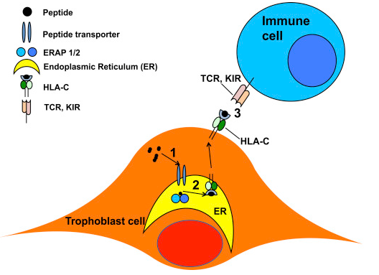
ERAP2 and the Immune System
White blood cells (lymphocytes) work by detecting antigens on cells
ERAP2 cleaves these antigens to be presented on HLA-C1 (3)
Figure from Ref. 5

Slide 4
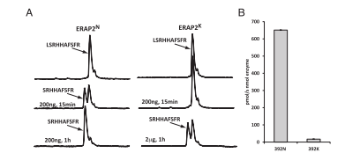
ERAP2N and ERAP2K
Difference in the protein level: N392K (asparagine and Lysine) (4)
Difference in the genetic level: determined by SNPs (single nucleotide Polymorphisms) in LD (linkage disequilibrium) (3)
ERAP2N has 165 times the cleaving capability (4)
“The largest functional changes described for a common coding polymorphism” (4)
Figure from Ref. 4

Slide 5
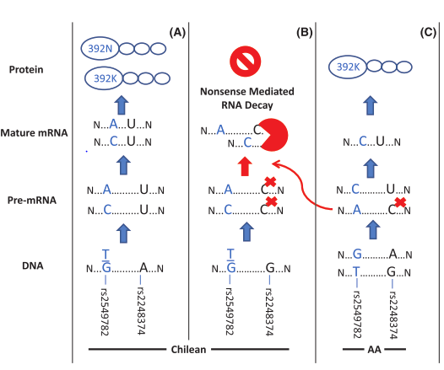
Genetics of ERAP2 N and K
Two SNPs determine the phenotype of the gene (SNP rs-22 and SNP rs-25) (6)
They are in LD so if there is a chance that SNP rs-25 codes for the N allele, the SNP rs-22 allele comes in and induces a premature stop codon in RNA so it never gets transcribed (6)
Chilean population: not linked, but STILL didn’t express the N allele (6)
Figure from Ref. 6

Slide 6
Hypothesis
If the gene editing results in the transcription of N allele, it would induce a great immune response brought on by the hyper cleaving of the ERAP2N that the uterus becomes a hostile environment resulting in termination of trophoblast cell and fetal survival.

Slide 7
Parts of the Experiment
1. Gene editing
a. crispr cas 9
b. western blot
2. Lymphocyte activation assay
a. Isolation of lymphocytes
b. Insertion of antibodies
c. Quantification of activated lymphocytes

Slide 8
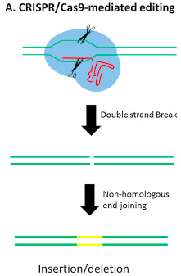
Gene Editing
JEG-3 Cells: (7)
SNP-rs22
Homozygous GG
SNP-rs25
Homozygous TT
SHOULD produce ERAP2N, but does not because of the LD with rs-22 and homozygous GG
If we can change homozygous GG--> homozygous AA so the N allele can be transcribed
Results checked with western blotting
ERAP2N= 110 Kda (3)
https://en.wikipedia.org/wiki/Cytotoxic_T_cell#/media/File:Antigen_presentation.svg

Slide 9
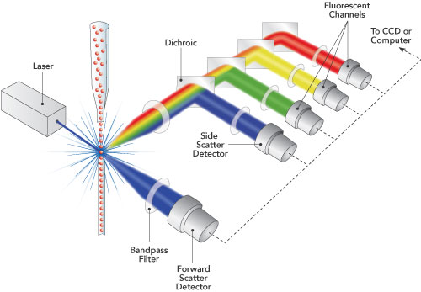
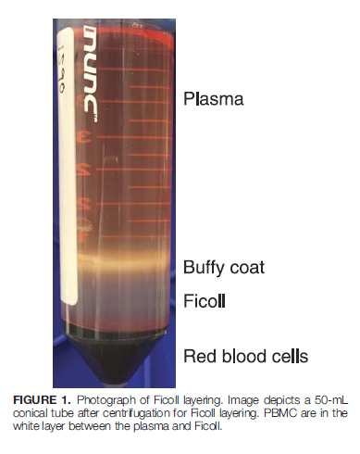
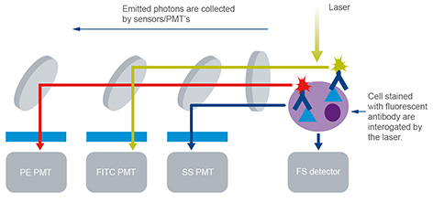
Lymphocyte Activation Assay
Isolation of Lymphocytes
PBMC protocol – centrifugation (8)
Insertion of florescence tagged antibodies (2)
CD8
CD4
CD56
CD69
CD16
Quantification by Flow cytometry
Figure from Ref. 8
http://www.abcam.com/protocols/introduction-to-flow-cytometry

Slide 10
Best Possible Results
1. The gene editing works and ERAP2N is transcribed
2. ERAP2N (double) induces more antibodies from binding to NKC and T cells.
ERAP2N (single) makes less lymphocytes from being activated
No ERAP2 makes almost none lymphocytes from being activated

Slide 11
Improvement/Pitfalls
Experiment 1 failure
Antibody binding

Slide 12
References
1.Colucci F, Boulenouar S, Kieckbusch J, Moffett A. How does variability of immune system genes affect placentation? Placenta. 2011;32(8):539-545. doi:10.1016/j.placenta.2011.05.001.
2. Human and Mouse CD Marker Handbook BD Biosciences 2010
3. Vanhille DL, Hill LD, Hilliard DD, et al. A novel ERAP2 haplotype structure in a Chilean population: implications for ERAP2 protein expression and preeclampsia risk. Molecular Genetics & Genomic Medicine. 2013;1(2):98-107. doi:10.1002/mgg3.13.
4. Evnouchidou I, Birtley J, Seregin S, Papakyriakou A, Zervoudi E, Samiotaki M, et al. A common single nucleotide polymorphism in endoplasmic reticulum aminopeptidase 2 induces a specificity switch that leads to altered antigen processing. J. Immunol. 2012;189:2383–2392
5. Lee D, Eun Endoplasmic Reticulum Aminopeptidase 2, a common immunological link to adverse pregnancy outcomes and cancer clearance? Placenta. 2017;(56)40-43 https://doi.org/10.1016/j.placenta.2017.03.012
6. Vanhille DL, Hill LD, Hilliard DD, et al. A novel ERAP2 haplotype structure in a Chilean population: implications for ERAP2 protein expression and preeclampsia risk. Molecular Genetics & Genomic Medicine. 2013;1(2):98-107. doi:10.1002/mgg3.13.
7. Lee D, Eun Comparative expression profiling of endoplasmic reticulum aminopeptidase 2 and human leukocyte antigen-C expression in choriocarcinoma cell lines Pregnancy Hypertension: An International Journal of Women's Cardiovascular Health 2015;5(1)

Slide 13
Thank You

